Slide 1
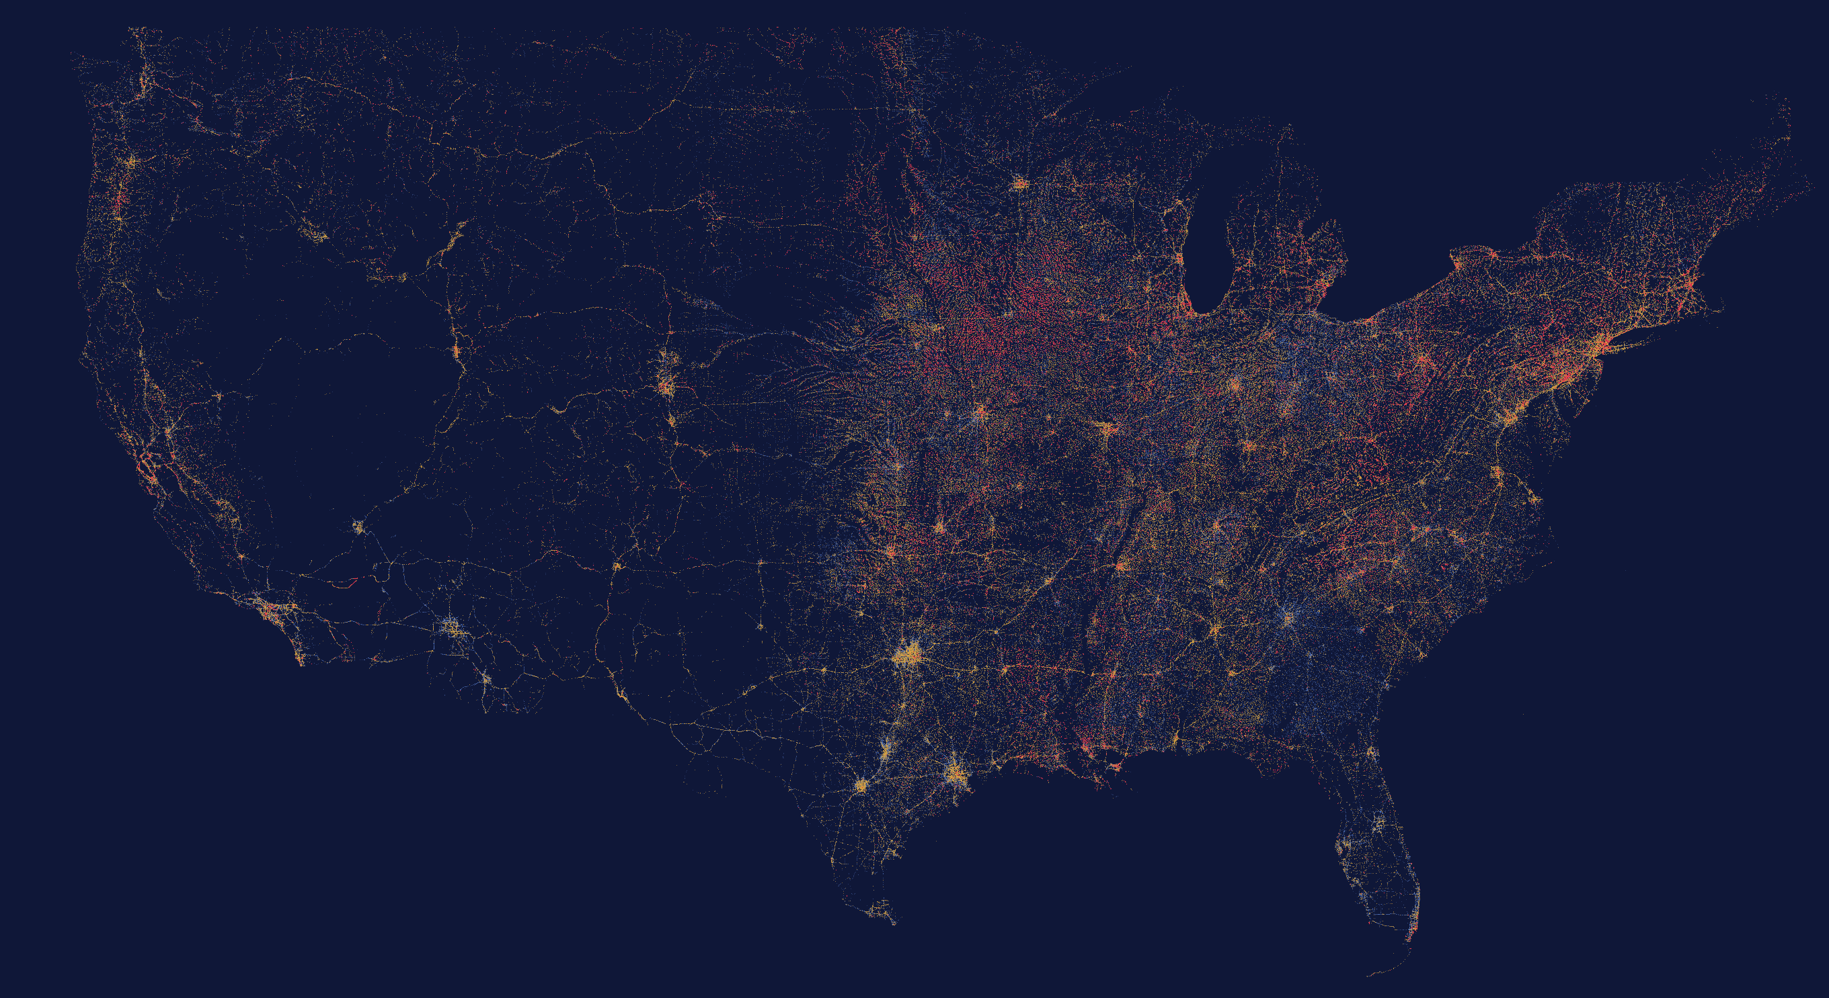
AI INNOVATION CHALLENGE 2026 | ROUND 3: AI EVOLUTION
DISSENT
The machine second opinion on America’s bridges
TEAM NEXUS NETWORK
621,137 STRUCTURES · 41,319 RATED POOR
DEPT. OF CSE (CYBER SECURITY)
Notes:
Open cold: "Every dot on this map is a real bridge in the federal record. 41,000 of them are rated poor. Tonight I am going to show you the ones whose paperwork is lying."

Slide 2
THE PROBLEM
A bridge does not fail
the day it becomes unsafe.
It fails the day the paperwork and the physical bridge stop agreeing, and nobody is looking at both.
24 months
between routine inspections, so a defect born the day after one waits a year on average to be seen
0–9
a coarse, inspector-subjective condition scale is the entire official record of a structure
< 20%
of the world’s long-span bridges carry any monitoring hardware at all
Notes:
Frame the gap. Inspections are slow, the record is coarse, and hardware does not scale. Nobody owns the disagreement between the file and the physical asset.

Slide 3
THE FORENSIC RECORD
In every collapse, the warning already existed.
Six of the eight documented failures we studied, across three continents. In each one the evidence was on file, in time to act, and belonged to nobody.
Morandi Bridge
I-35W Mississippi River Bridge
FIU pedestrian bridge
GENOA, ITALY · 14 AUG 2018 · 43 DEAD
MINNEAPOLIS, USA · 1 AUG 2007 · 13 DEAD
MIAMI, USA · 15 MAR 2018 · 6 DEAD
A satellite radar scatterer on the deck beside the failed pier accelerated from about 10 to 70 mm/yr starting March 2017, seventeen months before collapse (Milillo et al. 2019; contested by Lanari et al. 2020).
Inspection photographs from 1999 and 2003 already showed visibly bowed gusset plates (NTSB HAR-08/03).
Rapidly growing structural cracks, photographed and discussed by the engineer of record in the days before failure.
Champlain Towers South
Morbi suspension footbridge
Carola Bridge
SURFSIDE, USA · 24 JUN 2021 · 98 DEAD
GUJARAT, INDIA · 30 OCT 2022 · 135 DEAD
DRESDEN, GERMANY · 11 SEP 2024 · 0 DEAD
A satellite study published in 2020 had identified the site subsiding by about 2 mm/yr in the 1990s (Fiaschi and Wdowinski); a 2018 engineering report documented major structural damage.
Reopened four days after a renovation that never replaced or load-tested the original main cables; the inquiry later found 22 of the 49 wires in the failed cable already corroded.
Hidden hydrogen-induced corrosion of the prestressing steel, progressing for decades inside the one deck not yet refurbished (Marx report, TU Dresden).
Notes:
Do not read all six. Pick Morandi and Surfside: satellite evidence existed in both, published, before the collapse. The pattern is the product thesis.

Slide 4
THE IDEA
Infrastructure does not fail silently.
It fails contradicted.
DISSENT keeps two independent accounts of every structure and files their disagreement.
THE PAPER WITNESS
THE PHYSICS WITNESS
What the institution believes
What the evidence shows
Condition ratings 0–9, thirty-four years of filings, maintenance and construction history. Every human judgement is quarantined here.
Age, traffic and truck load, structural form, and real freeze–thaw and flood exposure. It is never shown a single inspector’s opinion.
When the two stop agreeing, the machine files a dissent: a dated obligation with the evidence attached.
Notes:
This is the one sentence to land. Two witnesses, one never sees the other. The product is the disagreement, not another risk score.

Slide 5
HOW IT WORKS
From the federal record to a dated obligation.
01
LEDGER
02
EVIDENCE
234,801 inspection filings across 4 states parsed into one trajectory per structure.
Physical features joined per asset: age, works history, traffic, form, and real ERA5 weather exposure.
03
RE-INSPECT
04
CALIBRATE
A gradient-boosted model predicts the rating from physics alone. Trained only to 2015; everything after is unseen.
Split-conformal intervals: every verdict ships with ±1.4 rating steps of honest uncertainty.
05
DISSENT
06
DOCKET
Three channels: the record claims better than evidence; the gap is accelerating; physics alone says the asset is severe.
Capped to real capacity: 12 mandatory, 24 scheduled, 48 watched per quarter.
No installed hardware. Every input is free and public.
Notes:
Move fast here. The point of step 3 is the time-split: frozen at 2015, judged on years it never saw. Step 6 is what makes it operational rather than academic.

Slide 6
THE PROOF
Flagged 9 years before the record caught up.
Vermont structure 101412003714121: the official rating fell from 8 to 3 in 2025. The model, frozen at 2015 and blind to everything after, had it inside the top-15% alert budget 9 years earlier, and kept it there every year since.
9 yrs
LEAD TIME BEFORE
THE RECORD MOVED
8 → 3
WHAT THE RECORD
FINALLY FILED
2025
YEAR THE PAPERWORK
CAUGHT UP
Real federal data. The model never saw a single post-2018 filing.
Notes:
Point at the flat black line: that is the official record, unchanged for years. The blue line is physics. The gap is the product. This case is one of 38 the frozen model caught early.

Slide 7
VALIDATION ON THE FUTURE
We hid the answers, then checked.
1,835 “the record was forced to catch up” events were mined from the trajectories: sudden drops of two or more rating steps, or closures. The 166 that happen after 2018 are pure holdout: the model was frozen in 2015 and never saw them.
234,801
0.7
89%
23%
3.5 yrs
REAL INSPECTION
FILINGS AUDITED
RATING STEPS OF ERROR
ON UNSEEN YEARS
CONFORMAL COVERAGE
(TARGET 90%, REPORTED HONESTLY)
OF HELD-OUT FAILURES CAUGHT EARLY
1.34× A RATING-MATCHED PICK
MEDIAN WARNING
BEFORE THE RECORD MOVED
“Why not just sort by the worst recorded rating?”
Because it can only ever point at bridges you already worry about. Of the 166 held-out failures, 58 were on structures the record already called bad — worst-first finds 40 of those, because that ranking is nearly a definition of the answer. The other 108 were on structures the paperwork still called fine.
ON THE 108 FAILURES THE RECORD STILL CALLED FINE
0 found by worst-first 25 found by dissent
Notes:
This is the slide a technical judge will interrogate. Frozen model, pure holdout, budgeted alerts. Do NOT claim we beat the naive baseline outright: on raw count it catches 40 of 166 and we catch 38. Claim the true and stronger thing: on the 108 failures where the record still read fine, worst-first found 0 and we found 25. Against a rating-matched blind pick we run 1.338x. Coverage is reported below target because we refuse to retune on test years.

Slide 8
SCALE
Every rated bridge in the United States, on one screen.
621,137
41,319
9,765
9.9 MB
STRUCTURES PLOTTED
RATED POOR
AUDITED IN DEPTH
NO BACKEND REQUIRED
Notes:
Show, do not tell. This is the live map in the app: the whole national inventory rendered client-side from a 9.9 MB binary. Red is poor condition. It traces the road network because that is where bridges live.

Slide 9
WHY THIS IS NEW
Everything else waits for one signal to get loud.
APPROACH
WHAT IT DOES
WHERE IT STOPS
Sensor monitoring
Hardware on one bridge, alarms on a threshold
Thousands per channel; almost nothing is instrumented
Satellite screening
Millimetre ground movement, delivered as reports
One modality, and no owner for the finding
Risk models
Rank cohorts by age and material
Cannot see an individual asset drift between inspections
Inspection AI
Computer vision on inspection photographs
Inherits the inspector’s verdict as ground truth
DISSENT
Audits the record itself, on 100% of an inventory, with zero installed hardware. Its output is a calibrated contradiction with a dated obligation attached, not another dashboard.
Notes:
The differentiator in one line: everyone else measures the asset. We audit the paperwork against the asset. That is a different product category.

Slide 10
WHAT IT CANNOT DO
The limits, stated before you ask.
It abstains rather than guess
Coverage is reported, not tuned
Structures newer than five years sit outside the model’s training support, so it issues no verdict on them at all: 81 of them in Rhode Island alone.
Our conformal intervals cover 89% of unseen cases against a 90% target. We report the shortfall rather than retune on the test years.
Some failures have no precursor
The satellite channel is not in this pilot
Sudden scour in a flood, or a construction-phase error on a structure too young to have a record, is invisible to any method built on filings.
No free processed radar covers these states, so the replay demonstrates that detector against a published finding instead, and cites the paper that disputes it.
A tool that audits records has to be auditable itself.
Notes:
Judges trust teams that volunteer limits. Say plainly: we abstain, we report our shortfall, and we cite the paper that disagrees with our own showcase evidence.

Slide 11
WHY IT MATTERS
A fixed inspection workforce,
pointed at the right bridges.
730 days
6–12 days
≈ $0
TODAY: THE AVERAGE GAP
BETWEEN LOOKS AT A STRUCTURE
WITH DISSENT: THE CADENCE
OF A FREE SATELLITE REVISIT
MARGINAL COST PER STRUCTURE:
EVERY INPUT IS PUBLIC
A county with five bridges and one engineer gets the same second opinion as a national railway, because there is nothing to install and nothing to buy.
NEXT JURISDICTION: INDIA
IBMS already inventories 172,517 National Highway structures on the same 0–9 idea, and MoRTH’s nationwide digital re-survey is creating exactly the fresh paper baseline this method audits. Morbi, 135 dead four days after a renovation nobody checked against the physical bridge, is that failure mode precisely.
Notes:
Close the loop to home. India has the record and is refreshing it right now. Morbi is the Indian Surfside: the renovation paperwork was never audited against the physical cables.

Slide 12
Infrastructure does not fail silently.
It fails contradicted. DISSENT files that contradiction.
THE LIVE CONSOLE
dissent-nexus.netlify.app
THE SOURCE CODE
github.com/ArockiaRajamanickam/dissent
TEAM NEXUS NETWORK
DEPARTMENT OF CSE (CYBER SECURITY)
234,801 REAL FILINGS · 621,137 STRUCTURES MAPPED · NOT ONE INVENTED NUMBER
Notes:
Final line, then stop talking: "Every number you have seen tonight is downloadable from the federal government. We did not simulate a single bridge." Then open the live console.

