Slide 1
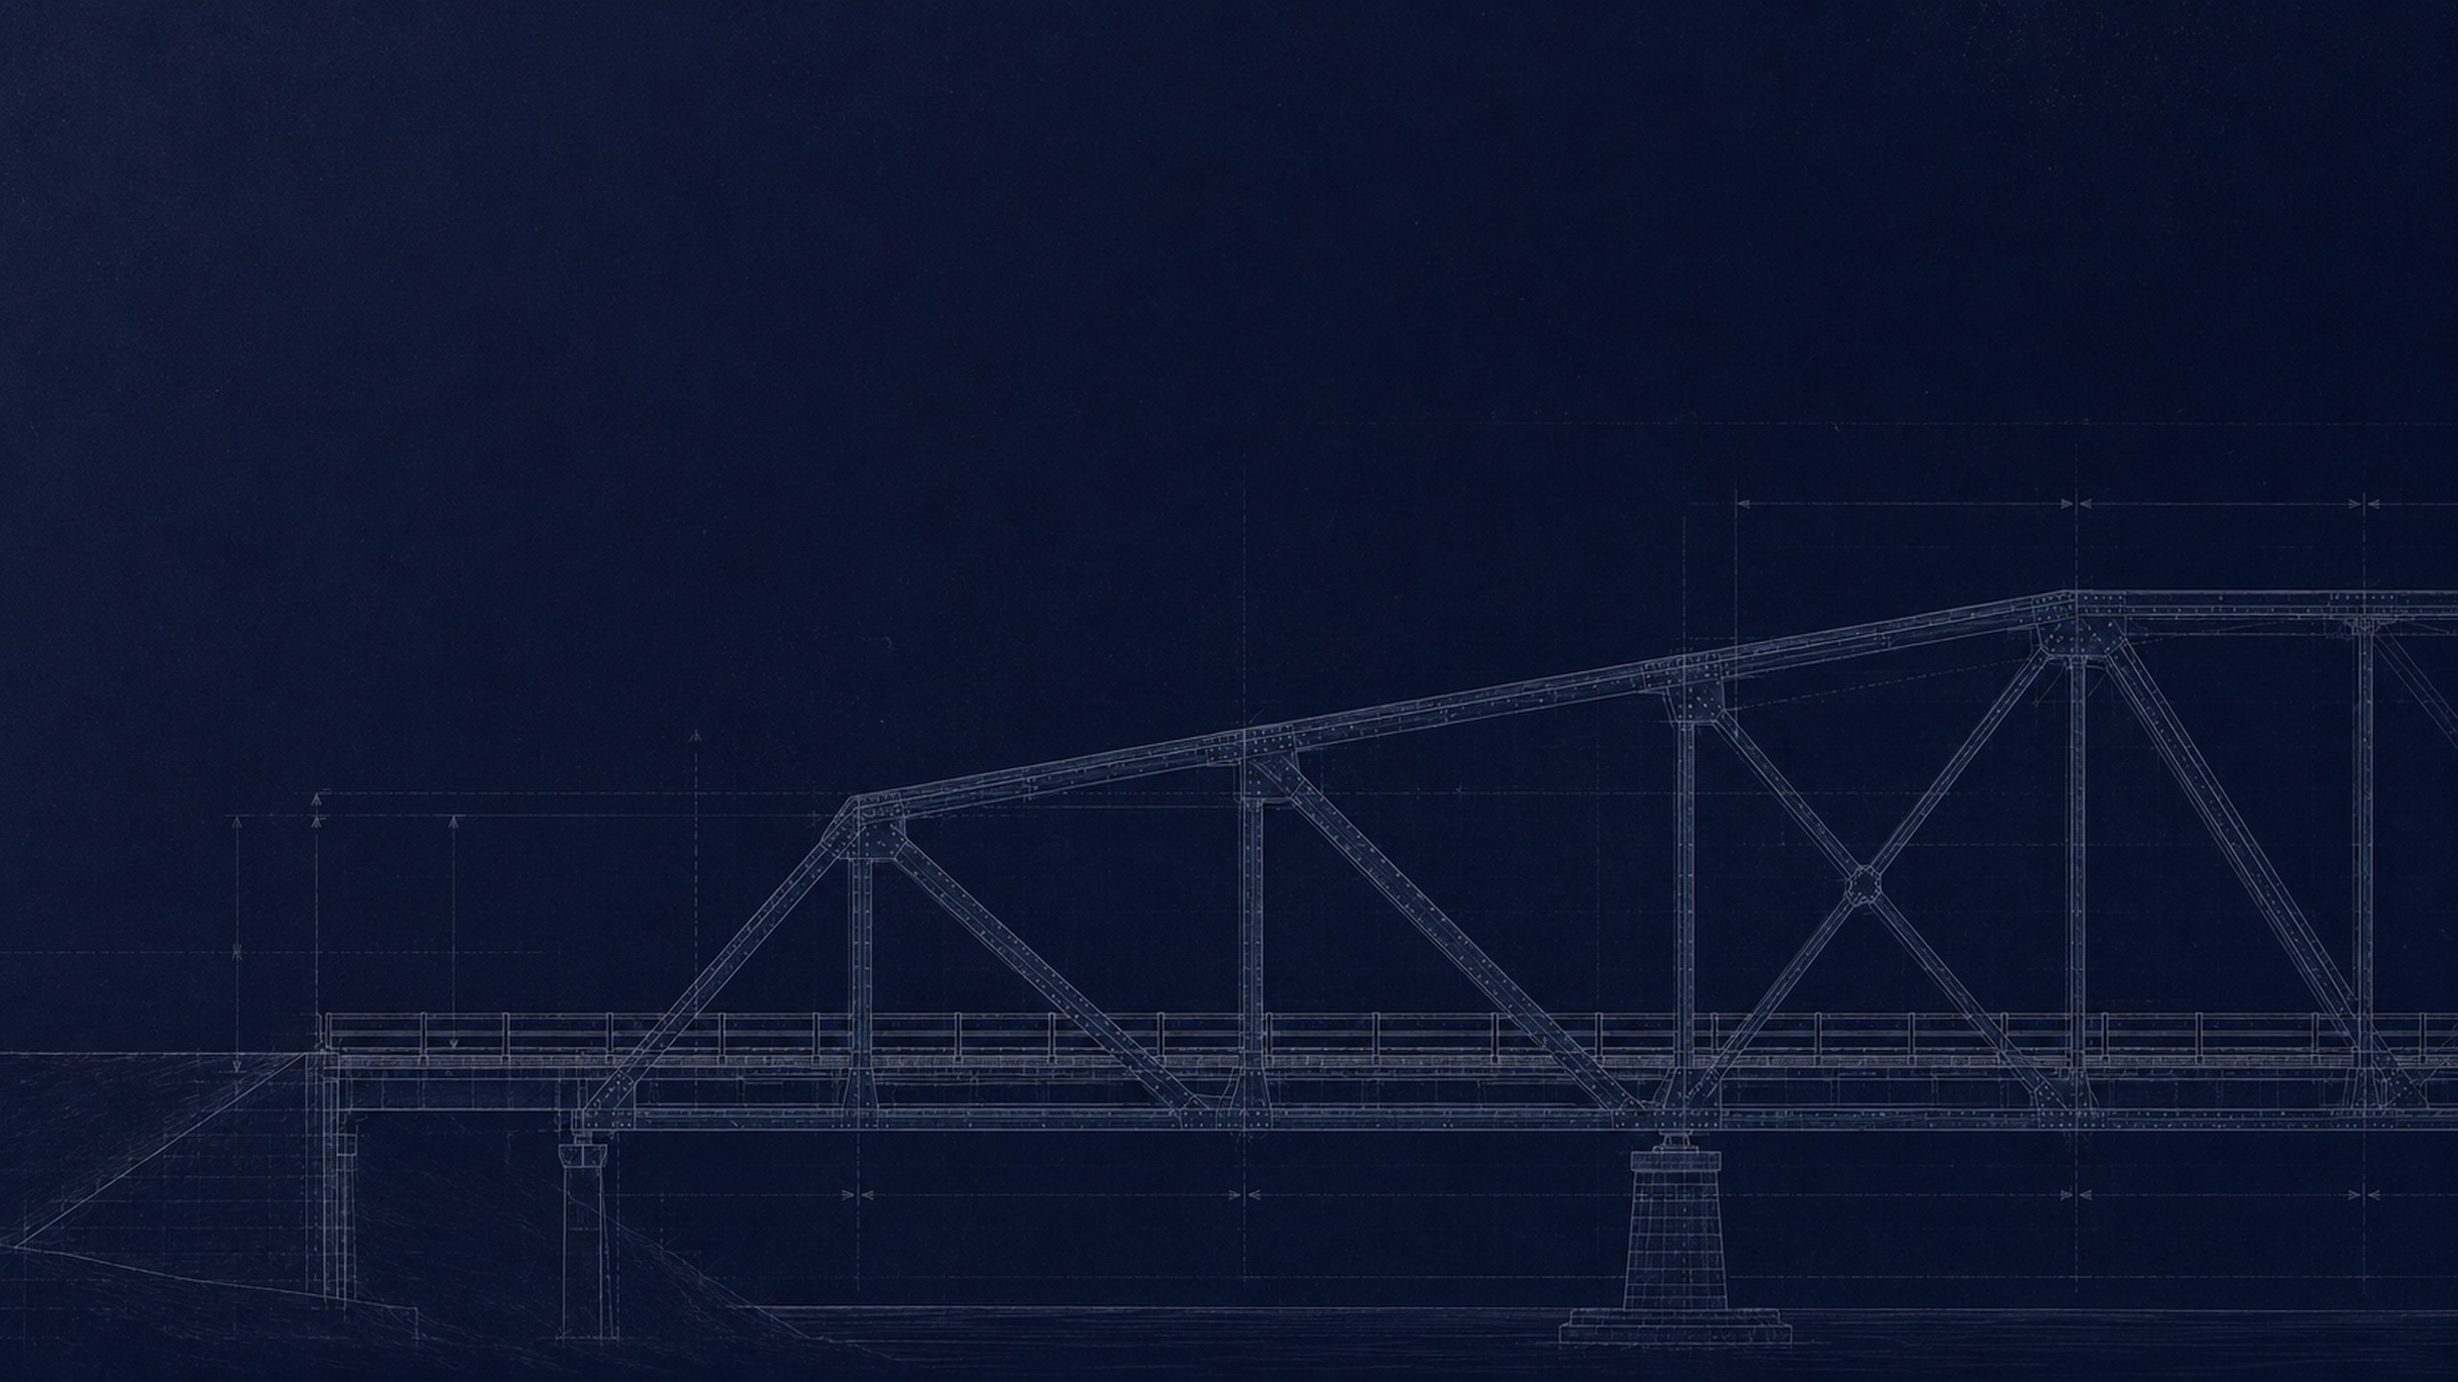
AI INNOVATION CHALLENGE 2026 · ROUND 3: AI EVOLUTION
DISSENT
Infrastructure does not fail silently.
It fails contradicted.
A machine second opinion on every bridge in the United States, built entirely from public records. It keeps a second, independent-of-opinion account of each structure and reports where the two stop agreeing.
TEAM NEXUS NETWORK
621,137 structures · 41,319 rated poor · NBI 1992–2025
DEPT. OF CSE (CYBER SECURITY)
dissent-nexus.netlify.app
Notes:
Open cold, let the drawing sit for three seconds, then: "Every bridge in America is inspected about once every two years, and the entire official record of its condition is a single number from 0 to 9. Tonight I am going to show you the ones whose paperwork is lying."

Slide 2

01 / THE PROBLEM
A bridge does not fail the day it
becomes unsafe.
It fails the day the paperwork and the physical bridge stop agreeing, and nobody is looking at both. Between one inspection and the next, the file is the only thing anyone consults — and the file is standing still while the structure is not.
24 months
between routine inspections. A defect born the day after one waits, on average, a year to be seen.
0 – 9
the lowest of a handful of filed condition digits is the operative account of a whole structure.
under 20%
of the world’s long-span bridges carry any monitoring hardware at all (Nature Communications, 2025). Sensors do not scale. Records do.
Notes:
Make them feel the gap. Two years between looks, a single subjective digit as the whole record, and almost no sensors anywhere. Hardware cannot cover an inventory. The paperwork already does.

Slide 3

02 / SCOPE
We chose bridges because their record is public,
national, per-structure and thirty-four years deep.
EXHIBIT — WHAT THE ABSENCE COSTS
The method needs something to argue with. A bridge in the United States has a public, per-structure, numeric condition record going back to 1992 — every inspection, every rating, every year. We know of no other asset class with all five of those properties at once.
Surfside
FLORIDA · JUNE 2021 · 98 DEAD
A published study had already flagged that exact building as subsiding, years before it fell. There was no condition record for anyone to audit it against, and no mechanism that would have made the contradiction anybody’s job.
This is a scientific choice, not a limitation. Bridges are where the idea can be proven against thirty-four years of ground truth. Buildings are where it goes next.
No comparable public per-building condition series exists. That is the gap, not the technology.
Notes:
The judge will ask why bridges. Answer it as a choice: bridges are the only asset class on earth with a public, national, thirty-four-year, per-structure condition record. You cannot audit a record that does not exist. Surfside is what the absence costs.

Slide 4

03 / THE DATA QUESTION
We used American data because that is where
a public record exists to test against.
The Federal Highway Administration publishes the National Bridge Inventory as plain delimited files, one per state per year, free to anyone. We know of no other public, national, per-structure inspection record that runs this long or this openly. If you want to prove a model can catch a record drifting away from reality, you have to run the experiment where a record exists to drift.
AND WHERE IT TRAVELS
India is building the same record right now.
IBMS already inventories 172,517 National Highway structures on the same 0–9 idea, and MoRTH’s nationwide re-survey is creating exactly the fresh paper baseline this method audits.
Morbi
GUJARAT · OCTOBER 2022 · 135 DEAD
A bridge reopened four days after a renovation, with no public per-structure series anyone outside could have checked against it. This is the failure mode, exactly.
Notes:
Answer this one head-on and without apology. The method audits a paper record, so it has to be tested where a public paper record exists. That is the United States. India is creating the same baseline now. Do NOT say we have deployed anything in India — say the method localises and the data is being created.

Slide 5

04 / THE IDEA
So we keep two witnesses, and we sell the argument between them.
ONE BRIDGE
the file
the structure
THE PAPER WITNESS
THE PHYSICS WITNESS
What the institution believes
What the evidence implies
An inspector visits every 24 months
and files one number from 0 to 9.
Age, traffic, trucks, span, material,
freeze-thaw, rainfall. No rating among them.
7
4.7
FILED RATING
PREDICTED RATING
THE DISSENT 2.3 rating steps of disagreement
This gap is the product. Not another risk score, the contradiction itself.
Notes:
This is the slide that wins or loses the pitch. Slow down. The paper witness is what the institution believes. The physics witness predicts what the rating should be from evidence alone, and no filed rating is ever one of its inputs. The product is not another risk score. The product is the disagreement.

Slide 6

05 / HOW IT WORKS
Two public inputs go in. A ranked, dated obligation comes out.
Nothing here needs a sensor, a site visit, or a procurement cycle. Every input is already published.
INPUT
FEATURES
MODEL
INTERVAL
COMPARE
OUTPUT
Federal file
+ weather
18 physical
features
Frozen at
2015
Conformal
±1.41
Record minus
physics
Ranked
docket
Both public. Both free.
No filed rating is among them.
It has never seen a later year.
Every verdict carries its uncertainty.
Three channels of disagreement.
Capped to a quarter of real capacity.
The whole design is one refusal: no inspector rating is ever one of its inputs. That is what makes it a second opinion rather than an echo.
THE BUDGET The docket is capped at what an inspection team can actually do in a quarter — 12 mandatory, 24 scheduled, 48 watched. A model that flags everything catches everything and helps nobody.
Notes:
Walk it left to right in about twenty seconds. Land two things only: the model is graded against the inspector rating but never allowed to read one, and the alert list is budgeted to real inspection capacity.

Slide 7
06 / PROVENANCE
Every number in this deck is downloadable from
the United States federal government.
234,801
621,137
41,319
inspection filings in the four-state deep panel, 1992–2025
structures in the 2025 national snapshot
of them rated poor by their own inspectors
THE RECEIPT — YOU CAN CHECK THIS TONIGHT
WHAT IS NOT REAL
fhwa.dot.gov/bridge/nbi/{year}/delimited/{ST}{yy}.txt
One series in the entire product is a reconstruction: the Morandi precursor chart. It is labelled as a reconstruction inside the app, and the paper that disputes the underlying finding is cited directly beneath it.
Thirty-four years, fifty-one jurisdictions, one file each. Weather comes from the Open-Meteo historical archive, an ERA5-class reanalysis, also free. The download script is in our repository.
Notes:
Be forensic here. Real federal data, downloadable tonight, and we hand them the URL pattern. Then volunteer the one thing that is NOT measured data before they find it.

Slide 8

07 / HOW YOU KNOW IT DID NOT CHEAT
The model was frozen in 2015 and has never
seen a single year we score it on.
THE WALL
TRAINED
CALIBRATED
NEVER SEEN
168,864 filings the model learned from
interval set here
46,541 rows of pure holdout
1992
2000
2008
2015
2018
2025
Everything we claim is measured to the right of the wall. Nothing the model saw is used to score it.
MAE 0.7
rating steps of error on years it never saw
89% / 90%
conformal coverage against target — reported short, not retuned
Notes:
This is the slide that lets a technical judge relax. Trained to 2015, calibrated on 2016 to 2018, and every number we quote comes from 2019 onward — forty-six thousand rows of pure holdout. And the coverage number is below its target on purpose: we refuse to retune on test years.

Slide 9
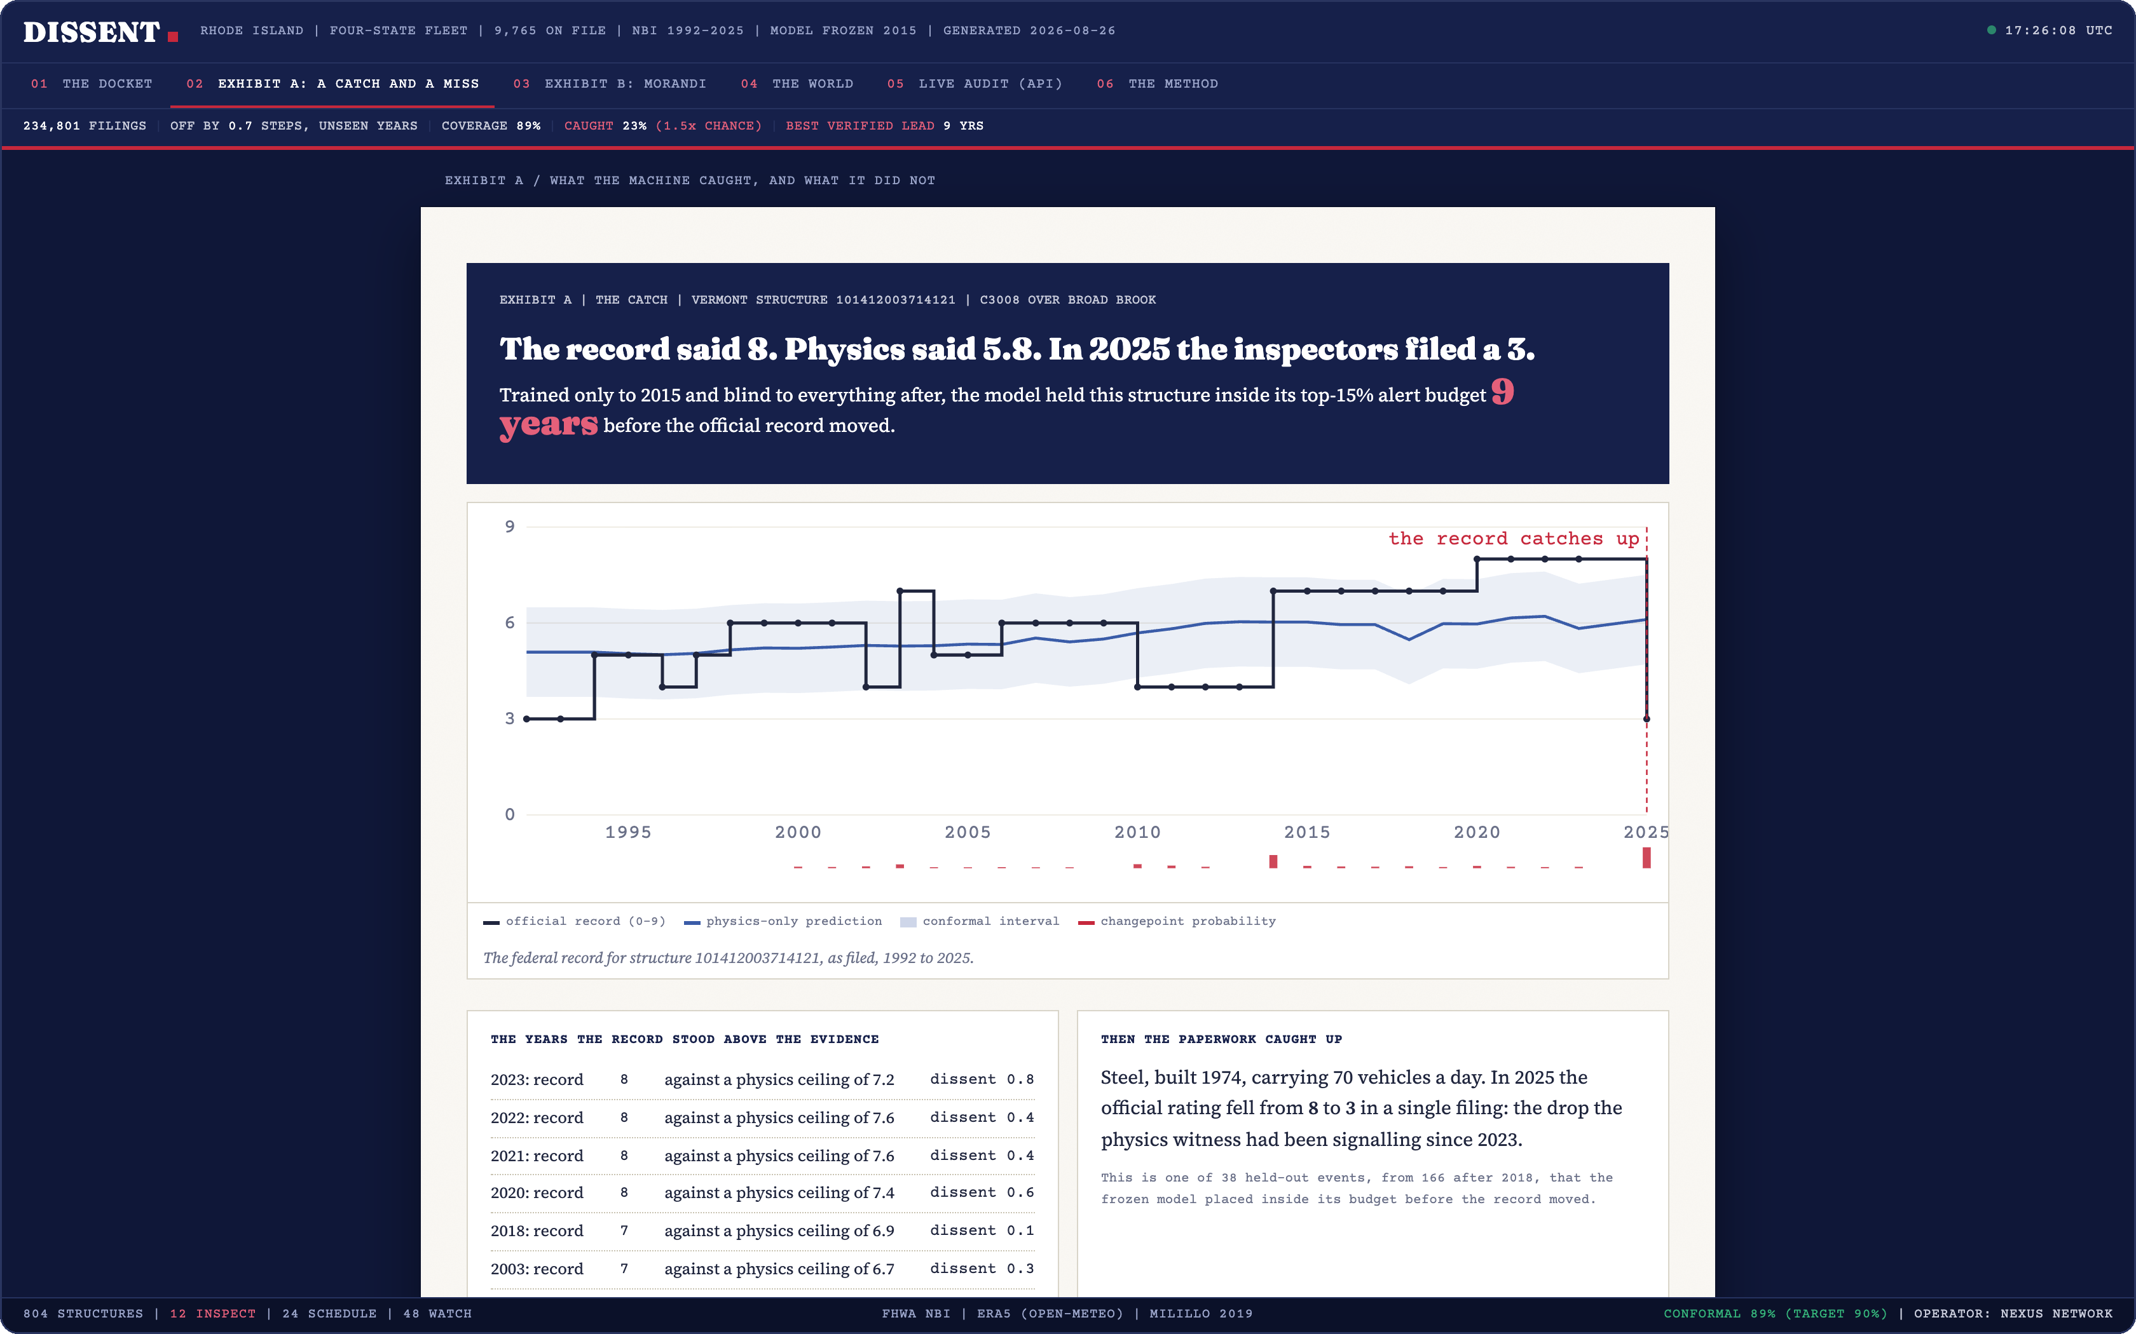
08 / ONE REAL STRUCTURE
The record called this bridge good
for years. The physics disagreed
the whole time.
THE RECORD SAID
8
a good rating, filed and re-filed
PHYSICS SAID
6
from age, traffic and weather alone
IN 2025 THEY FILED
3
poor. The record had caught up.
Exhibit A in the live console, showing this catch alongside a structure we missed.
We had it inside the alert budget nine years earlier.
Notes:
One bridge, told as a story. Point at the three numbers in order. The record said eight, our model — which never saw the record — said six, and in 2025 the inspectors came back and filed a three. We had it flagged nine years before the paperwork moved.

Slide 10
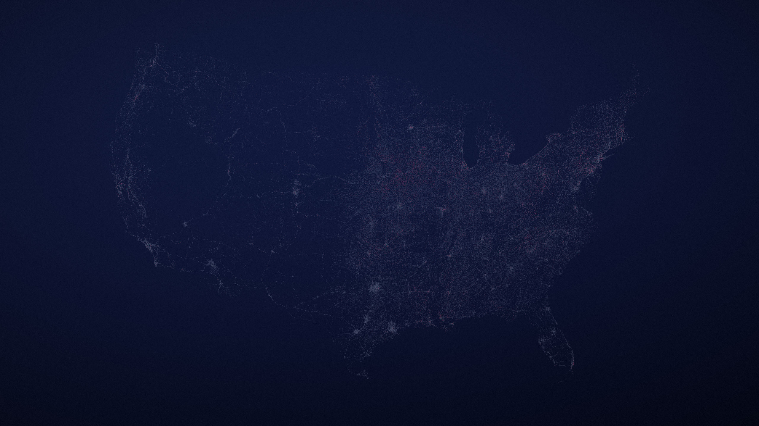
09 / VALIDATION AT SCALE
Then we hid the answers and did it 166 more times.
We mined 1,835 events where the record was forced to catch up — a rating dropping two or more steps, or a closure. The 166 that happen after 2018 are pure holdout.
38/166
23%
3.5 yrs
1.34×
HELD-OUT FAILURES CAUGHT
INSIDE A 15% ALERT BUDGET
RECALL AT THAT BUDGET
MEDIAN WARNING BEFORE
THE RECORD MOVED
OVER A RATING-MATCHED BLIND PICK
95% CI 0.99 – 1.73
WHY A BUDGET AND NOT AN ACCURACY SCORE
AND THE CAVEAT WE ARE NOT HIDING
A model that flags every bridge catches every failure and helps nobody. We score ours the way an inspection team works: a fixed number of alerts per quarter, and we count only the real failures that land inside it.
That 1.34× interval runs from 0.99 to 1.73. It includes 1.0, so on 166 events we cannot rule out that the physics witness adds nothing at all. The finding on the next two slides does not depend on it.
Notes:
Eighteen hundred events mined, 166 in the holdout era. We catch 38 of them inside a 15% budget with a median warning of three and a half years. If they look sceptical, the budget explanation is the answer.

Slide 11

10 / THE CONTROL THAT MATTERS
Now the obvious objection —
and it beats us.
SO WHY DOES THE MODEL EARN ITS PLACE
Because that ranking is nearly a definition of the answer, not a prediction of it.
A bridge already rated 5 is one step from poor. Sorting by the worst rating puts all of those first, so of course it catches the ones that cross the line. It is telling you what you already knew, faster.
Forget the model. Just sort every bridge by its worst recorded rating and inspect the top 15%. No machine learning at all.
It is also blind, by construction, to a bridge whose file still reads fine.
Sort by worst rating
40 of 166
DISSENT (ours)
38 of 166
And that is the only kind of failure that carries a warning: the one nobody was watching, because nobody had a reason to.
On the raw count, the version with no model in it wins. That is on our screen too.
Turn the page.
Notes:
Do not soften this. Say out loud that the dumb baseline beats us on the raw count — forty versus thirty-eight — and that it is printed on our own screen. Then explain WHY: for a threshold target, sorting by rating is nearly a definition of the answer. Then turn the page.

Slide 12
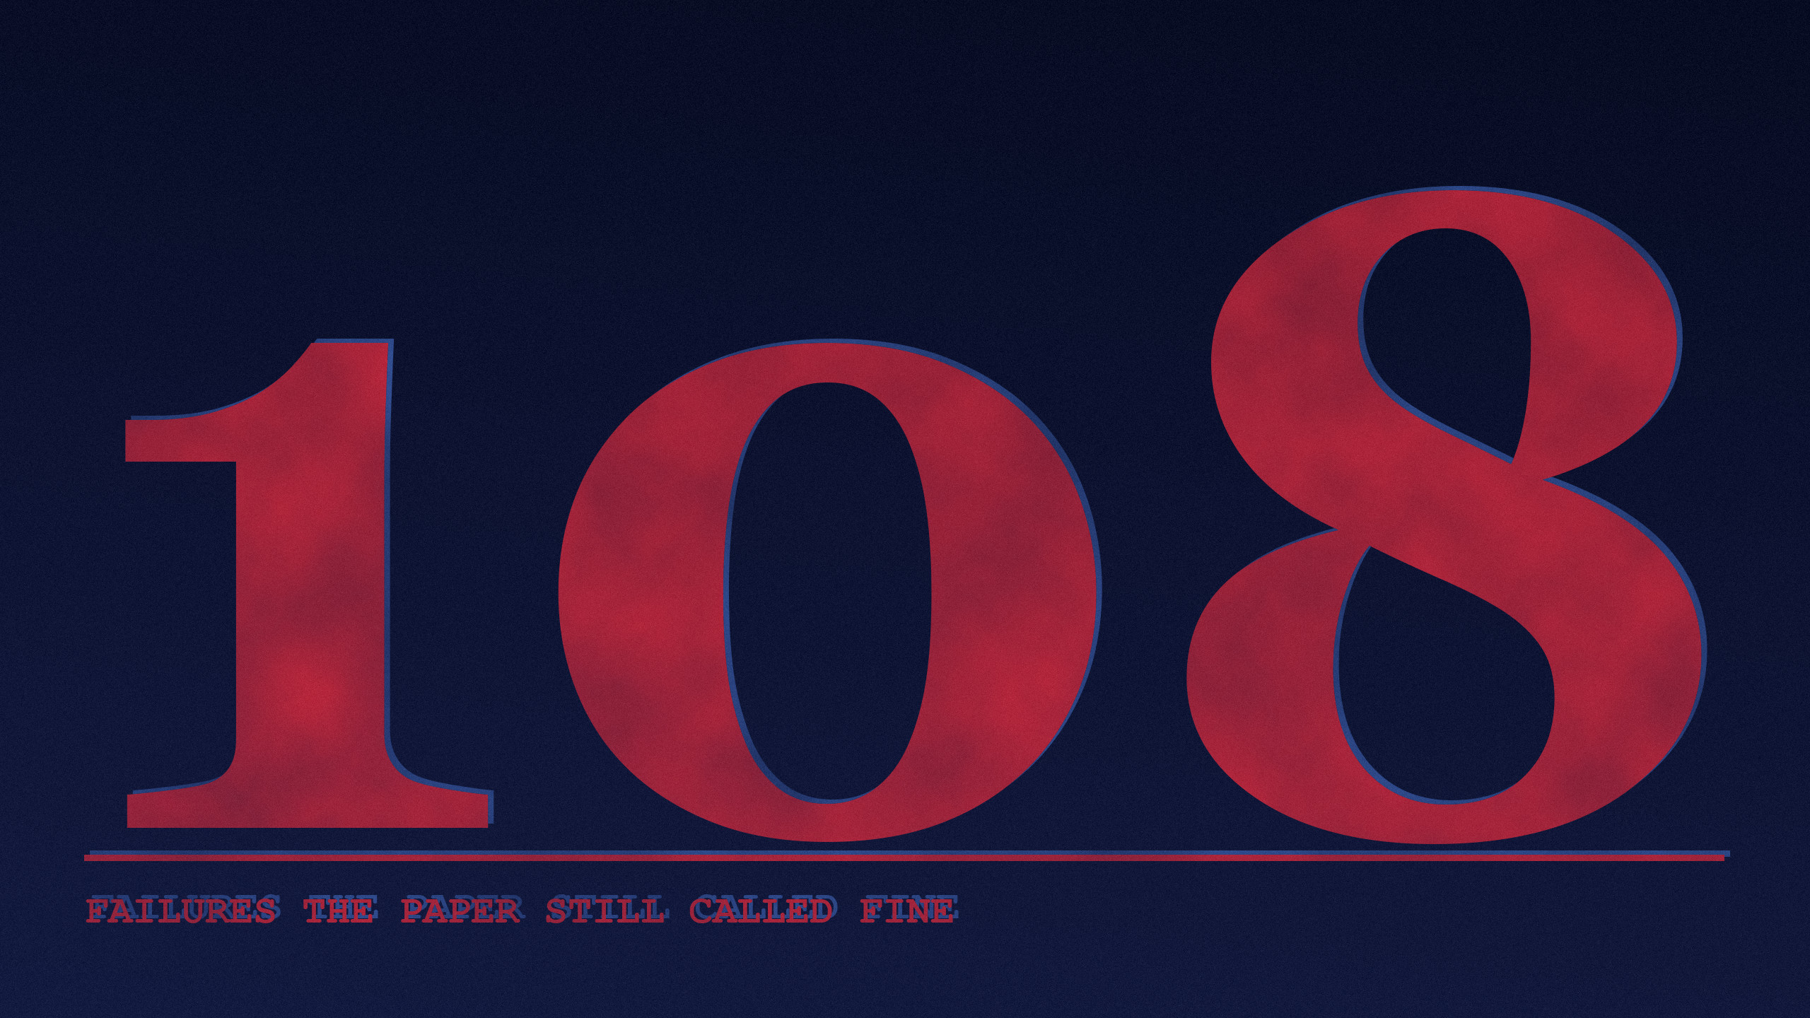
11 / THE ANSWER TO THE OBJECTION
Sorting by the worst recorded rating found none of them.
Notes:
Let the number sit for two seconds before you say anything. Then: of the 166 held-out failures, 108 were on bridges the paperwork still called fine — and the ranking with no model in it found zero of them. Not a small number. Zero.

Slide 13
12 / WHERE THE TWO RANKINGS DIFFER
Split the same 166 failures by what the file said at the time.
Same events, same alert budget, two ways of choosing who to look at.
WHAT THE FILE SAID AT THE TIME
FAILURES
SORT BY WORST RATING
DISSENT
The record already called it bad
58
40
13
Everyone can see these.
The record still called it FINE
108
0
25
Nobody was watching these.
Sorting by the worst recorded rating found none of the 108 failures on bridges the paperwork still called fine. It cannot: it is blind to them by construction.
Notes:
This is the payoff. Fifty-eight of the failures were on bridges the record already called bad — worst-first finds forty of those. The other hundred and eight were on bridges the paperwork still called fine, and worst-first finds zero. Not one. We find twenty-five. Sorting by rating can only point at bridges you already worry about.

Slide 14
13 / WHAT IT CANNOT DO
The limits are in the product, not just the appendix.
Each of these is enforced by the running system, where a judge can see it.
IT ABSTAINS
IT UNDER-COVERS
IT WITHHOLDS
IT MISSED ONE
On any structure under five years old. There is nothing to calibrate against yet, so it declines to have an opinion.
Conformal intervals cover 89% against a 90% target. We report the shortfall rather than retune on the test years.
The model calibrated on four cold, wet, Atlantic states. 27 of 51 jurisdictions sit outside that climate, so the national ranking is withheld for them. They are still audited.
The Washington Bridge closed in 2023 and we rated it slightly better than the record did. The failure was in anchor tie-down details no weather feature can see. It is displayed in the app as a miss.
A system that cannot tell you where it stops working is not a second opinion. It is a guess.
Notes:
Do not rush this. It is worth more than another feature. Every one of these four is enforced in the running product — the abstention, the shortfall, the withheld rankings, and the miss we display on purpose.

Slide 15
PART TWO
The thing itself.
Everything from here is a screenshot of software that is deployed and running right now, at a public address, that you can open on your own phone while I talk.
dissent-nexus.netlify.app
Notes:
Change gear here. Everything after this is the running product.

Slide 16
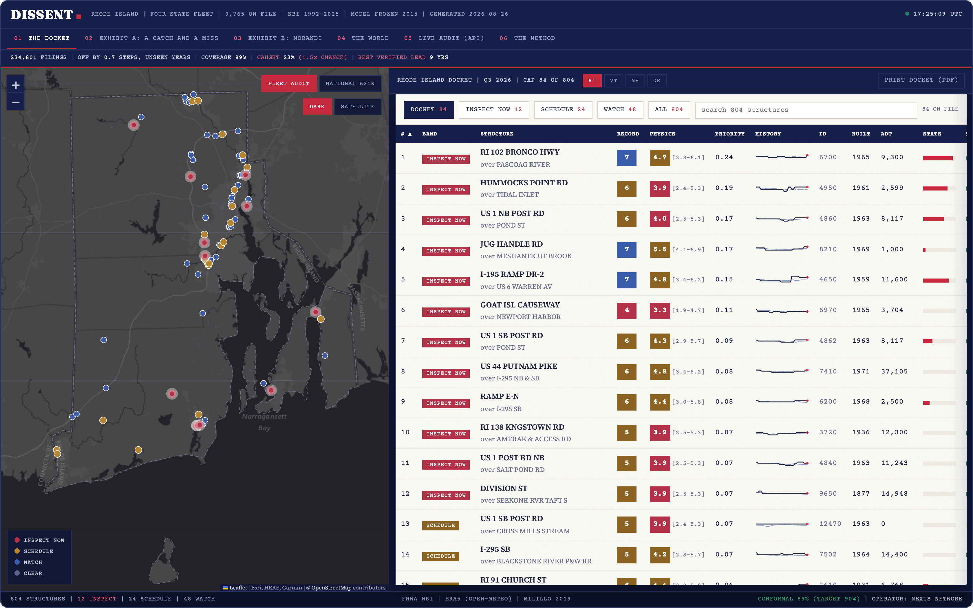
14 / THE PRODUCT — THE WORKING SURFACE
The output is not a dashboard. It is a docket:
a ranked list with a dated obligation on each row.
1 Every structure the model has an opinion about, ranked by how far the record has drifted from the evidence.
3
2
1
2 The two witnesses, side by side on every row: what was filed, and what the physics says — with its interval.
3 Bands sized to real capacity — INSPECT NOW, SCHEDULE, WATCH — so the list is a work order, not a wall of risk.
Click any row and a case file opens: the full trajectory, what drove the dissent, and a satellite view of the structure.
The Rhode Island docket. 804 structures on file, 12 flagged for immediate inspection.
Notes:
This is the working surface. Left is the map, right is the ranked docket. Point at the two badges on the top row: the record says 7, physics says 4.7. That gap is the product.

Slide 17
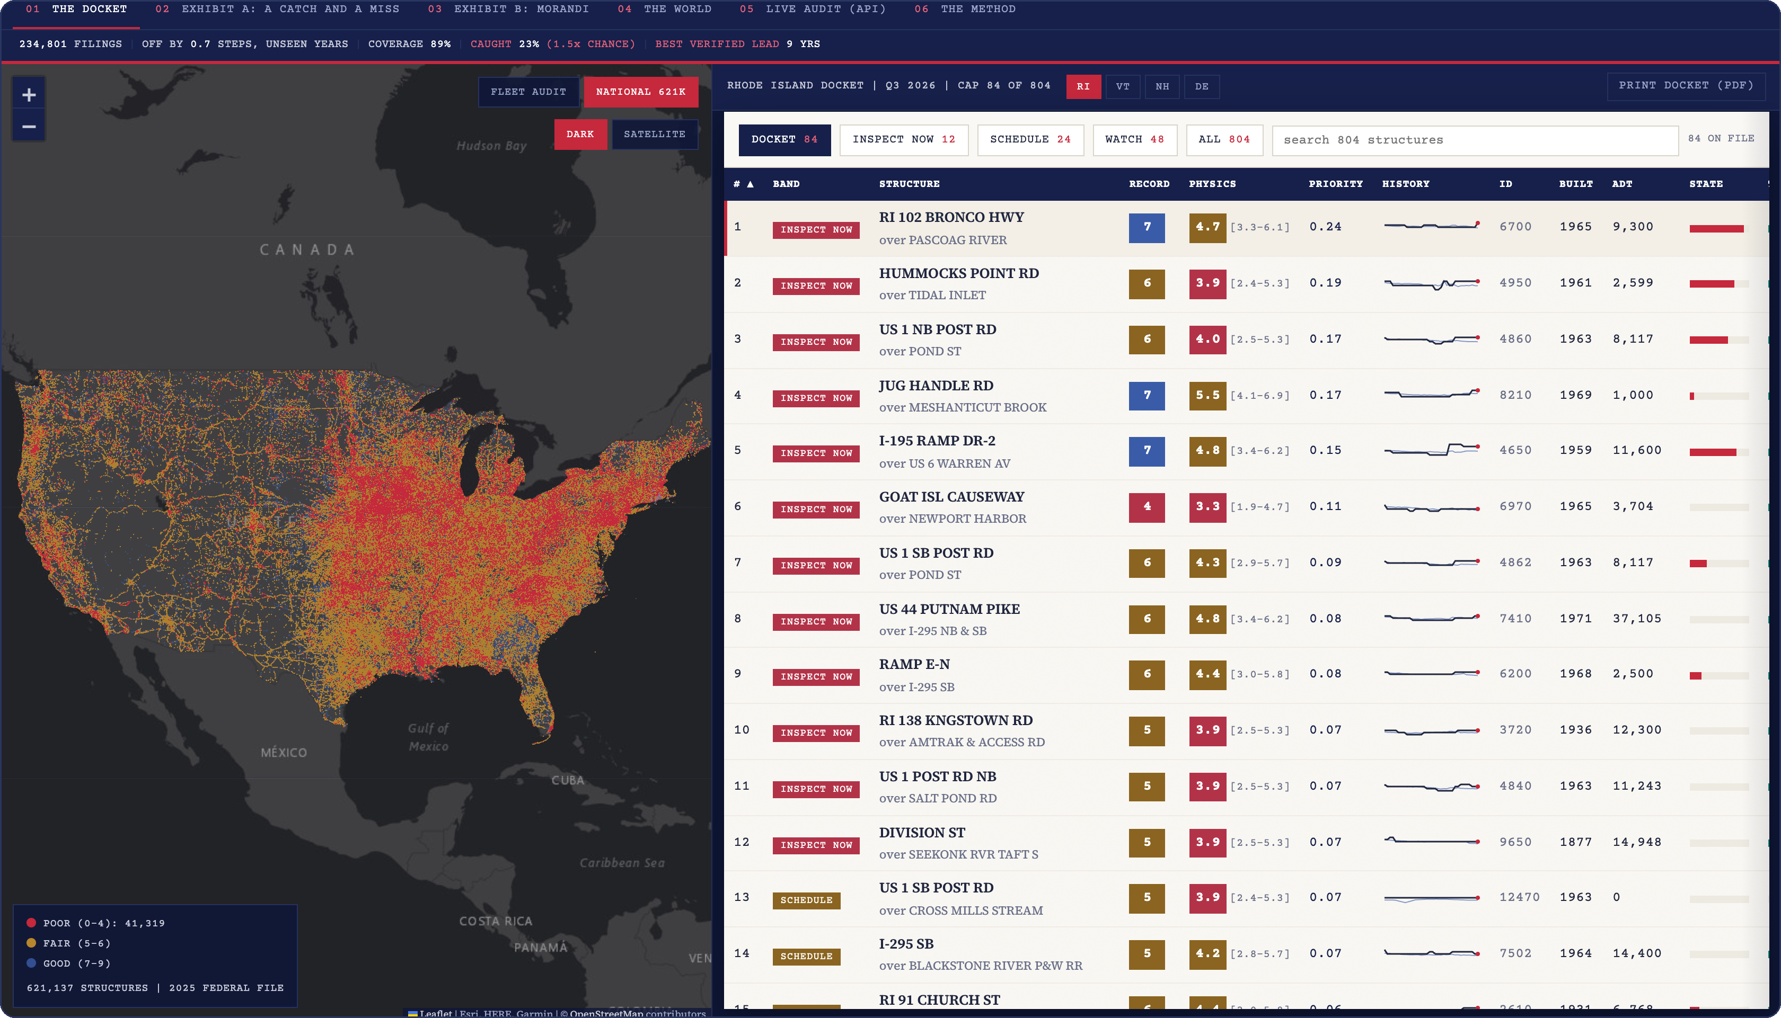
15 / THE PRODUCT — COVERAGE
All 621,137 rated structures in the United States, drawn in the browser.
NO SERVER INVOLVED
ZERO INSTALLED HARDWARE
THE WHOLE INVENTORY
This view streams a 10MB binary straight into the page. Nothing we run can crash while you are marking us.
Not one of these structures needed a sensor, a site visit, or a procurement cycle to appear here.
41,319 of them are rated poor by their own inspectors. Every one is scoreable by the same model.
Notes:
Let it land as scale. That is the whole country, live in the browser, from a ten megabyte file. This view deliberately does not depend on our server.

Slide 18
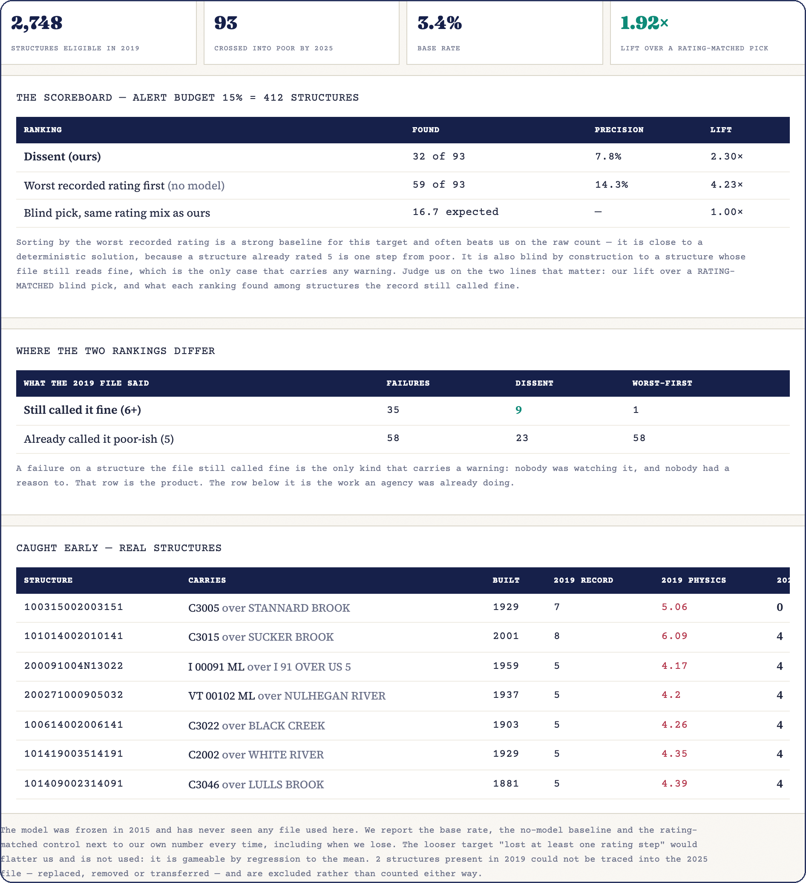
16 / THE PRODUCT — THE STRONGEST TEST WE CAN OFFER
You pick a state and a year. The model
grades its own past ranking, live.
The server pulls that year’s federal file, scores every structure with the model frozen in 2015, ranks them by dissent — then pulls the 2025 file and checks what actually happened to them.
VERMONT, START YEAR 2019 — AS RUN ON THIS SLIDE
2,748
structures still in fair-or-better condition in 2019
93
of them had crossed into POOR by 2025
35
of those were bridges the 2019 file still called fine
On those 35: sorting by worst rating found 1. Dissent found 9.
The base rate and the baseline that beats us are printed on screen every single time — including on the states where we lose.
Notes:
Ask a judge for a state and a year. Two and a half seconds later the server has pulled two federal files and graded itself. Then point at the honesty: the base rate and the baseline are on screen every time. Invite them to try a state where we lose.

Slide 19

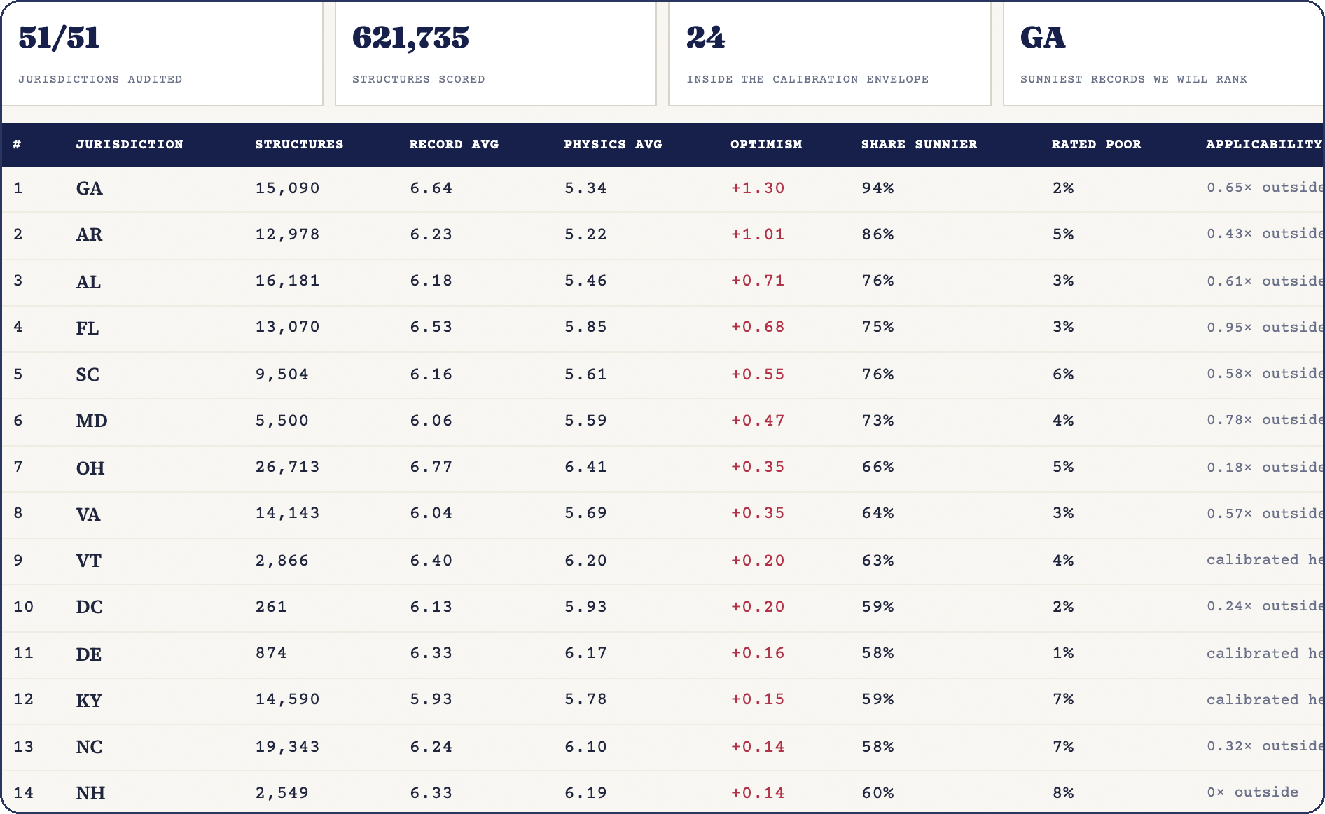
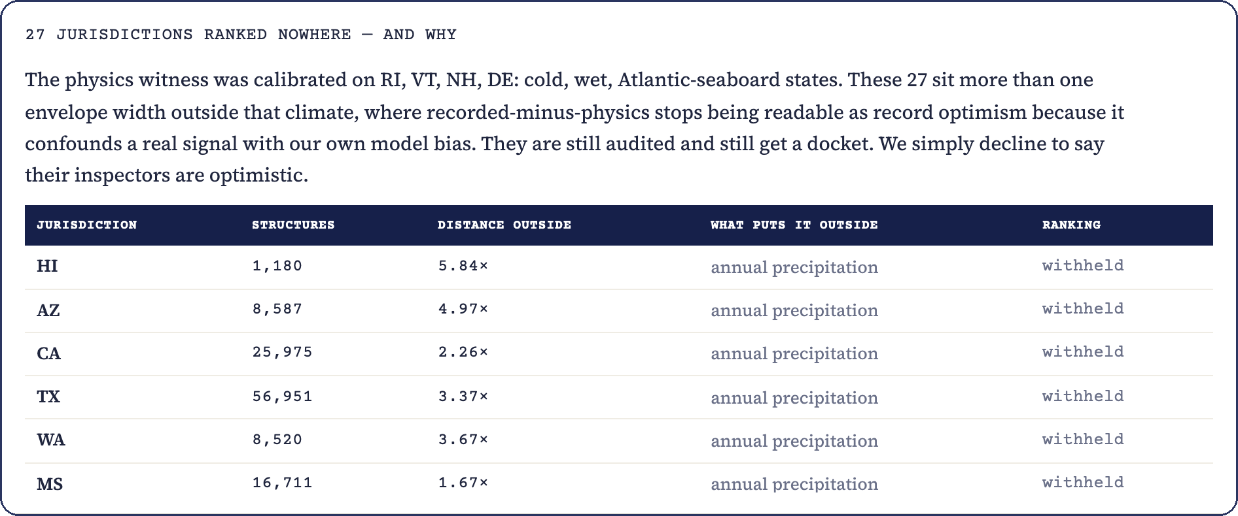
17 / THE PRODUCT — AND THE MOST TRUSTWORTHY THING IN IT
We scored all 51 jurisdictions.
Then we refused to rank 27 of them.
Every audit measures one thing across a whole jurisdiction: how much sunnier its filed ratings run than the physics witness. All 51 jurisdictions, every rated structure in each.
WHAT WE WILL SAY — AFTER DETRENDING OURSELVES
Georgia’s filings run +1.30 of a rating step sunnier than the evidence — +0.91 once we subtract our own extrapolation. Even inside the rankable band, climate distance explains a quarter of what we call optimism (r = 0.51). We publish the residual, not the raw number.
WHAT WE WILL NOT SAY
Anything at all about California, Texas or Arizona.
The model calibrated on four cold, wet, Atlantic states. Arizona sits five climate-envelope widths outside that. Out there we cannot separate “their inspectors are optimistic” from “our model is wrong”, so we publish no number. We still audit them, and they still get a docket. We just decline to pretend.
The index, and the second table listing every jurisdiction whose ranking is withheld and why. The 621,735 in its header is the server’s own per-state audit; the browser map on the previous slide draws 621,137 from the national snapshot. Two pipelines, 598 structures apart, and we would rather show you both than quietly pick one.
Notes:
This is the slide that buys you credibility for everything else. Say it deliberately: twenty-seven states are in the second table with no ranking at all, and the app tells you the reason for each one.

Slide 20
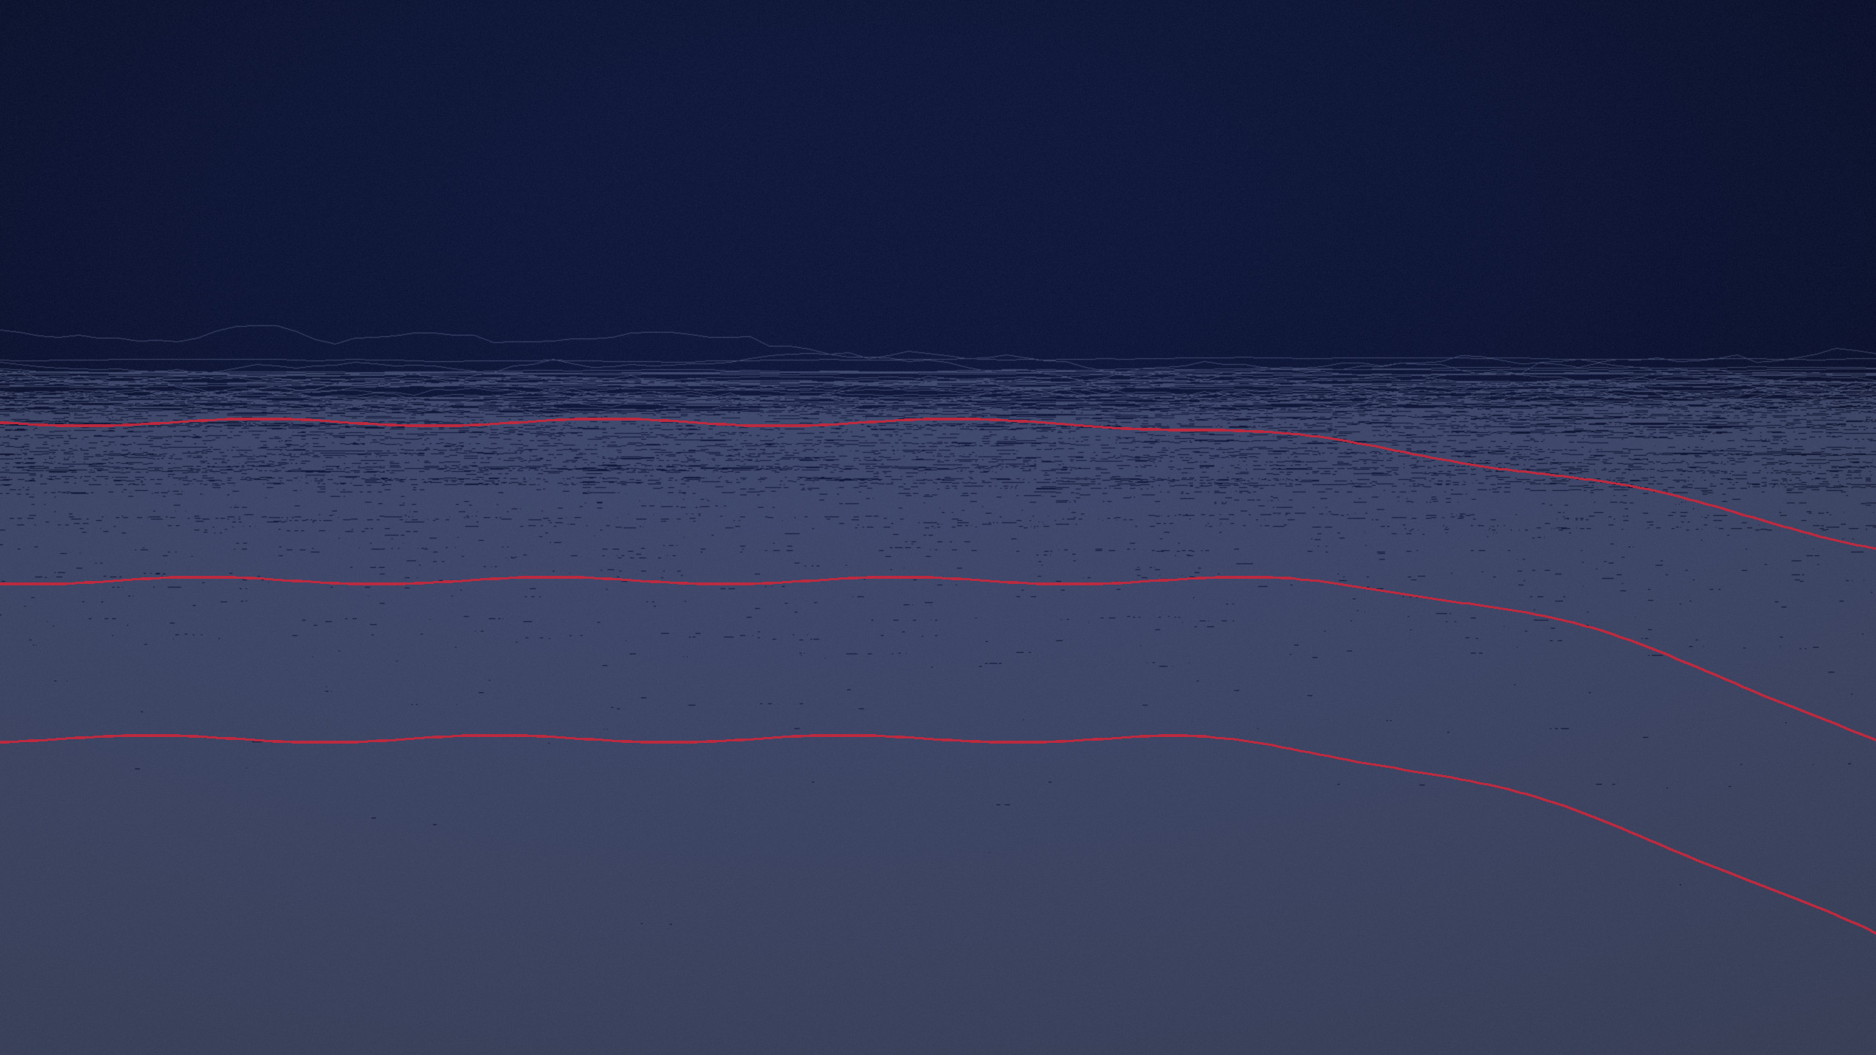
18 / IT IS A SYSTEM, NOT A NOTEBOOK
Half of this physically cannot run in a browser.
The federal files are tens of megabytes and their origin sends no cross-origin headers, so the browser is not allowed to fetch them at all. That half runs on a real server.
FASTAPI ON RENDER
Pulls any state’s live federal file and live weather, scores every structure, and returns a docket.
BOUNDED MEMORY
Texas is 56,951 structures and completes in about fifteen seconds on a free 512MB instance.
SERVER-RENDERED PDFs
Any case file downloads as a real document an engineer can sign.
THE WRITE-BACK LOOP
A field inspection outcome is filed back and stored as a label for the next build. The loop closes.
dissent-api-jgod.onrender.com/docs
Notes:
If they ask "is this just a static site" — this is the answer. Open the docs page. The API is real, documented, and does work a browser is not permitted to do.

Slide 21
19 / THE CATEGORY
Everything on the market measures the asset.
We audit the paperwork against it.
WHAT ALREADY EXISTS
WHAT WE DO
Measure the structure
Audit the account of it
Strain gauges. Satellite interferometry. Drone photogrammetry. Inspection-photo classifiers. Every one of them is good, and every one needs something installed, flown, or visited — so every one covers a fraction of an inventory.
A blind re-inspection setup in which no filed rating is ever an input. Conformal calibration, so every verdict carries valid uncertainty. A Bayesian changepoint detector on the record-versus-physics residual. And one deliberate refusal: we never train a rare-event classifier, because failures are one in thousands. We train a rating predictor on hundreds of thousands of pairs and mine the disagreements.
Coverage: the assets you paid to instrument.
Coverage: 100% of any inventory that files a record.
That is a different category, and it is why there is nothing to install and nothing to buy.
Notes:
Name the category difference plainly. Everyone else measures the asset; we audit the paperwork against the asset. Then name the four genuinely novel pieces.

Slide 22
20 / WHAT CHANGES
Seven hundred and thirty days between
looks becomes one model run.
A second opinion costs one model run. It can be re-run the day a new federal file lands, or the day the weather record updates. There is no visit to schedule and no hardware to wait for.
730 days
today, between routine inspections
one model run
to re-audit an entire national inventory
A county with five bridges and one engineer gets exactly what a national railway gets, because there is nothing to install and nothing to buy.
Notes:
Land the equity point: the small owner gets the same second opinion as the big one, because the marginal cost of one more structure is a model run.

Slide 23
IN CLOSING
We did not simulate a single bridge.
Every figure in this deck comes out of a file the United States government publishes for free, and both halves of the system are deployed and running tonight. If you want to check any number in it, the download script is in our repository.
THE CONSOLE
dissent-nexus.netlify.app
THE API
dissent-api-jgod.onrender.com/docs
THE SOURCE
github.com/ArockiaRajamanickam/dissent
TEAM NEXUS NETWORK
Infrastructure does not fail silently.
It fails contradicted.
DEPT. OF CSE (CYBER SECURITY)
Notes:
Close on verifiability, not on a slogan. Every number is downloadable, nothing was simulated, and both halves are live. Then open the console and hand them the demo.

