Slide 1
MFE 230ZA · GROUP 14 · REPLICATION & EXTENSIONS
Deep Learning
in Asset Pricing
Chen, Pelger & Zhu (Management Science, 2024): replicating the adversarial SDF in PyTorch,
what broke along the way, and what we built on top of it.
Aditya Aryan · Giancarlo Alves · Hashim Almodamagha · Thomas Claudel · Alex Roesler
September 11, 2026
Notes:
[0:20] Total budget 15 min including questions, so ~10:30 of slides. Say: Last term we wrote a referee report on Chen, Pelger and Zhu. This term we ran it. Everything you will see comes out of a PyTorch port of their TensorFlow code, on their own data, on an H100 — and the interesting part is not that it worked, it is the two places where it did not. Per-slide budget: 2) 0:55 3) 0:40 4) 0:50 5) 0:50 6) 1:15 7) 0:55 8) 1:40 9) 0:45 10) 1:05 11) 0:55 12) 0:25. Slide 14 is a backup for questions.

Slide 2
RECAP / 230P IN ONE MINUTE
Where we left off, and what is new today
LAST TERM: A REFEREE REPORT
TODAY
The claim, and our two objections
From reading the paper to running it
The paper estimates the SDF for ~10,000 U.S. stocks with three networks: an LSTM for macro states, a feedforward net for the SDF weights ω, and an adversary that picks the hardest test assets. The loss is the no-arbitrage condition E[M R] = 0, not a forecast error.
Headline: out-of-sample Sharpe 2.6 (annual), EV 8%, XS-R² 23%; beats FFN, elastic net and OLS.
Our objection 1: fitted once in 1986, never re-estimated, reported as one number over 25 years.
Our objection 2: turns over ≈100% of the book every month, every Sharpe ratio is gross of costs.
Replicated the paper end-to-end: simulation (Table II) and U.S. equities (Table III) with the authors' own data.
Ported the (dead) TensorFlow-1.12 code to PyTorch; every design choice is now inspectable and switchable.
Ran the ablations that isolate why it works: no adversary, no macro, raw macro without LSTM.
Built both 230P improvements into the code: transaction costs inside the objective, and a year-by-year test.
Added a third extension the paper skips: enforcing an admissible (positive) SDF.
Recap · Replication · Challenges · Results · Extensions · Next
Notes:
[0:55] One minute only — everybody has read the paper. Left, fast: three networks, and the loss is the no-arbitrage condition, not a forecast error. Headline out-of-sample Sharpe 2.6 annual. Our two objections last term were: fitted once in 1986 and reported as a single number for 25 years, and it turns the whole book over every month with every Sharpe quoted gross. Right: what is new today. We replicated it end to end, ported the dead TensorFlow code, ran the ablations, and built both 230P objections into the objective — plus a third extension the paper skips. Then move on. Do not re-explain the model.

Slide 3
REPLICATION / PIPELINE
What we replicated, and how the pieces fit
DATA
STAGE 1
STAGE 2
STAGE 3
ENSEMBLE
METRICS
Authors' npz panels
Unconditional
Adversary
Conditional
9 seeds → 1 model
SR · EV · XS-R²
Returns + 46 rank-normalised characteristics per stock-month; 178 macro series. Train 1967–86, valid 1987–91, test 1992–2016.
SDF net on E[M R_i] = 0 for every stock (g = 1). 256 epochs, Adam, dropout 0.05.
Freeze ω; train g(I, LSTM₃₂) with 8 tanh outputs to maximise the pricing error. 64 steps.
Freeze g; retrain ω on the 8 adversarial moments. 1024 epochs. Keep best validation Sharpe.
Average ω across seeds, L1-normalise each month, build the SDF factor F = −ω'R.
Second-stage β-network on R·F; project returns on β for EV and cross-sectional R².
→
→
→
→
→
REPLICATED
Table II (simulation, two DGPs) · Table III (U.S. equities: SR, EV, XS-R² for GAN vs. benchmarks) · Figure 6 ablations (no adversary, no macro, 178 raw macro series) · Figures 8, 9, 13 (variable importance, β-sorted deciles, LSTM macro states). Same architecture as the paper's Table I optimum: FFN 2×64, 4 SDF states, 32 adversary states, 8 moments, lr 0.001.
Recap · Replication · Challenges · Results · Extensions · Next
Notes:
[0:40] The pipeline, left to right. Point at the boxes, do not read them. The two things worth saying out loud: stage 2 is where the adversary picks the hardest test assets, which is the whole idea of the paper; and everything is a 9-seed ensemble, which turns out to matter more than we expected — that comes back on slide 8. Bottom strip: this is the full list of what we reproduced. Same architecture as their Table I optimum.

Slide 4
REPLICATION / DATA
The data: what the authors share, and what they don't
Split | Months | Window | Permnos in split | Stock-months | Avg stocks / month
Train | 240 | 1967–1986 | 3,686 | 336,113 | 1,400.5
Valid | 60 | 1987–1991 | 3,347 | 132,167 | 2,202.8
Test | 300 | 1992–2016 | 7,141 | 750,275 | 2,500.9
WHAT IS NOT SHARED
Three gaps we had to work around
No PERMNO identifiers. The stock index is consistent inside a split but not across splits, and each split holds only 3.7k / 3.3k / 7.1k names — the paper's "~10,000" is the union over the whole sample. Enough for turnover, not enough to join anything new.
No raw CRSP/Compustat: the characteristic construction (Table A.VII) cannot be re-run, so 2017–2026 cannot be appended without WRDS.
Macro is pre-transformed and final-vintage: our 230P real-time critique still stands and cannot be tested from this data.
1,218,555 stock-months. Shapes and windows match the paper exactly.
Inputs, exactly as in the paper
46 characteristics (past returns, investment, profitability, intangibles, value, frictions), each ranked cross-sectionally every month into [−0.5, 0.5]. A stock enters only when all 46 are available: ~31,000 CRSP names → ~10,000.
178 macro series: 124 FRED-MD, the 46 characteristic medians, 8 Welch–Goyal predictors; McCracken–Ng transformations, then standardised with training-window moments only.
Missing return = −99.99 sentinel → boolean mask; the loss weights each stock by its number of months T_i.
Recap · Replication · Challenges · Results · Extensions · Next
Notes:
[0:50] The authors share pre-built npz panels, and that is both the good news and the bad news. Good news: the shapes match the paper on the first load — 240 / 60 / 300 months, 46 characteristics, 178 macro series, 1.2 million stock-months. Nothing to reconstruct. Bad news, right-hand card: no PERMNOs, so we cannot join anything new; no raw CRSP, so the characteristics cannot be rebuilt and the sample cannot be extended past 2016; and the macro data is final-vintage and pre-transformed, so our 230P real-time critique cannot even be tested from this file. One surprise worth a sentence: each split holds three to seven thousand stocks, not ten thousand. The ten thousand is the union over the whole sample.

Slide 5
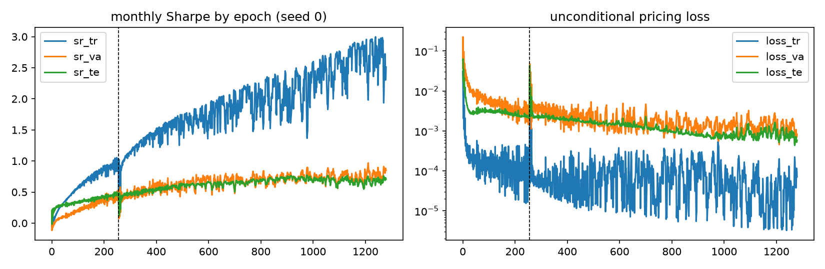
REPLICATION / METHOD
The objective we actually optimise
PRICING LOSS (authors' code, line for line)
L(ω, g) = mean over j, i of (T_i / T_max) · [ (1/T_i) Σ_t M_{t+1} · R_{t+1,i} · g_{j,t,i} ]²
M_{t+1} = 1 + Σ_i ω(I_{t,i}, h_t) R_{t+1,i} h_t = LSTM₄(macro_{1..t}) g_{j} = tanh(FFN(I, LSTM₃₂(macro)))
Stage 1 sets g ≡ 1. Stage 2 maximises L in g. Stage 3 minimises L in ω with g frozen.
Seed 0. At the dashed line the SDF net is reset to its best-validation-loss weights and the adversarial moments take over: training Sharpe then runs away to 3.0 while validation and test stay flat at 0.7 — the ensemble is what keeps that gap honest.
SELECTION & ENSEMBLE
Every epoch: unconditional loss and Sharpe on train / valid / test. Checkpoints kept for best validation loss (used to move between stages) and best validation Sharpe (used for the ensemble).
Nothing in the 1992–2016 window is used for any decision; it is printed for the training-curve plot only.
Ensemble = mean of raw ω over 9 seeds, then L1-normalised per month, so F is the return on $1 gross.
Hyperparameter | Paper (Table I) | Ours
SDF net layers × units | 2 × 64 | 2 × 64
SDF / adversary LSTM states | 4 / 32 | 4 / 32
Adversary layers / moments | 0 / 8 | 0 / 8
lr · dropout · epochs | 0.001 · 0.95 · 256/64/1024 | same
Recap · Replication · Challenges · Results · Extensions · Next
Notes:
[0:50] The objective, in one line. This is the only equation in the deck. Read it as: for every test asset j and every stock i, the average of M times the excess return times the adversarial weight should be zero. Stage 1 sets g to one — that is the unconditional model. Stage 2 maximises this in g. Stage 3 minimises it in omega. Selection card: nothing in 1992–2016 touches any decision. Test Sharpe is printed every epoch only so we can draw the picture on the right — and that picture is the honest story of the method: training Sharpe goes to 3.0, validation and test sit at 0.7. Table: our hyper-parameters are theirs.

Slide 6
CHALLENGES
Four things that did not just work
1 · THE CODE IS DEAD
2 · DEFAULTS ARE PART OF THE MODEL
3 · THE SEARCH IS TOO BIG
4 · STATE THAT CARRIES OVER
TensorFlow 1.12, Python 3.6, 2019 APIs
The first full run had the shape but not the numbers
384 configs × validation × 4 finalists × 9 seeds
LSTM memory across train → valid → test
placeholders, dynamic_rnn, boolean_mask, tf.train.Saver: none of it installs on a 2026 machine. Getting the GPU was its own detour — pip resolved the CPU wheel until we installed torch from the cu128 index alone.
Test Sharpe 0.63 against the paper's 0.75, and the cost-aware extension was nearly worthless at 0.09. Nothing was obviously broken. Framework defaults were silently doing the work: initialisers, where Adam's epsilon sits, whether dropout is on for a frozen network.
Even on an H100 a full re-tune is days, not an evening. And selection on validation Sharpe means the paper's test numbers are themselves conditional on that search.
The macro state at January 1992 depends on 25 years of history. Evaluate the test window from a zero state and the model prices with amnesia.
HOW WE DEALT WITH IT
HOW WE DEALT WITH IT
HOW WE DEALT WITH IT
HOW WE DEALT WITH IT
Rewrote the model in PyTorch against the TF graph, function by function: same data layer, same masked loss with the T_i weighting, same three-stage schedule and checkpoint rules. Verified on a synthetic panel with a planted SDF, then on the paper's own simulation DGP, before touching CRSP data.
Line-by-line audit against their graph and notebook, then eight fixes: TF Glorot init with LSTM forget bias 1, a tf.train.Adam-exact update with a fresh optimiser per stage, dropout left active on the frozen nets, the adversary's 4×64 loop, ignore_epoch 32. Headline 0.63 → 0.68; the cost extension 0.09 → 0.51.
Fixed the architecture at their reported optimum (Table I) and spent the compute on 9 seeds per model plus the ablations — about one fortieth of their budget. Then report the seed dispersion, which the paper does not.
Run the LSTM over the concatenated macro history and slice the window — what the authors' getNextInitialState does. The same trick lets us read the four hidden states over the whole sample.
Recap · Replication · Challenges · Results · Extensions · Next
Notes:
[1:15] This is the slide the assignment is really about, so slow down here. 1. The code is dead. TensorFlow 1.12 on Python 3.6 does not install in 2026. And before any of that, a plain pip install gave us the CPU build of torch — the H100 sat idle until we reinstalled from the CUDA index alone. 2. This is the one worth telling. Our first complete run looked right — right shapes, right pictures, ablations in the right order — and was wrong. Test Sharpe 0.63, and our cost-aware extension came out at 0.09, basically useless. Nothing was broken. PyTorch just has different defaults from TensorFlow: different initialisers, epsilon in a different place inside Adam, and dropout switched off on a frozen network where TensorFlow feeds keep-prob to the whole graph. Eight fixes later the headline went to 0.68 and the extension went to 0.51 — a five-fold move from changes that are invisible in a results table. If you take one thing from the replication, take that. 3. We could not redo their 384-configuration search, so we took their optimum and spent the compute on seeds instead. 4. The LSTM state has to carry across the split boundary or the model prices 1992 with amnesia.

Slide 7
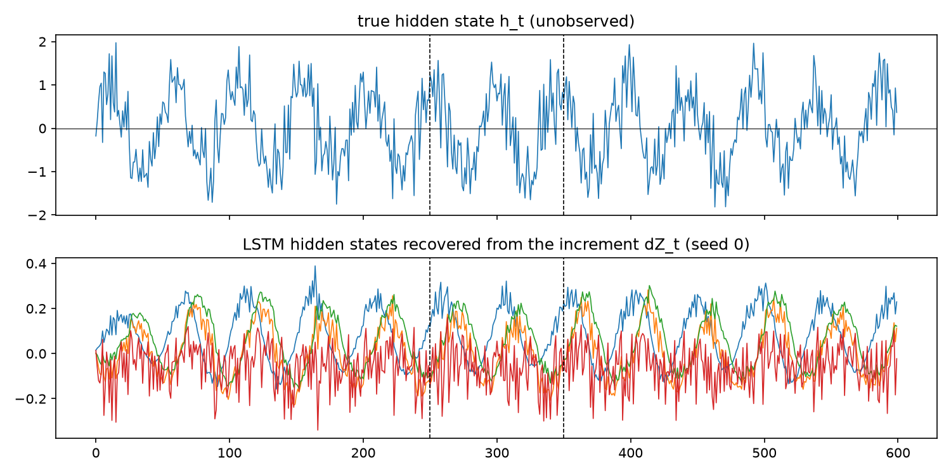
RESULTS / 1 · SIMULATION (TABLE II)
On the paper's own DGP, the port recovers the SDF
R = β F + ε, F ~ N(0.32, 0.1), ε ~ N(0,1), N = 500, T = 250 / 100 / 250. Setup 1: β = C₁·C₂ (a pure interaction). Setup 2: β = C·sign(h_t), h_t a noisy sine cycle observed only through its trended increment.
Setup 1: two characteristics | SR train | SR valid | SR test | EV test | XS-R² test
Population SDF (paper) | 0.96 | 1.09 | 0.94 | 0.17 | 0.17
GAN (paper) | 0.98 | 1.11 | 0.94 | 0.13 | 0.07
GAN (ours, 3 seeds) | 0.99 | 0.92 | 1.00 | 0.17 | 0.12
FFN forecast (paper / ours) | 0.94 / 0.97 | 1.04 / 0.92 | 0.89 / 1.02 | 0.05 / 0.17 | −0.33 / 0.13
Linear (paper / ours) | 0.07 / 0.12 | −0.10 / 0.04 | 0.01 / −0.09 | 0.00 / 0.00 | 0.01 / 0.00
WHAT THIS BUYS US
Setup 1 is the clean check on the port: GAN test Sharpe 1.00 against a population SDF of 1.02 and the paper's 0.94, while the linear model finds nothing in the interaction — exactly the paper's result.
Costs minutes on a GPU, so any change to the objective can be regression-tested here before it touches CRSP.
Setup 2: char + hidden macro state | SR test | EV test | XS-R² test
Population (paper) | 0.86 | 0.17 | 0.15
GAN with LSTM (paper / ours) | 0.64 / 0.60 | 0.17 / 0.01 | 0.15 / 0.00
FFN, last macro obs (paper / ours) | 0.06 / 0.02 | 0.02 / 0.16 | 0.02 / 0.20
SETUP 2 · THE LSTM RECOVERS A CYCLE IT NEVER SEES
Setup 2 caveat: the loading is C·sign(h_t), and our β-network sees characteristics only — as the authors' own config does — so no function of C can represent it and EV / XS-R² are ≈0 by construction, not by failure. The SDF weights, which do see the state, still reach 0.60 against the paper's 0.64 — though our population SDF scores 0.97 there against their 0.86, so the two calibrations are not identical. Our FFN and LS benchmarks are our own code (the authors released no simulation script) and are stronger than theirs.
Recap · Replication · Challenges · Results · Extensions · Next
Notes:
[0:55] Before the real data: does the port work at all? The simulation is where you can answer that, because there is a population SDF to compare against. Setup 1, top table: our GAN gets test Sharpe 1.00, the population SDF gets 1.02, the paper gets 0.94. The linear model gets minus 0.09 — it cannot see an interaction between two characteristics, which is the point the paper is making. So the port is right. Setup 2, bottom: the loading flips sign with a hidden macro cycle that is only observable through a noisy trended increment. Our Sharpe 0.60 against the paper's 0.64. The picture on the right is the one to point at: top panel is the true hidden state, bottom is what the LSTM reconstructed from the increment. Correlations 0.45 to 0.64 across the four units. That is the mechanism the whole paper rests on. If asked about the two zeros in the bottom table: our β-network is fitted on characteristics only, exactly as their released config does it, and the true loading depends on the macro state — so those two metrics are zero by construction. The Sharpe, which uses the weights, is fine.

Slide 8
RESULTS / 2 · U.S. EQUITIES (TABLE III)
The ordering replicates; the level lands 9 % low
Model | SR train | SR valid | SR test (monthly) | SR test (annual) | EV test | XS-R² test
GAN, hidden macro states (paper) | 2.68 | 1.43 | 0.75 | 2.60 | 0.08 | 0.23
GAN, hidden macro states (ours, 9 seeds) | 2.99 | 1.36 | 0.68 | 2.36 | 0.084 | 0.228
spread across the 9 seeds (test SR) |  |  | 0.283 – 0.750
UNC: no adversary (paper / ours) | 1.93 / 1.52 | 1.33 / 0.72 | 0.53 / 0.45 | 1.84 / 1.57 | 0.07 / 0.104 | 0.19 / 0.287
GAN, no macro (paper / ours) | 1.90 / 1.75 | 1.35 / 1.49 | 0.69 / 0.62 | 2.39 / 2.15 | — / 0.101 | — / 0.258
GAN, 178 raw macro, no LSTM (paper / ours) | 1.07 / 1.03 | 0.05 / 0.02 | 0.05 / 0.07 | 0.17 / 0.23 | — / 0.117 | — / 0.279
FFN forecast (paper) | 0.45 | 0.42 | 0.44 | 1.52 | 0.04 | 0.15
Elastic net (paper) | 1.37 | 1.15 | 0.50 | 1.73 | 0.04 | 0.19
THE HEADLINE: 0.68 VS 0.75
THE ORDERING REPLICATES — BUT NOT ON EV
WHAT THE PAPER NEVER REPORTS
9 % low, on one fortieth of the compute and with no hyper-parameter search. Train came in above the paper (2.99 vs 2.68), so our fit ran slightly further before validation stopped it. EV and XS-R² land on the paper: 0.084 / 0.228 vs 0.08 / 0.23.
Sharpe ranks exactly as in the paper: adversary 0.68 > none 0.45, and states 0.68 > no macro 0.62 > raw macro 0.07. EV and XS-R² do not rank at all: every ablation, including the run that collapses to 0.07, scores as high or higher.
Across 9 seeds the test Sharpe runs 0.28 to 0.75 — a spread wider than the paper's gap between the GAN and OLS. The ensemble (0.68) beats the average seed (0.49) and 8 of the 9, but not seed 0.
Ours = 9-seed ensembles of best-validation-Sharpe checkpoints; the raw-macro ablation has 4 seeds. XS-R² is the T_i-weighted definition the authors' notebook prints — unweighted it is 0.045.
Recap · Replication · Challenges · Results · Extensions · Next
Notes:
[1:40] The main slide. Give it time. Row 1 is the paper, row 2 is us: 0.68 against 0.75 monthly, 2.36 against 2.60 annual. We are 9 % low. The most likely reason is right there in row 2 — our training Sharpe is 2.99 against their 2.68, so our fit ran a bit further into the training window before validation stopped it, and we did none of their 384-configuration search. EV 0.084 and XS-R² 0.228 sit on their 0.08 and 0.23. Then the ablations, and this is the part that replicates cleanly. Take the adversary away and it falls to 0.45. Take the macro states away and it falls to 0.62. Feed all 178 raw macro series without the LSTM and it collapses to 0.07 out of sample — the paper says the same thing. So the ordering is theirs. Middle card: the honest finding. The ordering only replicates on Sharpe. On EV and cross-sectional R² the ablations all score as high as the headline model or higher — the run that collapses to 0.07 has the best EV in the table. Our second-stage β-network is fitted on characteristics alone, so it explains a similar amount whatever SDF factor you point it at. We would not present EV as evidence that this model is better than the alternatives. Right card, the number we would put in a referee report: across nine seeds the test Sharpe runs 0.28 to 0.75. The paper's own gap between the GAN and OLS is smaller than the spread between two seeds of the same model.

Slide 9
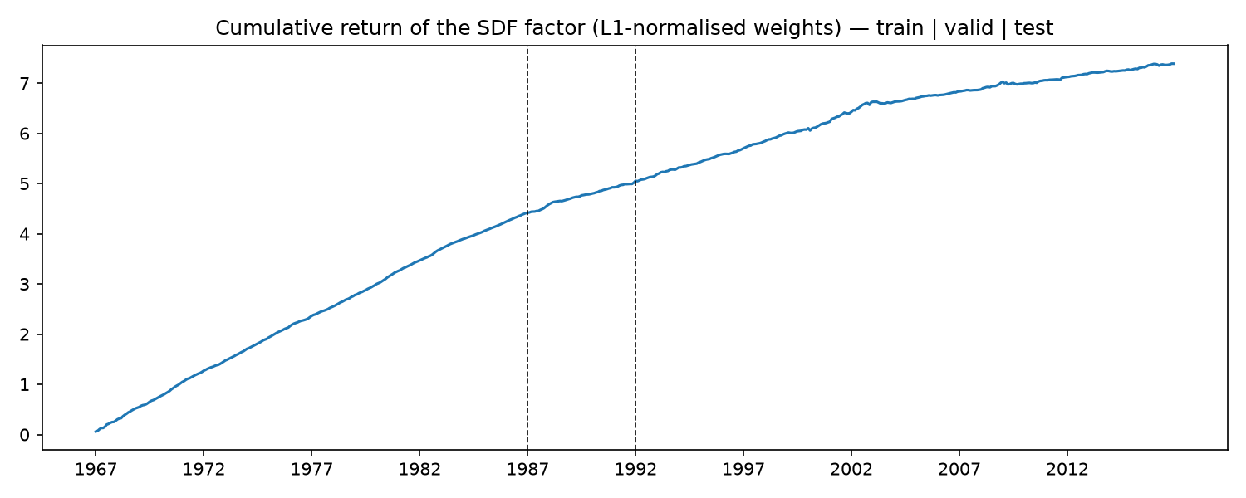
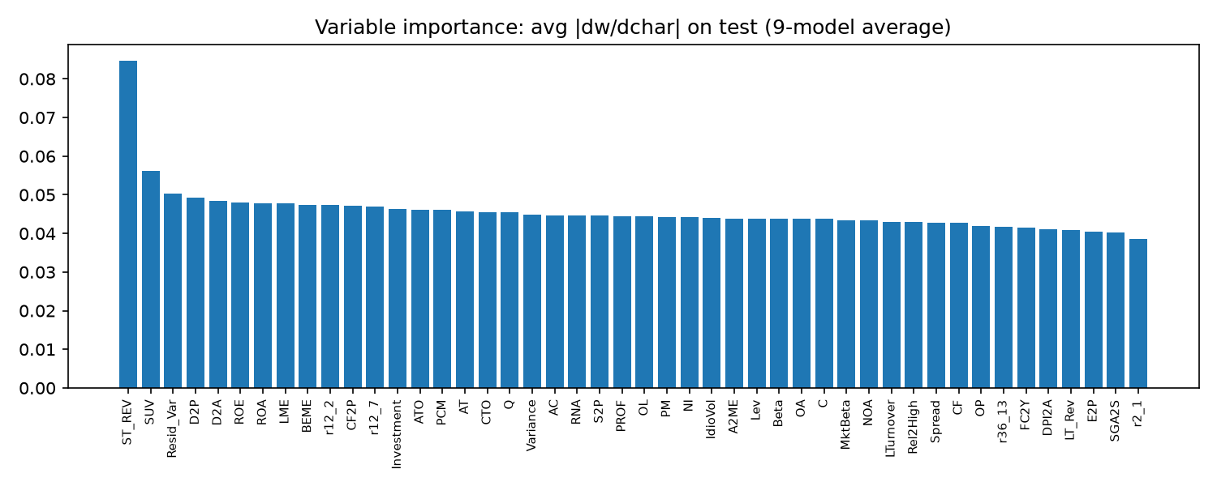
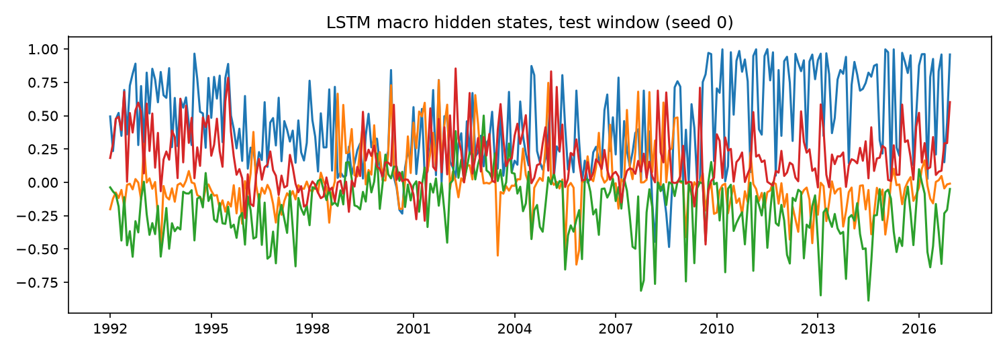
RESULTS / 3 · WHAT THE MODEL LEARNED
Two of the paper's three pictures come back
① Cumulative SDF factor — 9-seed ensemble, L1-normalised weights
② Variable importance — mean |∂ω/∂char| on test, 9-model average
③ The four LSTM macro states over the test window
HOW TO READ THESE
① Still climbing after 1992, and the drawdown is tiny: worst month −4.5 %, max drawdown 5.5 % over 25 years. This is the picture that makes the paper's claim look strong.
② The shape, not the names: short-term reversal (0.085) and SUV (0.056) stand out, then 43 of 46 characteristics sit flat between 0.050 and 0.038. The paper's Fig. 8 is far more concentrated — we do not replicate which characteristics matter.
③ The honest one. Paper Fig. 13 has four smooth cyclical states peaking in recessions the model never saw. Ours are high-frequency and show no visible business-cycle structure. The states are never written to disk, so we cannot quantify it — we can only report it.
Recap · Replication · Challenges · Results · Extensions · Next
Notes:
[0:45] Three pictures, thirty seconds each. One: the cumulative SDF factor. The two dashed lines are the split boundaries. It keeps climbing after 1992 and the worst month in 25 years is minus 4.5 % with a 5.5 % max drawdown. That is the picture that sells the paper. Two: variable importance. Short-term reversal and SUV separate; then forty-three characteristics sit in a flat band. The paper's version is much more concentrated. So we reproduce the model's performance without reproducing its story about which characteristics matter. Do not over-claim here. Three, and this is the one that does not replicate. Their Figure 13 shows four smooth states that peak in recessions the network never saw — that is the headline picture of the macro half of the paper. Ours are noise at monthly frequency. We cannot even quantify it, because the state series are plotted and then thrown away rather than saved. That is on our list to fix.

Slide 10
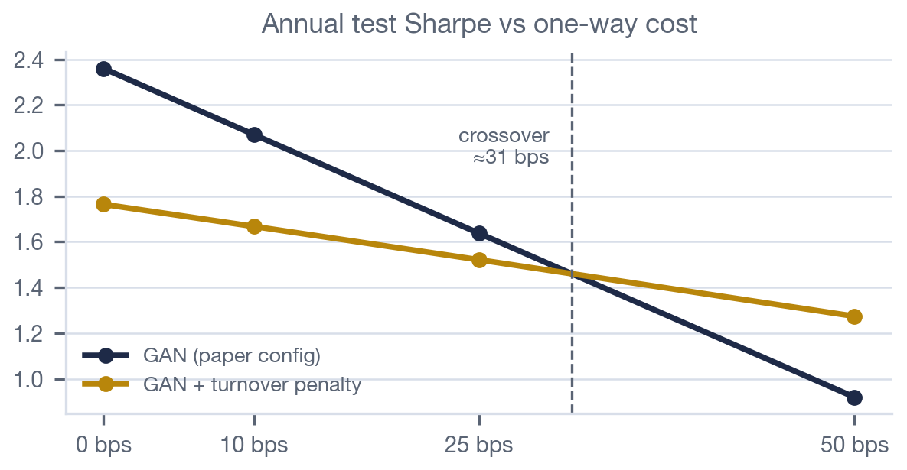
EXTENSIONS / 1 · TRANSACTION COSTS
The 2.36 survives 25 bps, not 50
0.96
1.64
1.52
monthly turnover of the L1-normalised book on test — we guessed ≈1.0 in 230P
annual test Sharpe net of 25 bps one-way costs (2.36 gross)
same for the cost-aware model — at 25 bps the penalty still loses
POST HOC (what we proposed in 230P)
INSIDE THE LOSS (new)
Each month subtract cost × turnover from the SDF-factor return and recompute the Sharpe at 0 / 10 / 25 / 50 bps. The portfolio never saw the cost, so this is a floor, not an estimate. Computed for every run in results.json. The paper's headline 2.6 is the 0 bps column and nothing else.
Add λ · E_t Σ_i |ω̃_{t,i} − ω̃_{t−1,i}| to the pricing loss on L1-normalised weights, λ = 0.002. Turnover 0.96 → 0.24 and gross Sharpe 2.36 → 1.76: the network pays four fifths of its trading to keep three quarters of its Sharpe. Net of cost it loses at 25 bps (1.52 vs 1.64) and wins at 50 (1.27 vs 0.92). Crossover ≈ 31 bps one-way.
Recap · Replication · Challenges · Results · Extensions · Next
Notes:
[1:05] Our first 230P objection, now inside the model. The number on the left is the one we were guessing at last term: monthly turnover of 0.96. We estimated about 1.0 from their figures. So the criticism was right — this book turns over essentially in full every month. How bad is it? Middle number: at 25 basis points one-way the headline 2.36 becomes 1.64. It survives. At 50 basis points it is 0.92, so most of the paper's claim is gone. The extension: put the trading cost inside the objective instead of subtracting it afterwards. λ of 0.002 cuts turnover from 0.96 to 0.24 — a quarter of the trading — and gross Sharpe falls from 2.36 to 1.76. And here is the honest result, the third number on the left, in red: at 25 basis points the cost-aware model is still worse, 1.52 against 1.64. It only wins at 50, where it gets 1.27 against 0.92. The crossover is about 31 basis points one-way. So the answer is conditional: if you trade large-cap US equities you should not bother, and if you are paying more than about 30 basis points you should. That is a more useful statement than the one we made last term. Caveat if asked: λ was one choice, not a sweep. A sweep is three minutes per config on this GPU.

Slide 11
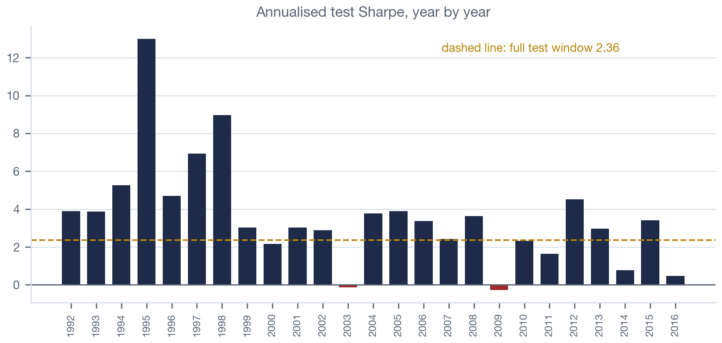
EXTENSIONS / 2 · STABILITY AND ADMISSIBILITY
Two things the paper reports as one number, or not at all
ADMISSIBLE SDF (NEW)
A pricing kernel must be positive
No-arbitrage requires M_{t+1} > 0. The paper checks this in-sample and never imposes it; nothing stops the estimated M from going negative in a crash month out of sample.
We add λ · E[max(0, −M_{t+1})²] to the loss (one line). λ = 1.
Result: M < 0 in 0 of 300 test months for the baseline already (minimum M = 0.944), and 0 of 300 with the penalty (minimum 0.946). The constraint never binds.
It is not free: test Sharpe falls 0.68 → 0.23 and turnover 0.96 → 0.79 for no measurable gain in admissibility.
Why it is unmeasurable: we report M on L1-normalised weights, so M sits in [0.94, 1.05] by construction, while the penalty acts on the raw weights during training — and only the normalised weights are saved. Fixing that is a two-line change we did not make before the deadline.
OUR 230P IMPROVEMENT 1, DELIVERED
First five test years average 6.15 annualised, last five 2.42; 1992–2004 averages 4.72 against 2.43 for 2005–2016, with two negative years (2003, 2009). The single number 2.60 hides a model that is three times better in its first decade than its last. The expanding-window refit needs PERMNOs and stays on the 230ZB list.
Recap · Replication · Challenges · Results · Extensions · Next
Notes:
[0:55] Two things, one slide. Left, our other 230P objection: the paper reports one Sharpe for a 25-year window. Here it is year by year. First five years average 6.15 annualised, last five 2.42. Two negative years, 2003 and 2009. Nineteen ninety-five alone is 13. So the model is roughly three times better in its first decade out of sample than in its last, and the single number 2.6 hides that entirely. That is the argument for re-estimation, and it is now evidence rather than an assertion. Right, the extension the paper skips. A pricing kernel has to be positive or there is an arbitrage; the paper checks this in sample and never imposes it. We added one line: penalise the squared negative part of M. And we got a null result that is worth reporting properly. The baseline never goes negative — zero months out of 300, minimum M is 0.944 — so there was nothing to fix at the scale we measure M. Meanwhile the penalty costs two thirds of the Sharpe, 0.68 down to 0.23. The reason it is unmeasurable is in the last bullet, and it is our fault, not the paper's: we report M on normalised weights, which pins it near one, while the penalty acts on the raw weights during training — and the raw weights are the ones we did not save. Two-line fix, on the list.

Slide 12
NEXT / TOWARDS 230ZB AND A PAPER
What we would do with WRDS access and another term
EXTEND THE SAMPLE
INFERENCE, AND SAVE MORE STATE
Rebuild the 46 characteristics from CRSP/Compustat, append 2017–2026, and test the 1986 model through COVID and the 2022 rate cycle. Then the expanding-window refit from 230P.
Block-bootstrap the test months across the 9-seed ensemble to put confidence bands on SR, EV and XS-R² differences — with a seed spread of 0.28 to 0.75, no comparison in this literature should be made without them. Also dump the raw weights and the LSTM states, the two things we could not check today.
STRESS THE ADVERSARY
THE RL LINK (THIS COURSE)
Vary the number of moments (4 / 8 / 16), run more than one adversarial round, and hold out characteristics from the adversary. Cheap with the current code.
The cost-aware SDF is a sequential decision: state = (characteristics, macro state, current book), action = ω, reward = pricing error + trading cost. A natural actor–critic formulation of the same problem.
Recap · Replication · Challenges · Results · Extensions · Next
Notes:
[0:25] Four lines, do not read them all. The one to say out loud is bottom right, because it is this course: the cost-aware SDF is a sequential decision problem. State is characteristics plus macro state plus the book you are already holding, action is the portfolio weights, reward is pricing error minus trading cost. The turnover penalty we showed is the myopic one-step version of that. An actor-critic formulation is the natural next step and it is the same code. The other three in one sentence: extend the sample past 2016 with WRDS, put confidence bands on everything given the seed spread we showed, and stress the adversary.

Slide 13
Questions?
Code, configs and every number in this deck: github.com/Aroesler1/dlap-torch-replication — run.py, simulate.py, summarize.py, deck/review.md
Backup slide follows: every deliberate deviation from the authors' implementation.
Notes:
Likely questions and the short answers: • Why is your Sharpe below theirs? One fortieth of the compute, no hyper-parameter search, and our training Sharpe is above theirs — the fit ran slightly further before validation stopped it. The gap is about one and a half ensemble standard deviations. • Did you replicate the FFN / elastic net / OLS benchmarks on real data? No. Those rows on slide 8 are the paper's. We ran our own FFN and OLS only in the simulation. • Is 0.68 vs 0.75 significant? We cannot say without the bootstrap on the next-steps slide. That is exactly the point of the seed-spread number. • Why is your XS-R² 0.228 and not 0.045? Two definitions. The authors' notebook prints the T_i-weighted one and that is what their 0.23 is. Unweighted we get 0.045. • Did you change the model to get these numbers? No. The extensions are opt-in flags and both are off in the replication config. What we did change was fidelity to their TensorFlow graph — the appendix slide lists all eight.

Slide 14
APPENDIX
Deviations from the authors' implementation (for the record)
Eight fidelity gaps were found by a line-by-line audit against the authors' graph and notebook, and all eight were fixed before the numbers in this deck were produced (test Sharpe 0.63 → 0.68, cost-aware extension 0.09 → 0.51). What remains below is what still differs, on purpose.
Item | Authors (TF 1.12) | Ours (PyTorch) | Effect
Hyper-parameters | 384-config grid, best 4 on validation, 9 seeds each | Their Table I optimum, 9 seeds, no search | Same architecture, ~1/40 of the compute. Most likely source of 0.68 vs 0.75
Random draws | TF RNG, float32 reduction order | PyTorch RNG, float32 reduction order | Moves seed-level paths only; our seed spread is 0.283–0.750
Simulation benchmarks | No code released | Our own FFN and LS implementations | Ours are stronger than the paper's reported rows (setup 1 FFN EV 0.17 vs 0.05)
Empirical benchmarks | FFN, elastic net, OLS on CRSP | Not run — the paper's values are quoted | Slide 8 rows marked (paper)
EV / XS-R² | β network, T_i-weighted (notebook prints WXSR2) | Same, plus the unweighted value and an ω-projection | Extra diagnostic; weighted 0.228 vs unweighted 0.045
Extensions | — | turnover_penalty, sdf_hinge, yearly Sharpe, net-of-cost Sharpe | Opt-in flags, both off in configs/gan.json; the replication is pure
Recap · Replication · Challenges · Results · Extensions · Next
Notes:
Backup slide — do not present unless asked. The framing to use: the eight things that were wrong in our first run were all fixed and are listed in the repo's notes.md. This table is what still differs on purpose. The first row is the honest answer to "why is your number lower": we ran their optimum, not their search. The fourth row is the one to volunteer before someone finds it: we did not re-run the FFN, elastic-net and OLS benchmarks on real data. Those numbers on slide 8 are quoted from the paper and are labelled as such.

