Slide 1
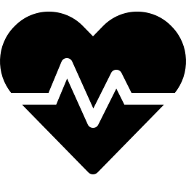
Heart Failure
Clinical Decision Support System
Predicting mortality risk before it becomes irreversible
For: Hospital Risk Teams | Clinicians | Insurance Assessors

Slide 2
Heart Failure Kills Silently
Heart failure patients deteriorate gradually — declining lab values, worsening kidney function, dropping ejection fraction. By the time a patient crashes, the warning signs were present weeks earlier. Most hospitals only react after the crisis.
32%
of heart failure patients in our dataset died during follow-up
61%
mortality rate for patients aged 75 and above
72.7%
death rate among patients with critically low ejection fraction AND elevated creatinine
The goal: flag high-risk patients before the crisis — not after.

Slide 3



One System. Three Decision Makers.
Hospital Risk Team
Clinician
Insurance Assessor
"Which patients need escalation before discharge?"
"What is driving this patient's risk score?"
"What is this patient's mortality risk profile?"
Ranked risk list updated in real time. Act before the patient deteriorates.
Clinical flags explain every prediction — ejection fraction, creatinine, sodium, age.
Probability score with full audit trail. Every prediction logged with timestamp.

Slide 4

What the Data Reveals
Four clinical findings that directly shaped the model and the triage protocol:
Ejection fraction and creatinine are the two strongest predictors of death
Survivors averaged 40.3% EF vs 33.5% for non-survivors. Creatinine averaged 1.18 vs 1.84. Both markers are routinely measured — they just weren't being used for triage.
Asymptomatic patients carry the highest heart disease risk
Male patients with no chest pain symptoms had an 82.9% heart disease rate — the highest of any group. The absence of symptoms is itself the warning sign.
Age 75+ represents a clinical cliff edge
Mortality rate jumps from 25-34% in younger groups to 61% for patients 75 and above. Age-stratified protocols are clinically justified.
Combined organ failure is multiplicatively dangerous
Patients with both low ejection fraction (<30%) AND high creatinine (>1.5) had a 72.7% death rate — compared to 11.4% for low-risk patients. A simple rule, a dramatic difference.

Slide 5
How Reliable Are the Predictions?
Three models were trained and compared. The winner was selected on clinical grounds — not just statistical accuracy.
✓ SELECTED
Logistic Regression
Random Forest
XGBoost
89.5%
84.2%
68.4%
Death Detection Rate
Death Detection Rate
Death Detection Rate
ROC-AUC: 0.882
ROC-AUC: 0.900
ROC-AUC: 0.858
Missed deaths: 2 of 19
Missed deaths: 3 of 19
Missed deaths: 6 of 19
Decision threshold set at 0.3 (not 0.5) — deliberately conservative to minimize missed deaths.

Slide 6
What a Clinician Actually Sees
Enter a patient's lab values. Receive a full clinical brief — instantly.
Patient Input
HIGH RISK — 96.9%
• Age: 65
⚠ CRITICAL: Ejection fraction severely reduced (<30%)
• Ejection Fraction: 20%
• Serum Creatinine: 1.9 mg/dL
⚠ WARNING: Elevated creatinine — kidney stress
• Serum Sodium: 130 mEq/L
⚠ WARNING: Low sodium — fluid imbalance
• Follow-up: 30 days
ℹ NOTE: Anaemia + hypertension present
• Anaemia: Yes
• High Blood Pressure: Yes
IMMEDIATE ACTION REQUIRED
Escalate to senior clinician. Consider admission.

Slide 7
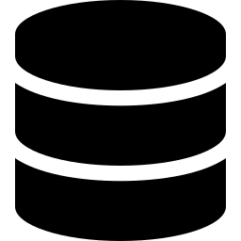

Built to Stay Accurate Over Time
Patient populations shift. Treatment protocols change. This system monitors itself.
New patient data arrives
System compares it to the original baseline
Drift detected — retraining triggered
Model updated, accuracy preserved
Two datasets monitored independently — clinical records and diagnostic records.
Every prediction logged to the database with timestamp for full clinical audit trail.

Slide 8
Where This Goes Next
1
Connect to live hospital EHR system for real-time patient scoring at admission
2
Integrate risk scores into nursing dashboard so care teams see flags automatically
3
Build the heart disease detection model (v2.0) for pre-diagnosis screening
4
Deploy to cloud infrastructure for multi-site hospital access
5
Define escalation protocol — what exact actions follow each risk level
Questions or a specific clinical use case in mind? Let's talk.

