Slide 1
Context-Aware Multi-Modal Transportation Recommendation
Date : 2019/05/02
Reporter: M10715049 羅濟威
M10715087 蘇皓群
M10715091 湯景淳
Adviser : Hahn-Ming Lee

Slide 2


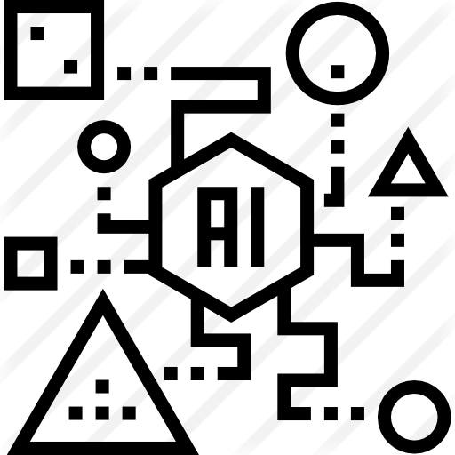


Architecture Diagram
Raw Train Data
train_queries.csv
train_plans.csv
profiles.csv
Merging
Preprocessing
Modeling
train_clicks.csv
Training Phase
Detecting Phase
Raw Test Data
Result
test_queries.csv
test_plans.csv
Merging
Preprocessing
Prediction
profiles.csv

Slide 3
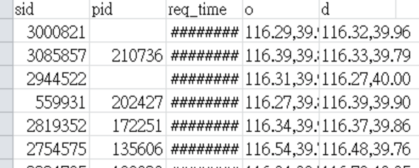
Data Analysis
Fill with 0
Train_queries.csv
p0 | p1 | … | p65
0 | 0 | 0 | 0
Add new row
[1 rows x ˊ66columns]
Profiles.csv

Slide 4
Data Merging
Train_queries.csv
Train_plans.csv
Train_clicks.csv
Columns:
1.sid
2.pid
3.req_time
4.o
5.d
Total:
500000 rows
5 columns
Columns:
1.sid
2.plan_time
3.plan
Total:
491054 rows
3 columns
Columns:
1.sid
2.click_time
3.click_mode
Total:
453336 rows
3 columns
1-1
1-1

Slide 5
Data Merging
Train_merges.csv
profiles.csv
Columns:
1.sid
2.pid
3.req_time
4.o
5.d
6.plan_time
7.plan
8.click_time
9.click_mode
Total:
453336 rows
9 columns
Columns:
1.pid
2.p0
3.p1
.
.
.
.
66.p64
67.p65
Total:
68 columns
1-1

Slide 6
Data Merging
Train_merges.csv
Columns:
1.sid
2.pid
3.req_time
4.o
5.d
6.plan_time
7.plan
8.p0
.
.
73.p65
74.click_time
75.click_mode
Total:
453336 rows
75 columns

Slide 7
Data Preprocessing
Train_merges.csv
req_time
2018/11/10 12:47:12
Columns:
1.req_time
2.o
3.d
4.plan
5.p0
.
.
70.p65
71.click_mode
Total:
453336 rows
71 columns
One Hot encoding
[1 rows x 1 columns]
Transform into seconds
Mon | Tue | Wed | Thu | Fri | Sat | Sun
0 | 0 | 0 | 0 | 0 | 1 | 0
d_time
46032
[1 rows x 7 columns]
[1 rows x 1 columns]
o
116.39,39.92
d
116.41,39.91
[1 rows x 1 columns]
[1 rows x 1 columns]
Split
Split
o_x | o_y
116.39 | 39.92
d_x | d_y
116.41 | 39.91
[1 rows x 2 columns]
[1 rows x 2 columns]

Slide 8
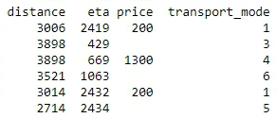
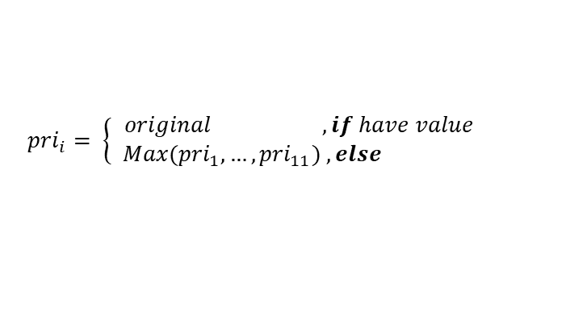
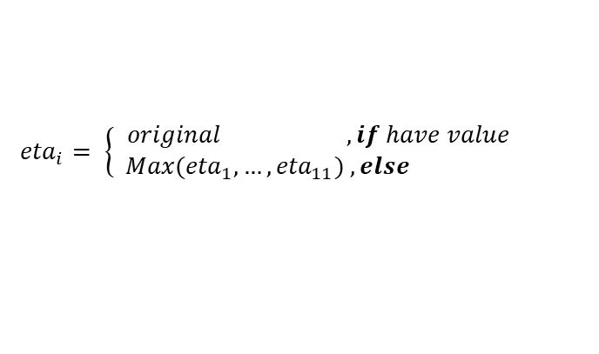
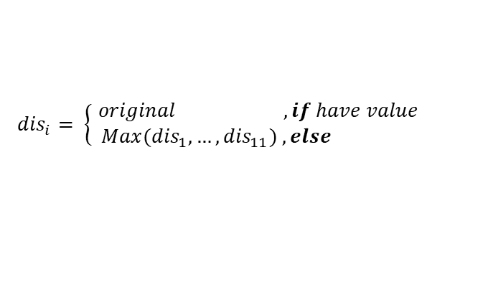
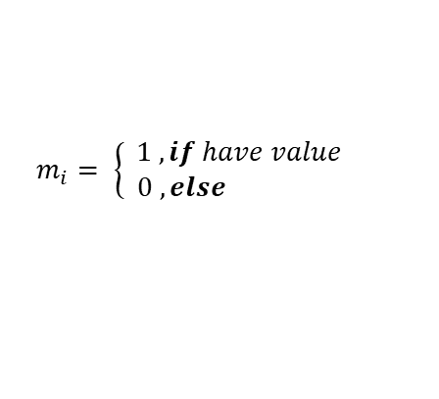
Data Preprocessing
Train_merges.csv
Columns:
1.req_time
2.o
3.d
4.plan
5.p0
.
.
70.p65
71.click_mode
Total:
453336 rows
71 columns
One Hot encoding
m1 | dis1 | eta1 | pri1 | m2 | dis2 | eta2 | pri2 | … | m11 | … | …
1 | 3006 | 2419 | 200 | 0 | MAX | MAX | MAX | … | 0 | … | …
[1 rows x 44 columns]
$${dis}_{i}= \left\{\begin{aligned}original ,if have value \\ Max({dis}_{1},…,{dis}_{11}) , else \end{aligned}\right.$$
$$m_{i}= \left\{\begin{aligned}1 ,if have value \\ 0 , else \end{aligned}\right.$$
$${eta}_{i}= \left\{\begin{aligned}original ,if have value \\ Max({eta}_{1},…,{eta}_{11}) , else \end{aligned}\right.$$
$${pri}_{i}= \left\{\begin{aligned}original ,if have value \\ Max({pri}_{1},…,{pri}_{11}) , else \end{aligned}\right.$$

Slide 9
Data Preprocessing
mon | … | sun | d_ time | o_x | … | d_y | m1 | dis1 | eta1 | pri1 | … | pri11 | p1 | … | p65 | click mode
0 | … | 1 | 46032 | 116.39 | … | 39.92 | 1 | 3006 | 2419 | 200 | … | 0 | 0 | 0 | 1 | 3
[1 rows x 123 columns]
Min_Max_Scaler
mon | … | sun | d_ time | o_x | … | d_y | m1 | dis1 | eta1 | pri1 | … | pri11 | p1 | … | p65 | click mode
0 | … | 1 | 0.672 | 0.875 | … | 0.674 | 1 | 0.726 | 0.986 | 0.467 | … | 0 | 0 | 0 | 1 | 3
[1 rows x 123 columns]

Slide 10
Data Modeling
XGBOOST
[ Depth = 20 ] Train Accuracy : 99.52 %
Test Accuracy : 71.36 %
[ Depth = 10 ] Train Accuracy : 99.53 %
Test Accuracy : 71.42 %
[ Depth = 6 ] Train Accuracy : 72.13 %
Test Accuracy : 70.89 %
Random Forest
[ Default ] Train Accuracy : 0.98
Test Accuracy : 0.68
80%
train.csv
train_merge.csv
20%
test.csv

Slide 11
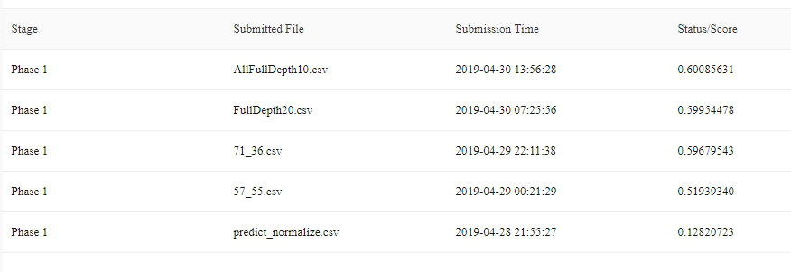
Result

Slide 12
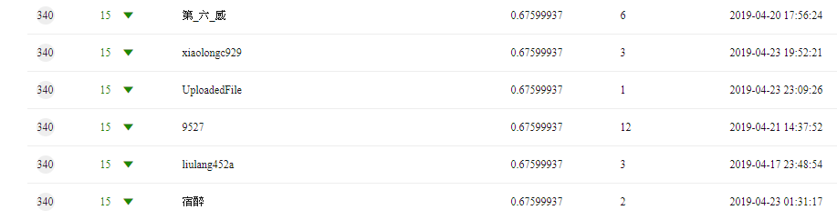
Result

Slide 13
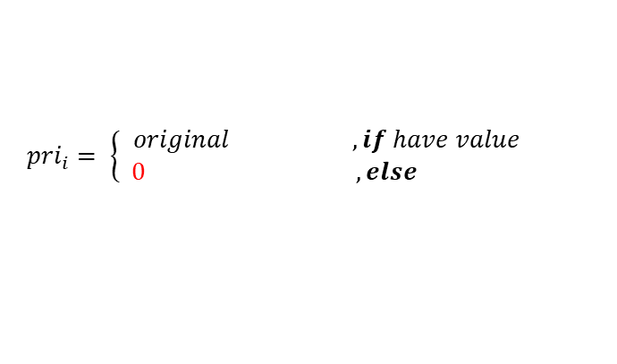

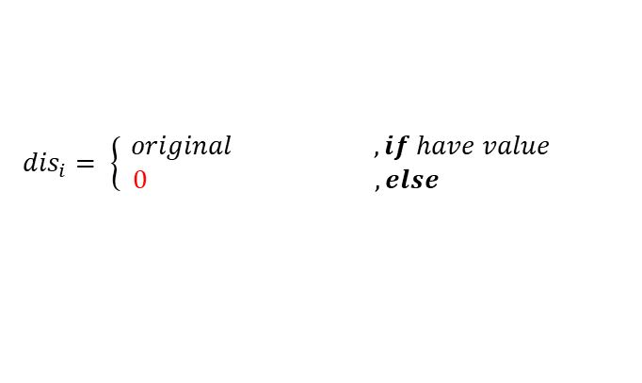
Future Work
Train_merges.csv
Columns:
1.req_time
2.o
3.d
4.plan
5.p0
.
.
70.p65
71.click_mode
Total:
453336 rows
71 columns
One Hot encoding
m1 | dis1 | eta1 | pri1 | m2 | dis2 | eta2 | pri2 | … | m11 | … | …
1 | 3006 | 2419 | 200 | 0 | 0 | 0 | 0 | … | 0 | … | …
[1 rows x 44 columns]
$${dis}_{i}= \left\{\begin{aligned}original ,if have value \\ 0 , else \end{aligned}\right.$$
$$m_{i}= \left\{\begin{aligned}1 ,if have value \\ 0 , else \end{aligned}\right.$$
$${eta}_{i}= \left\{\begin{aligned}original ,if have value \\ 0 , else \end{aligned}\right.$$
$${pri}_{i}= \left\{\begin{aligned}original ,if have value \\ 0 , else \end{aligned}\right.$$

Slide 14
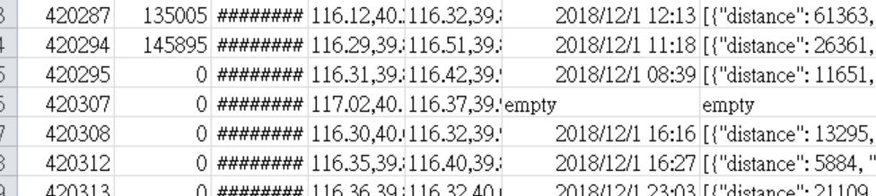
Future Work
Test_merges.csv
Output :0

Slide 15
Mastering the game of Go with deep neural networks and tree search & without human knowledge
Silver, David and Huang, Aja and Maddison, Chris J and Guez, Arthur and Sifre,
Laurent and Van Den Driessche, George and Schrittwieser,
Julian and Antonoglou, Ioannis and Panneershelvam, Veda and Lanctot, Marc and others
In nature,
2016 / 2017

Slide 16
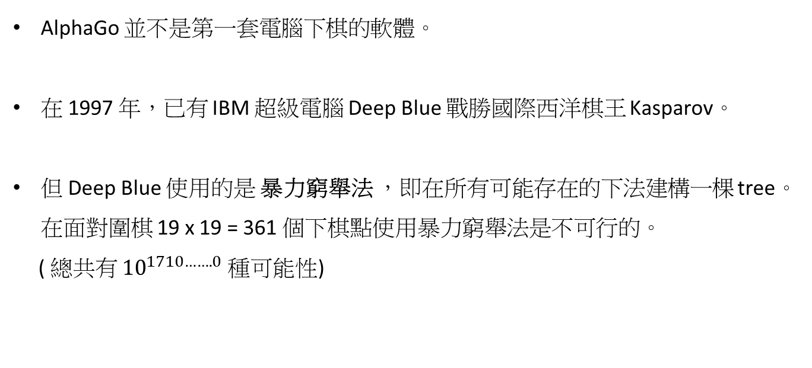
介紹
AlphaGo 並不是第一套電腦下棋的軟體。
在 1997 年，已有 IBM 超級電腦 Deep Blue 戰勝國際西洋棋王 Kasparov。
但 Deep Blue 使用的是 暴力窮舉法 ，即在所有可能存在的下法建構一棵 tree。在面對圍棋 19 x 19 = 361 個下棋點使用暴力窮舉法是不可行的。
( 總共有 ${10}^{1710…….0}$ 種可能性)

Slide 17
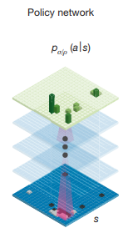
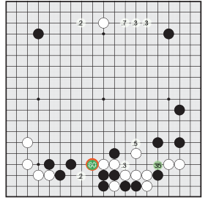
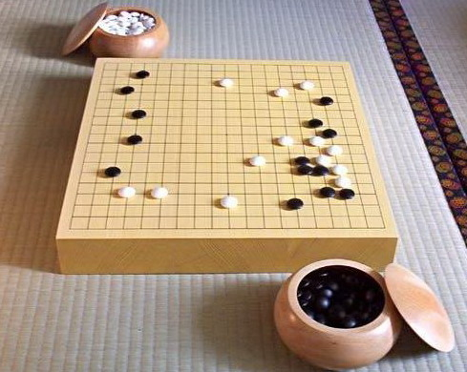
最早的 AlphaGo
採 Supervised learning of policy network
採集了 KGS (網路圍棋對戰平台) 上，超過百萬人的對弈棋局的 Data Set。
Policy Network:
輸入目前的局面，預測下一步機率
input
Policy Network
output

Slide 18
最早的 AlphaGo
採 Supervised learning of policy network
採集了 KGS (網路圍棋對戰平台) 上，超過百萬人的對弈棋局的 Data Set。
缺點:
1. KGS 上棋手實力高低不一，並非每個 Sample 都是好的下棋方案
2. 頂尖高手的棋譜很少，且價格昂貴
3. 只關心棋手是怎麼下的，而不是注重輸贏

Slide 19

AlphaGo
採 Reinforcement learning of policy network
差別在於收到的反饋是評估性而不是指導性
缺點:
1. 該版本的 AlphaGo 只根據現在的棋局局面做出下一步的動作
(即憑直覺下棋)
2. 缺乏判斷後續發展的大局觀 (手下一着子，心想三步棋)
initialize
self-play
Supervised learning of
policy network
Reinforcement learning of
policy network A
Reinforcement learning of
policy network B

Slide 20
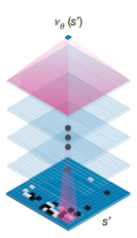
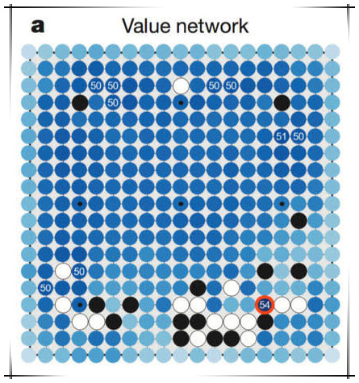
AlphaGo
Value Network
利用 Reinforcement learning 產生 3000 萬個
現在局面下對弈後的勝負情況的 Sample
達成無需模擬完全局，即可快速預測現在局面的勝率。
效果:
讓 AlphaGo 在有限時間內可以推演現在局面更多的可能性，
從而找到更好的下一步方案。

Slide 21
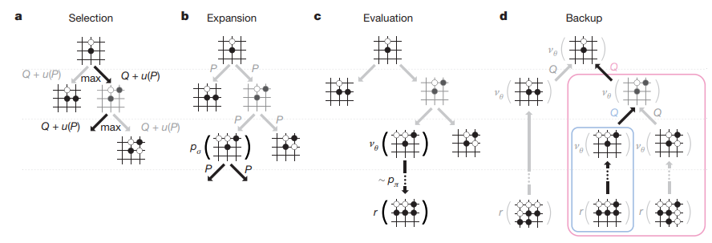
AlphaGo
Fast rollout
加速決策時間。
Monte Carlo tree search:
隨機模擬雙方下棋的方式，最後勝利則回饋正，輸了則回饋負。
效果:
將會試探很多種未來下一步可能性及其對應的勝負結果
Notes:
蒙地卡羅樹搜尋演算法 是一類隨機演算法的統稱。
這類方法特點是，可在隨機採樣中計算得到近似結果，隨著採樣增多，得到正確結果的機率逐漸加大。但在獲得全部統計結果之前，無法肯定當下就是真實的結果。
舉個例子：一籃有 1000 個蘋果，想挑出最大蘋果。於是這樣挑選：先隨便拿起一個，再隨機拿另一個跟這個比，手上留下比較大的，再隨機拿下一個……每拿一次，手上的蘋果都至少比上次的大。拿的次數越多，挑的蘋果就越大。這個挑蘋果的方式，就屬於蒙地卡羅演算法：盡量找大的，但不保證一次就能挑中最大的。

Slide 22
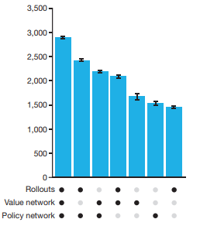
AlphaGo
AlphaGo = Policy Network + Value Network + Fast rollout
AlphaGo 在試探每一步的時候不再使用隨機算法選擇下一步。
Policy Network : 模擬每個局面的下一步機率分布的估算
Value Network : 模擬每個局面的勝率估算
Fast rollout : 快速多次模擬雙方對弈的勝負結果
Elo Rating

Slide 23
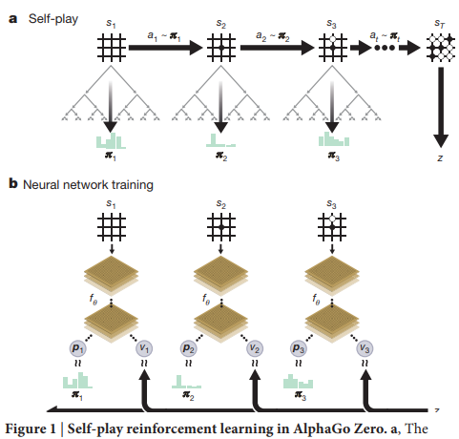
AlphaGo Zero
從 Tabula rasa 開始，以 100：0 擊敗了之前版本的 AlphaGo
AlphaGo Versus AlphaGo Zero :
 | AlphaGo | AlphaGo Zero
Input | 黑白子 + 部分人工特徵 | 黑白子
Learning | Supervised + Reinforcement | Reinforcement
Neural Network | 兩個神經網路 Policy Network + Value Network | 一個神經網路 下一步位置和輸贏評估 都在同一個神經網路執行
Rollout | 有 | 無，使用高品質的評估
Notes:
tabula rasa，意為「白板」，指所有的知識都是逐漸從他們的感官和經驗而來
不再需要任何人類指導，全程 Reinforcement learning，自己當自己的導師
AlphaGo Zero 只使用棋盤上的黑子和白子作為輸入，而之前版本 AlphaGo 的輸入均包含部分人工特徵；

Slide 24
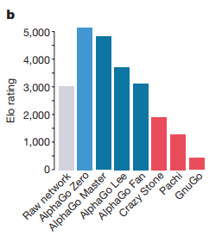
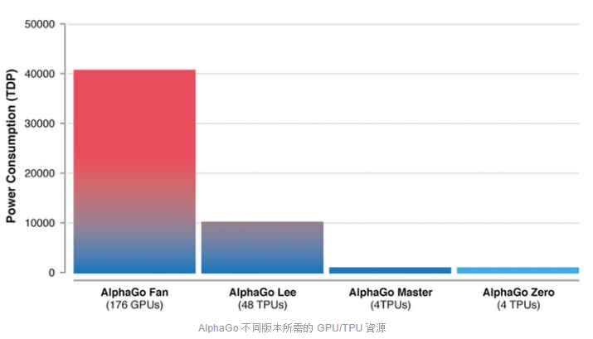
AlphaGo Zero

Slide 25
討論
AlphaGo 幾乎完全沒用到圍棋領域的專業知識。
AlphaGo會取代什麼職業的人？
應用於台灣法官
喜歡以大量條文來解讀判決的這類法官，不考慮社會觀感公平性的判決。
正是大數據 + 深度學習的電腦軟體專長。
應用於記者
電腦自動寫新聞稿

Slide 26
Reference
[1] Silver, David, et al, "Mastering the game of Go with deep neural networks and tree search," In nature, 2016
[2] Silver, David, et al, "Mastering the game of go without human knowledge," In nature, 2016
[3] http://www.ppvs.org/blog/alphago-research-notes-long-text-into-carefully-2.html?fbclid=IwAR3YyIomCfusWnwisin8Wx5M8p9v6Viurw0LvMsBS244qhE5JrI519Sz22E
[4] https://www.inside.com.tw/article/10829-alphago-zero
[5] https://kknews.cc/zh-tw/science/62lab2l.html
[6] https://www.inside.com.tw/article/9417-analyzing-new-alphago
[7] http://technews.tw/2016/03/14/about-alphago-algorithm/

Slide 27
Alpha go讀書報告
M10715049 羅濟威/M10715087 蘇皓群/M10715091 湯景淳

Slide 28
Mastering The Game Of Go With Deep Neural Networks And Tree Search N AT U R E | VO L 5 2 9 | 2 8 JA N UA RY 2 0 1 6
M10715049 羅濟威/M10715087 蘇皓群/M10715091 湯景淳

Slide 29
Outline
Introduction
About Games
Model Architecture
Monte Carlo tree
Policy networks
Supervised learning
Reinforcement learning
Value networks
Searching
Evaluating the playing strength of AlphaGo

Slide 30
Introduction – About Games
v* (s)： optimal value function, which determines the outcome of the game, from every board position or state s, under perfect play by all players.
In large games, exhaustive search is infeasible
chess (b ≈ 35, d ≈ 80)
Go (b ≈ 250, d ≈ 150)
Monte Carlo tree search (MCTS)：uses Monte Carlo rollouts to estimate the value of each state in a search tree.
Notes:
All games of perfect information have an optimal value function, v*(s), which determines the outcome of the game, from every board position or state s, under perfect play by all players.
In large games, such as chess (b ≈ 35, d ≈ 80) and especially Go (b ≈ 250, d ≈ 150), exhaustive search is infeasible, but the effective search space can be reduced by two general principles.
Monte Carlo tree search (MCTS) uses Monte Carlo rollouts to estimate the value of each state in a search tree. As more simulations are executed, the search tree grows larger and the relevant values become more accurate.

Slide 31
Introduction – About Games
Two general principles
Reduce the depth of the search：truncating the search tree at state s and replacing the subtree below s by an approximate value function v(s) ≈ v*(s) that predicts the outcome from state s.
Reduce the breadth of the search： sampling actions from a policy p(a|s) that is a probability distribution over possible moves a in position s.
Deep convolutional neural networks
Notes:
Two principle to reduced search space:
First, the depth of the search may be reduced by position evaluation: truncating the search tree at state s and replacing the subtree below s by an approximate value function v(s) ≈ v*(s) that predicts the outcome from state s.
Second, the breadth of the search may be reduced by sampling actions from a policy p(a|s) that is a probability distribution over possible moves a in position s.
Recently, deep convolutional neural networks have achieved unprecedented performance in visual domains. They use many layers of neurons, each arranged in overlapping tiles, to construct increasingly abstract, localized representations of an image.
In this paper, they employ a similar architecture for the game of Go. They pass in the board position as a 19 × 19 image and use convolutional layers to construct a representation of the position. They use these neural networks to reduce the effective depth and breadth of the search tree: evaluating positions using a value network, and sampling actions using a policy network.

Slide 32
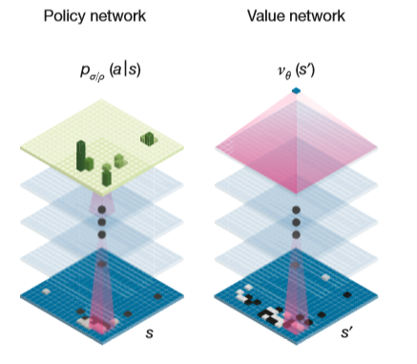
Introduction - Model Architecture
Two neural network structures
Policy
Value
Notes:
Two different learning models are in alpha go, two neural network structures: a policy network and an value network.

Slide 33
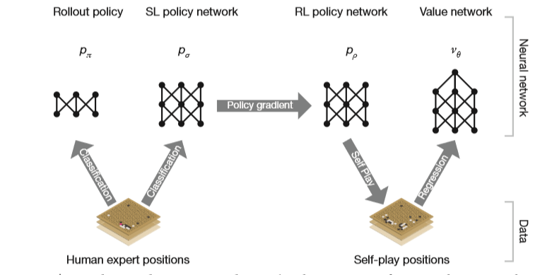
Introduction - Model Architecture
Policy network:
Rollout
SL policy network
RL policy network
Value:
Value network
Notes:
The "policy network" is divided into two types: supervised learning and reinforcement learning.
The first type is basically a simple supervised learning to determine the most likely position of the opponent. His approach is to enter a large amount of the game of the world's professional players, to predict the opponent's most likely position.
The second type of the reinforcement learning aims at improving the policy network by policy gradient reinforcement learning (RL). We play games between the current policy network pρ and a randomly selected previous iteration of the policy network.
The value network focuses on position evaluation, estimating a value function vp(s) that predicts the outcome from position s of games played by using policy p for both players.

Slide 34
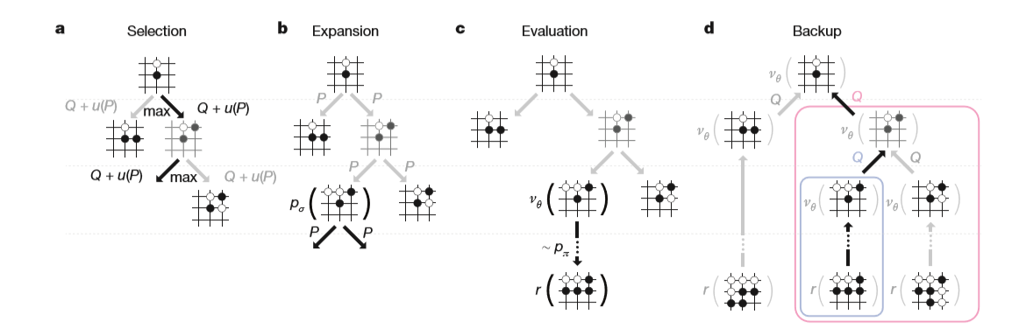
Introduction - Monte Carlo tree
4 Steps
Notes:
There are four main steps in Monte Carlo Tree.

Slide 35
Introduction - Monte Carlo tree
Selection
according to the current state, select several possible opponent drop modes.

Slide 36
Introduction - Monte Carlo tree
Expansion
According to the opponent's fall, expand to our biggest winning mode (we call it the first-order Monte Carlo). In AlphaGo's search tree it doesn't really expand all combinations.

Slide 37
Introduction - Monte Carlo tree
3. Evaluation
Evaluate the best action.
Two ways to evaluate:
throw the game after the action to the evaluation network to evaluate the winning rate
do the deeper Monte Carlo .The results evaluated by these two methods may be quite different.
AlphaGo uses a mixing coefficient to integrate the two evaluation results.

Slide 38
Introduction - Monte Carlo tree
4. Backup
After deciding the best action position, then quickly evaluate the opponent's possible next step and the corresponding search evaluation through the strategy network according to this position.

Slide 39
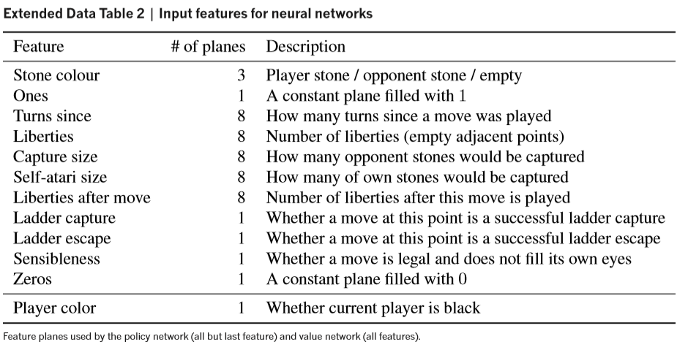
Policy network – Supervised learning
The SL policy network Pσ(a | s) alternates between convolutional layers with weights σ, and rectifier nonlinearities.
a: A final softmax layer outputs a probability distribution over all legal moves.
s: A simple representation of the board state. (see Extended Data Table 2)

Slide 40

Policy network – Supervised learning
The policy network is trained on randomly sampled state-action pairs (s, a), using stochastic gradient ascent to maximize the likelihood of the human move a selected in state s.

Slide 41
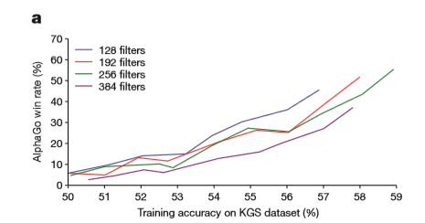
Policy network – Supervised learning
the SL policy network: a 13-layer policy network, from 30 million positions from the KGS Go Server.
Small improvements in accuracy led to large improvements in playing strength (Fig. 2a).
Larger networks achieve better accuracy but are slower to evaluate during search.

Slide 42
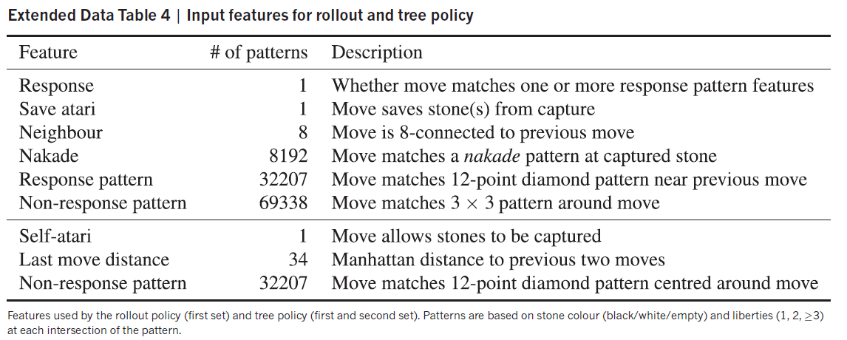
Policy network – Supervised learning
less accurate rollout policy pπ(a|s): less accurate but faster. Using a linear softmax of small pattern features with weights π; this achieved an accuracy of 24.2%, using just 2 μs to select an action, rather than 3 ms for the policy network.

Slide 43

Policy network – Reinforcement learning
The RL policy network Pρ, ρ = σ
Reward function r(s)
zero for all non-terminal time steps t < T.
zt = ± r(ST) is the terminal reward
+1 for winning at time step t
+1 for winning at time step t
Weights are updated at each time step t by stochastic gradient ascent in the direction that maximizes expected outcome.

Slide 44

Value network
Reinforcement learning
Vp(s): predicts the outcome from position s of games played by using policy p for both players.
v*(s): the optimal value function under perfect play
VPρ: strongest policy in practice, using the RL policy network Pρ.
Approximate the value function using a value network vθ(s) with weights θ,
Vθ(s) ≈VPρ(s)≈ V*(s) .
Notes:
Estimating a value function Vp(s) that predicts the outcome from position s of games played by using policy p for both players.
Ideally, they would like to know the optimal value function under perfect play v*(s); in practice, they instead estimate the value function VPρ for our strongest policy, using the RL policy network Pρ.

Slide 45
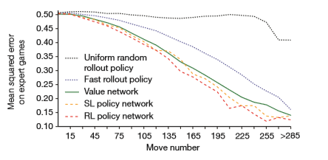

Value network
This neural network has a similar architecture to the policy network, but outputs a single prediction instead of a probability distribution.
Train the weights of the value network by regression on state-outcome pairs (s, z), using stochastic gradient descent to minimize the mean squared error (MSE) between the predicted value vθ(s), and the corresponding outcome z.

Slide 46
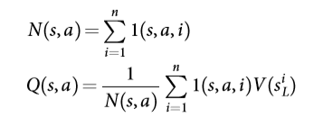


Searching
Each edge (s, a) of the search tree stores an action value Q(s, a), visit count N(s, a), and prior probability P(s, a).
The tree is traversed by simulation starting from the root state.
At each time step t of each simulation, an action at is selected from state St.
So as to maximize action value plus a bonus that is proportional to the prior probability but decays with repeated visits to encourage exploration.
Notes:
Searching With Policy And Value Networks

Slide 47

Searching
The leaf node is evaluated in two very different ways: first, by the value network Vθ(sL); and second, by the outcome ZL of a random rollout played out until terminal step T using the fast rollout policy Pπ; these evaluations are combined, using a mixing parameter λ, into a leaf evaluation V(sL) .
The final version of AlphaGo used 40 search threads, 48 CPUs, and 8 GPUs. We also implemented a distributed version of AlphaGo that exploited multiple machines, 40 search threads, 1,202 CPUs and 176 GPUs.

Slide 48
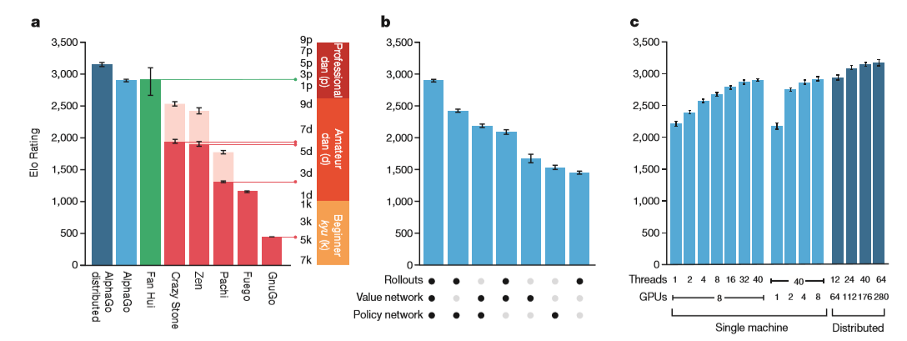
Evaluating the playing strength of AlphaGo
Notes:
To evaluate AlphaGo, we ran an internal tournament among variants of AlphaGo and several other Go programs, including the strongest commercial programs Crazy Stone13 and Zen, and the strongest open source programs Pachi14 and Fuego15. All of these programs are based on high-performance MCTS algorithms. In addition, we included the open source program GnuGo, a Go program using state-of-the-art search methods that preceded MCTS. All programs were allowed 5 s of computation time per move.
The results of the tournament (see Fig. 4a) suggest that singlemachine AlphaGo is many dan ranks stronger than any previous Go program, winning 494 out of 495 games (99.8%) against other Go programs. To provide a greater challenge to AlphaGo, we also played games with four handicap stones (that is, free moves for the opponent); AlphaGo won 77%, 86%, and 99% of handicap games against Crazy Stone, Zen and Pachi, respectively. The distributed version of AlphaGo was significantly stronger, winning 77% of games against single-machine AlphaGo and 100% of its games against other programs.

Slide 49
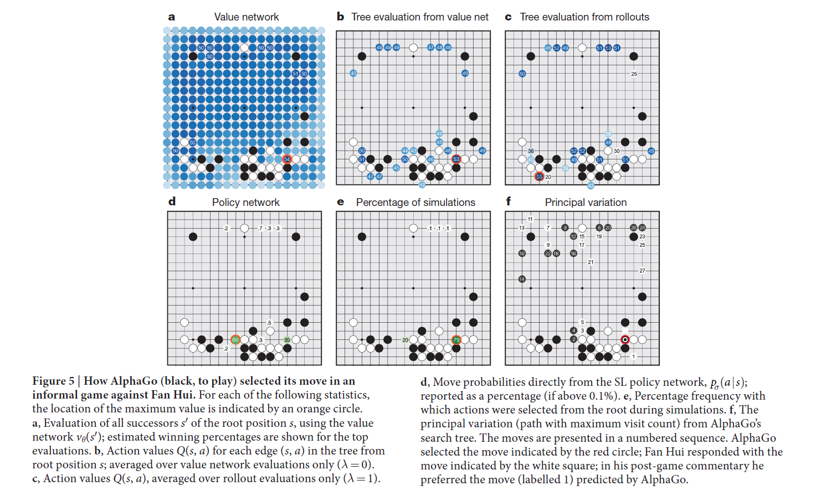

Slide 50
Mastering the game of Go without human knowledge N AT U R E | VO L 5 5 0 | 1 9 o c to b er 2 0 1 7
M10715049羅濟威/M10715087蘇皓群/M10715091湯景淳

Slide 51
Outline
Introduction
Model
Reinforcement learning
Monte Carlo tree Search
Empirical analysis training
Knowledge learned
Final performance
Conclusion

Slide 52
Introduction
Difference between AlphaGo Zero and Alpha Go :
With less computing but better result
Self-play reinforcement learning, starting from random play, starting from zero
Without any supervision or use of human data
Find out new Go strategy that human never knew
One single neural network, merge the policy network and value network in the further paper
Tabula rasa

Slide 53
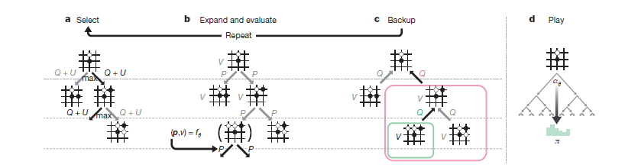
Model - Reinforcement learning
One edge represents one move
One node representes one position/state
Policy p : It controls what move should we take next.
Value function v : How likely to win at a board position s.

Slide 54
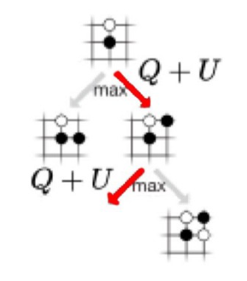
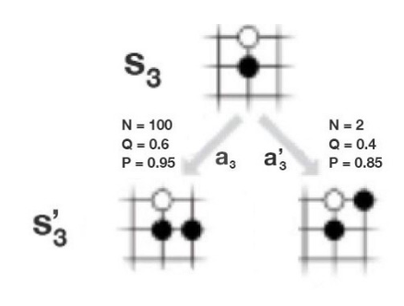
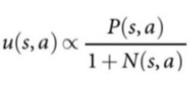
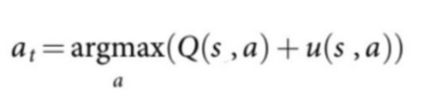
Model - Monte Carlo Tree Search
Select
exploitation: Perform more searches that look promising (i.E. High Q value).
exploration: Perform searches that are not frequently explored (i.E. Low visit count N).

Slide 55
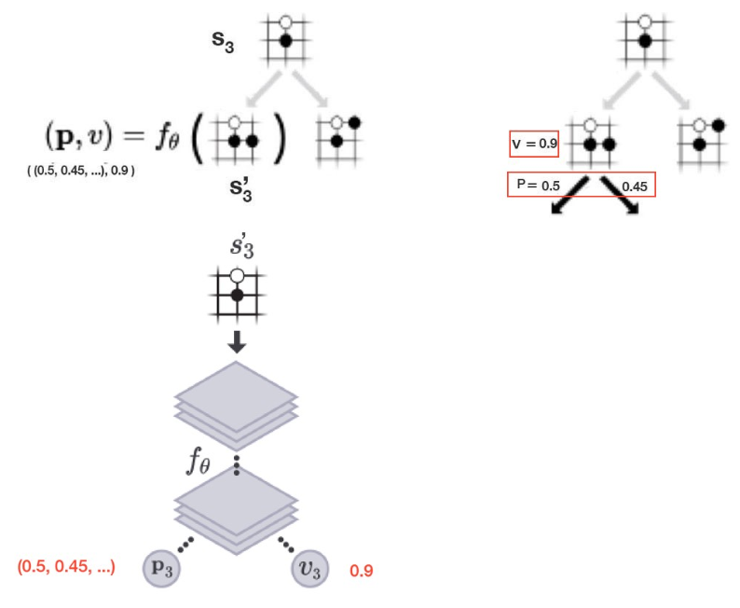
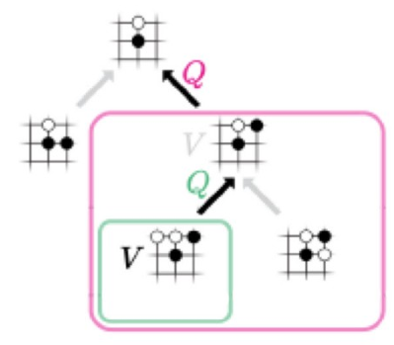
Model - Monte Carlo Tree Search
Expand and evaluate
Deep network f (composed of convolutional layers) on s’3 to compute the policy p and the value functions v.
Backup
Once p and v are calculated for the leaf node, we backup v to update the action value Q for every edge (s, a) in the selected path.

Slide 56
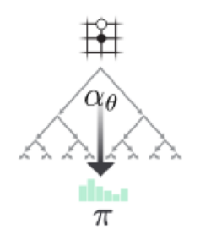

Model - Monte Carlo Tree Search
Play
When τ is 1, we select moves based on the visit count.
When τ → 0, only the move with the highest count will be picked. So τ =1 allows exploration while τ → 0 does not.

Slide 57
Model - Monte Carlo Tree Search
Improvement
MCTS improves our policy evaluation (improves Q)
Use the new evaluation to improve the policy (policy improvement).
Re-apply the policy to evaluate the policy again.
These repeated iterations of policy evaluation and policy improvement are called policy iteration in RL.
After self-playing many games, both policy evaluation and policy improvement will be optimized to a point that it can beat the masters.

Slide 58
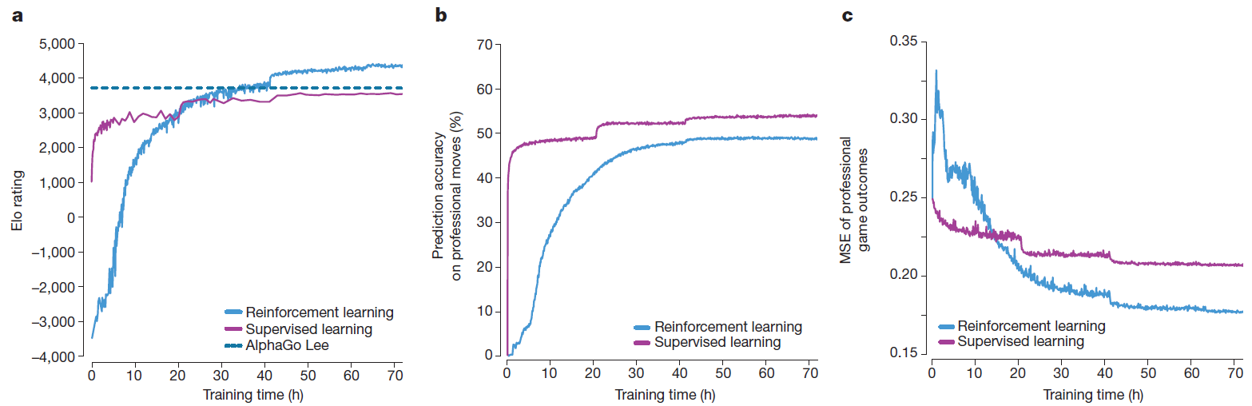
Model - Empirical analysis training
a, Performance of selfplay reinforcement learning. The plot shows the performance of each MCTS player αθi from each iteration i of reinforcement learning in AlphaGo Zero. Elo ratings were computed from evaluation games between different players, using 0.4 s of thinking time per move (see Methods). For comparison, a similar player trained by supervised learning from human data, using the KGS dataset, is also shown.

Slide 59
Model - Empirical analysis training
b, Prediction accuracy on human professional moves. The plot shows the accuracy of the neural network θ f i , at each iteration of self-play i, in predicting human professional moves from the GoKifu dataset. The accuracy measures the percentage of positions in which the neural network assigns the highest probability to the human move. The accuracy of a neural network trained by supervised learning is also shown.

Slide 60
Model - Empirical analysis training
c, Mean-squared error (MSE) of human professional game outcomes. The plot shows the MSE of the neural network θ f i , at each iteration of self-play i, in predicting the outcome of human professional games from the GoKifu dataset. The MSE is between the actual outcome z∈{−1, +1} and the neural network value v, scaled by a factor of 1 4 to the range of 0–1. The MSE of a neural network trained by supervised learning is also shown.

Slide 61
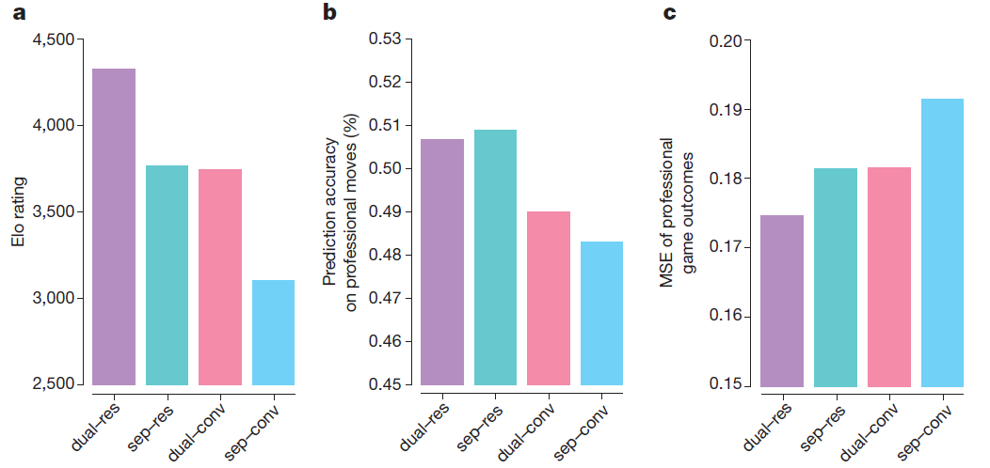
Model - Empirical analysis training
a, Each trained network was combined with AlphaGo Zero’s search to obtain a different player. Elo ratings were computed from evaluation games between these different players, using 5 s of thinking time per move.

Slide 62
Model - Empirical analysis training
b, Prediction accuracy on human professional moves (from the GoKifu dataset) for each network architecture

Slide 63
Model - Empirical analysis training
c, MSE of human professional game outcomes (from the GoKifu dataset) for each network architecture..

Slide 64
Model - Knowledge learned
A. five human joseki (common corner sequences) found during alphago zero training. The associated timestamp indicates that each sequence first appears during self-training training (considering rotation and reflection).
B. five joseki are favored at different stages of self-training. During the iteration of the self-learning training, each displayed corner sequence is played at the maximum frequency in all corner sequences. The timestamp of this iteration is indicated on the timeline.
C. In the first 80 games of the three self-competitions conducted at different training stages, each search used 1,600 simulations (about 0.4 seconds). In 3 hours, the game greedily focused on capturing stones (enclosed), just like human beginners. In 19 hours, the game understands where it is still alive. Where is the dead chess, the fundamentals of influence and territory. In 70 hours, the entire network is close to training.

Slide 65
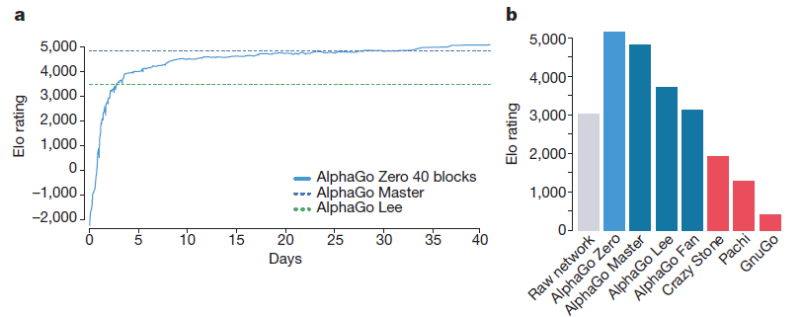
Final performance
a, Learning curve for AlphaGo Zero using a larger 40-block residual network over 40 days. The plot shows the performance of each player αθi from each iteration i of our reinforcement learning algorithm. Elo ratings were computed from evaluation games between different players, using 0.4 s per search (see Methods).

Slide 66
Final performance
b, Final performance of AlphaGo Zero. AlphaGo Zero was trained for 40 days using a 40-block residual neural network. The plot shows the results of a tournament between: AlphaGo Zero, AlphaGo Master (defeated top human professionals 60–0 in online games), AlphaGo Lee (defeated Lee Sedol), AlphaGo Fan (defeated Fan Hui), as well as previous Go programs Crazy Stone, Pachi and GnuGo. Each program was given 5 s of thinking time per move. AlphaGo Zero and AlphaGo Master played on a single machine on the Google Cloud; AlphaGo Fan and AlphaGo Lee were distributed over many machines. The raw neural network from AlphaGo Zero is also included, which directly selects the move a with maximum probability pa, without using MCTS. Programs were evaluated on an Elo scale25: a 200-point gap corresponds to a 75% probability of winning.

Slide 67
Conclusion
A pure reinforcement learning approach is fully feasible, even in the most challenging of domains: it is possible to train to superhuman level, without human examples or guidance, given no knowledge of the domain beyond basic rules.
Pure reinforcement learning approach requires just a few more hours to train, and achieves much better asymptotic performance, compared to training on human expert data.

Slide 68
Thank you for your attention

