Slide 1
Midterm Report
May. 2, 2019
Team No.3: T2_509
Presenter: Kai-Chuan Yang, Wei-Long Cheng
The Electronic Design Automation Laboratory
Department of Electrical Engineering
National Taiwan University of Science and Technology
Taipei 106, Taiwan

Slide 2
2019 KDD CUP

Slide 3
Data analysis
Data Set
profiles.csv
63090 profile ID (PID), each PID has own user attributes (65)
train_queries.csv
500000 session ID (SID), each SID consists of a PID (may be empty), a timestamp, coordinates
We can observe from timestamp that the data was collected between Oct. ~ Nov.
train_plans.csv
491054 SID, each SID consists of a timestamp and plans (distance, price, eta, mode)
Plan mode may repeat with different distance, price and eta
train_clicks.csv
453336 SID, each SID consists of a timestamp and click mode

Slide 4
Method
Training Data
Train_x
500000 (SID)* 67 (features)
Train_y
500000 (SID)* 1 (click mode)
Feature
Plan mode 0 to 11 in binary (mode 0 means no plan)
Distance, price, eta (maximum, minimum, mean)
Day (Mon. ~ Sun.), time (0 a.m. ~ 23 p.m.)
Profile attribute (dimensionality reduction)

Slide 5
Results
Platform
Anaconda 1.6.5 on Linux
Editor & IDE
Jupyter Notebook
Training Model
XGBoost
The classifiers are learned sequentially
Optimized gradient boosting library (using second-order Taylor expansion)
Result
Team name: T2_509
Ranking: 188 / 461 (2019/05/01)
Accuracy: 0.68943085

Slide 6
Challenge & future plan
Challenge
Features extraction
Add more features
Data preprocessing takes too long
Dimensionality reduction
Multithreading techniques
Future plan
Generate more features
Coordinates to Manhattan distance (m)
Median of distance, price, eta
Holiday from Oct. to Nov.
…
Parameter tuning

Slide 7
AlphaGo & AlphaGo Zero

Slide 8
AlphaGo & AlphaGo Zero
AlphaGo vs AlphaGo Zero
 | AlphaGo | AlphaGo Zero
Supervised learning | Yes | No
Reinforcement learning | Yes | Yes
Policy network & Value network | Apart | Merge
Monte Carlo method | Yes | Yes
Learning Speed | Fast | Slow

Slide 9
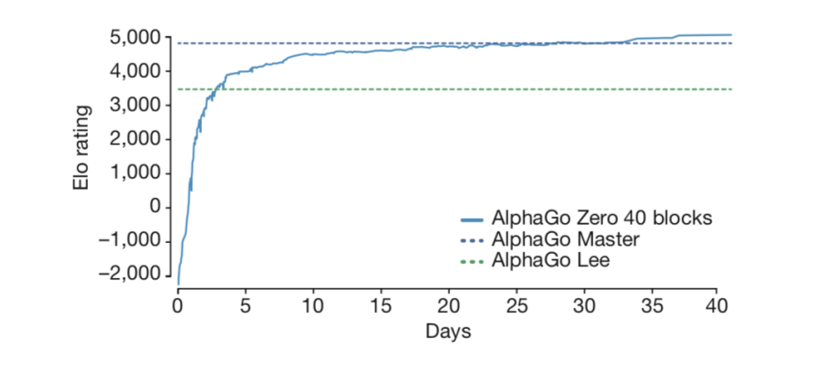
AlphaGo & AlphaGo Zero
AlphaGo vs AlphaGo Zero
Passes AlphaGo Lee after just 3 days of self-play
Passes AlphaGo Master after about 21 days
Strongest Go player in the world after 40 days of self-play starting only from first principles

Slide 10
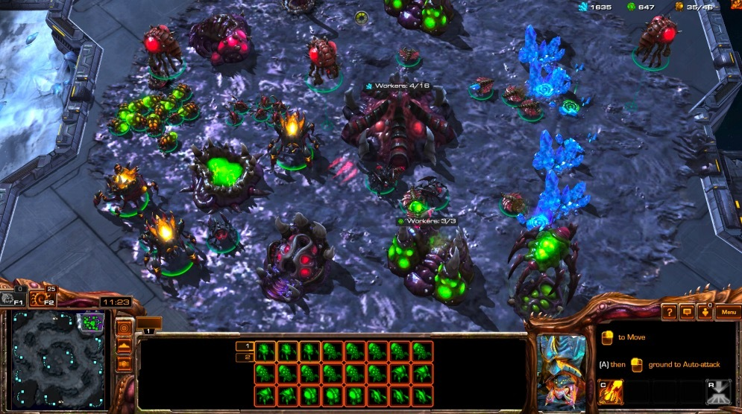
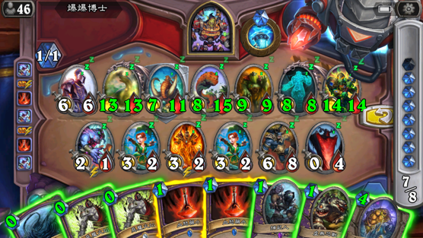
AlphaGo & AlphaGo Zero
Future work
StarCraft
Transformer network + LSTM
Hearthstone

Slide 11
Q&A

