Slide 1
KDD-CUP2019 skrai_ntust
第四組
M10715062 戈善磊
M10715012 蔡亦凱
M10702253 吳冠毅
Notes:
https://www.slideshare.net/ccckmit/30alphago
http://ktiml.mff.cuni.cz/~bartak/ui_seminar/talks/2017ZS/YuuSakaguchi_AlphaGo.pdf
https://www.slideshare.net/jackeikuo/alphago-61395515

Slide 2
CONTENT
Task & Data description
Our features & method
Result Demo
AlphaGo & AlphaGo Zero

Slide 3
PART I: PROGRESS REPORT -
KDD CUP 2019

Slide 4
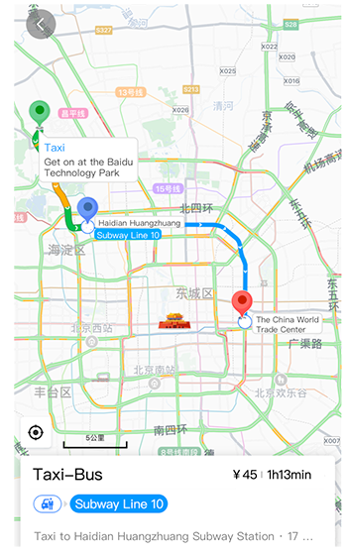
TASK DESCRIPTION
Recommend the most appropriate transport mode
Given a user an OD pair and the situational context
it is requested to recommend the most proper transport mode m ∈ M for user u to travel between the OD pair od

Slide 5
dATA (1) - About query record
sid | pid | req_time | o | d
387056 | 234590 | 2018-11-01 15:15:36 | (116.30,40.05) | (116.35,39.99)
902489 | 849336 | 2019-01-16 19:57:41 | (117.33,39.08) | (117.32, 39.09)
156976 | 221455 | 2018-12-17 09:05:12 | (121.48,31.21) | (121.44,31.11)
183026 | 891650 | 2019-01-04 12:38:16 | (112.52,38.18) | (112.54,38.10)
729561 | 8322489 | 2019-04-01 21:47:37 | (120.01,31.71) | (120.01,31.72)
day

Slide 6
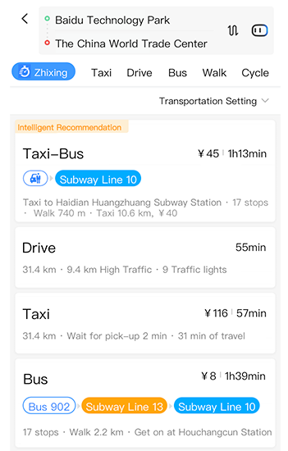
Data (2) – about plans
Features
Construct 11 columns
for the following attributes:
transport mode (one-hot)
Each ranking of transport mode
Each mode of distance
Each mode of ETA
Each mode of price
sid | route plans 1 |  |  |  | ... | route plans N
 | transport mode | Distance (m) | ETA (s) | estimated price (RMB cent) |  | ... | ... | ... | ...
387056 | 2018-11-01 15:15:40 | 1 | 8220 | 2134 | 2600 | ... | ... | ... | ...
902489 | 2019-01-16 19:57:44 | 3 | 1645 | 740 | 200 | ... | ... | ... | ...

Slide 7
DATA (3) - Click record & User attribute
Click record
We don’t use the click time attribute
because testing data miss this record
User profile
We use the whole user profile attribute
We have not solve missing value problem
sid | click_time | click_mode
387056 | 2018-11-01 15:15:47 | 1
902489 | 2019-01-16 19:57:46 | 3
156976 | 2018-12-17 09:05:30 | 7
183026 | 2019-01-04 12:38:22 | 8
729561 | 2019-04-01 21:47:39 | 6

Slide 8

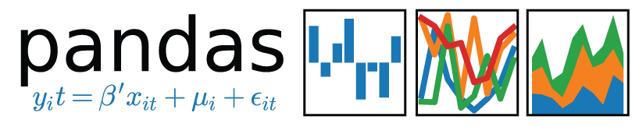
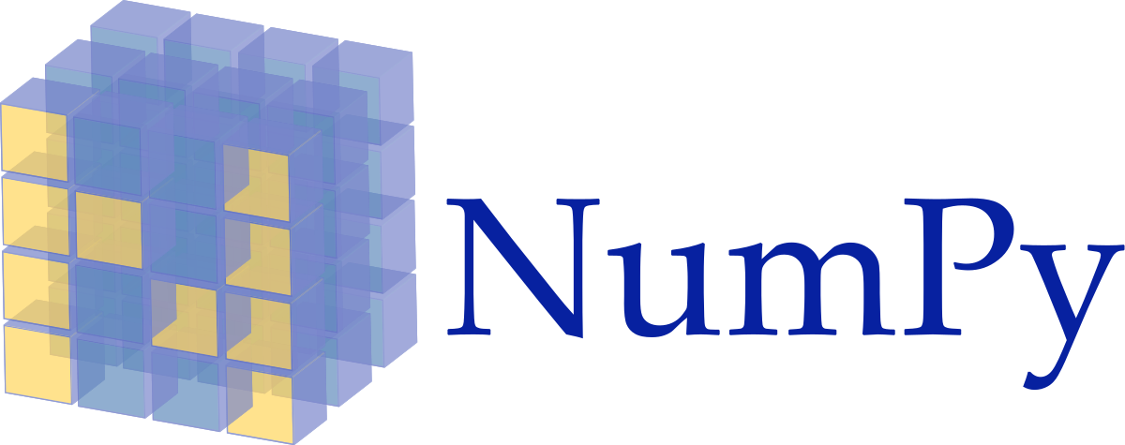


Analyzing tOOL
pandas
Python
Numpy, Pandas, Scipy
Sklearn
Tensorflow & Keras

Slide 9
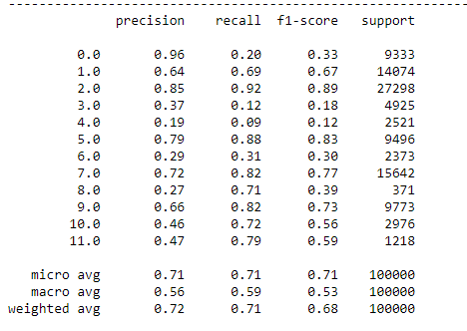
Performance RESULT
Our experiments
Classifier | F1 Score | Remark
KNN | 0.65 | K = 13
RF | 0.67 | max_features=90, n_estimator=10000
SVM | 0.69 | kernel=‘rbf’, class_weight =‘balanced’
ANN | 0.68 | Not tuned
LOGISTIC REGRESSION | 0.67 | solver=‘saga’, class_weight=‘balanced’

Slide 10
Next step
For Data Features:
Solve missing values problem
For classifiers:
Tuning hyperparameters
Try other NN models

Slide 11
PART II: AlphaGo & AlphaGo Zero
Mastering the Game of Go
with deep neural networks and tree search
without Human Knowledge

Slide 12
AlphaGo vs. AlphaGo Zero
AlphaGo
透過人類經驗 ( CNN training + tree search) 來學習圍棋。
AlphaGo Zero
自主學習，不依賴人類經驗。
透過與自己對弈來學習圍棋，讓自己更為強大。

Slide 13
不依賴人類經驗反而更強大？
AlphaGo Zero走自己的路，找出了人類意想不到的技巧。
比起來，AlphaGo 被人類經驗給限制住，所以贏不了AlphaGo Zero。

Slide 14
對我們人類來說
前人的經驗或許才是我們的絆腳石。
跳脫傳統的觀點，也許能讓我們發現新的事物。
儘管 AlphaGo Zero已經無人能敵，但我們不需為此過度感傷，因為它就只會下圍棋。

Slide 15
未來的AI
在做機器學習的時候，都需要一個龐大數據集。
然而 AlphaGo Zero 不需要數據集，靠著自主學習就能夠訓練完成。
未來AI的研究方向，也許會對數據集的依賴程度降低？

Slide 16
\~~ END ~~/

