Slide 1
Employee datasets analysis using excel
STUDENT NAME:M.AROIKKA MARY JEFFINA
REGISTER NO:422200469
NAAN MUDHALVAN:688CA64438BE97FAF0242E429779C087
DEPARTMENT:B.COM(ISM)
COLLEGE:VALLIAMMAL COLLEGE FOR WOMEN

Slide 2
PROJECT TITTLE
Employee salary analysis using excel

Slide 3
agenda
PROBLEM STATEMENT
PROJECT OVERVIEW.
WHO ARE THE END USERS.
OUR SOLUTION AND IT’S VALUE PROPOSITION.
DATASET DESCRIPTION.
THE “ WOW” IN OUR SOLUTION.
MODELLING.
RESULT.
CONCLUSION.

Slide 4
PROBLEM STATEMENT
This salary analysis is used to find out whether the salary of the employee is increased or not

Slide 5
PROJECT OVERVIEW
Analyse the salary of the employee by considering various factors of like Gender , Employee ID, Start date , Employee type , Department , etc.. We use these in order to identify the trends , patterns of different categories of employee Salary like very high , high , medium and low

Slide 6
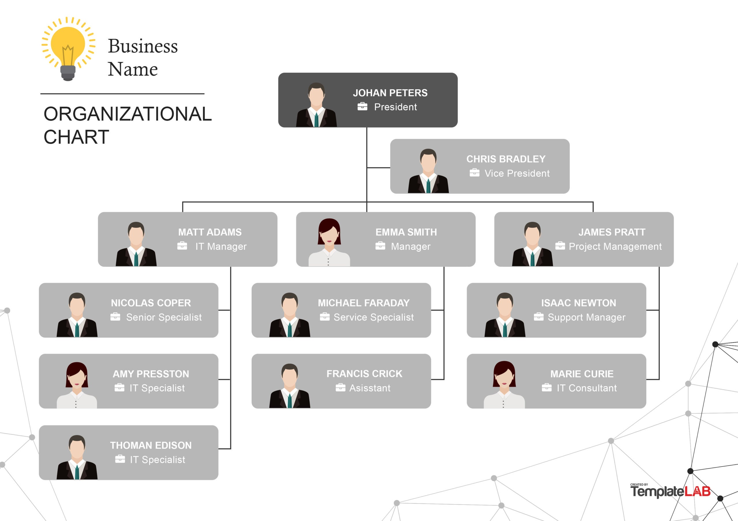
WHO ARE THE END USERS

Slide 7
OUR SOLUTION AND IT’S VALUE PROPOSITION
Conditional Formatting –Blank values.
Sort & Filter –Filter –Remove Blank Values.
Formula –Salary .
Pivot Table –Summary.
Graph –Data Visualization.

Slide 8
DATASET DESCRIPTION
Employee Dataset –Edunet Dashboard.
11 Features .
5 Features
Employee ID –Numerical Values.
Name –Text
Gender –Text.
Salary –Numerical Values.
Start Date –Numerical Values.

Slide 9
THE “ WOW “ IN OUR SOLUTION
We use this formula =IFS(Z8>=5,”VERYHIGH”,Z8>=4,”HIGH”,Z8>=3,”MED”,TRU E,”LOW”)
To find the salary level of the employee.

Slide 10
MODELLING
DATA COLLECTION :
Naan mudhalvan .
Edunet Dashboard.
FEATURE SELECTION :
11 Features.
5 Features.
DATA CLEANING :
Colour blank values
Filter –Remove Blank Values

Slide 11
SALARY LEVEL :
Very High.
High
Medium.
Low
PIVOT TABLE :
▪ Employee ID.
▪ Name.
▪ Gender.
▪ Salary.
▪ Salary level

Slide 12
Start date.
Employee Type.
CHART :
Employee ID.
Name.
Gender.
▪ Salary.
▪ Salary Level.
▪ Start Date.
▪ Employee Type.
▪ Data Visualization.

Slide 13
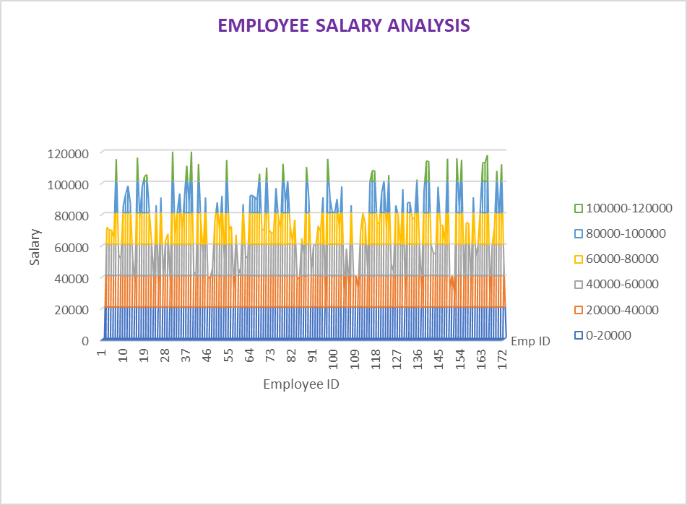
RESULTS

Slide 14
CONCLUSIONS
While comparing the salary level of the employee , the employee’s are getting their salary according to their employee type and start date.

