Slide 1

AI SRE Copilot
MULTI-AGENT AI SRE PLATFORM
Autonomous incident investigation for Kubernetes
Alerts fire, the platform investigates on its own, produces a grounded root-cause report and an execution-ready runbook — and a human approves anything that touches the cluster.
AI/ML Bootcamp Capstone

Slide 2
THE PROBLEM
AI SRE Copilot
SRE toil doesn't scale with headcount
01
Alerts outpace attention
A cascading outage can fire dozens of alerts in minutes. Someone still has to open Grafana, Jaeger, and kubectl, by hand, for every one.
02
Root cause lives across three tools
Metrics say what broke. Traces say where. Kubernetes events say why. No single dashboard correlates all three under time pressure.
03
Tribal knowledge doesn't transfer
The engineer who remembers last quarter's near-identical incident isn't always the one on call this time.
Multi-Agent AI SRE Platform
2

Slide 3
CORE FEATURES
AI SRE Copilot
What the platform actually does
Autonomous detection
Parallel multi-agent investigation
Alertmanager posts a firing alert to the webhook; the copilot investigates with nobody watching, no polling.
Metrics, Trace, and Kubernetes agents gather evidence at once — every tool call is visible, not hidden.
Grounded root-cause reports
Execution-ready runbooks
The RCA is tied to the actual metrics and traces pulled for this incident, not a generic response.
A second structured LLM pass turns the RCA into concrete, ready-to-run remediation steps.
Human-gated remediation
Incident memory
The one cluster-mutating action pauses on a real approval gate — nothing touches the cluster without a person deciding.
Semantic search over past incidents answers “has this happened before?” instead of starting cold.
Multi-Agent AI SRE Platform
3

Slide 4
LIVE DEMO
AI SRE Copilot
What we'll walk through
1
Trigger
2
Auto-triage
3
Investigate
kubectl scale deployment product-catalog --replicas=0 — a real failure in the live cluster.
Alertmanager posts to the webhook; the copilot picks it up with nobody asking, no polling.
Metrics, trace, and Kubernetes agents gather evidence in parallel; the coordinator correlates it.
4
Root cause + runbook
5
Approve
6
Resolve
An LLM produces a grounded RCA and an execution-ready remediation runbook.
The proposed fix parks on awaiting_approval until a human clicks Approve — in the Web UI or CLI.
Operations Hub's KPIs and the Timeline update live — resolution rate, time-to-mitigate, the works.
Multi-Agent AI SRE Platform
4

Slide 5
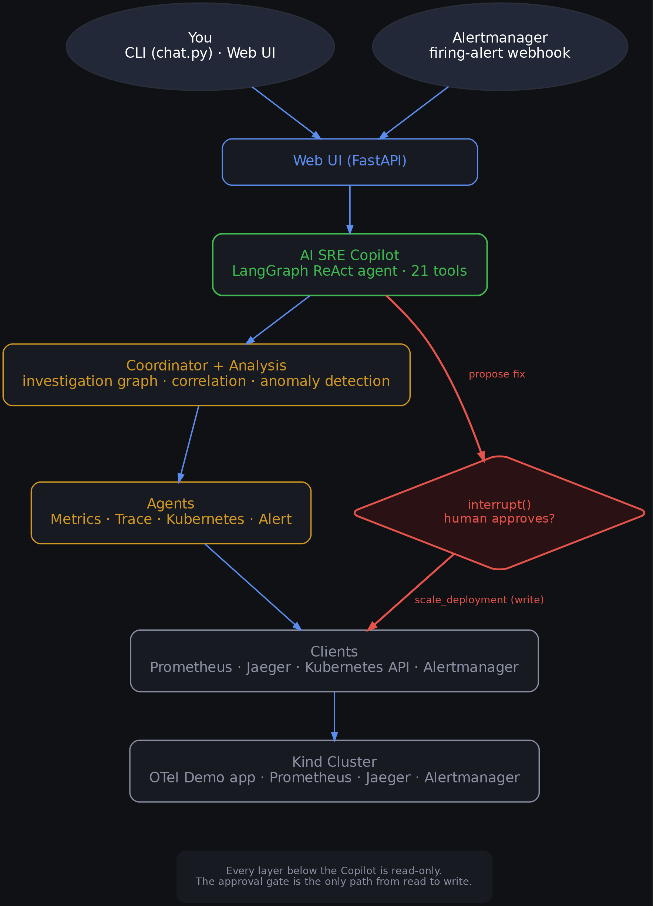
ARCHITECTURE
AI SRE Copilot
Six layers, one approval gate
Multi-Agent AI SRE Platform
5

Slide 6
ALSO INCLUDED
AI SRE Copilot
Beyond the core loop
Alert correlation
Anomaly detection
Groups related alerts into one incident instead of a dozen separate pings for the same outage.
Z-score checks flag a metric behaving unusually against that service's own history.
Knowledge base search
Operations Hub
Semantic / TF-IDF search over human-authored runbooks and playbooks, not just past incidents.
KPI dashboard — resolution rate, time-to-mitigate, pending approvals — at a glance.
Google sign-in + PII redaction
CLI copilot
Real per-user auth, plus a regex scrub before cluster data reaches the LLM or gets stored.
Same agent, same tools, from a terminal instead of the browser.
Multi-Agent AI SRE Platform
6

Slide 7
ROADMAP
AI SRE Copilot
Stated plainly: what's next
ACCEPTED TRADE-OFFS
PLANNED NEXT
No per-role authorization — every allowlisted user can also approve a remediation.
PII redaction is pattern-based, not a compliance-grade classifier.
OAuth client secret and session key still live in plaintext .env.
Token refresh isn't implemented — sessions simply expire after 8 hours.
Per-role authorization — separate “can view” from “can approve a remediation.”
Slack / Microsoft Teams notifications.
MCP server support.
True embedding-based search everywhere — Voyage AI is optional today, TF-IDF is the fallback.
Multi-Agent AI SRE Platform
7

Slide 8
AI SRE Copilot
Questions
AI SRE Copilot — Multi-Agent AI SRE Platform — thank you.

