Slide 1
Employee Data Analysis using Excel
STUDENT NAME: K. AROKIYA MERIFA
REGISTER NO: 312216913
DEPARTMENT: B. COM( GENERAL)
COLLEGE: SHRI KRISHNASWAMY COLLEGE FOR WOMEN

Slide 2
PROJECT TITLE
Salary and Compensation Analysis Through Excel Data Modelling

Slide 3


AGENDA
Problem Statement
Project Overview
End Users
Our Solution and Proposition
Dataset Description
Modelling Approach
Results and Discussion
Conclusion
3/21/2024 Annual Review

Slide 4

PROBLEM STATEMENT
1. Gather and Prepare Data :
Data Sources: Collect data from HR systems, payroll records, or surveys.
Data Fields: Common fields might include employee ID, job title, department, salary, bonuses, benefits, location, and years of experience.
Cleaning: Ensure data consistency, handle missing values, and correct any errors.
2 . Create Data Model in Excel:
Import Data: Load your data into Excel using either direct import or copy-pasting.
Organize Data: Structure the data in a tabular format with appropriate headers for clarity.
Create Tables: Use Excel tables for better data management and ease of use.

Slide 5

PROJECT OVERVIEW
Scope:
Data Collection and Preparation: Data Sources: HR records, payroll systems, or surveys. Key Fields: Employee ID, job title, department, base salary, bonuses, benefits, location, experience, etc.
Data Cleaning: Ensure data quality by handling missing values, correcting errors, and standardizing formats.
Data Modeling in Excel Analysis: Compute key statistics such as mean, median, standard deviation, and range. Pivot Tables: Use PivotTables to analyze data by various dimensions (e.g., department, location).
Import Data: Load data into Excel and organize it into a structured table format. Data Structuring: Create tables to facilitate analysis and ensure data integrity.

Slide 6

WHO ARE THE END USERS?
HR Professionals.
Finance Department.
Management and Executives.
Compensation Analysts.
Employees (Indirectly).

Slide 7
OUR SOLUTION AND ITS VALUE PROPOSITION
Steps in solution:
Data Collection and Preparation:
Gather data from HR systems, payroll records, or surveys. Clean and organize data to ensure accuracy and consistency.
2. Data Modeling in Excel:
Import data into Excel and structure it using tables. Create PivotTables and use advanced functions to model and analyze data.
3. Reporting and Recommendations:
Develop actionable recommendations for optimizing compensation strategies.

Slide 8
Dataset Description
Dataset Overview:
Purpose: To analyze salary and compensation data to identify trends, disparities, and insights for strategic decision-making. Format: Excel spreadsheet with structured tables.
2. Data Characteristics:
Frequency: Typically updated on a quarterly or annual basis, depending on data availability and reporting needs. Range: Covers a range of roles, departments, and levels within the organization.
3. Data Integrity:
Accuracy: Ensure all fields are correctly filled and values are accurate.
Consistency: Standardize formats for dates, salary figures, and other numerical values.

Slide 9
THE "WOW" IN OUR SOLUTION
WOW Factor in Our Salary and Compensation Analysis Solution:
Comprehensive Insights.
User-Friendly Interface.
Dynamic Reporting.
Actionable Insights.
Scalability.
Strategic Decision Support.
Cost-Effective Solution.
Enhanced Transparency.
3/21/2024 Annual Review
9

Slide 10
MODELLING
Salary and compensation analysis is a great use case for Excel data modeling. Here’s a high-level overview of the steps:
Data Collection:
Gather data on salaries, compensation, and relevant factors (eg, job title, department, location, experience, performance ratings) from various sources (e.g., HR systems, surveys, market research).
2. Data Cleaning:
Ensure data accuracy, handle missing values, and perform data, transformation as needed.
10

Slide 11
MODELLING
3.Data Modeling:
Create an Excel data model to organize and structure the data. This may involve creating tables for different data entities.
4. Analysis:
Use Excel formulas, functions, and data visualization techniques (eg, pivot tables, charts, scatter plots) to analyze and gain insights from the data.
5. Reporting:
Present findings and insights through clear and effective reports, dashboards, or presentations.
By applying these steps and techniques, you can perform and comprehensive salary compensation analysis using Excel data modeling.

Slide 12
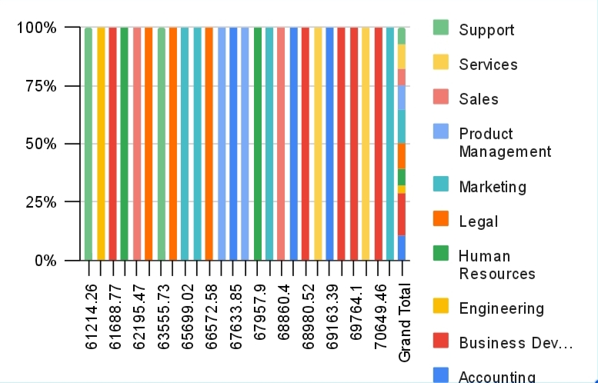
RESULTS
12

Slide 13
conclusion
In conclusion, salary and compensation analysis through Excel data modeling provides valuable insights into compensation structures, trends, and disparities within an organization or across the industry. By leveraging Excel’s capabilities to organize, analyze, and visualize data, one can identify patterns and anomalies in salary distribution, assess the alignment of compensation with performance and market benchmarks, and make data-driven decisions for equitable pay practices. Effective data modeling enables accurate forecasting of compensation trends and supports strategic planning for talent management and budget allocation. Overall, this approach facilitates a comprehensive understanding of compensation dynamics, helping organizations to attract, retain, and motivate talent effectively.

