Slide 1
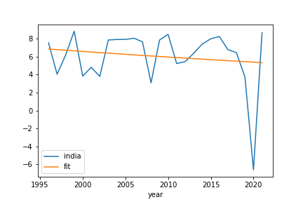
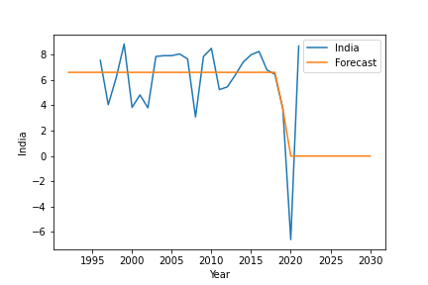
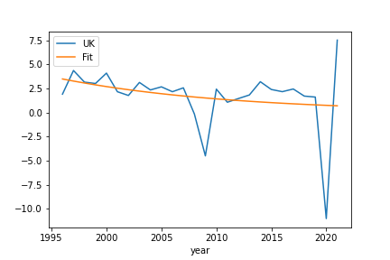
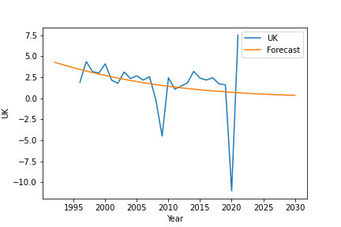
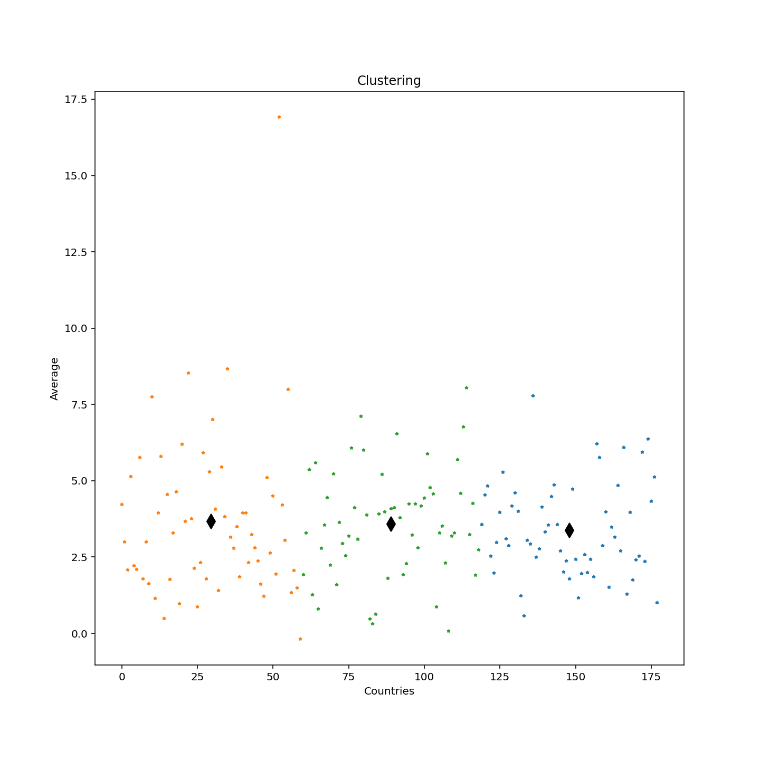
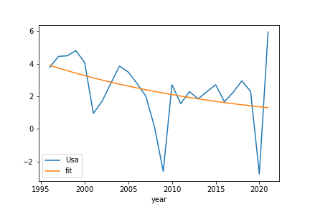
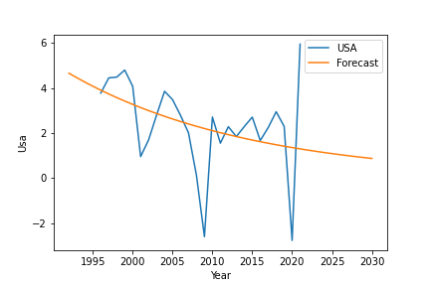
Analysing the growth of GDP
Introduction
Annual GDP growth refers to the percentage increase in a country's Gross Domestic Product (GDP) from one year to the next. GDP is a measure of the value of all goods and services produced in a country during a specific period of time, usually a year. A positive GDP growth rate indicates that the economy is expanding, while a negative GDP growth rate indicates that the economy is contracting.
It's worth noting that GDP growth can vary significantly from country to country and can also be affected by short-term and long-term economic fluctuations such as recessions and booms. Some countries may have higher GDP growth rates due to a variety of reasons such as resource abundance or favorable government policies, while others may have lower GDP growth rates due to political instability, poor infrastructure, or other factors.
The World Bank provided the information that was used to create this poster. From 1960 to 2020, 295 nations and regions are included. In this poster, only years from 1995 through 2020 are used. The CSV format is used to acquire the data.
Few countries with missing data are not taken into account. The information is then combined with another dataset that contains continents and subregions for every nation. This information makes it simple to understand which countries belong on which continents and in which subregions.
The dataset shows the change in Annual GDP growth refers to the percentage increase in a country's Gross Domestic Product (GDP) from one year to the next.
Clustering
It is one of the best methods for identifying patterns and trends in the GDP's annual growth rate over time. In this case, the data were fitted to a KMeans clustering model with the requisite 3 clusters. The retrieved cluster labels and estimated cluster centers are done next. The silhouette score is then used to assess how well the clustering performed. A score of 1 denotes a favorable cluster structure, whereas a score of -1 denotes an unfavorable one. The score for a silhouette ranges from -1 to 1. Each dot shows how much the Annual GDP has changed overall in comparison to the previous year for each country. Each cluster is represented by a colored dot. The black point represents the centroid of the cluster.
Trend Analysis
The amount of GDP change in comparison to prior years has fluctuated throughout time in all three countries, increasing and decreasing. However, it is clear that the USA and the UK experienced a significant deflation in GDP growth between the years 2008 and 2020 as a result of unnatural events that resulted in the collapse of the country's GDP. Change in GDP % has significantly declined. It turned negative, slowing the sharp decrease in the yearly GDP.
However, India’s GDP growth fluctuates constantly, maintaining a balanced rate of expansion. It is evident that the change in GDP % for India in 2020 will drastically decrease. It went to negative a rate which decreased the annual GDP growth.
Conclusion
The percentage rise in a nation's Gross Domestic Product (GDP) from one year to the next is referred to as annual GDP growth. GDP is a measurement of the total value of goods and services produced in a nation over a given time period, often a year. When the GDP growth rate is positive, the economy is growing, but when it is negative, the economy is contracting. In all three countries, the GDP change from earlier years has fluctuated over time, but significantly in the year 2020, every country saw a huge economic collapse. In terms of GDP growth, the UK and the USA experienced a severe reaction in 2002.
GitHub link:
https://github.com/AromaDsouza/Clustering-and-Fitting.git

