Slide 1

OLYMPIC DATA ANALYSIS
Team members:
02 – Sonali Rasal
24 – Pranjal Singh
30 – Aroma Sinha
Team Guide: Mr. Aniket Mishra

Slide 2
Introduction
Olympic games – A prime event
Over these years there have been following improvements:
a. Increase in number of participating nations
b. Increase in number of participating Athletes
c. Increase/Decrease in number of events
d. Increase in the expenditure cost of the event
e. improvement in performance of particular country
f. Increase in women participation
g. Participation Ratio of Men to Women

Slide 3
OBJECTIVE
Various factors
To analyse the various factors mentioned above which plays a vital role in the evolution of the Olympic Games over the years.
visualization
Include the visualization and explanation of the change in trends of the various factors over the years
PERFORMANCE
These analysis will help improve the performance of athletes.
Analysis
Analysis of height , weight, medals will help in predicting better moves for their next games.

Slide 4
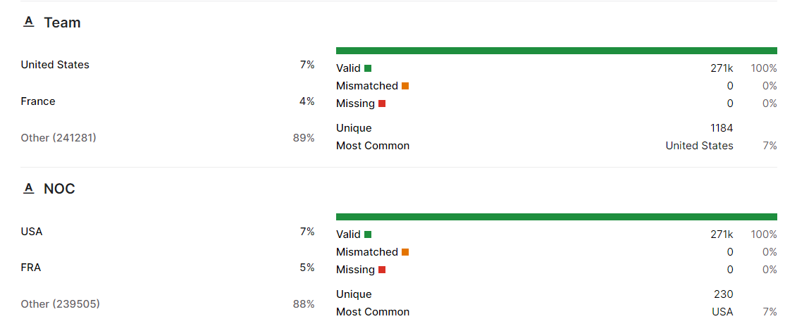
TECHNOLOGY USED
Language : Python
Libraries : NumPy, Pandas, Seaborn, Matplotlib
Data Source : Kaggle
Software used : Google Collab , Microsoft Excel

Slide 5
EXPLORATORY DATA ANALYSIS

Slide 6
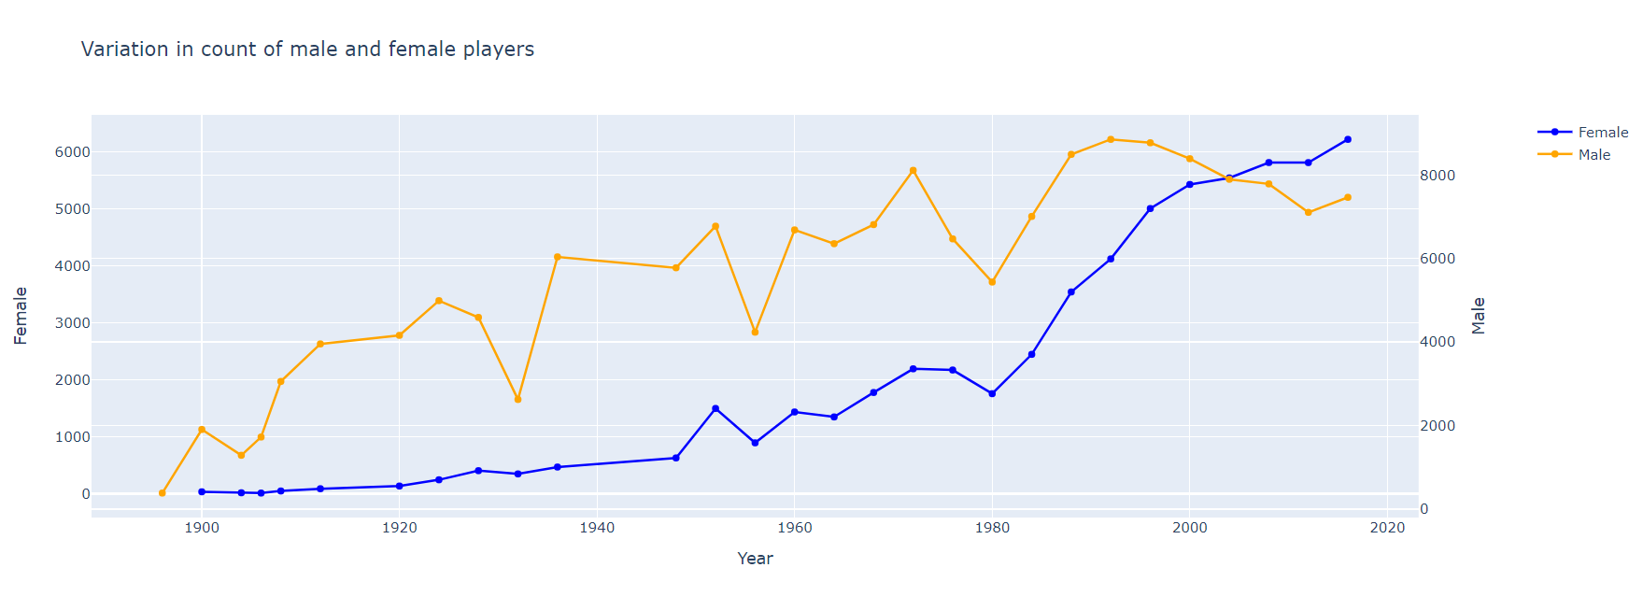
COUNT OF MALE AND FEMALE PLAYERS
- 22 women of 997 started playing in the year 1900
- Female players started to drastically increase after 1980

Slide 7
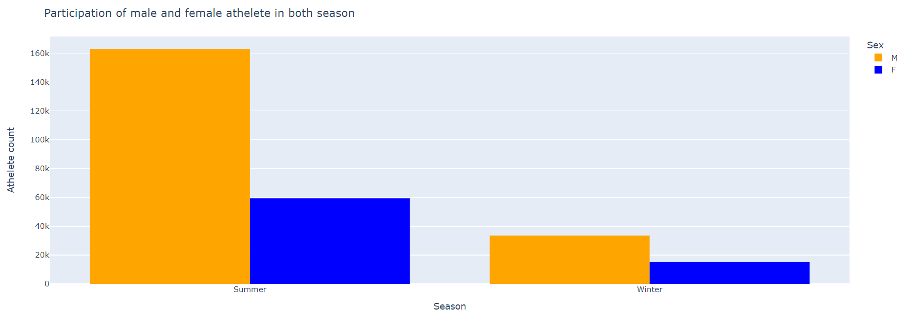
Participation of male and females
- Summer season had more no of male participation than female
- Participation count was around 160k in males and approx. 60k in females

Slide 8
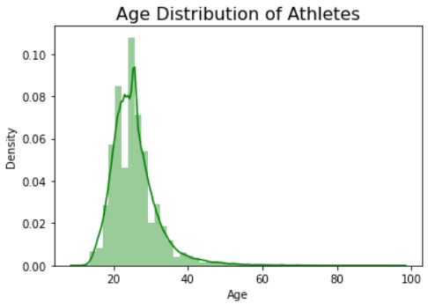
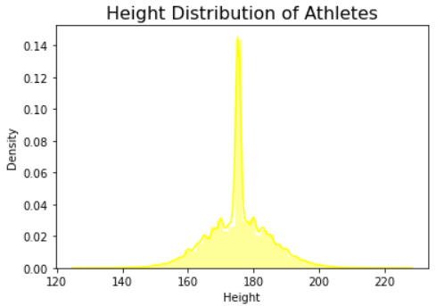
Age and height distribution among players
- Height is an advantage to various sports like basketball etc.

Slide 9
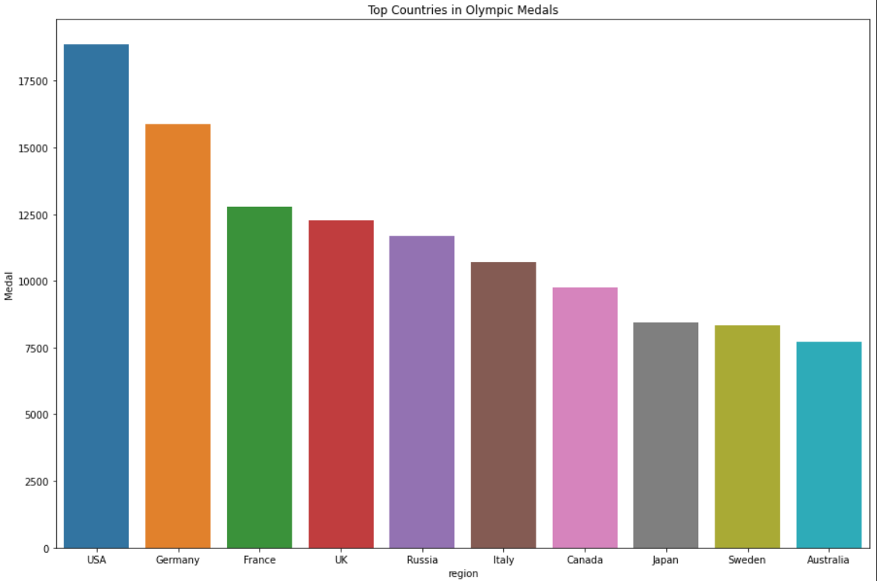
TOP COUNTRIES FOR OLYMPIC MEDALS

Slide 10
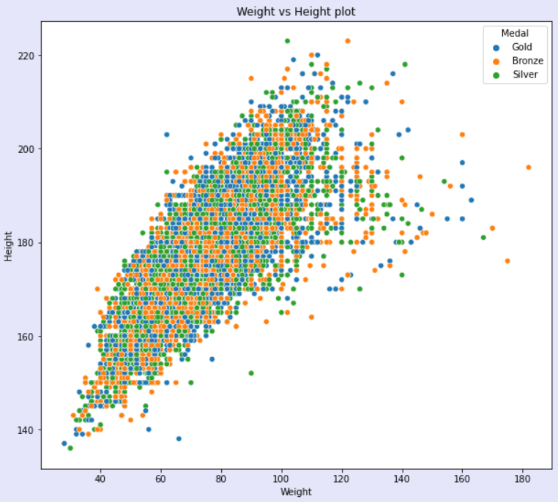
WEIGHT VS HEIGHT PLOT

Slide 11
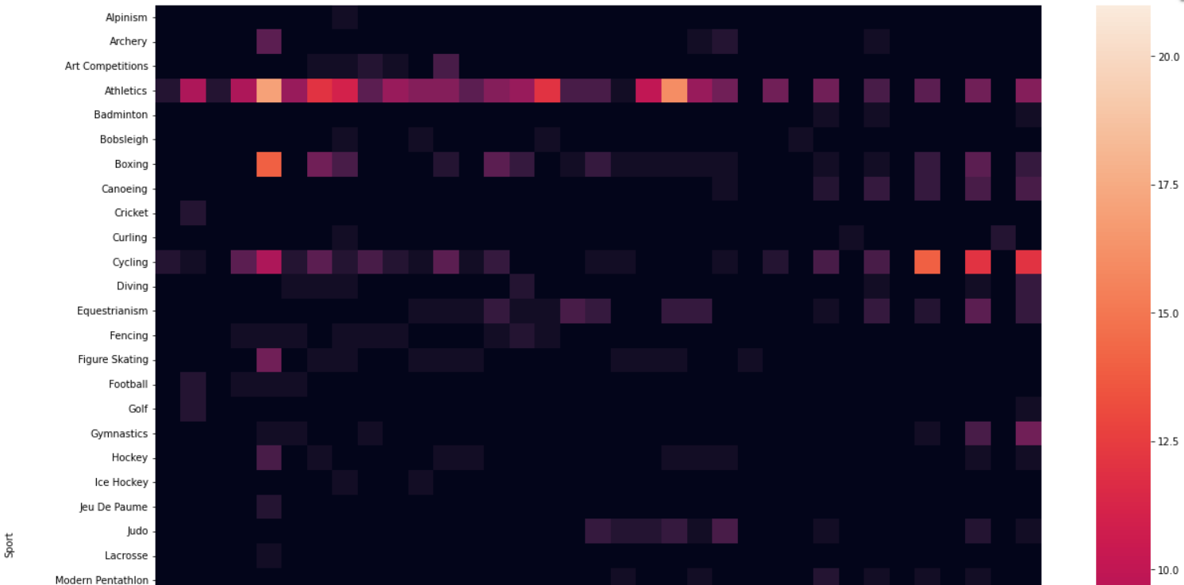
HEATMAP FOR DIFFERENT SPORTS
- Heatmap in Seaborn is to display a color-coded correlation matrix for easy visualization of the relationship between the features in the data.

Slide 12
CONCLUSION
- The main Objective of this study was to Analyze and visualize the various factors which have contributed in the Evolution of Olympic Games over the years.
- There are various factors which provides the valid evidence that the Olympics have changed a lot.
- Apart from these there are many more factors which depicts the Evolution of Olympic Games over the time.
- Visualization of these factors has been done to explain and validate the Analysis in various Graphical formats like a Line graph, Scatter Plots, Bar Graphs, Density Plots etc.

Slide 13
References
[1] Wikipedia contributors: https://en.m.wikipedia.org/wiki/Olympic Games, last accessed 2020/11/02.
[2] Dey S K, Rahman M M, Siddiqi U R and Howlader A 2020 Analyzing the epidemiological outbreak of COVID-19: A visual exploratory data analysis approach J. Med. Virol. 92 632–8
[3] Bondu R, Cloutier V, Rosa E and Roy M 2020 An exploratory data analysis approach for assessing the sources and distribution of naturally occurring contaminants (F, Ba, Mn, As) in groundwater from southern Quebec (Canada) Appl. Geochem. 114 104500
[4] Cutait, M.: Management performance of the Rio 2016 Summer Olympic Games. Research Paper submitted and approved to obtain the Master’s degree in Sports Administration at AISTS in Lausanne, Switzerland.
[5] Moreno A, Moragas M and Paningua R 1999 The evolution of volunteers at the Olympic Games Proceedings of Symposium on Volunteers (Lausanne, Switzerland: Global Society and the Olympic Movement) pp 1–18
[6] Abeza G, Braunstein-Minkove J R, S´eguin B, O’Reilly N, Kim A and Abdourazakou Y 2020 Ambush marketing via social media: The case of the three most recent Olympic Games Int. J. Sport Communication 1–25
[7] Yamunathangam D, Kirthicka G and Shahanas P 2018 Performance Analysis in Olympic Games using Exploratory Data Analysis Techniques International Journal of Recent Technology and Engineering (IJRTE) 7 251–3
[8] Wikipedia contributors: Exploratory data analysis, https://en.wikipedia.org/wiki/Exploratory data analysis, last accessed 2020/11/11.
[9] Ramachandran K. M. and Tsokos C P 2020 Mathematical statistics with applications in R (Academic Press)
[10] Lange D Summer Olympics: number of participating countries 1896-2016 Statista.com

Slide 14
THANKYOU

