Slide 1


MCA MINI PROJECT · FINAL PRESENTATION
Talent Flow
Real-Time Remote Technical Interview & Assessment Platform
Interviewer
SUBMITTED BY
Aromal Anil
MLM25MCA-2024
Department of Computer Applications
Academic Year 2025–27
GUIDE
Ms. Anjaly Sajeev
Assistant Professor
Department of Computer Applications
Candidate
AI Review · Proctoring · PDF Scorecard
Real-Time Video · Collaborative Coding · AI-Based Evaluation
MANGALAM COLLEGE OF ENGINEERING, ETTUMANOOR
(Affiliated to APJ Abdul Kalam Technological University)
Notes:
Introduce yourself, the project title, your guide and the department. Talent Flow is a single platform for remote technical interviews.

Slide 2





Introduction
Background
Technical hiring has moved online, but interviews still run across several separate tools.
TODAY: SEPARATE TOOLS
Video call tool
Coding platform
The problem
Switching between video, coding and scoring tools disrupts both the interview and the evaluation.
Manual evaluation
Separate records
The need
An integrated platform that keeps video, code and assessment together in one place.
WITH TALENT FLOW
One unified interview platform
Video · Code · AI Review · Proctoring · Reports
Purpose of Talent Flow
Unify live video, collaborative coding, AI review and PDF reports for Interviewers and Candidates.
Notes:
Explain that interviews today use several disconnected tools. Talent Flow brings them into one platform.

Slide 3




Abstract
Problem
Interviews rely on disconnected tools and manual scoring, making them slow and hard to monitor.
Solution
A single web platform that joins live video, shared coding, evaluation and reporting.
Technologies
MERN stack with Socket.IO, WebRTC and Monaco Editor, using MongoDB as the database.
AI & real-time
Groq API reviews submitted code; Socket.IO syncs the editor; WebRTC carries video and audio.
Outcome
One workflow from scheduling to a downloadable PDF scorecard for the Interviewer.
Notes:
Walk through the abstract row by row: problem, solution, technologies, AI and real-time, outcome.

Slide 4

Problem Definition
“
Technical interviews depend on disconnected tools and manual evaluation, making them difficult to manage, monitor and assess consistently.
Disconnected tools
Video, coding and scheduling live on different platforms.
Manual evaluation
Scoring depends on notes, causing delays and inconsistency.
Hard to monitor
Interview integrity and records are difficult to keep in one place.
Notes:
State the problem in one sentence, then briefly support it with the three points.

Slide 5

Objectives
1
Unified web app with integrated video and coding environments
2
Real-time synchronized editor with multi-language code execution
MAIN OBJECTIVE
Build a unified web platform for live technical interviews with integrated video, coding, AI review and reporting.
3
AI-based code review and real-time proctoring (e.g., tab-switch tracking)
4
Automated, downloadable PDF scorecards for post-interview workflows
Expected outcome
A complete interview workflow, from scheduling to PDF report, on one platform.
Benefits to users
Interviewers: less tool switching, faster evaluation.
Candidates: a smoother, consistent interview experience.
Notes:
One main objective and four specific objectives. Then the expected outcome and the benefits.

Slide 6



Existing System
Typical current workflow
Schedule interview
Video call (Zoom / Google Meet)
Coding task (HackerRank / LeetCode or screen share)
Manual evaluation
Separate records
Zoom / Google Meet
HackerRank / LeetCode
Overall limitations
STRENGTH
Strong video and audio communication
LIMITATION
No built-in coding environment
Code is shared through screen sharing
STRENGTH
Strong code execution and practice
LIMITATION
Video usually needs a separate tool
Interviewer evaluates code manually
LIMITATION
Manual, time-consuming evaluation
Management spread across tools
Integrity monitoring handled separately
Notes:
Be factual: Zoom and Meet are excellent for video, HackerRank and LeetCode for coding. The gap is that no single tool covers the whole interview.

Slide 7





Proposed System
Schedule
Join room
Video + Code
AI review
Proctor & score
PDF report
Unified environment
Video, chat and coding in a single interface.
Real-time collaboration
Shared Monaco editor kept in sync with Socket.IO.
AI evaluation
Groq API reviews the submitted code.
Proctoring
Tab-switch tracking with warnings and incident records.
Automated reports
Downloadable PDF scorecards after the interview.
Centralized management
Dashboard for sessions, history and secure access.
Notes:
Talent Flow solves the problem by consolidating the whole interview into one workflow.

Slide 8




Scope of the Project
TARGET USERS
FUNCTIONAL COVERAGE (INCLUDED)
APPLICATION AREA
Remote technical interviews on one platform
Real-time video and audio using WebRTC
Remote technical recruitment and hiring assessments
Interviewer
Schedules, conducts and evaluates interviews.
Collaborative coding with Monaco Editor and Socket.IO
Code execution in multiple programming languages
POSSIBLE FUTURE APPLICATIONS
AI-based code review using Groq API
Campus placement drives
Coding assessments
Enterprise hiring teams
Candidate
Joins the session, writes and runs code.
Automated proctoring of suspicious activity
Detailed PDF interview scorecards
Notes:
Target roles are Interviewer and Candidate. Future applications are possibilities, not current features.

Slide 9
Literature Review
Title & Year | Author & Publication | Algorithm Used | Feature Extracted / Methodology | Performance Metric | Result / Findings
[1] Intelligent Candidate Monitoring and Interview Surveillance System (2026) | Dr. T. Manoj Prasath et al., IJRASET | YOLO + MediaPipe + ML | Face tracking, object detection, gaze estimation, alerts | Detection accuracy (value Not Reported) | Improved remote interview integrity
[2] Secure Real-Time Coding Interview System with AI-Based Evaluation and Monitoring (2026) | Harshavardhan et al., IJARCCE | CRDT + WebSockets + AI + Docker | Collaborative editor, AI evaluation, WebRTC, secure execution, behavioral monitoring | Collaboration accuracy, AI evaluation (values Not Reported) | Integrated platform with secure coding and monitoring
[3] An Intelligent Online Interview System Based on AI | IEEE | Machine Learning | AI-assisted interview automation and candidate assessment | Assessment accuracy (Not Reported) | Improved interview consistency
[4] AI-Based Automatic Interview Assessment | IEEE | NLP + Deep Learning | Automatic evaluation of candidate responses | Precision / recall (Not Reported) | Reduced evaluator bias
[5] Online Remote Proctoring System Using AI | IEEE | Computer Vision | Remote monitoring and malpractice detection | Detection rate (Not Reported) | Enhanced assessment security
[6] Collaborative Online Code Editor Using WebRTC and Socket.IO | IEEE | WebRTC + Socket.IO | Real-time collaborative programming | Synchronization latency (Not Reported) | Improved collaborative coding
[7] Remote Technical Interview Platform with Real-Time Collaboration | IEEE | WebSockets | Live coding, chat, interviewer dashboard | Response time (Not Reported) | Better interview experience
Performance values are shown as Not Reported because the source material lists the metric type only. Author details for IEEE entries are not available.
Notes:
Seven studies on interview platforms, collaborative editors, AI assessment and proctoring. Metrics are only named in the sources, so values are Not Reported.

Slide 10



Technologies Used
Frontend
Backend
Database
React.js (Vite)
Node.js
Express.js
MongoDB
Tailwind CSS
HTML5
JWT authentication
JavaScript
Real-Time
Code Editor
AI
Groq API
Socket.IO
Monaco Editor
WebRTC / SimplePeer
PDF / Reporting
jsPDF
html2canvas
Notes:
Database is MongoDB. Frontend is React with Vite; backend is Node.js with Express.

Slide 11









Software & Hardware Requirements
Software Requirements
Hardware Requirements
Operating System
Windows 10 / 11
Processor
Intel Core i5 or equivalent
Browser
Google Chrome / Microsoft Edge (latest)
RAM
8 GB recommended
Editor / IDE
Visual Studio Code
Storage
SSD with sufficient free space
Runtime
Node.js (LTS) with npm
Camera
Built-in or external webcam
Database
MongoDB
Microphone
Built-in or headset microphone
Libraries
React.js, Express.js, Socket.IO, SimplePeer, Monaco Editor, jsPDF, html2canvas
Internet
Stable broadband connection
Recommended configuration for development and use; these are not measured specifications.
Notes:
These are reasonable development requirements, not benchmarked specifications.

Slide 12


System Architecture
User Interaction
Interviewer
Candidate
External Services & Integrations
Socket.IO
Real-time code sync
Application Layer (Frontend)
React.js + Vite UI
Monaco Editor
Dashboard & Interview Room
WebRTC / SimplePeer
Video & audio
Groq API
AI code evaluation
Business Logic (Backend)
Node.js + Express.js
REST APIs & JWT Auth
Interview & Session Management
Code Execution
Runs submitted code
Database Layer
PDF Report
jsPDF + html2canvas
MongoDB: users, interviews, questions, evaluations, logs
Notes:
Flow: Interviewer or Candidate -> React frontend -> Node.js and Express backend -> MongoDB. Socket.IO, WebRTC, Groq API, code execution and PDF generation are the supporting services.

Slide 13
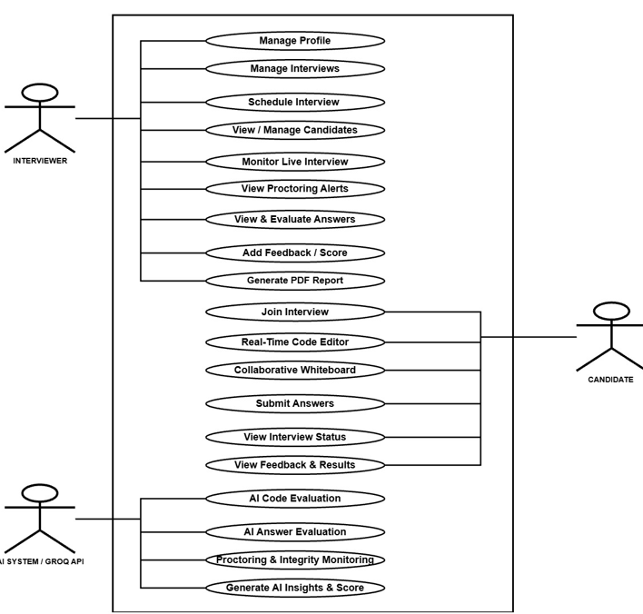
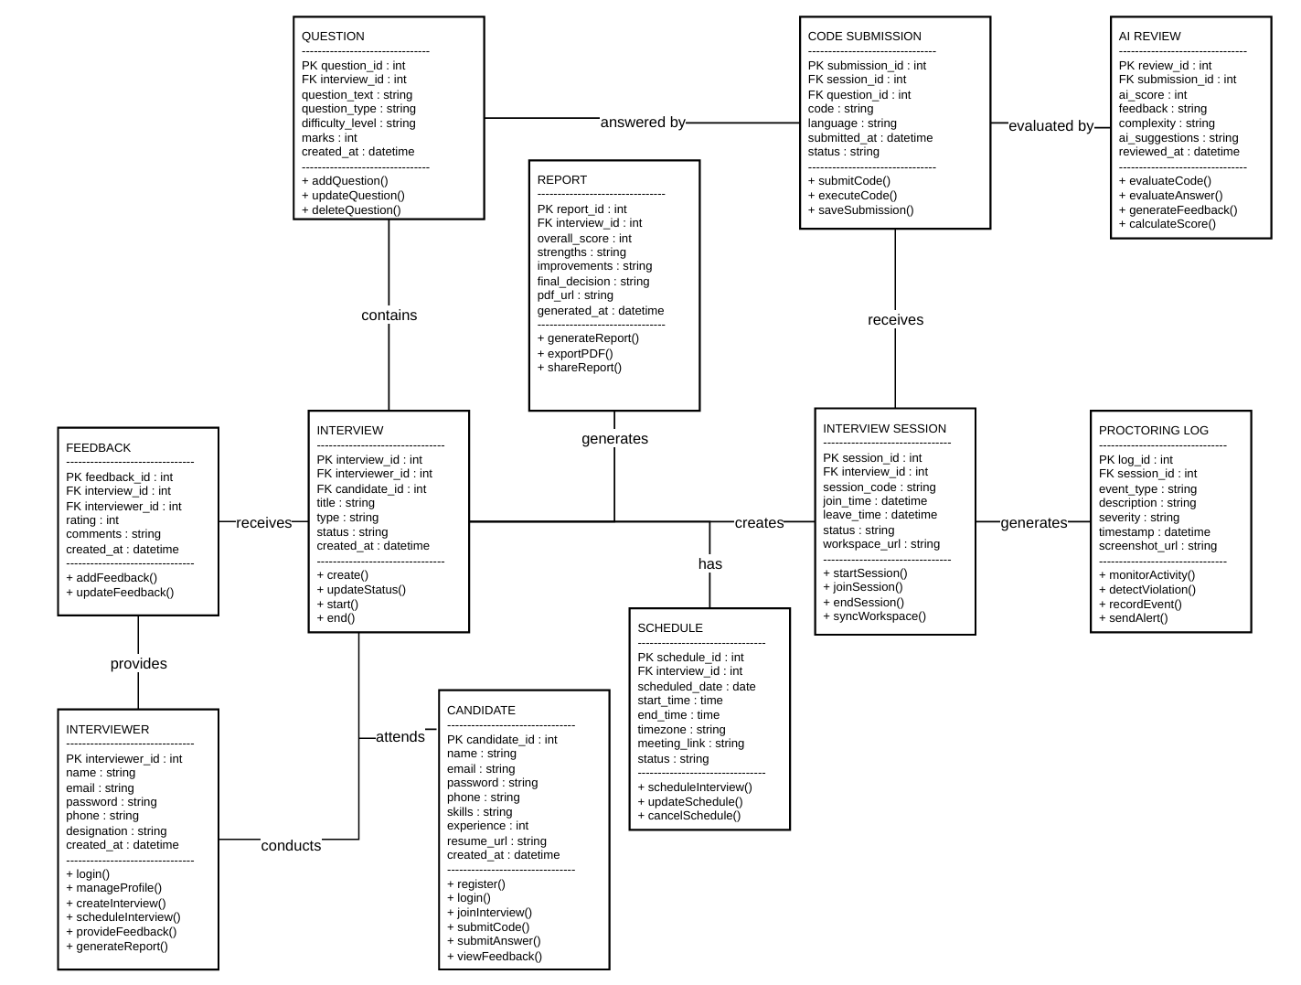
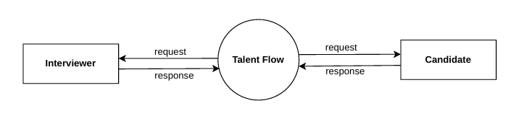
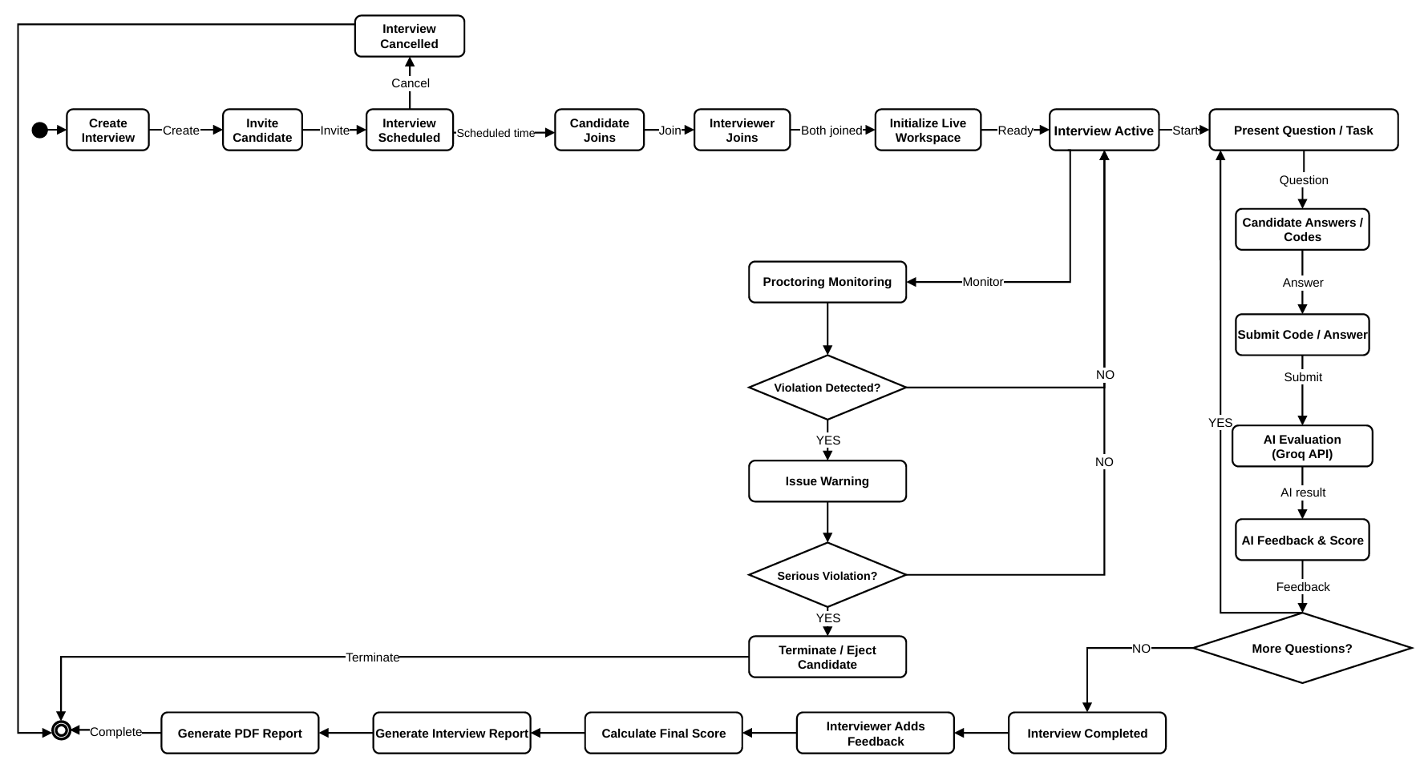
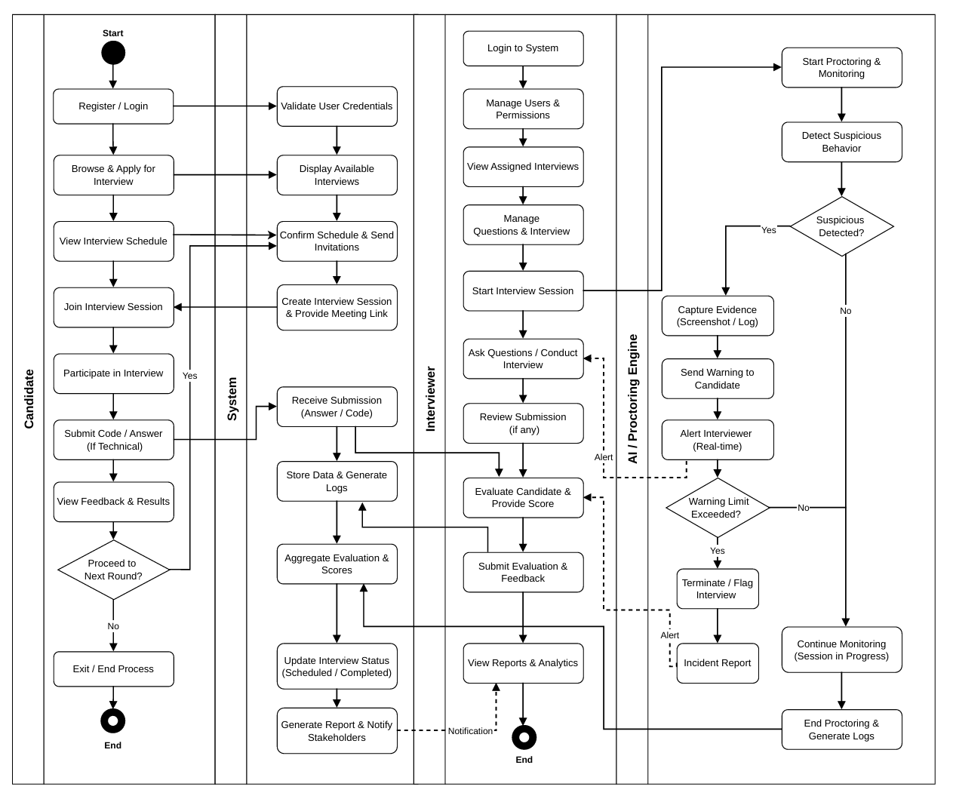
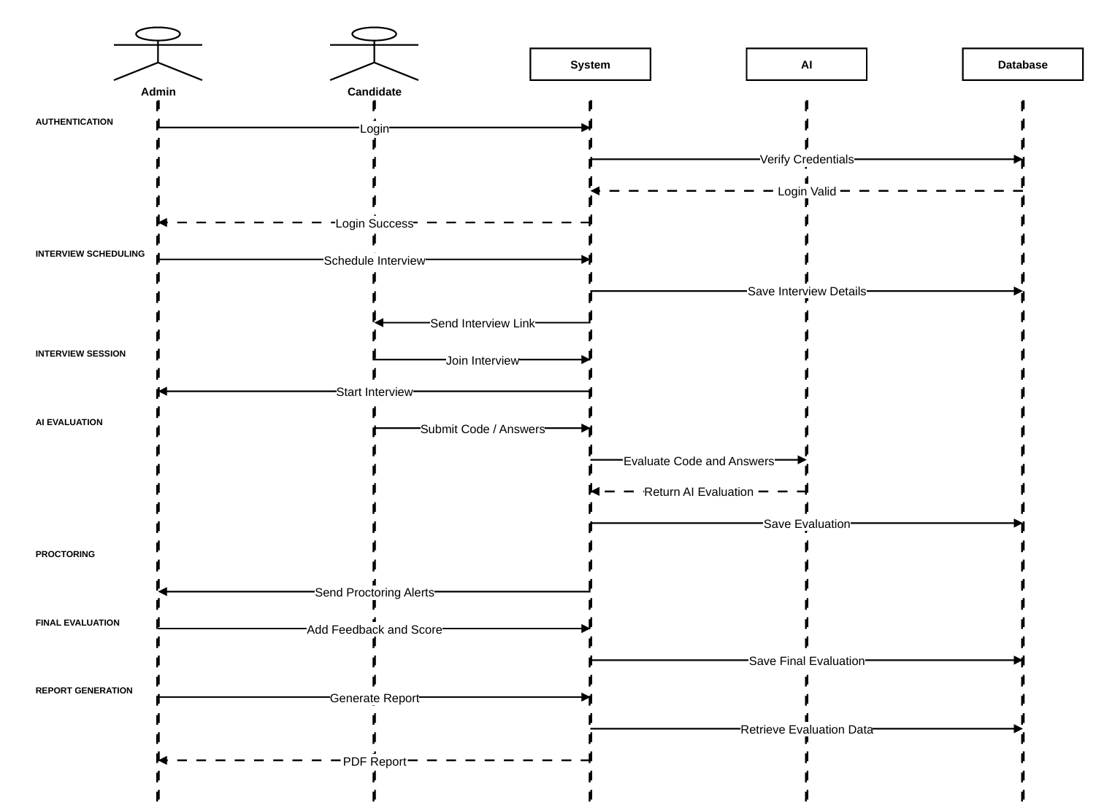
Design Diagrams
DFD (Level 0)
Use Case Diagram
Class Diagram
State Diagram
Activity Diagram
Sequence Diagram
Notes:
Overview of the design diagrams. Level 1 DFDs cover Interviewer, Interviewer Evaluation, Candidate, AI Code Evaluation and Proctoring. Open the full diagrams from the project report if asked.

Slide 14


Module Description
1
2
3
User Module
Registration, login and secure access for Interviewer and Candidate.
Interviewer Module
Schedules interviews, manages questions, monitors and evaluates candidates.
Interview Module
Handles the end-to-end interview session from joining to completion.
4
5
6
Coding Assessment Module
Collaborative Monaco editor with multi-language code execution.
Communication & Proctoring Module
WebRTC video and audio with tab-switch monitoring and warnings.
AI Evaluation & Reporting Module
Groq-based code review, scoring and PDF scorecard generation.
Notes:
Six modules, one line each.

Slide 15

Algorithm / Methodology
1
2
3
4
5
Authentication
Secure login for both roles
Interview Scheduling
Interviewer creates a session
Interview Session
Participants join the room
Video / Audio
WebRTC peer connection
Collaborative Coding
Monaco editor via Socket.IO
6
7
8
9
10
Code Execution
Run code in chosen language
AI Code Evaluation
Groq API reviews the code
Proctoring
Tab-switch tracking and warnings
Feedback & Scoring
Interviewer records assessment
PDF Report
Downloadable scorecard
DEVELOPMENT APPROACH (FROM PROJECT PLAN)
Requirements Analysis
System Design
Frontend Development
Backend Development
Database Integration
AI Integration
Testing
Deployment
Notes:
The interview flow runs from authentication to PDF report. Proctoring monitors the session continuously while coding takes place. The strip below shows the development approach from the project plan.

Slide 16
Implementation
Frontend
Backend
Database (MongoDB)
React.js with Vite and Tailwind CSS
Dashboard, login and interview-room screens
Monaco Editor for in-browser coding
Node.js and Express.js REST APIs
JWT authentication with role-based access
Interview and session management
Persistent storage and retrieval of data
Users, interviews and questions
AI evaluations and proctoring logs
Real-Time
AI Integration
Reporting
Socket.IO keeps the shared editor in sync
WebRTC / SimplePeer for video and audio
Live chat and session events
Groq API reviews submitted code
Feedback returned to the Interviewer
Final judgement stays with the Interviewer
jsPDF and html2canvas
Interview scorecard exported as PDF
Downloadable from the dashboard
Notes:
Keep it technical but simple. Mention MongoDB as the database and Socket.IO plus WebRTC for real-time features.

Slide 17
Results / Analysis
Functional results (qualitative observations). No quantitative benchmarks recorded.
Authentication
Registration and login for Interviewer and Candidate.
Interview workflow
Interviews scheduled, joined and completed from the dashboard.
Real-time communication
Video and audio between participants using WebRTC.
Collaborative coding
Shared Monaco editor kept in sync through Socket.IO.
Code execution
Submitted code run directly from the editor.
AI evaluation
Groq-based review returned for submitted code.
Proctoring
Tab-switch activity tracked with warnings and records.
Report generation
Interview scorecard exported as a PDF.
Accuracy, precision, recall, F1-score and response time: Not Available.
Notes:
Be clear these are qualitative observations. No accuracy or response-time figures were measured.

Slide 18
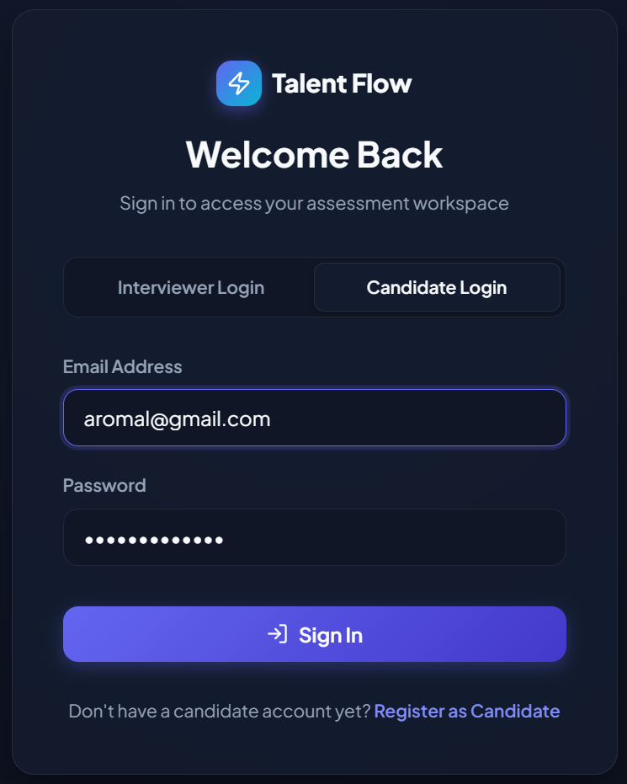
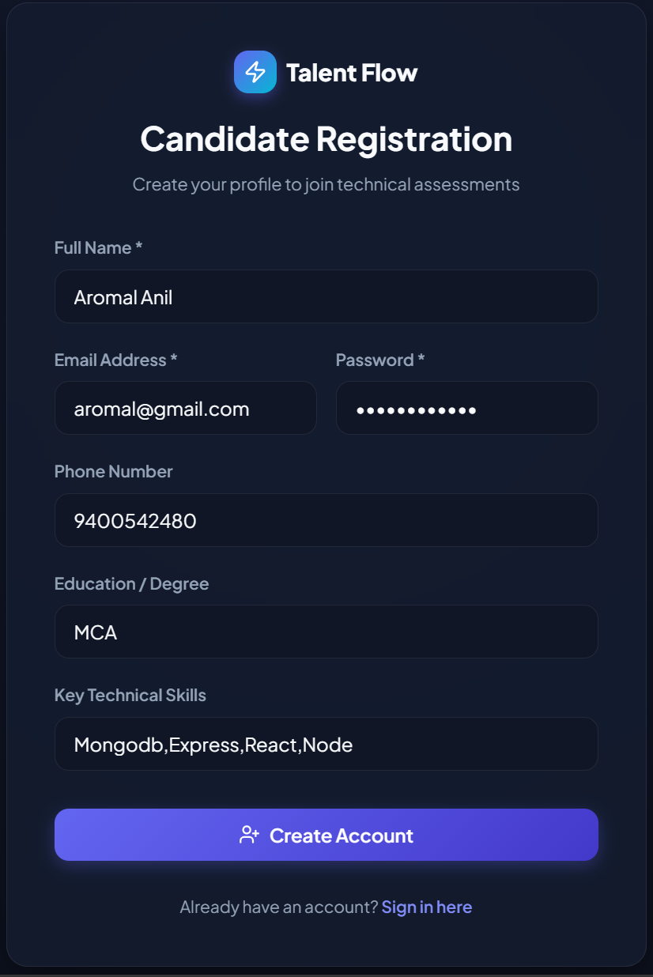
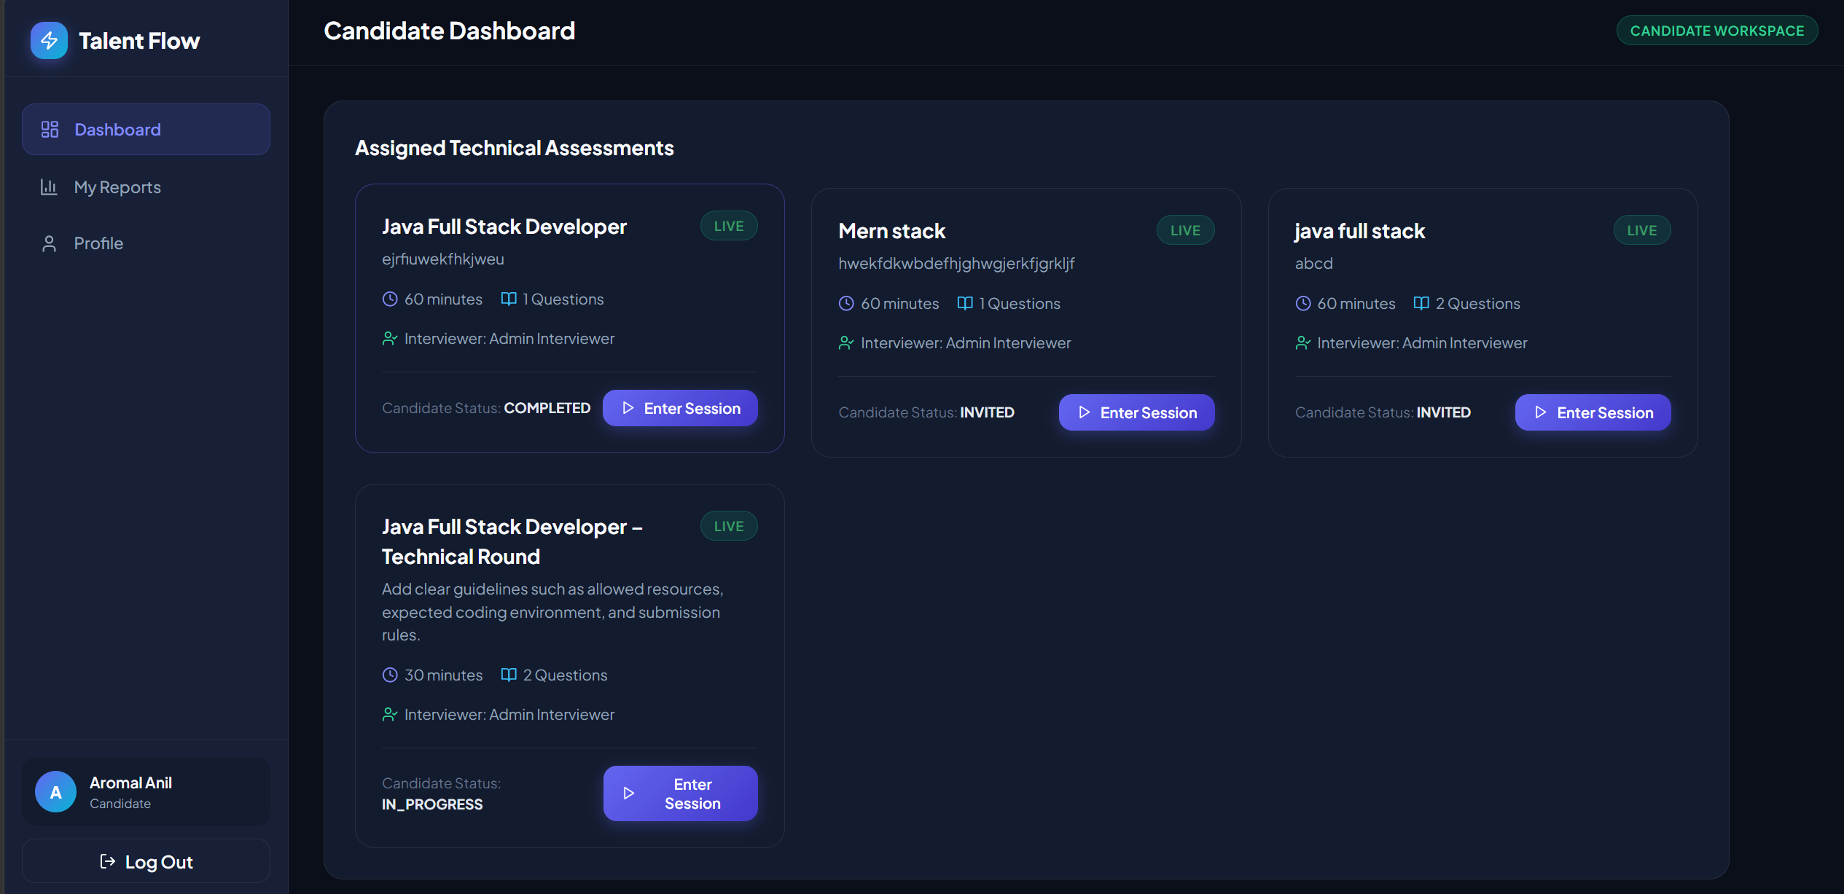
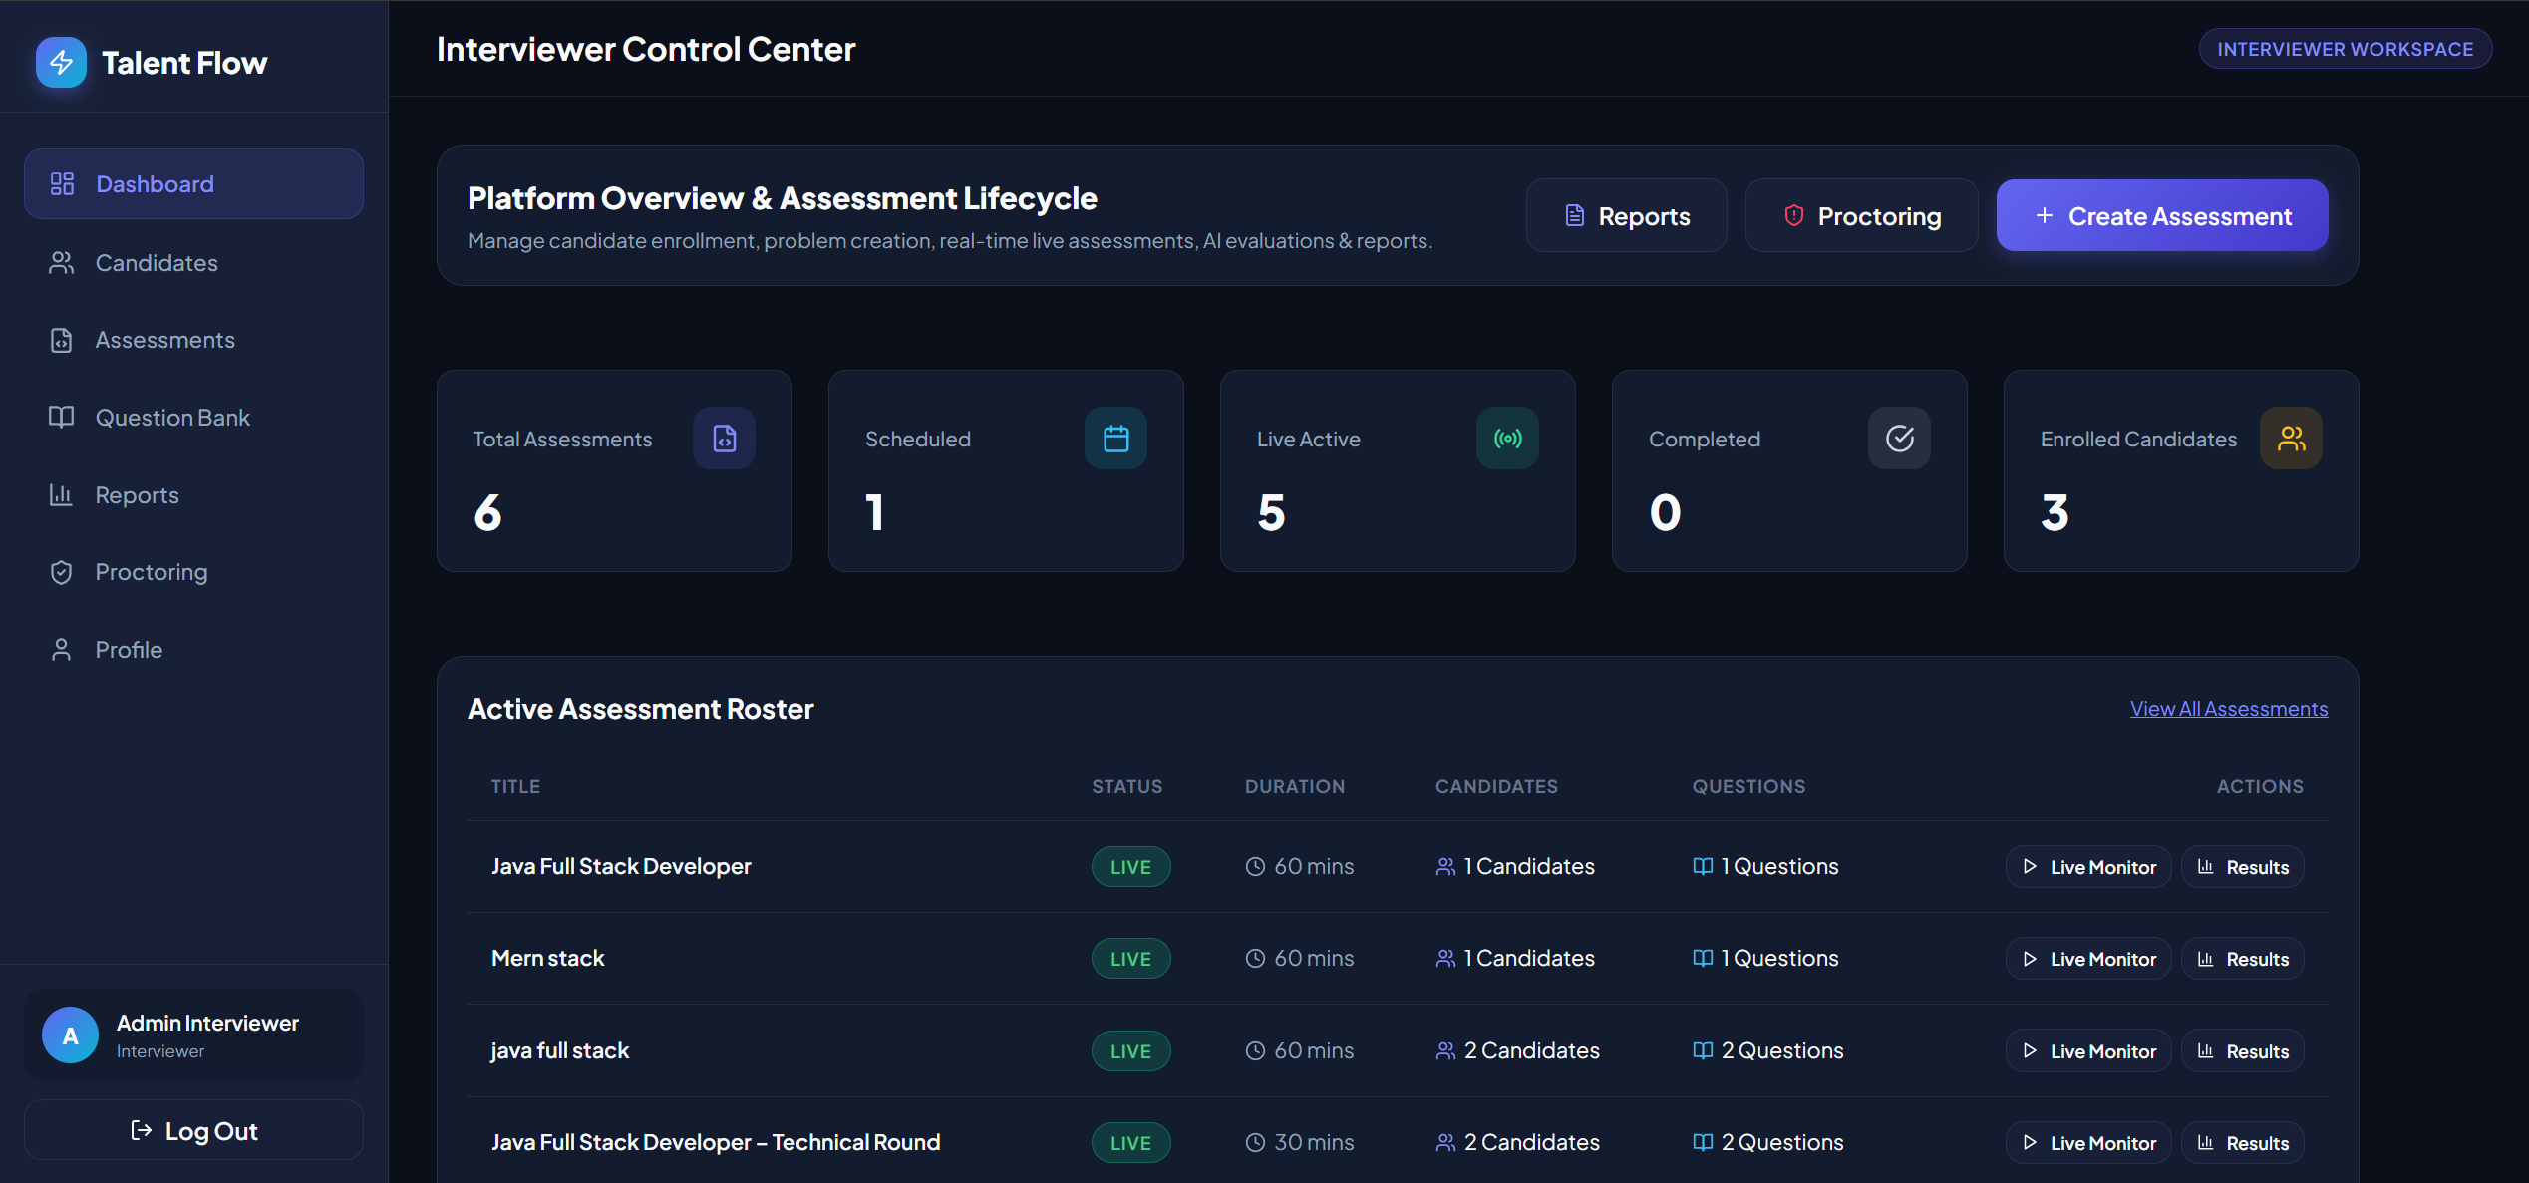
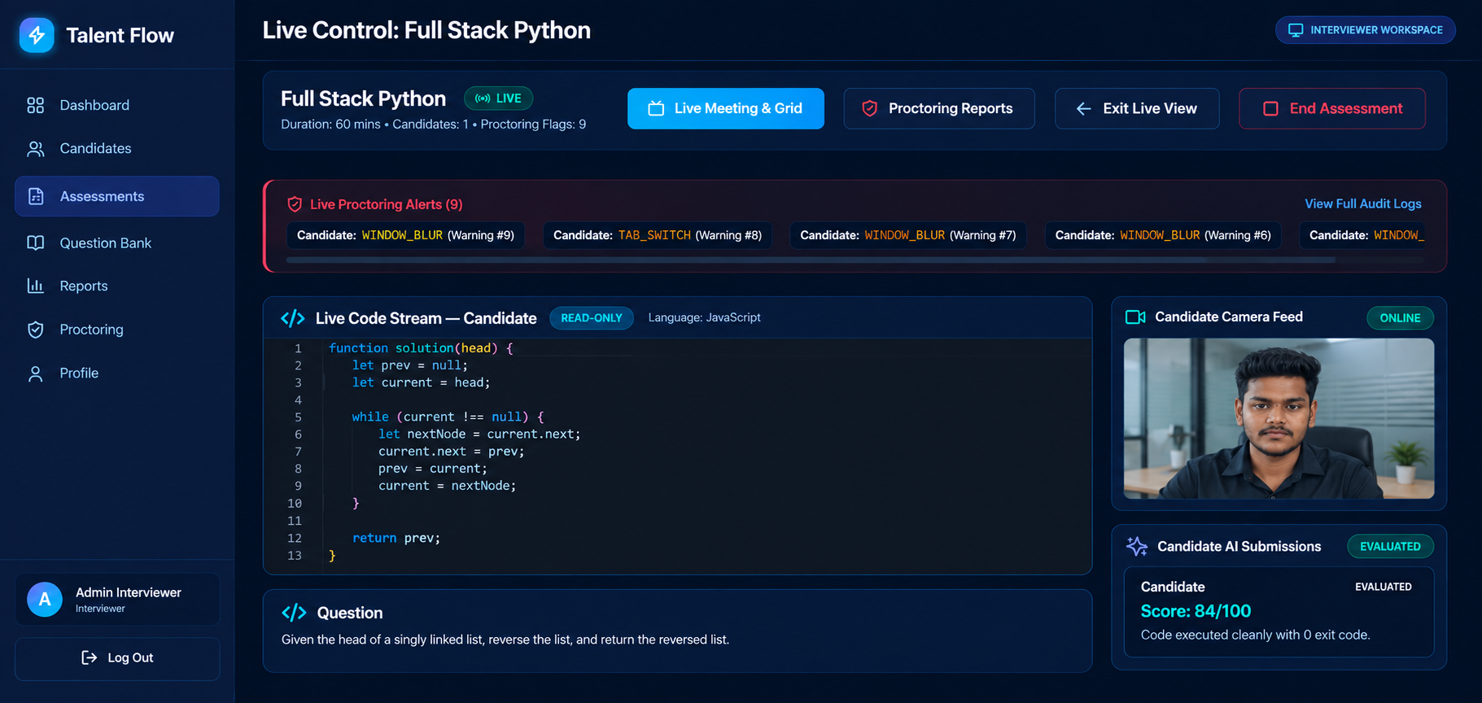
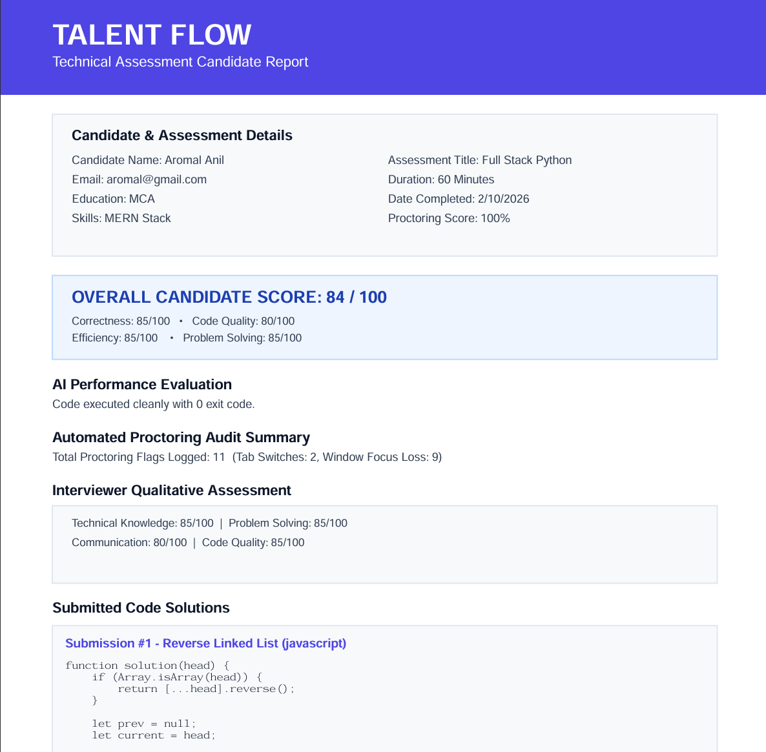
Screenshots / Output
Login page
Registration page
Candidate dashboard
Interviewer dashboard
Live interview room with code editor
PDF Scorecard
Notes:
Screenshots are taken from the earlier presentation. The last tile is reserved for the PDF report or proctoring screenshot.

Slide 19
Comparison with Existing System
Feature | Existing System | Talent Flow
Video Communication | Separate meeting tool (e.g., Zoom, Google Meet) | Built-in WebRTC video and audio in the interview room
Coding Environment | Separate coding platform or screen sharing | Integrated Monaco editor with multi-language execution
Real-Time Collaboration | Limited; depends on screen sharing | Shared editor synchronized through Socket.IO
AI Evaluation | Manual review by the interviewer | AI-based code review using Groq API
Proctoring | Manual observation or a separate tool | Built-in tab-switch tracking with warnings
Interview Management | Spread across several tools | Dashboard for sessions and interview history
Reporting | Manual notes and records | Automated PDF scorecard
Accessibility | Multiple tools and accounts | Browser-based single platform
Security | Varies by tool | Secure authentication and role-based access
Notes:
Keep the comparison factual. Existing tools are strong at their own job; Talent Flow combines the jobs.

Slide 20
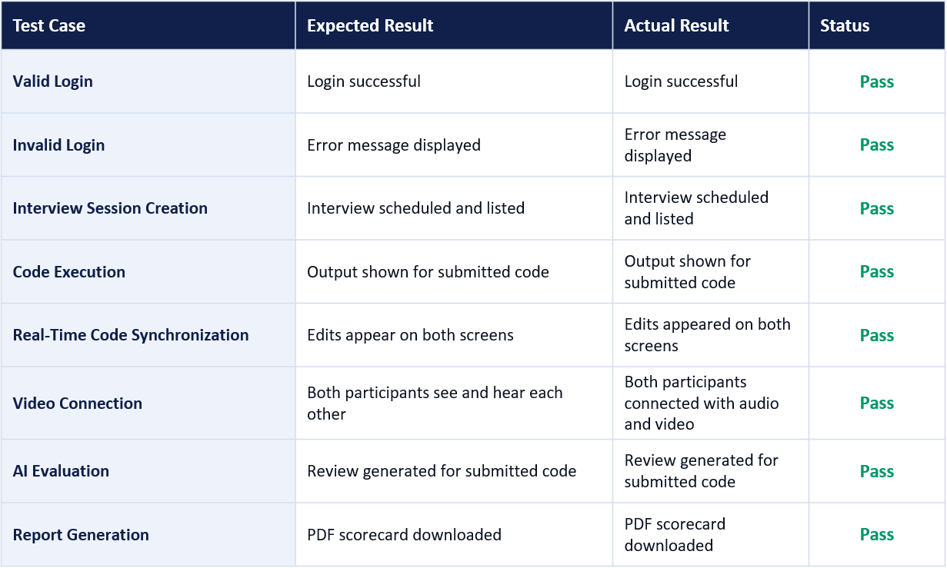




Testing
Unit Testing
Individual functions and components
Integration Testing
Frontend, backend and MongoDB together
System Testing
Complete interview workflow end to end
User Acceptance
Feedback from users, if applicable
Results recorded from manual functional testing of the project; no test statistics are claimed.
.
Notes:
Fill in Actual Result and Status after running each test case before the viva.

Slide 21


Demo Video
Suggested demo flow
1
Register and log in
2
Schedule an interview
3
Live room: video + code
4
AI evaluation and proctoring
5
PDF scorecard
Talent Flow – Project Demonstration
QR code / link
Add before presenting
Notes:
Insert the demo video here, or add the link or QR code in the placeholder.

Slide 22








Advantages
Unified interview environment
Video, code and assessment together.
Fewer tools needed
Reduced dependency on separate platforms.
Real-time collaboration
Interviewer and Candidate share one live editor.
AI-assisted evaluation
Groq API supports faster code review.
Integrated proctoring
Tab-switch tracking with warnings.
Automated reporting
PDF scorecards generated after the interview.
Centralized management
Sessions and history in one dashboard.
Improved workflow
Smoother process for both roles.
Notes:
Eight advantages of an integrated platform.

Slide 23






Limitations
Internet dependency
Video and live sync need a stable connection.
Browser compatibility
WebRTC behaviour can vary across browsers.
AI needs verification
AI evaluation should be confirmed by the Interviewer.
Supported languages
Code execution depends on the supported languages and environment.
Proctoring review
Proctoring indicators need Interviewer review.
External API dependency
AI features depend on the availability of the Groq API.
These are design boundaries of the current version; several are addressed in Future Scope.
Notes:
Present these honestly as boundaries of the current version, not failures.

Slide 24

Conclusion
Talent Flow brings the whole technical interview into one platform.
What it provides
Live video, shared coding, AI review, proctoring and PDF reporting in one place.
Problem addressed
Replaces scattered tools and manual scoring with a centralized workflow.
Unified activities
Scheduling, interview, evaluation and reporting follow one connected flow.
Technology contribution
Groq-based code review plus WebRTC and Socket.IO real-time collaboration.
Notes:
Summarize in a few sentences: what Talent Flow provides, how it addresses the problem, how activities are unified, and the contribution of AI and real-time technologies.

Slide 25




Future Scope
Future possibilities, not current features
Advanced AI assistance
Smarter AI support during interviews.
More languages
Wider programming language support.
Behavioral analysis
Enhanced candidate behavior insights.
Advanced analytics
Richer reports and trends.
Cloud deployment
Scalable hosting for more sessions.
Improved proctoring
More robust integrity monitoring.
Mobile support
Better experience on mobile devices.
Enterprise integrations
Connect with hiring and HR systems.
Notes:
Stress that these are possible future improvements and are not part of the present implementation.

Slide 26
References
[1] T. Manoj Prasath et al., “Intelligent candidate monitoring and interview surveillance system,” Int. J. Res. Appl. Sci. Eng. Technol. (IJRASET), 2026.
[2] Harshavardhan et al., “Secure real-time coding interview system with AI-based evaluation and monitoring,” Int. J. Adv. Res. Comput. Commun. Eng. (IJARCCE), 2026.
[3] “An intelligent online interview system based on AI,” IEEE.
[4] “AI-based automatic interview assessment,” IEEE.
[5] “Online remote proctoring system using AI,” IEEE.
[6] “Collaborative online code editor using WebRTC and Socket.IO,” IEEE.
[7] “Remote technical interview platform with real-time collaboration,” IEEE.
[8] “CodeSync: Real-time collaborative code editor,” Int. J. Creative Res. Thoughts (IJCRT), 2026.
[9] “REALCODEAI: Real-time code collaboration and interview platform,” Int. J. Sci. Res. Sci. Eng. Technol. (IJSRSET), 2025.
[10] “Code Together: Collaborative code editing using CRDT,” 2024.
[11] “Smart AI-based online proctoring system,” IEEE, 2022.
[12] “AI-based fully automated online proctoring systems survey,” IEEE, 2022.
[13] “Deep learning based online exam proctoring systems review,” Int. J. Sci. Res. Sci. Eng. Technol. (IJSRSET), 2022.
Author names, volume, pages and DOI were not available in the project material and should be completed before submission.
Notes:
References follow IEEE style as far as the available source details allow.

Slide 27
THANK YOU
Talent Flow
Real-Time Remote Technical Interview & Assessment Platform
Questions & Discussion
Aromal Anil · MCA (S3) · 2025–27 · Guide: Ms. Anjaly Sajeev
Notes:
Thank the panel and invite questions.

