Slide 1
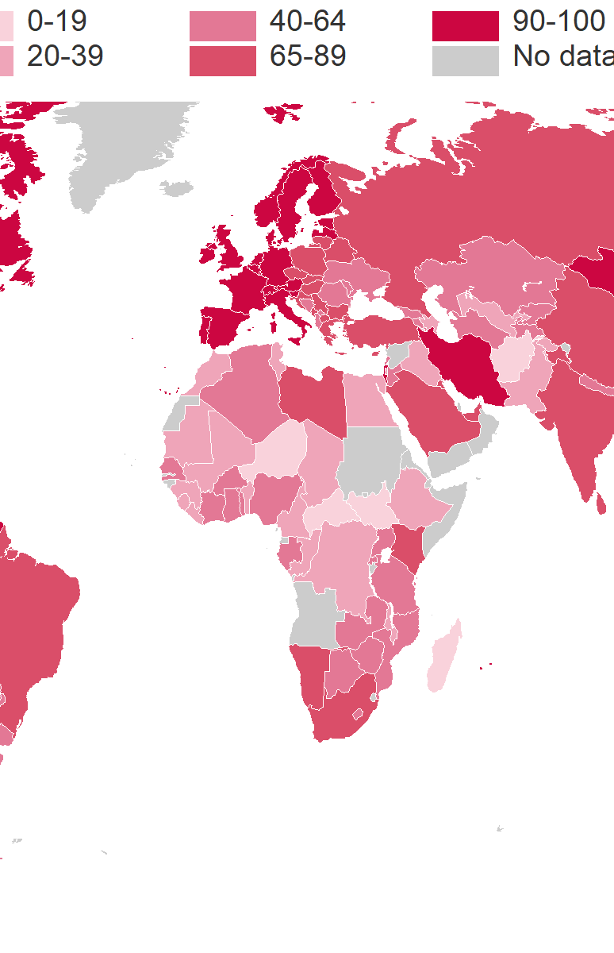
PROJECT ON ISPFL7
SUSTAINABLE DEVELOPMENT GOAL BASED SYSTEM

Slide 2

WHAT IS SUSTAINABLE DEVELOPMENT GOALS?
The Sustainable Development Goals (SDGs), also known as the Global Goals, were adopted by the United Nations in 2015 as a universal call to action to end poverty, protect the planet, and ensure that by 2030 all people enjoy peace and prosperity.
ispfl1

Slide 3
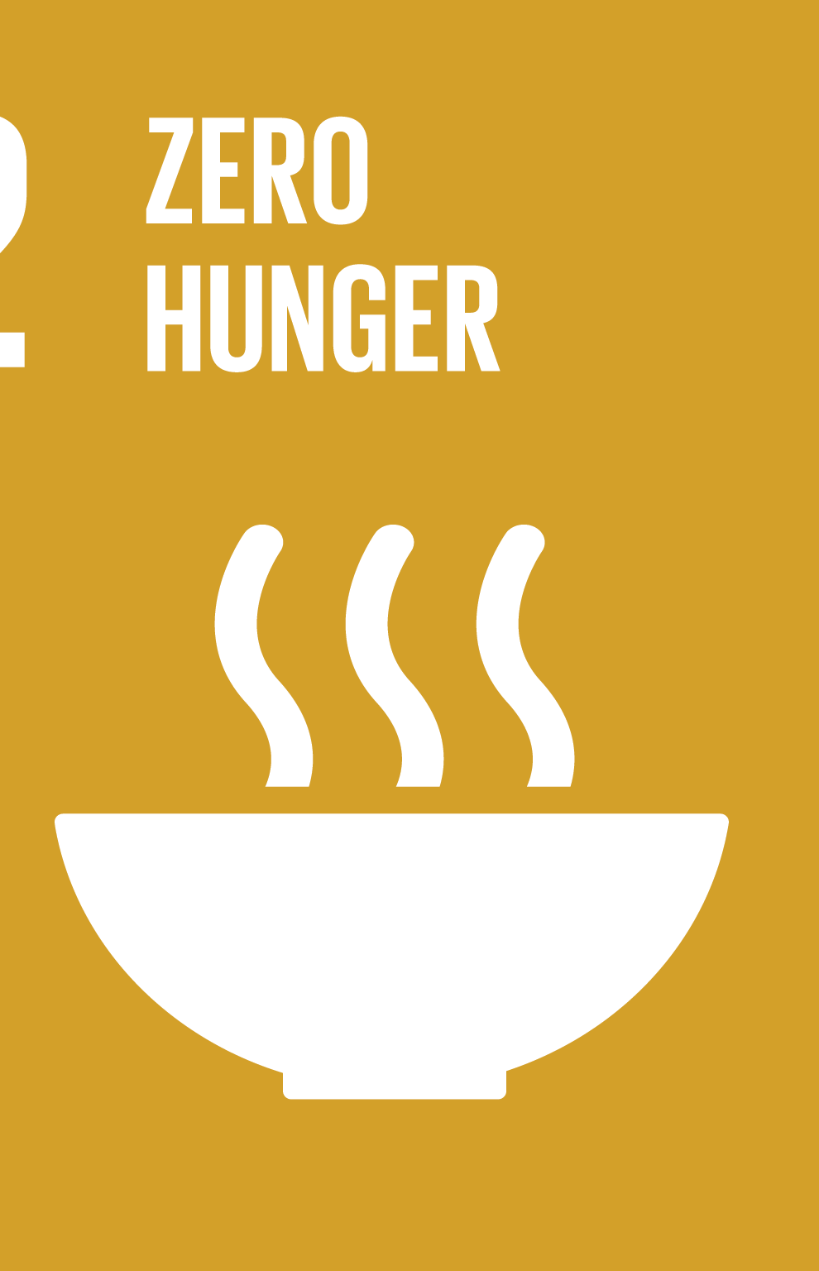
Zero hunger
Helping paws ( ft. stray animals )

Slide 4
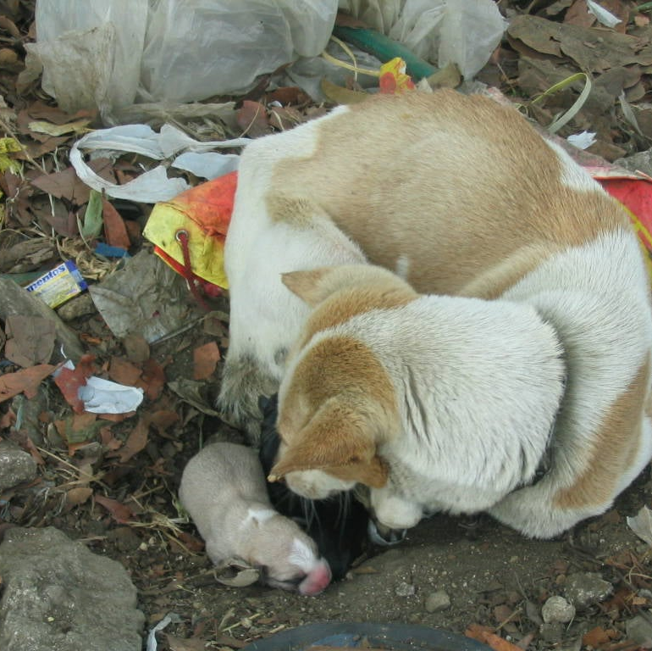
HELPING PAWS ( FT. STRAY ANIMALS )
THIS PROJECT IS A LITTLE GIFT TO ANIMALS THAT DONT HAVE AN OWNER. A SMALL AMOUNT OF YOUR HELP AND A DROP OF YOUR SYMPATHY IS A WHOLE LOT OF HAPPINESS TO THIS LITTLE ONCE.
Zero hunger

Slide 5
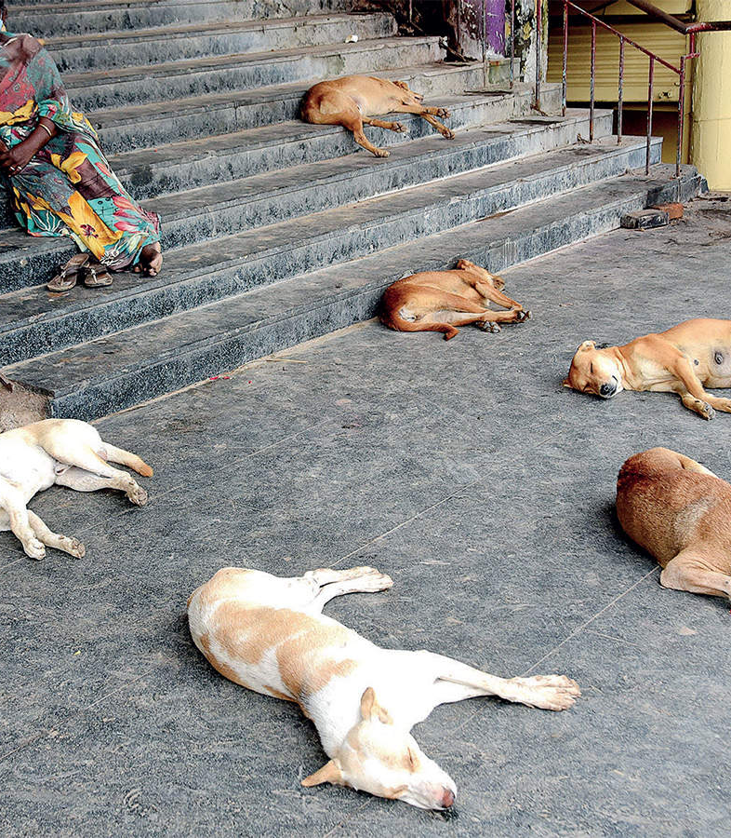
We need help!
Starvation is a common cause of death for animals who survive to old age. At some point, animals' bodies simply wear out and they are no longer able to forage.
As we know animals like cats and dogs are not the type animals that haunt for their foods and for that reason they are dependent to us humans.
Due to hunger some of the stray animals learn to steal foods but most of the time that they're being caught stealing foods they get punished or worst they could get killed.
Zero hunger

Slide 6
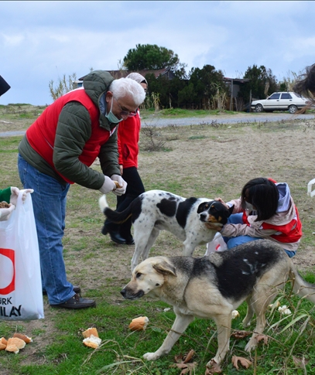
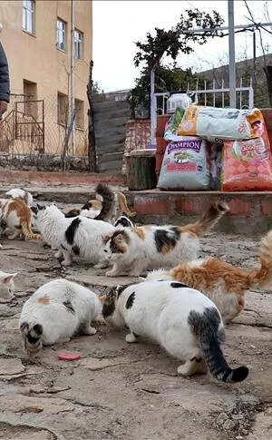
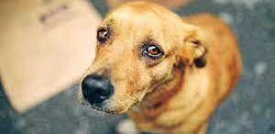
You are welcome!
The target customers for this project would be pet lovers or those persons that have sympathy for animals. Young, Old , Men, Women or Anyone that have the heart to help this little once, this is for you.
Zero hunger

Slide 7

LETS TAKE ACTION!
TOGETHER WITH MY GROUP WE CAME UP WITH THIS IDEA.
SOLUTION
Making an application that connects the customer to an organization that helps stray animals. This application accepts donations that can help the organization to feed more stray animals.
This application also lets the organization upload a picture of different stray animals and the story of how they found it or any description about this animal and if anyone is interested to it can adopt it.
We may not be able to help every animal in this planet but with the help of this application we can help a thousand of paws.
Zero hunger

