Slide 1
TestGenius: Your Test Simulator
Intro
Start
Drop
Bank
Questions
Loop
Shown
Answers
FLOWCHART SCHEMA
PSEUDO CODE
Aron Limos (000371798) Joash Daligcon (000358654)
Lance Mirano (000368826)
Notes:
By Aron, Joash, Lance

Slide 2
What is TestGenius
Intro
Start
Drop
Bank
Questions
Loop
Shown
Answers
TestGenius is a platform for educational and training purposes, offering realistic simulated testing environment. Users can choose a category and a difficulty to their choice of liking. Our purpose is for users to match their learning objectives and receive interactive feedback to improve their skills effectively.
1

Slide 3
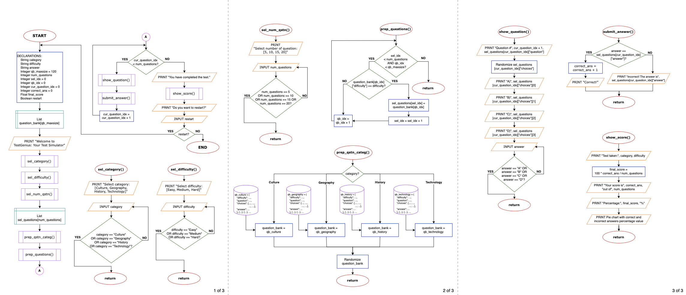
Intro
Start
Drop
Bank
Questions
Loop
Shown
Answers
FLOWCHART OVERVIEW
2

Slide 4
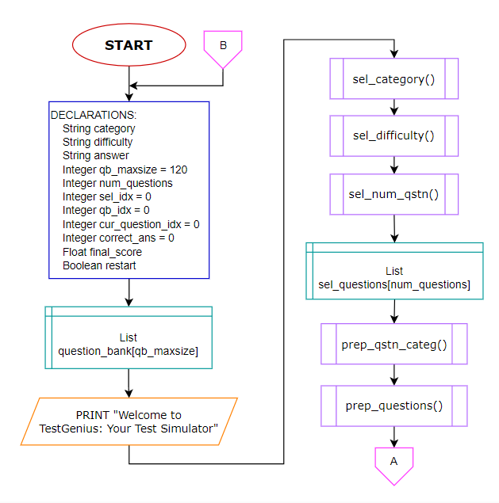
START
Intro
Start
Drop
Bank
Questions
Loop
Shown
Answers
In this flowchart we have our starting diagram, below consist of the following:
Declarations
Methods (Functions)
Internal Storage(List)
Objective: We declared values that are utilized throughout this chart, along with methods that will be used to call these functions during runtime. Additionally, we refer to the internal storage where it will be used to gather questions from the bank.
3

Slide 5
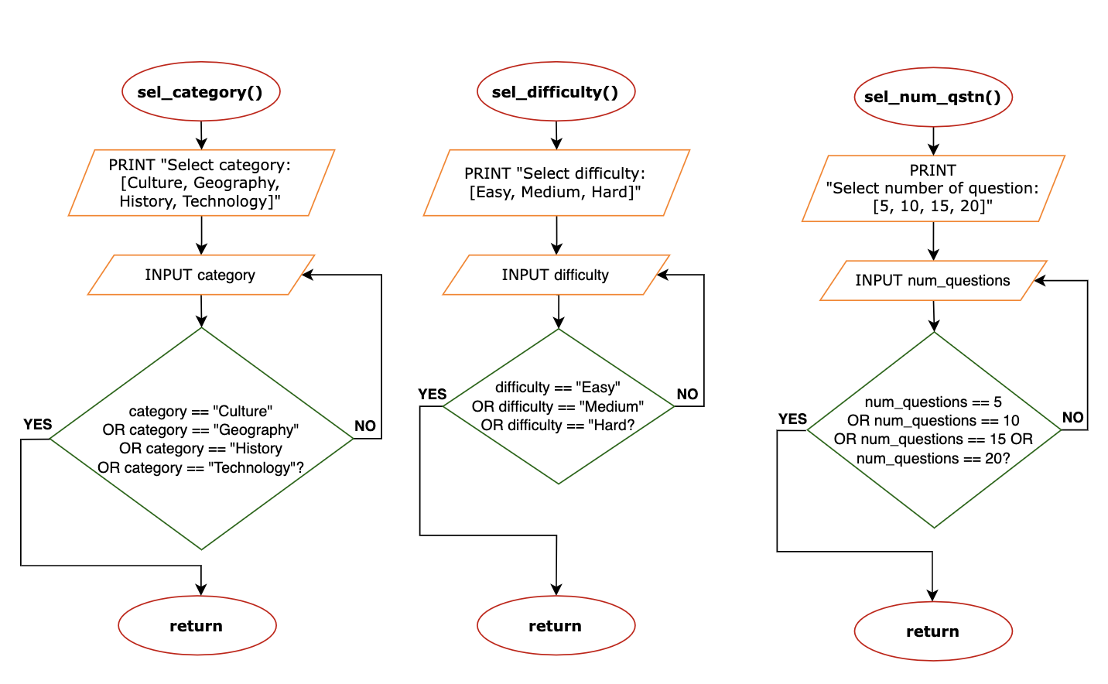
DROP DOWN
Intro
Start
Drop
Bank
Questions
Loop
Shown
Answers
This flowchart provides structed view of how the program navigates through different choices:
sel_category()
sel_difficulty()
sel_num_qtn()
Objective: Each drop down we are able to choose a category, difficulty and the amount of questions. According to which you choose this will be all accessed from the bank.
4

Slide 6
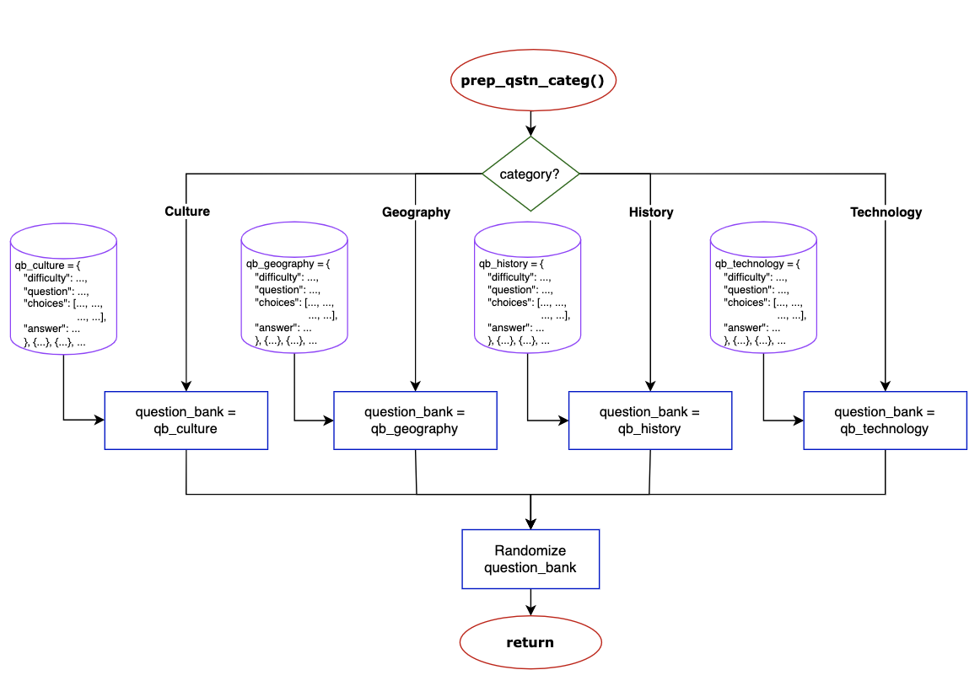
QUESTION BANK
Intro
Start
Drop
Bank
Questions
Loop
Shown
Answers
In this flowchart we outline the process of preparing questions through our bank:
Question Banks
Category, Difficulty, Number of Question
Randomizer
Objective: We used a key-value pair to match up question according to each corresponding topic. Through different choices and inputs we are able to set up parameters for the quiz. Once stored, questions are shuffled within each category and is returned.
5

Slide 7
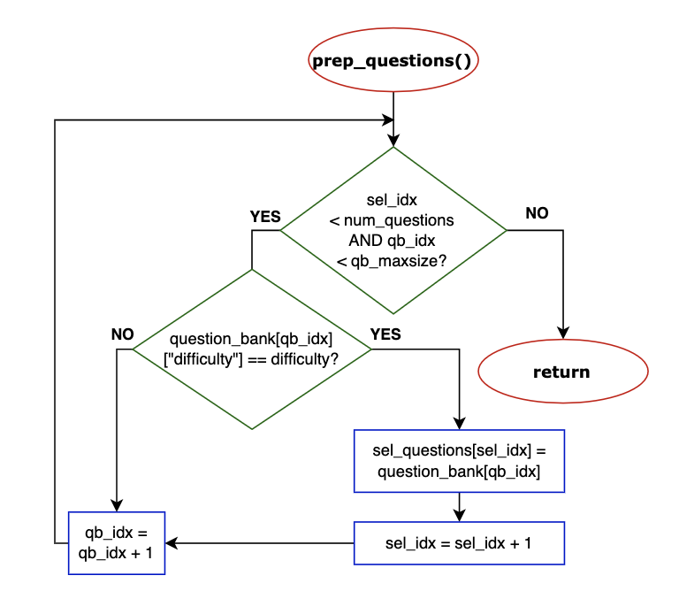
SELECTING QUESTIONS
Intro
Start
Drop
Bank
Questions
Loop
Shown
Answers
In this flowchart we are specified a difficulty and desired number of questions coming from that bank.
Selecting the number of questions
Questions from the bank
Objective: The first counter is executed if the questions chose matches user choice of difficulty, it will accumulate the total number of question chosen. The second is executed when the question does not match. Therefore it will continue to search the bank to match the category and difficulty.
6

Slide 8
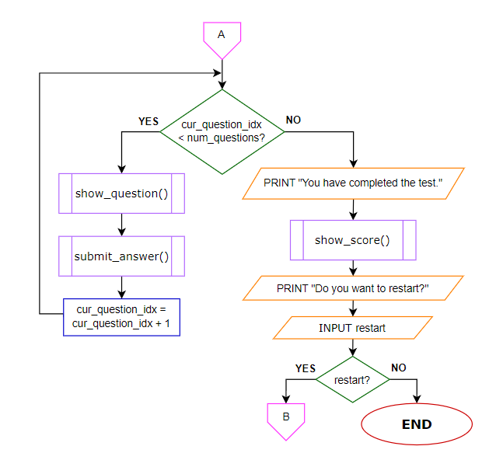
LOOP QUESTIONS
Intro
Start
Drop
Bank
Questions
Loop
Shown
Answers
In this section we display the overview of the show question loop. This loop is connected via the off-page connector "A" after calling the methods for preparing questions.
Objective: The show question loop continues to execute until the current question counter exceeds the number of questions.
7

Slide 9
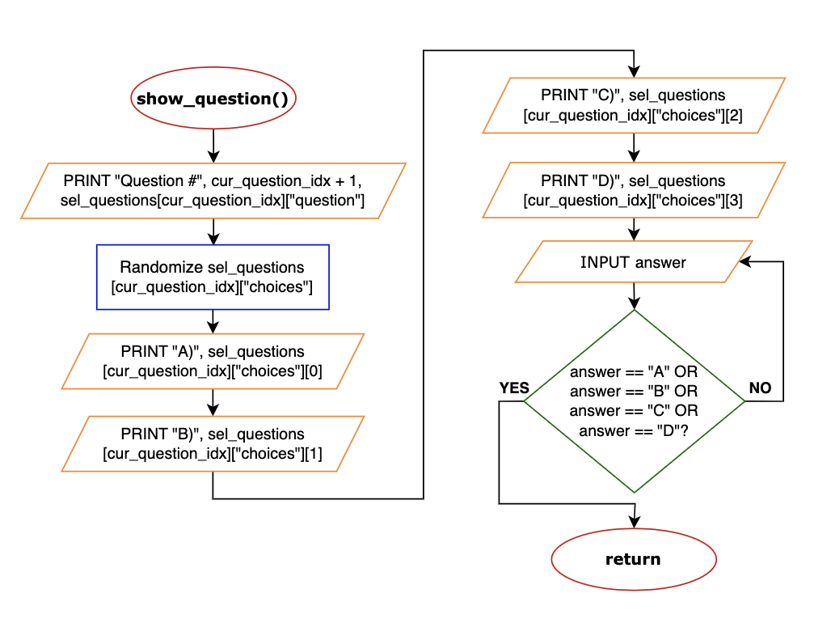
SHOW QUESTION
Intro
Start
Drop
Bank
Questions
Loop
Shown
Answers
In this flowchart we are in the process of showing the questions and collecting the answers:
Showing Question
Choices
Answer
Objective: The gathered questions will be printed on to the page alongside with the choice. Questions will be randomized so its not in order. Users will be able to choose a answer out of the four choices.
8

Slide 10
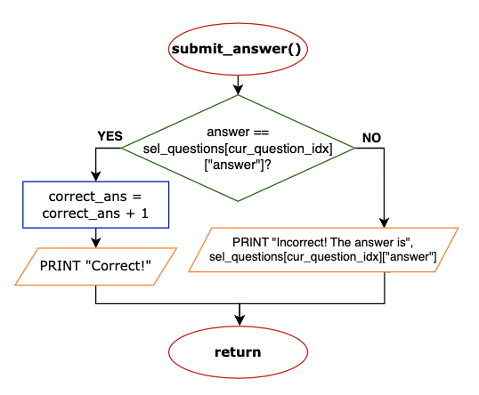
SUMBIT ANSWER
Intro
Start
Drop
Bank
Questions
Loop
Shown
Answers
This flowchart shows the submit answer method which does the following:
If the answer from user is correct, a message is printed. At the same time, a counter tracks the number of correct answers.
If the answer is incorrect, a message is also printed and displays the correct answer.
Objective: This method evaluates the user input and checks from the question bank if it is correct or incorrect.
9

Slide 11
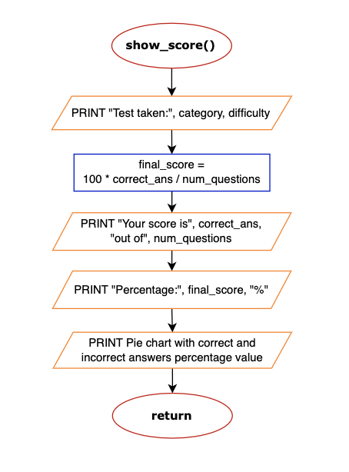
SCORE
Score
Restart
In this flowchart users will be able to see their score on their test.
The final score is dived by the total question and multiplied by 100 to get the percentage.
Objective: Once finished, the type of test and difficulty will be shown along with the amount of score, the percentage, and a pie chart. These statement will show the amount of questions users got correct along side different version of how they can view their scores.
10

Slide 12
RESTART
Score
Restart
In this section we display the overview of the show question loop. After all the questions are answered and the score has been shown, the user can decide if he wants to restart or end the program.
Objective: The off-page connector "B" connects back to the start of the flowchart and does the declaration and initialization of variables all over again if the user decided to restart the test. Otherwise, the flow ends and the program is terminated.
11

Slide 13
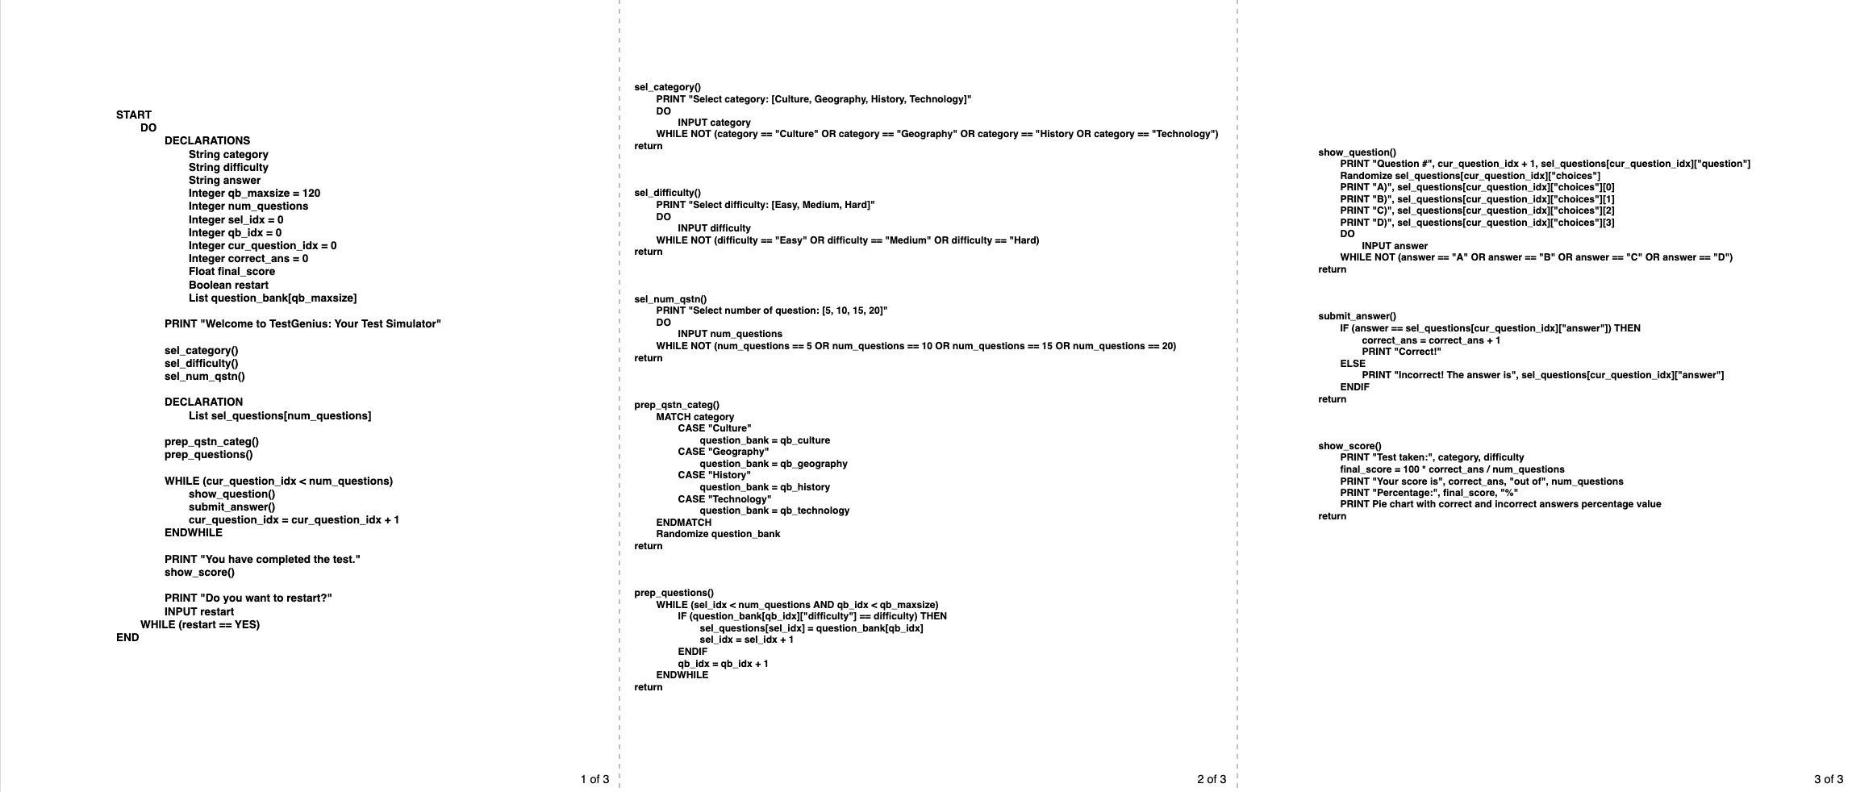
Pseudo
Main
Select
Prepare
Show
Submit
Score
PSEUDOCODE OVERVIEW
12

Slide 14
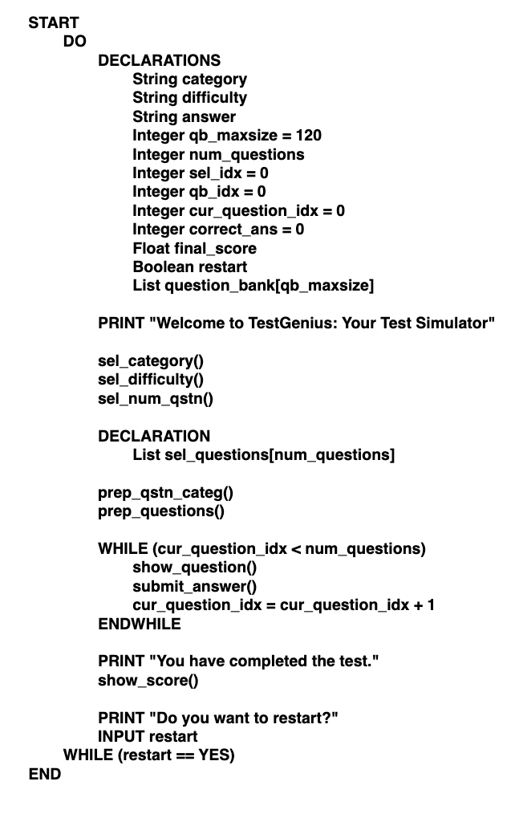
MAIN LOGIC
Pseudo
Main
Select
Prepare
Show
Submit
Score
In this section, we have our main pseudocode in which it contains the following:
Variable Declarations
Function Calls and Loops
Main Program Logic
Objective: The variables and values from the flowchart are used and initialized for the pseudocode, alongside the methods or functions to be used. In addition, the whole main program logic is enclosed in a do-while loop for the restart functionality.
13

Slide 15
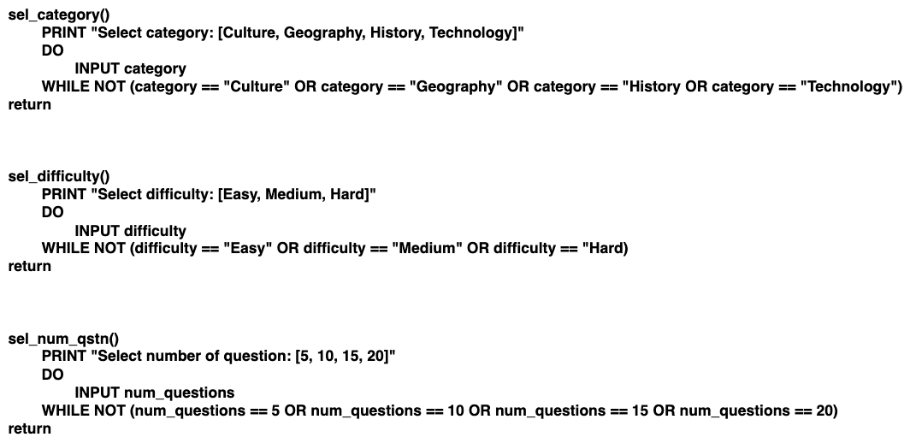
SELECT OPTIONS
Pseudo
Main
Select
Prepare
Show
Submit
Score
This section displays three (3) select options to the user:
Category
Difficulty
Number of question
Objective: Each select option displays the choices to the user. In addition, the user input is enclosed in a do-while loop that checks and ensures the validity of the input value.
14

Slide 16
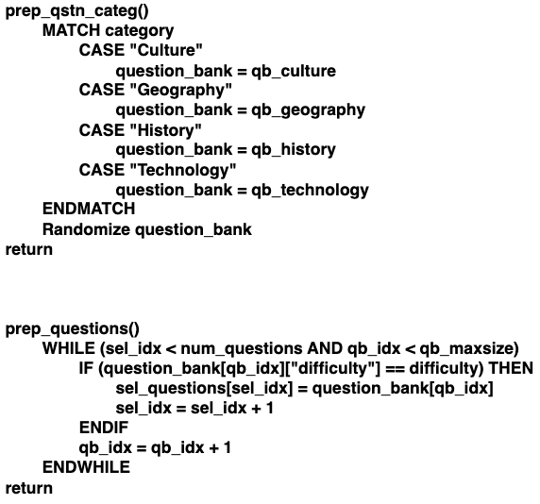
PREPARE QUESTIONS
Pseudo
Main
Select
Prepare
Show
Submit
Score
Two (2) prepare functions are defined as:
Function for preparing the question category
Function for preparing the questions based on the difficulty
Objective: From the question bank, we are getting the target questions from the selected category using match case. Furthermore, these are randomized and each question is being filtered by difficulty using a while loop.
15

Slide 17
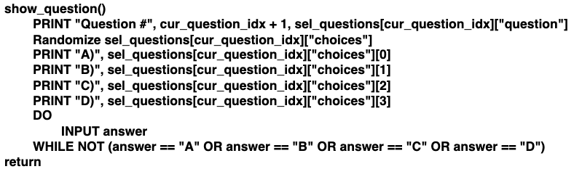
SHOW QUESTION
Pseudo
Main
Select
Prepare
Show
Submit
Score
This function shows the question from the previous prepare functions. It also shows the four (4) choices corresponding to that question in random order. Then it takes an input for the answer.
Objective: The function uses a variable to track the current shown question and choices. It checks the validity of the user input by using a do-while loop.
16

Slide 18
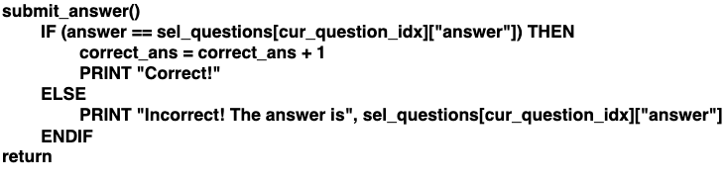
SUBMIT ANSWER
Pseudo
Start
Select
Prepare
Show
Submit
Score
This function checks if the answer from the user input is the same as the answer for the current question.
Objective: The function prints a message if correct, it will count the number of correct answer. If incorrect, it also shows a message and shows the correct answer.
17

Slide 19
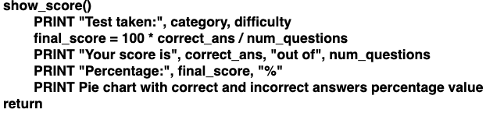
SHOW SCORE
Pseudo
Start
Select
Prepare
Show
Submit
Score
This function calculates the score in percentage and displays the following:
Category and difficulty of the test taken
Correct answers out of number of questions
The calculated final score
Objective: The function displays the summary of the test and a visualization of correct and incorrect answers using a pie chart.
18

Slide 20
#Thanks!
Check the website hiperdocumentos in Spanish
Do you have any questions?
Please keep this slide for attribution

