Slide 1
TestGenius: Your Test Simulator
Intro
Home
Overview
Test
Result(1)
Result(2)
Complete
Pie(1)
GUI & PYTHON CODE
Aron Limos Joash Daligcon
Lance Mirano
Notes:
By Aron, Joash, Lance

Slide 2
What is TestGenius
Intro
Home
Overview
Test
Result(1)
Result(2)
Complete
Pie(1)
TestGenius is a platform for educational and training purposes, offering realistic simulated testing environment. Users can choose a category and a difficulty to their choice of liking. Our purpose is for users to match their learning objectives and receive interactive feedback to improve their skills effectively.

Slide 3
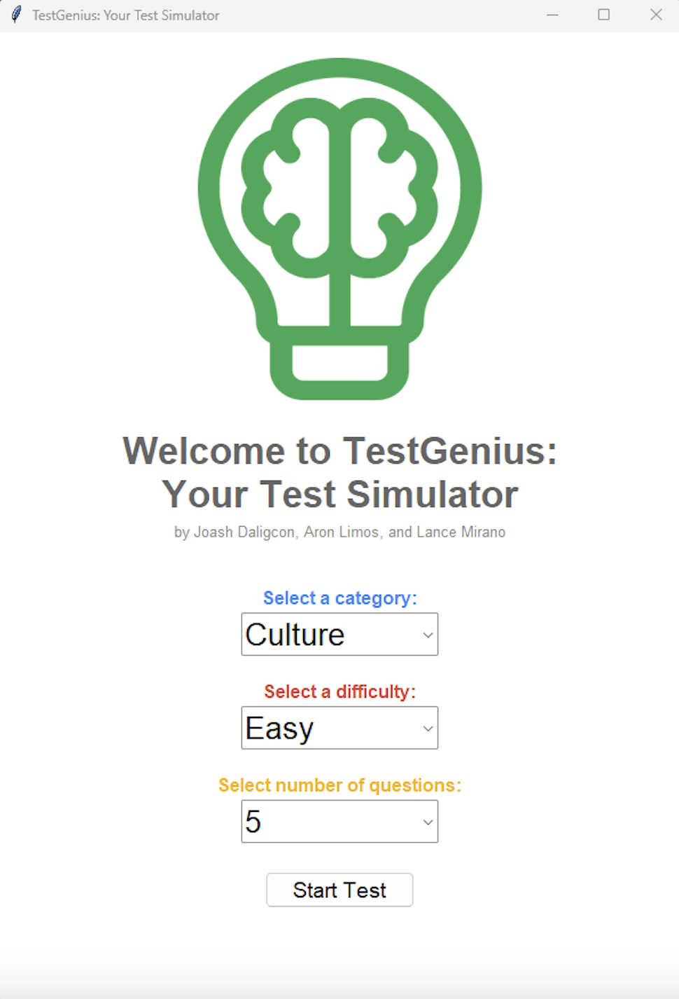
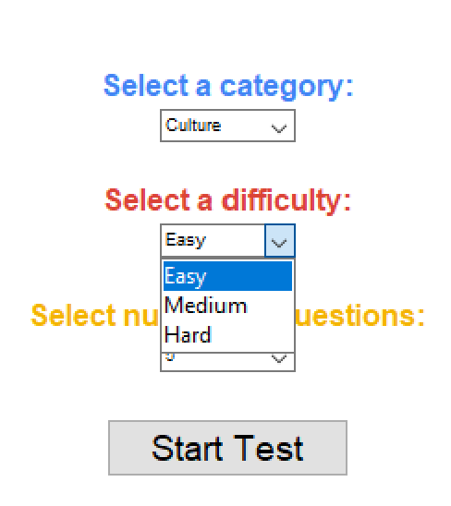
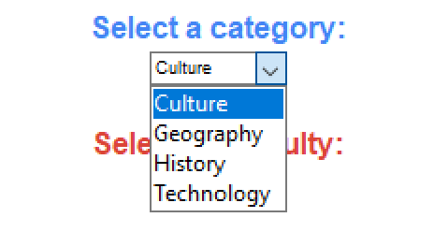
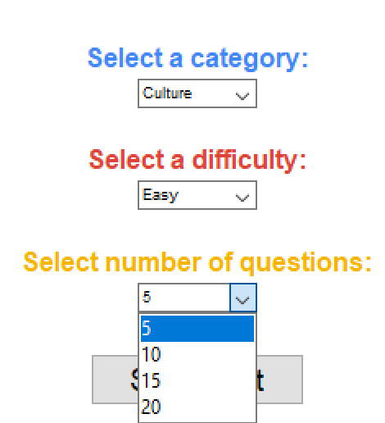
HOME PAGE
Intro
Home
Overview
Test
Result(1)
Result(2)
Complete
Pie(1)
In this section we have our homepage demonstrating our GUI. Below are the following interactive choices:
Category
Difficulty
Number of Questions
Start Test
OBJECTIVE: Users will have a choice to choose a category with a difficulty based on their knowledge. It comes with a quantity of questions to choose from depending on the users. Once everything is settled, click the start button to proceed.

Slide 4
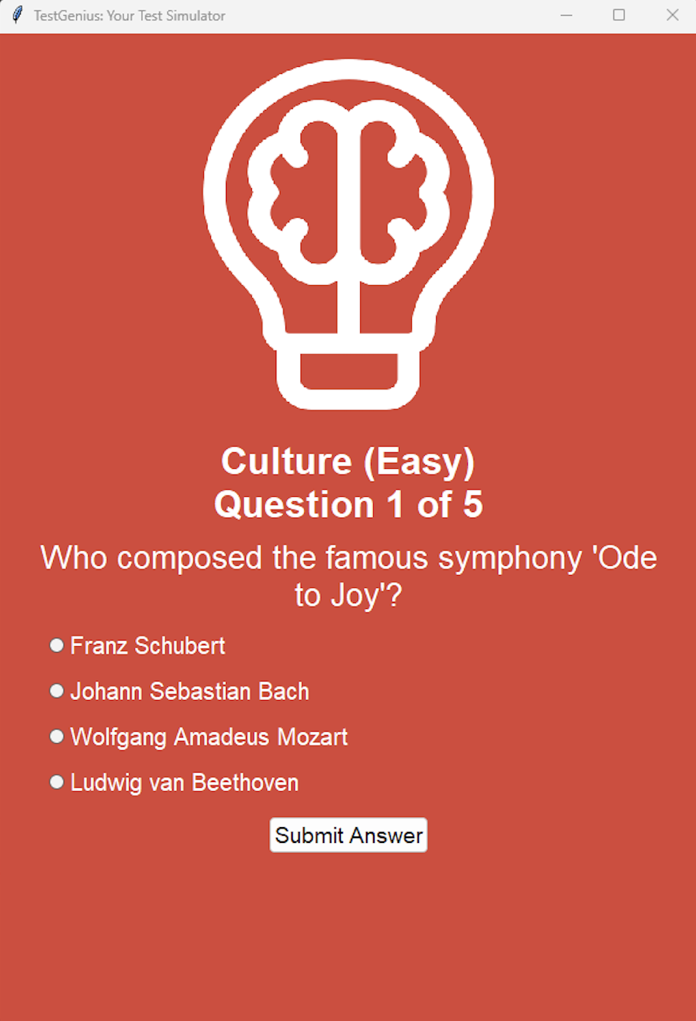
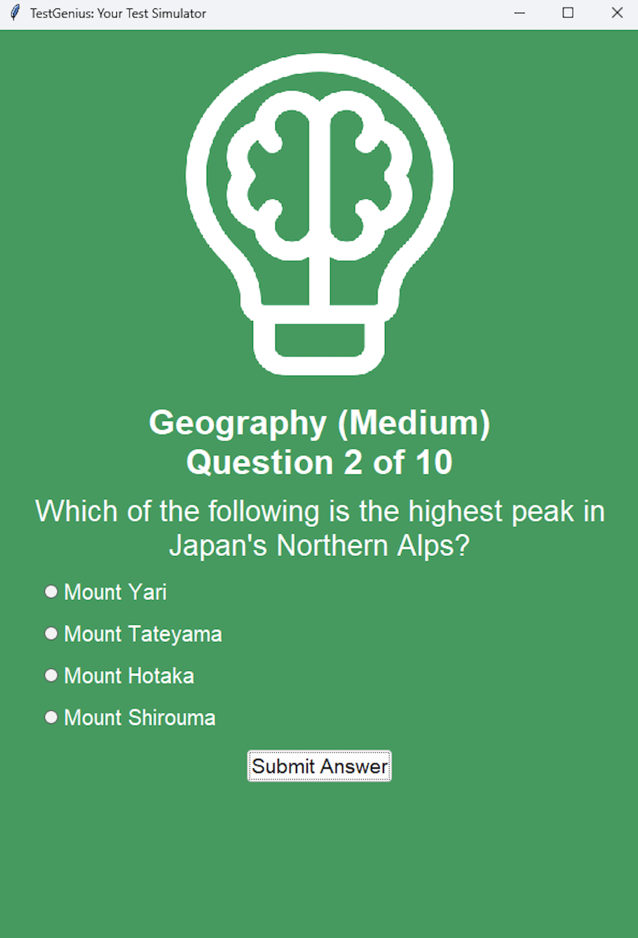
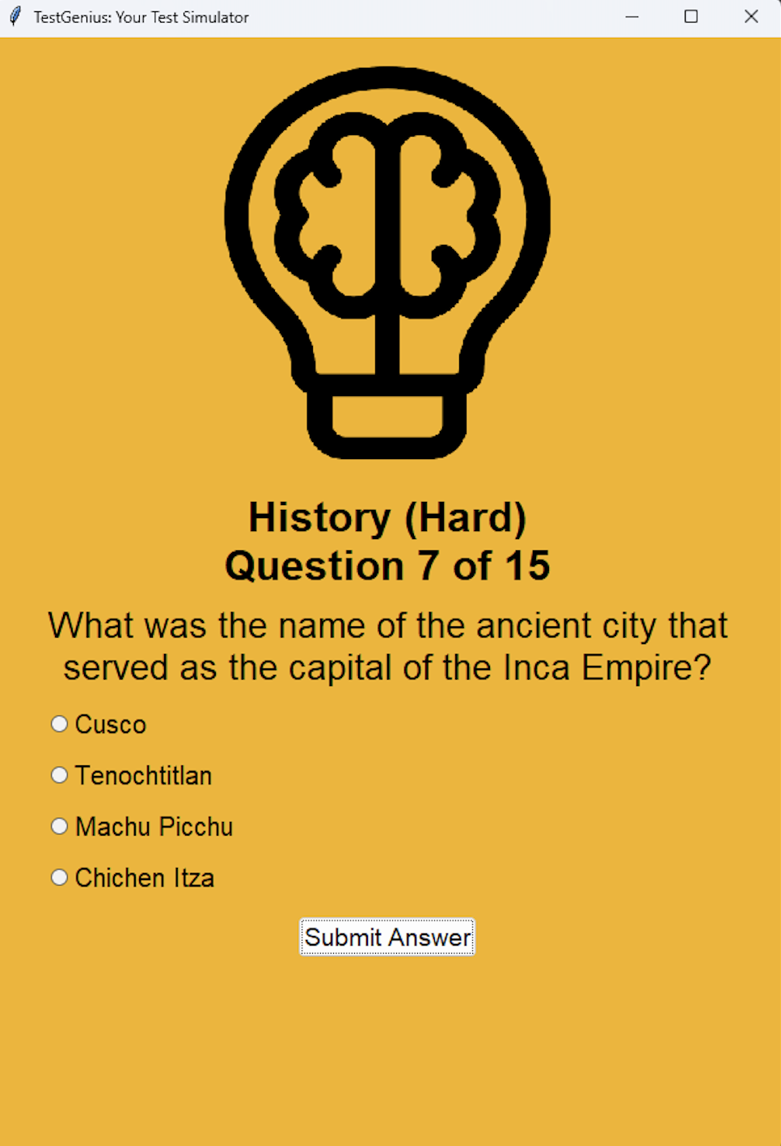
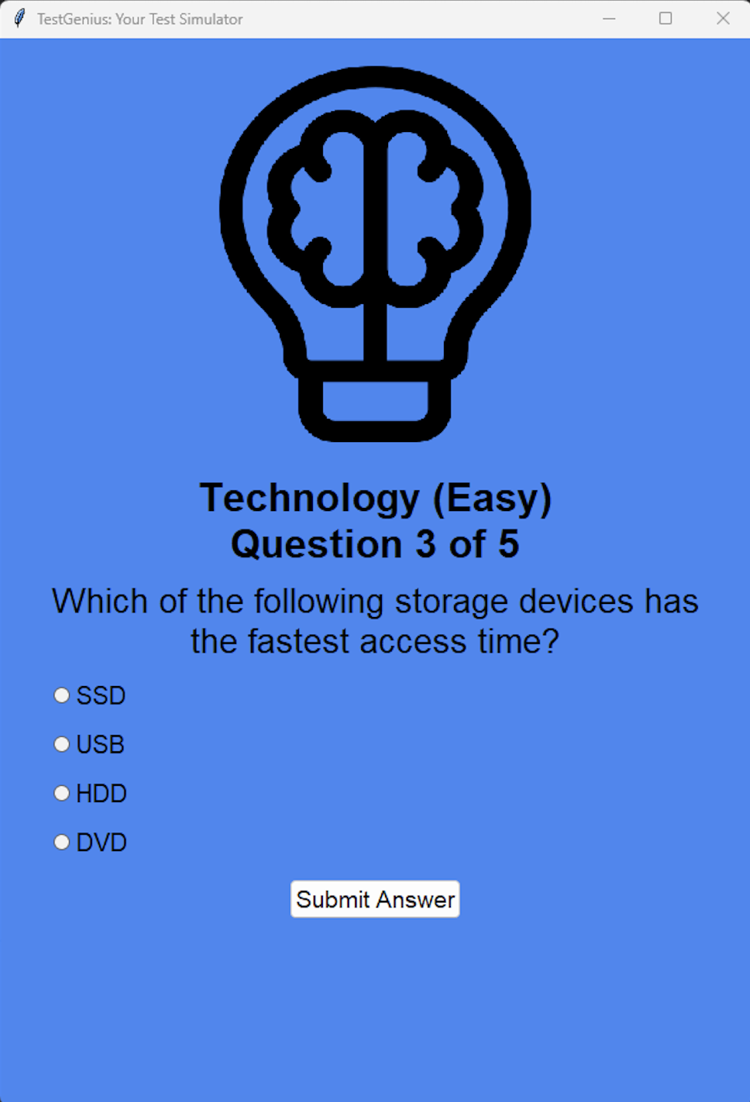
TEST PAGE OVERVIEW
Intro
Home
Overview
Test
Result(1)
Result(2)
Complete
Pie(1)

Slide 5
TEST PAGE
Intro
Home
Overview
Test
Result(1)
Result(2)
Complete
Pie(1)
In the test page we are shown:
Category
Difficulty
Number of Current Questions
Number of Total Questions
Question
Choices
Submission
TESTING TESTING: Users will only be give a total of four choices throughout all category. Each question is interactive and only one answer is correct. Once thorough examination, users have a choice to either pick a final choice or submit a final answer.

Slide 6
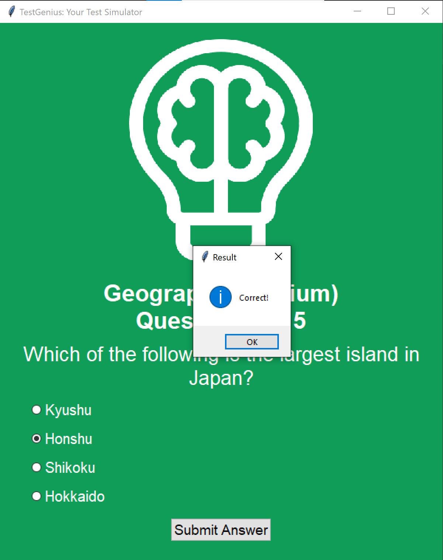
CORRECT
Intro
Home
Overview
Test
Result(1)
Result(2)
Complete
Pie(1)
CORRECT! After answering the question, a message box will tell the user if the answer is correct. In the following example, the answer to the question is correct! Users can continue onward with the next questions by clicking the OK button or by closing the pop up window.

Slide 7
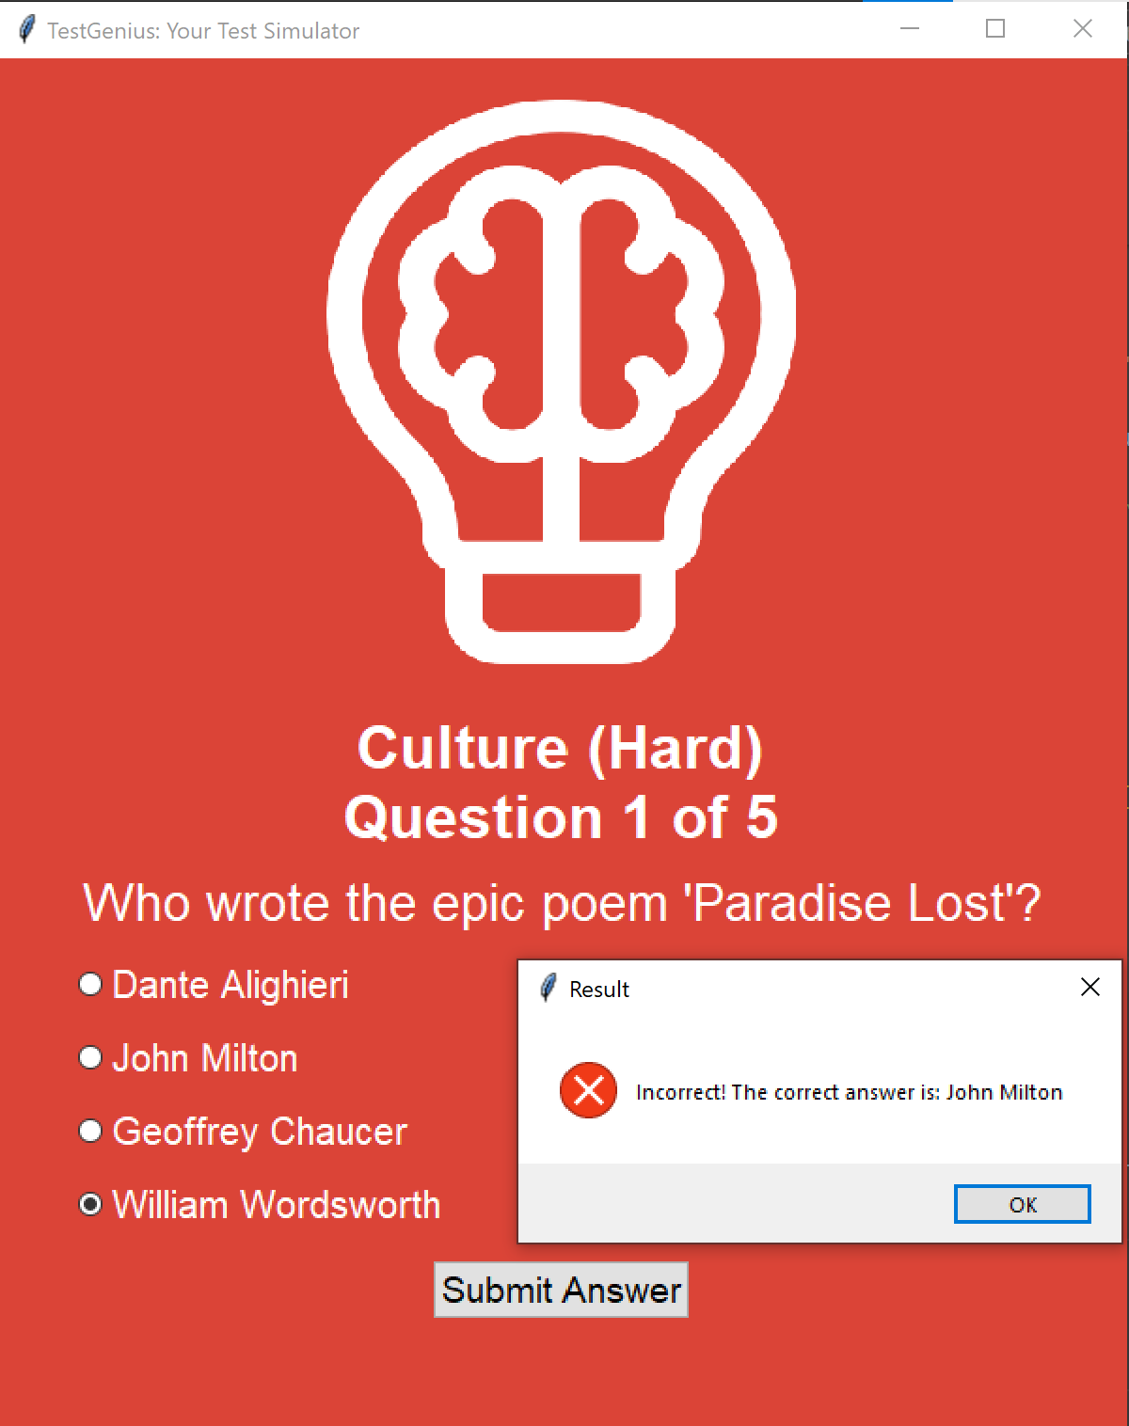
Intro
Home
Overview
Test
Result(1)
Result(2)
Complete
Pie(1)
INCORRECT
WRONG! When the chosen answer is incorrect, a red X message box will pop up. This indicates that the answer does not match the question. On the side note, the correct answer will be given and users will be able to continue by clicking the OK button or by closing the pop up window.

Slide 8
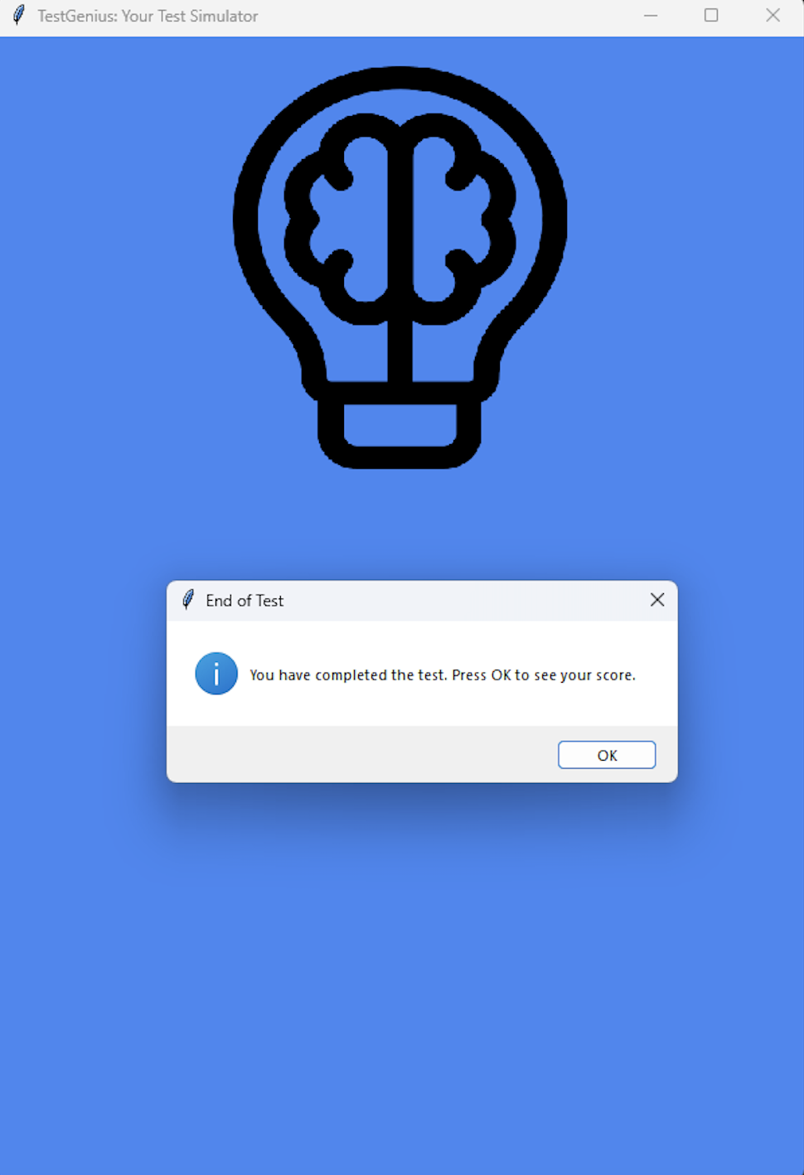
COMPLETE
Intro
Home
Overview
Test
Result(1)
Result(2)
Complete
Pie(1)
You have completed the test! The following are shown on this page:
Message Box( With completion prompt)
Hide Question
# Note(Logo will be applied to all screen.)
COMPLETE!: When users have finished answering the questions, a pop up alert will identify that the test is done. Users will be able to see their scores by following the instructions given by the pop up. The questions will be hidden after the test is done.

Slide 9
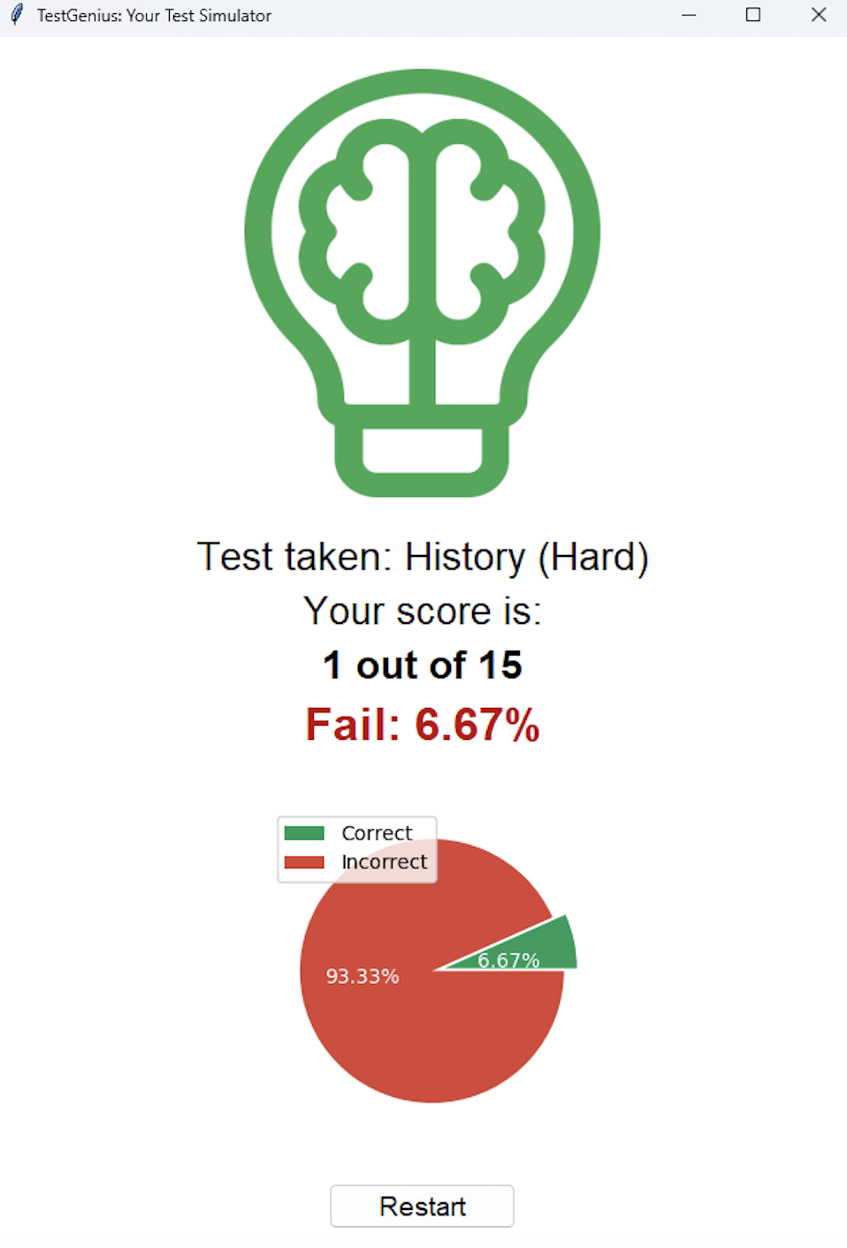
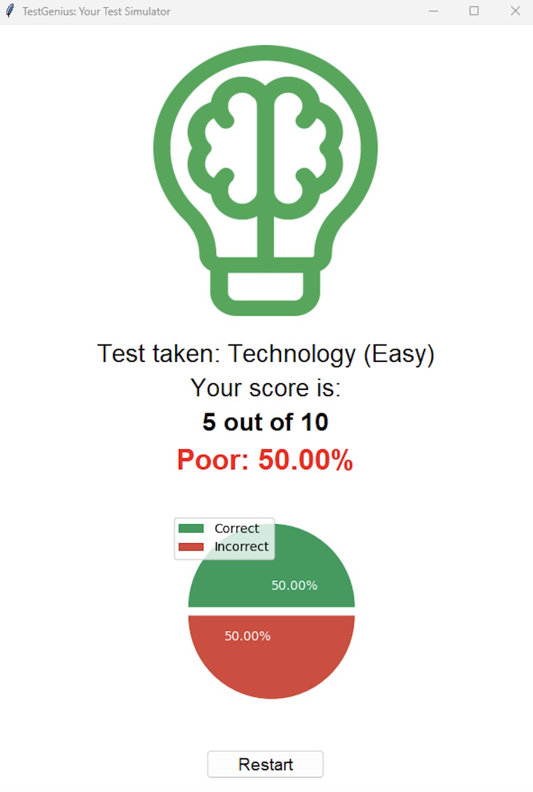
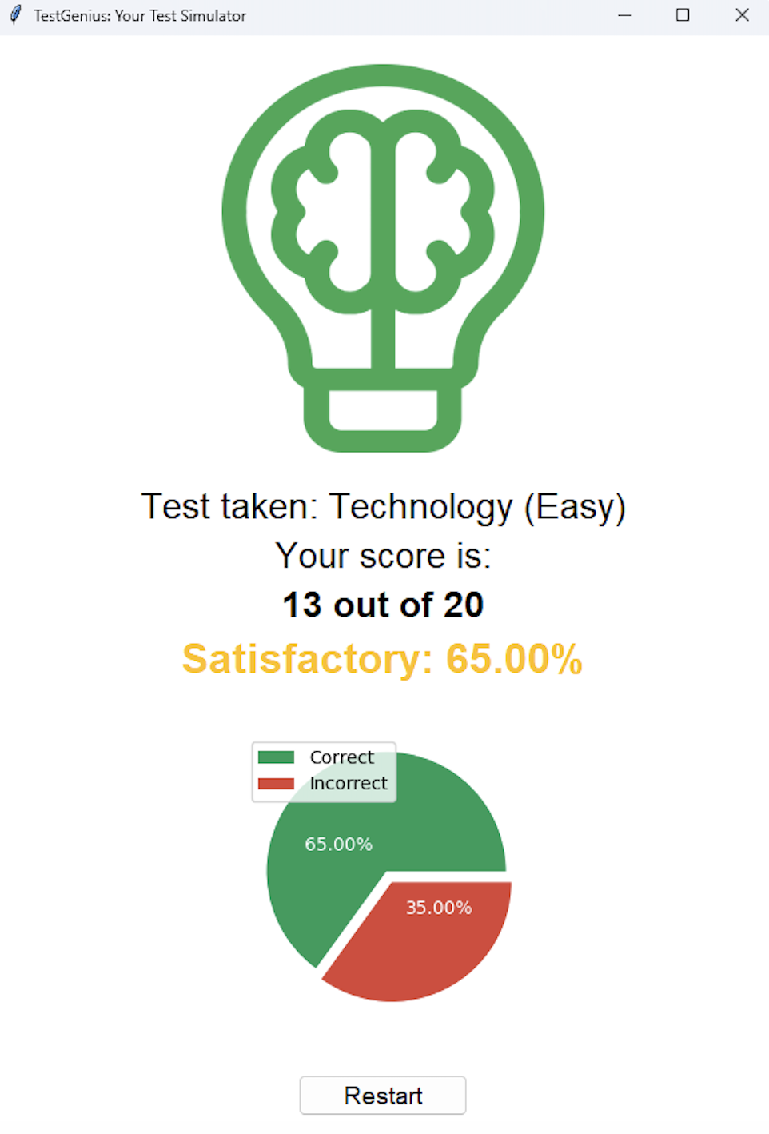
Intro
Home
Overview
Test
Result(1)
Result(2)
Complete
Pie(1)
PIE-CHART(1) OVERVIEW

Slide 10
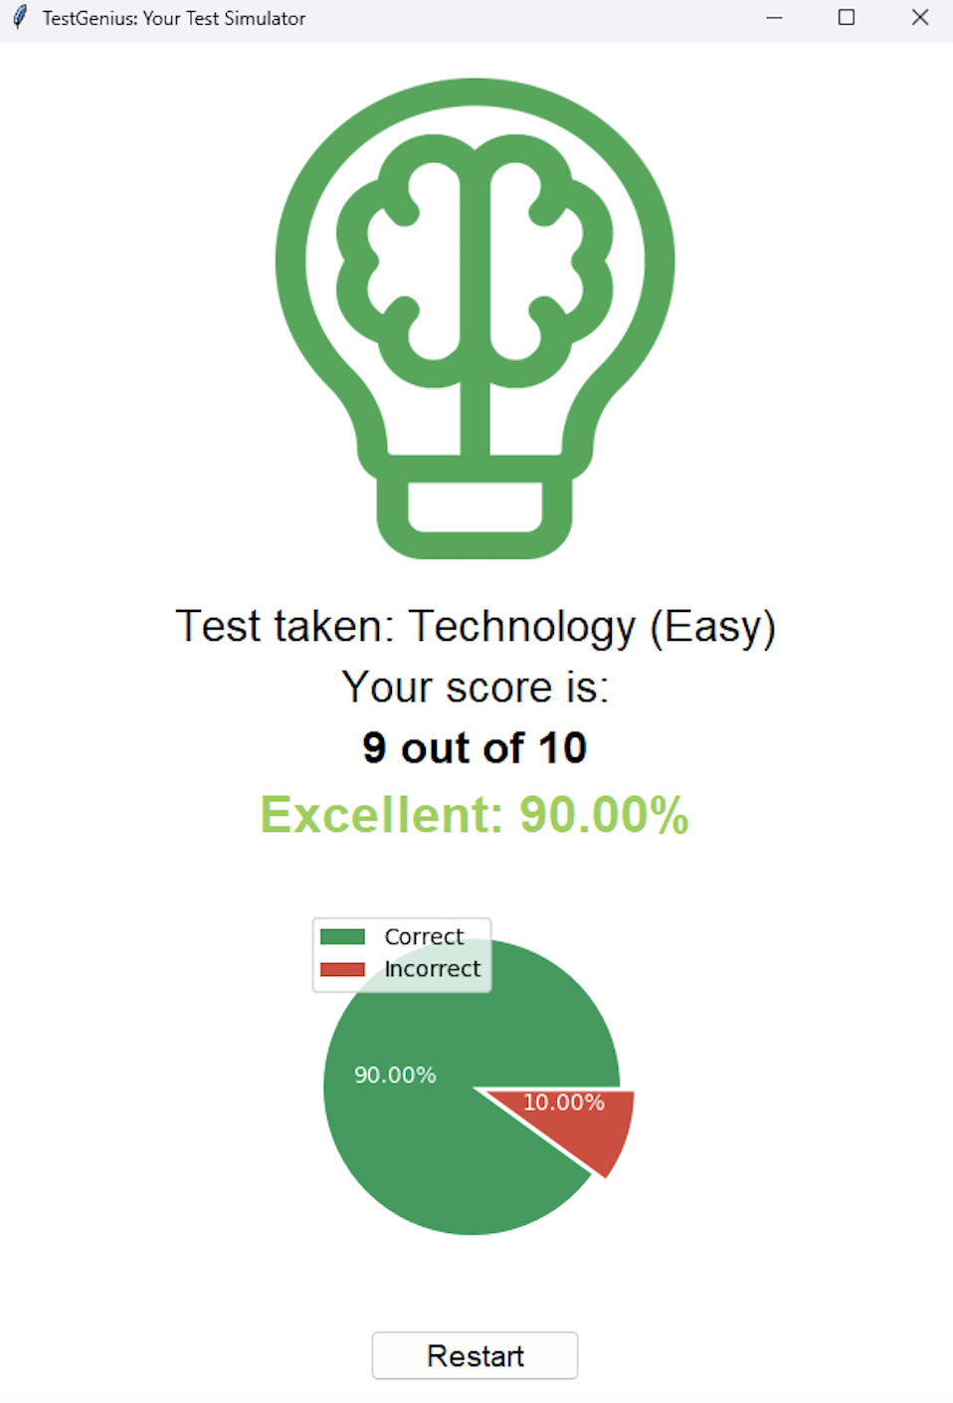
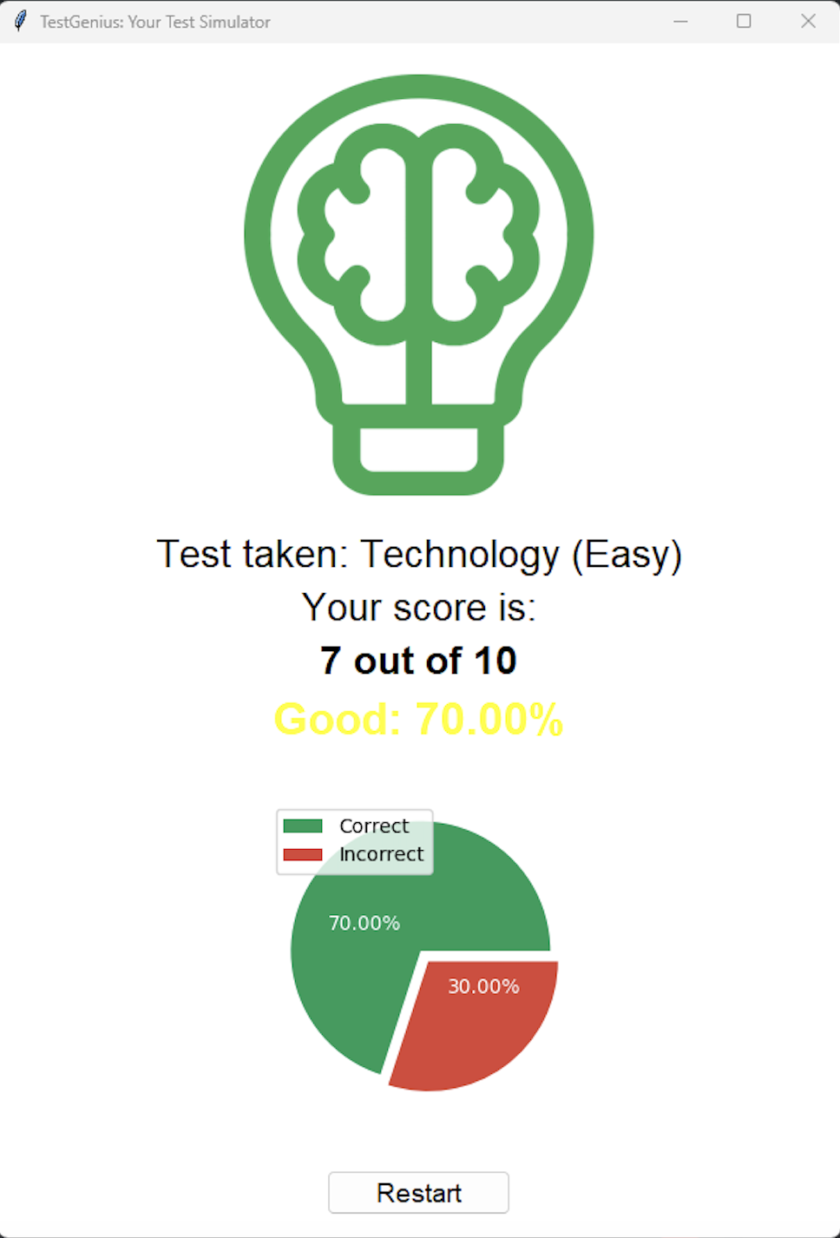
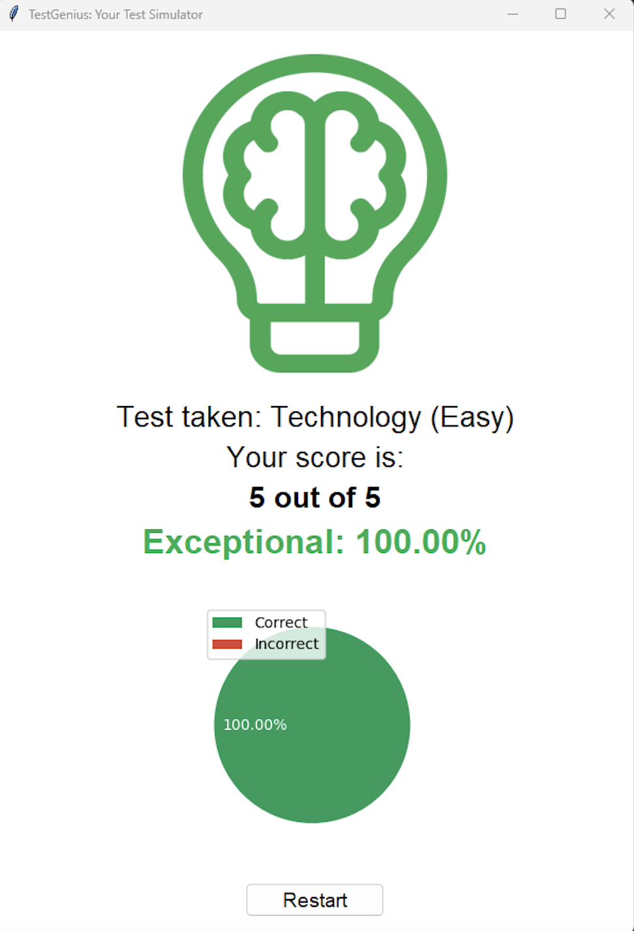
Pie(2)
Code
PIE-CHART(2)OVERVIEW

Slide 11
Pie(2)
Code
PYTHON CODE CLASS OVERVIEW
class TestSimulator(tk.Frame):
def __init__(self, root, question_database): …
def sel_category(self): …
def sel_difficulty(self): …
def sel_num_qstn(self): …
def hide_welcome_screen(self): …
def start_test(self): …
def prep_qstn_categ(self): …
def prep_questions(self): …
def show_question(self): …
def submit_answer(self): …
def hide_question(self): …
def show_score(self): …
def restart(self): …

Slide 12
#Thanks!
Check the website hiperdocumentos in Spanish
Do you have any questions?
Please keep this slide for attribution

