Slide 1
May Financial Performance Overview
Finance / FP&A dataset · 1,152 rows

Slide 2
EXECUTIVE SUMMARY
Stable total actuals indicate consistent financial health despite minor declines.
● Total actual remains steady at $517k, reflecting stability.
● Sales leads departments at $149k, contributing 28.8% of total actual.
● Sales experienced a decline of -$5k compared to the prior month.
● Salaries & Wages is the top category at $231k, making up 44.8% of total.
● Salaries & Wages declined by -$2k versus the prior month.
Source: figures verified against the source data.

Slide 3
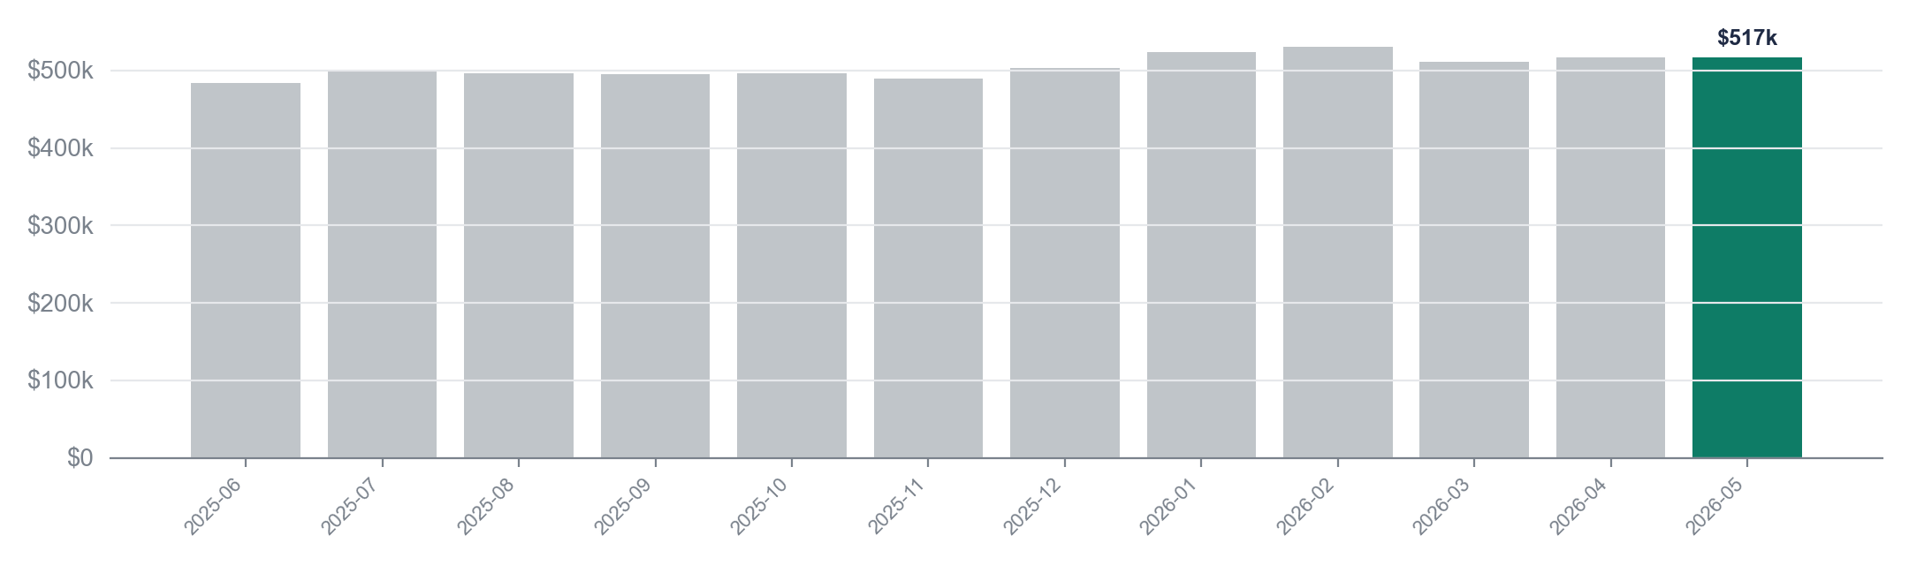
FINANCIAL PERFORMANCE
Actual remained stable at $517k in 2026-05, matching April's performance.
$517k
$530k
$484k
+$32k
Latest month (2026-05)
Peak month (2026-02)
Lowest month (2025-06)
Change since 2025-06
Source: performance: Monthly actual, verified against the data.

Slide 4
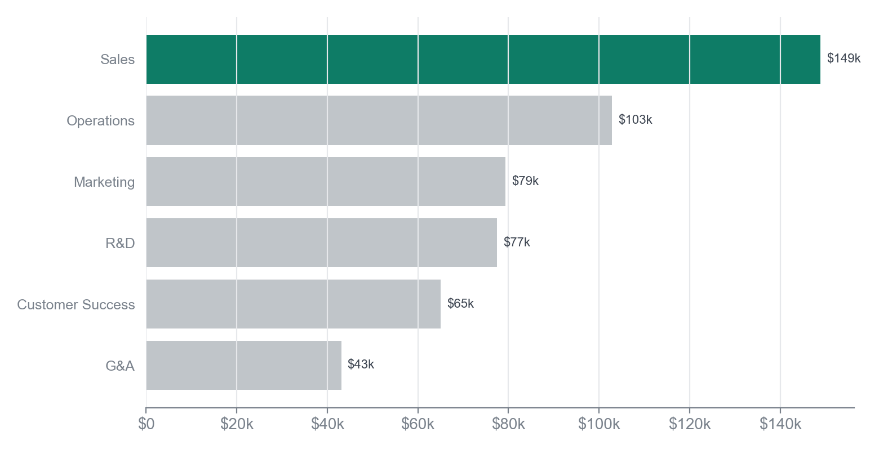
DEPARTMENT BREAKDOWN
Sales leads with $149k, but decreased by -$5k from last month.
KEY TAKEAWAY
The decline in Sales may require strategic focus to reverse the trend.
• Sales at $149k, down -$5k from April.
• Customer Success increased by +$2k to $65k.
• Marketing also saw growth, up +$2k to $79k.
In May 2026, the Sales department leads with a total of $149k, representing a significant portion of the overall departmental spend. However, it experienced a decline of -$5k compared to April 2026. Customer Success is the biggest mover, increasing by +$2k to reach $65k, reflecting a positive trend in that area.
Source: dim_department: actual by department (2026-05), verified against the data.

Slide 5
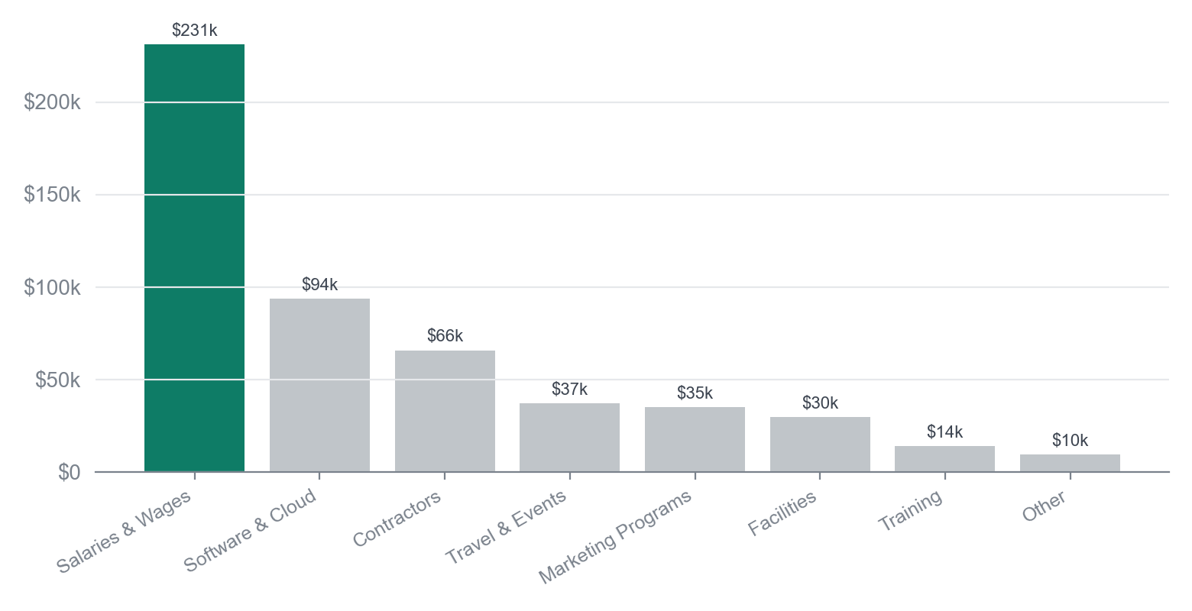
CATEGORY BREAKDOWN
Salaries & Wages dominate at $231k, with Software & Cloud increasing by $2k.
KEY TAKEAWAY
The increase in Software & Cloud spending suggests a strategic focus on technology enhancements.
• Salaries & Wages: $231k (44.8% of total)
• Software & Cloud: $94k, up $2k
• Travel & Events: $37k, up $224
In May 2026, Salaries & Wages led all categories with a total of $231k, representing 44.8% of total spend. Software & Cloud saw the largest increase, rising by $2k to $94k, while Salaries & Wages experienced a decrease of $2k compared to the previous period. This indicates a shift in spending priorities towards technology investments.
Source: dim_category: actual by category (2026-05), verified against the data.

Slide 6
RECOMMENDATIONS
Priorities for the coming month
1. Analyze Sales performance to identify drivers behind the $5k decline and implement corrective actions.
2. Review Salaries & Wages expenditures to optimize costs and address the $2k decrease.
3. Enhance forecasting methods to mitigate the -0.1% change in total actual and improve future projections.
4. Prioritize investment in Sales initiatives to regain momentum and boost the department's contribution.
Source: figures verified against the source data.

