Slide 1
May 2026 Revenue Insights
Marketing / Web dataset · 3,650 rows

Slide 2
EXECUTIVE SUMMARY
Organic Search drives growth, while Social declines impact overall performance.
● Total revenue increased to $303k, reflecting a positive trend.
● Organic Search generated $103k, contributing 33.9% of total revenue.
● Total revenue grew by +4.7% compared to April 2026.
● Social channel experienced a decline of -$6 compared to the prior month.
Source: figures verified against the source data.

Slide 3
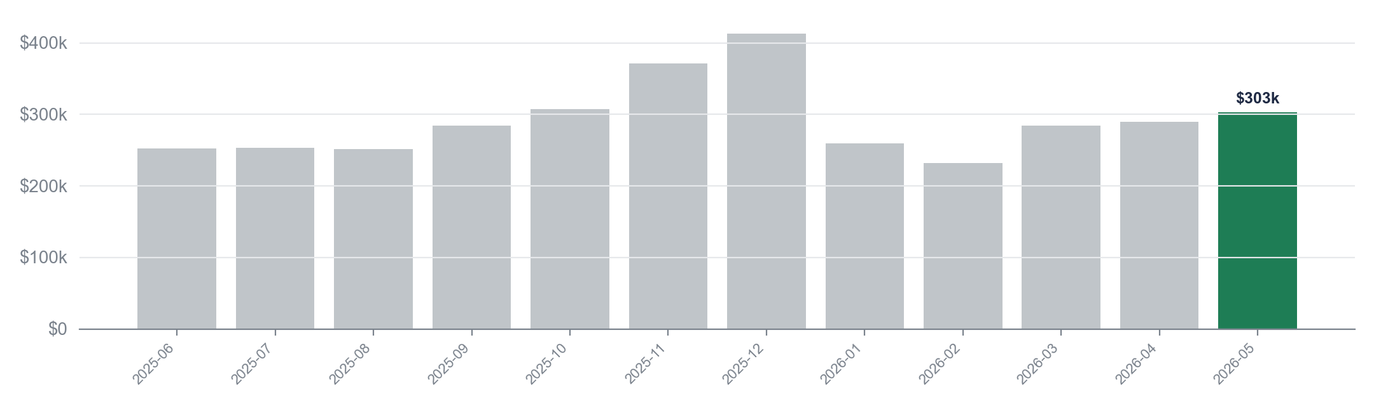
FINANCIAL PERFORMANCE
Total revenue increased to $303k in 2026-05, up $13k from April.
$303k
$413k
$232k
+$51k
Latest month (2026-05)
Peak month (2025-12)
Lowest month (2026-02)
Change since 2025-06
Source: performance: Monthly revenue, verified against the data.

Slide 4
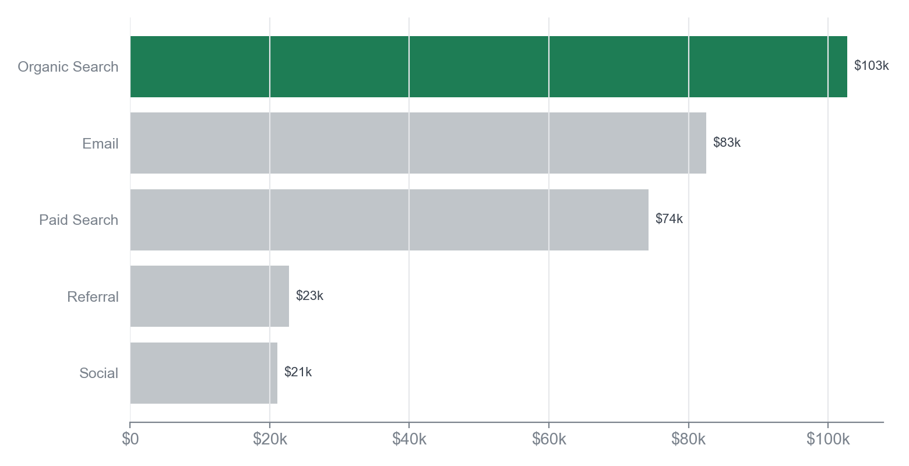
CHANNEL BREAKDOWN
Organic Search leads with $103k, accounting for 33.9% of total revenue.
KEY TAKEAWAY
Focusing on Email's growth potential can enhance overall revenue performance.
• Organic Search dominates with $103k, leading all channels.
• Email shows significant growth, up $6k from April.
• Total revenue concentration remains high in top three channels.
In May 2026, Organic Search generated $103k, making it the top channel and representing 33.9% of total revenue. Email follows closely with $83k, while Paid Search contributes $74k. The biggest mover is Email, increasing by $6k from the previous month, indicating strong growth in this channel.
Source: dim_channel: revenue by channel (2026-05), verified against the data.

Slide 5
RECOMMENDATIONS
Priorities for the coming month
1. Increase investment in Organic Search to capitalize on its $103k contribution and 33.9% share.
2. Analyze and address the decline in Social, which decreased by -$6, to prevent further losses.
3. Enhance marketing strategies to sustain the overall revenue growth of $303k, reflecting a +4.7% increase.
4. Conduct a channel performance review to identify opportunities for improvement across all revenue streams.
Source: figures verified against the source data.

