Slide 1
May 2026 Revenue Performance
Retail / Commerce dataset · 104,567 rows

Slide 2
EXECUTIVE SUMMARY
Revenue growth indicates strong market positioning and channel effectiveness.
● Total revenue reached $998k in May 2026, reflecting a growth of +4.5%.
● North America generated $262k, accounting for 26.2% of total revenue.
● Online sales led with $537k, representing 53.8% of total revenue.
● Electronics category sales totaled $293k, making up 29.4% of total revenue.
● The Coffee Grinder experienced a decline of -$2k compared to the prior month.
Source: figures verified against the source data.

Slide 3
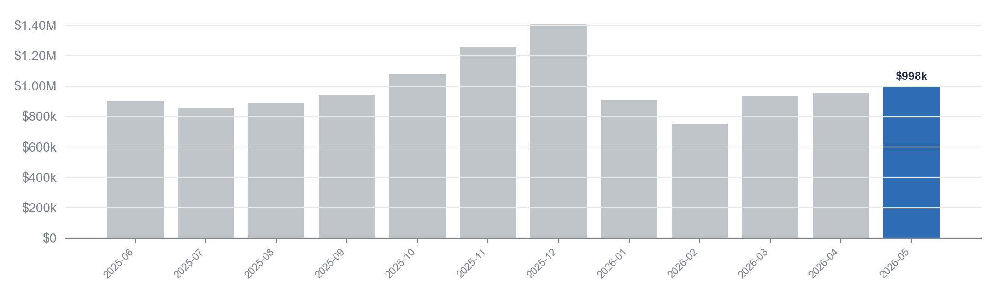
FINANCIAL PERFORMANCE
Total revenue increased by $43k to $998k in 2026-05, indicating growth.
$998k
$1.41M
$753k
+$96k
Latest month (2026-05)
Peak month (2025-12)
Lowest month (2026-02)
Change since 2025-06
Source: performance: Monthly revenue, verified against the data.

Slide 4
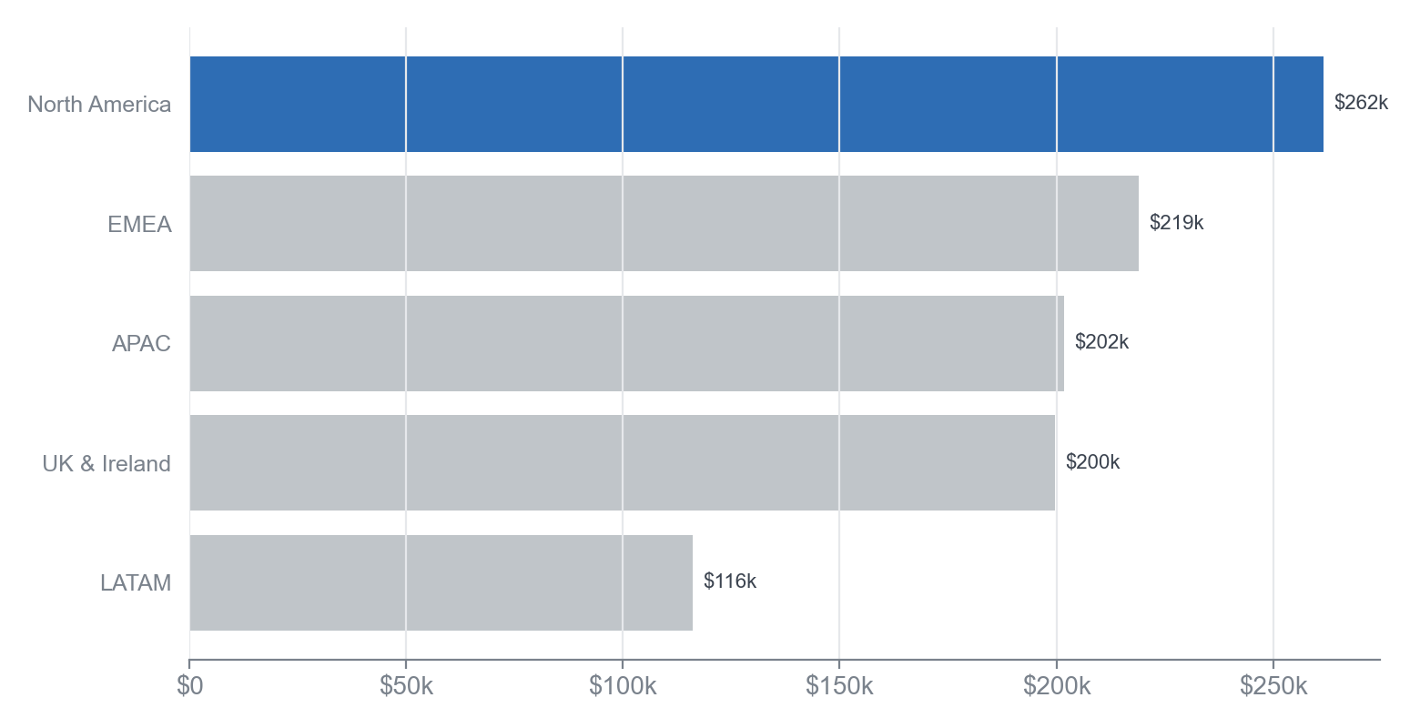
REGION BREAKDOWN
North America leads with $262k, while EMEA grows by +$14k.
KEY TAKEAWAY
Focusing on EMEA's growth can enhance overall revenue performance.
• North America: $262k, leading region in revenue.
• EMEA: $219k, biggest mover with +$14k growth.
• APAC contributes $202k, maintaining strong performance.
In the revenue breakdown for 2026-05, North America stands out with a total of $262k, representing the highest contribution among all regions. EMEA follows with a total of $219k, showing a significant increase of +$14k compared to the previous period. The concentration of revenue is highest in North America, followed by EMEA and APAC, which totals $202k.
Source: dim_region: revenue by region (2026-05), verified against the data.

Slide 5
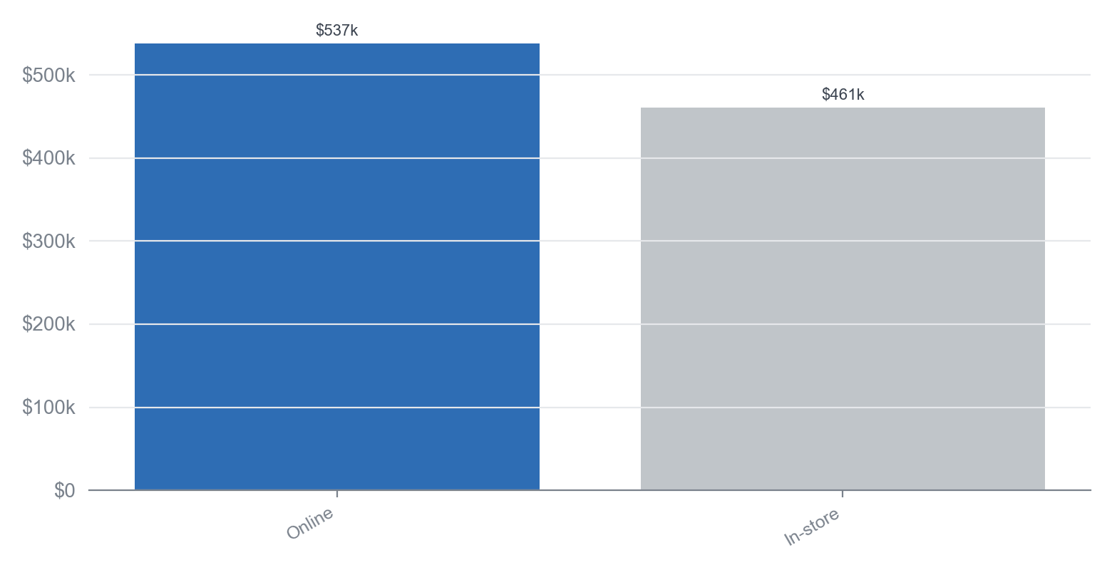
CHANNEL BREAKDOWN
Online leads with $537k, capturing 53.8% of total revenue.
KEY TAKEAWAY
The strong growth in Online revenue suggests a shift in consumer purchasing behavior favoring digital channels.
• Online revenue increased by +$35k from April to May.
• In-store revenue rose by +$8k in the same period.
• Online accounts for over half of total revenue, highlighting its dominance.
In May 2026, Online revenue reached $537k, representing 53.8% of total revenue, while In-store revenue was $461k. The Online channel not only leads in total revenue but also showed a significant increase of +$35k compared to the previous month. In-store revenue also grew, but at a lower rate of +$8k, indicating a stronger momentum for Online sales.
Source: dim_channel: revenue by channel (2026-05), verified against the data.

Slide 6
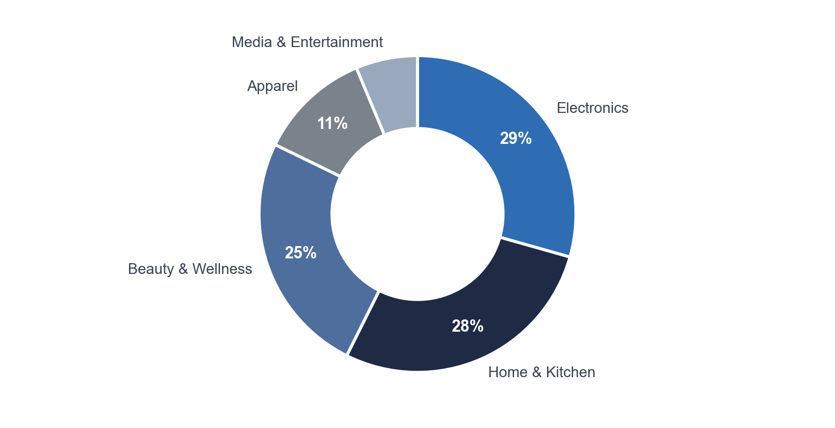
CATEGORY BREAKDOWN
Electronics leads with $293k, while Home & Kitchen grows by $24k.
KEY TAKEAWAY
The growth in Home & Kitchen suggests a rising consumer preference that could drive future strategy.
• Electronics: $293k, leading category
• Home & Kitchen: $279k, +$24k growth
• Beauty & Wellness: $248k, +$10k growth
In May 2026, Electronics generated $293k, making it the top category. Home & Kitchen follows closely with $279k, showing significant growth of $24k from the previous month. Beauty & Wellness also performed well, increasing by $10k to reach $248k, indicating a strong demand in these categories.
Source: dim_category: revenue by category (2026-05), verified against the data.

Slide 7
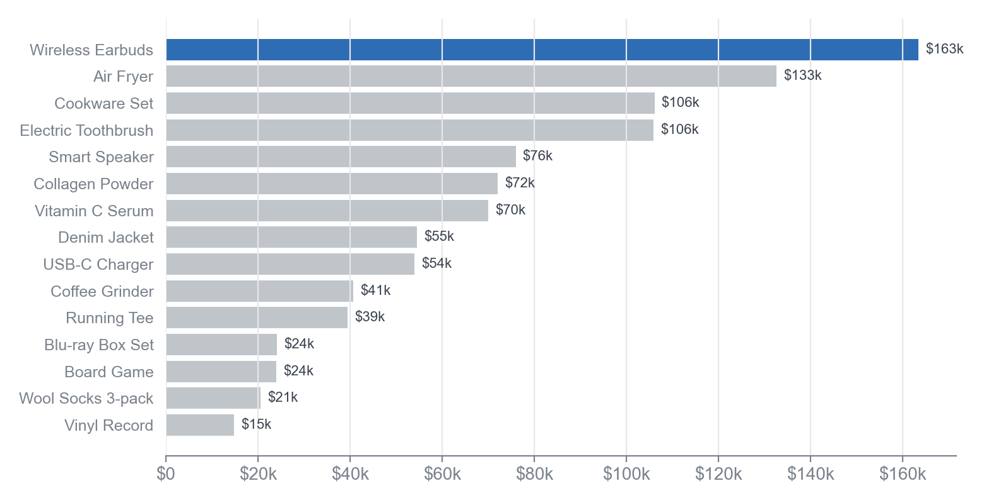
PRODUCT BREAKDOWN
Wireless Earbuds lead with $163k, while Air Fryer grows by $15k.
KEY TAKEAWAY
Focusing on high-performing products like Wireless Earbuds and Air Fryer can drive future growth.
• Wireless Earbuds at $163k dominate the product lineup.
• Air Fryer shows the largest growth with an increase of $15k.
• Top two products represent a significant revenue concentration.
In May 2026, Wireless Earbuds generated $163k, making it the top product by revenue. The Air Fryer followed with $133k, showing significant growth of $15k from the previous month. This indicates a strong concentration in the top two products, which together account for a substantial portion of total sales.
Source: dim_product: revenue by product (2026-05), verified against the data.

Slide 8
RECOMMENDATIONS
Priorities for the coming month
1. Increase online marketing efforts to boost the $537k from the online channel.
2. Focus on promoting the Wireless Earbuds, which generated $163k, to maximize sales.
3. Investigate the decline of the Coffee Grinder, which decreased by -$2k, and implement corrective actions.
4. Expand product offerings in the Electronics category, currently at $293k, to capture more market share.
Source: figures verified against the source data.

