Slide 1
Monthly MRR Performance Review
SaaS / Subscriptions dataset · 1,152 rows

Slide 2
EXECUTIVE SUMMARY
Declining MRR signals urgent need for strategic adjustments.
● Total MRR decreased to $3.82M, down -1.4% from $3.87M.
● Enterprise remains the top plan at $1.99M, contributing 52.2% of total MRR.
● Business plan experienced the largest decline at -$30k compared to the prior month.
● United States leads countries with $515k, accounting for 13.5% of total MRR.
● United States saw a decline of -$43k from the previous month.
Source: figures verified against the source data.

Slide 3
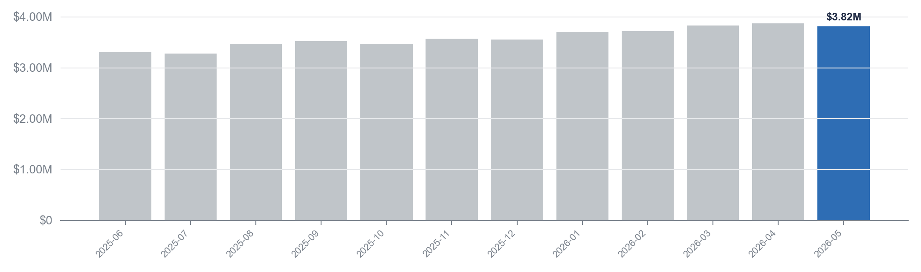
FINANCIAL PERFORMANCE
Total MRR decreased to $3.82M in May, down $53k from April.
$3.82M
$3.87M
$3.28M
+$512k
Latest month (2026-05)
Peak month (2026-04)
Lowest month (2025-07)
Change since 2025-06
Source: performance: Monthly mrr, verified against the data.

Slide 4
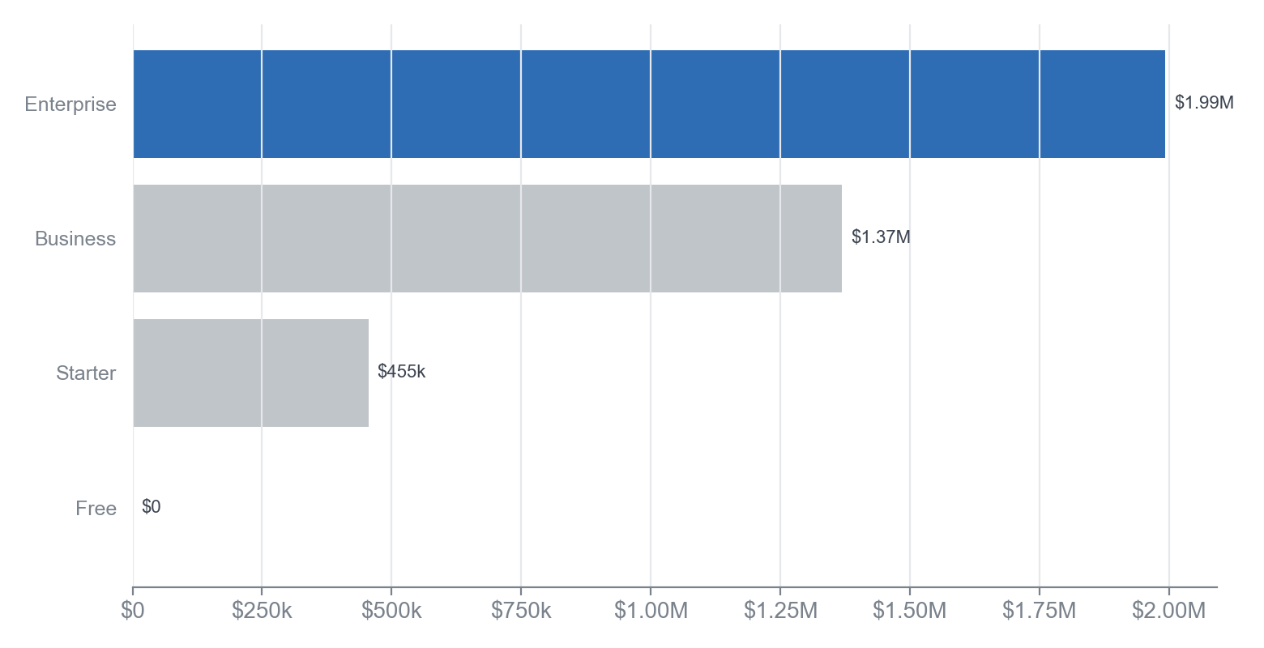
PLAN BREAKDOWN
Enterprise leads MRR at $1.99M, with Business declining by $30k.
KEY TAKEAWAY
The decline in Business and Starter plans signals potential challenges in customer retention.
• Enterprise plan contributes $1.99M, leading overall MRR.
• Business plan's MRR decreased by $30k, the largest drop.
• Starter plan's MRR fell to $455k, showing a downward trend.
In May 2026, the Enterprise plan dominates with a total MRR of $1.99M, accounting for 52.2% of the overall MRR. The Business plan, while significant at $1.37M, experienced the largest decline of $30k compared to the previous month. The Starter plan also saw a decrease, falling to $455k from $471k, while the Free plan remains at $0.
Source: dim_plan: mrr by plan (2026-05), verified against the data.

Slide 5
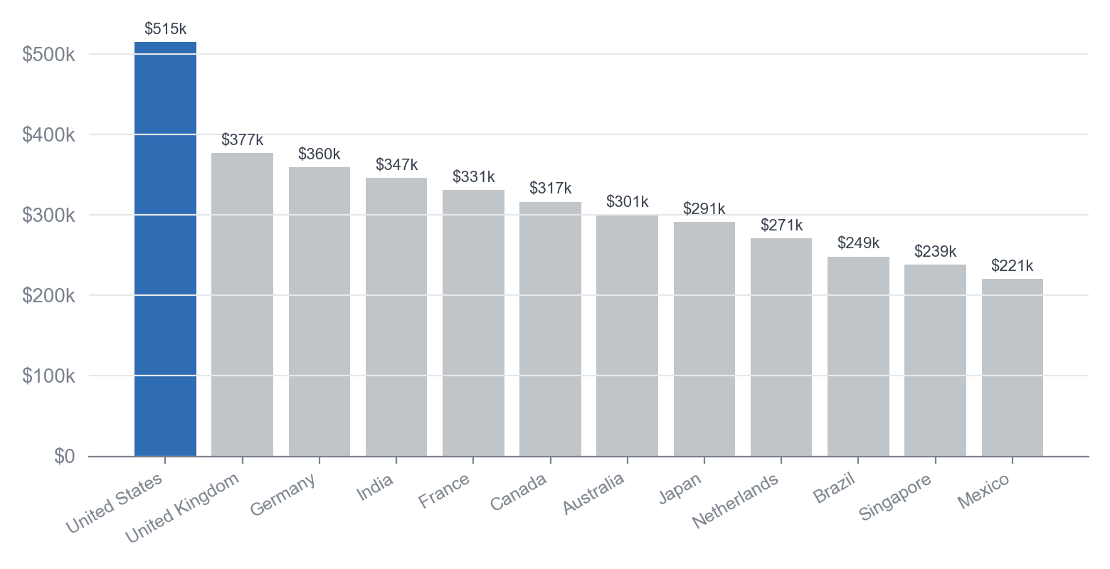
COUNTRY BREAKDOWN
The United States leads MRR at $515k, but decreased by -$43k this period.
KEY TAKEAWAY
This shift highlights the need to address declining MRR in key markets while leveraging growth in others.
• Top three countries contribute significantly to overall MRR concentration.
• France's MRR increased by +$16k, indicating positive growth.
• The United States experienced the largest decline at -$43k.
In May 2026, the United States remains the top contributor to MRR with $515k, followed by the United Kingdom at $377k and Germany at $360k. The overall MRR concentration is significant, with the top three countries accounting for a substantial portion of total MRR. Notably, France is the biggest mover this period, increasing its MRR by +$16k compared to April 2026.
Source: dim_country: mrr by country (2026-05), verified against the data.

Slide 6
RECOMMENDATIONS
Priorities for the coming month
1. Analyze and address the $30k decline in the Business plan to stabilize MRR.
2. Enhance marketing strategies in the United States to recover the $43k decline in revenue.
3. Focus on increasing the Enterprise plan, which currently represents $1.99M or 52.2% of total MRR.
4. Implement customer retention initiatives to prevent further declines in overall MRR, currently at $3.82M.
Source: figures verified against the source data.

