Slide 1
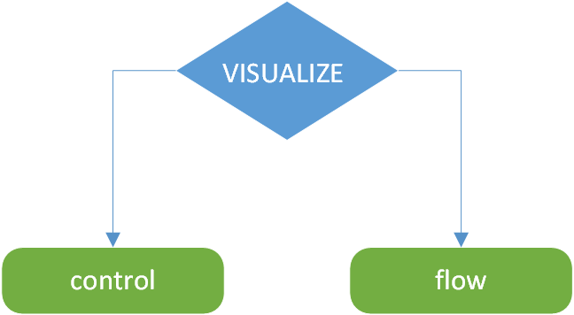
Visualize Control Flow
A VS Code Extension for students

Slide 2
Our Story
Evan Kanter – UofT Computer Science
Aron Zeng – UofW Computer Engineering
How did we get this idea?

Slide 3
The Problem
“Understanding code is tough. Nested conditionals, loops, recursion -- the abstraction can be hard to visualize.”

Slide 4
The Solution
“This extension generates a control flow diagram to help students visualize their code.”

Slide 5
Our Focus
Python
Ease of Use
Early Stage limitations

Slide 6
Details
Reads the Active Python File
Parses the file into a FlowTree
That’s an Abstract Syntax Tree, with some added features for specifically marking up Control Flow
Generates an .svg from the FlowTree
Displays an SVG

Slide 7
Demo time!

Slide 8
Next Steps
Export SVG
More complex Control Flow

