Slide 1

Federated Learning-based Intrusion Detection System for SDN-enabled IoT Networks
Aaron B Ajay
1BM23CS003
Aaryan Prakash
1BM23CS006
Amal Roy
1BM23CS025
Amogh Krishna J S
1BM23CS029
Guide: Mr. Syed Akram
Assistant Professor
Department of Computer Science and Engineering
B.M.S. College of Engineering
Notes:
Team and guide as on the earlier presentation drafts.

Slide 2
Outline
1
Sustainable Development Goals
6
Results: Datasets, Graphs, Tables and Output Snapshots
2
Problem Statement and Objectives
7
Conclusion and Future Enhancements
3
High Level Design
8
Papers Published
4
Detailed Design
9
References
5
Implementation

Slide 3
Sustainable Development Goals (SDGs) Addressed
9
SDG 9: Industry, Innovation and Infrastructure
16
SDG 16: Peace, Justice and Strong Institutions
Strengthens the security of network infrastructure that IIoT systems depend on: manufacturing, power and transport.
Detects attacks, resists poisoned training and blocks attackers through SDN flow rules, which supports smart systems.
Strengthens cybersecurity and protects sensitive digital data.
Raw traffic never leaves a site during training; only model weights and capped alerts are shared.
Attacks are detected and blocked, which supports secure and resilient digital systems.
Notes:
SDG 11 was removed on request; only SDG 9 and SDG 16 are kept.

Slide 4
Problem Statement
IoT and IIoT networks managed with SDN face floods, scans, web attacks, malware and man-in-the-middle attacks, while their devices run with little host security. A centralised intrusion detection system needs all raw traffic in one place, which raises privacy, bandwidth and scalability problems.
Federated learning keeps traffic on each site, but it opens new weaknesses: a few poisoned client updates can ruin the shared model, and a classifier trained on known labels cannot recognise an attack it has never seen. Reported accuracy on the Edge-IIoTset data is also often inflated by random packet splits and by errors in the released CSV, and a detection rarely changes what the network does.
Therefore, there is a need for a federated IDS that resists poisoned updates, detects unseen attacks, is measured on a strict test, and turns detections into enforced network rules.
Privacy and scale
Raw traffic cannot be pooled centrally
Poisoned updates
30% bad clients broke plain FedAvg
Unseen attacks
A classifier only knows its labels
Inflated results
Random splits leak connections
No enforcement
Detection does not block traffic
Notes:
Rewritten from Draft 5 for the project as built: adds unseen attacks, inflated evaluation and the missing link to enforcement.

Slide 5
Objectives
1
Malicious Client Detection and Filtering
2
Efficient, Privacy-Aware FL Design
Develop a trust-based filter on the server that identifies and excludes compromised clients from federated aggregation.
Build a lightweight federated framework in which raw traffic stays on each client, and link its verdicts to enforced SDN rules.
3
Model Optimization for Scalability
4
Semi-Supervised and Anomaly-Based Detection
Apply weight pruning to reduce the computational and communication load on resource-constrained IoT devices.
Add an autoencoder backstop to a boosting classifier so that attacks never seen in training are still flagged.
Notes:
Same four objectives as the report (Section 1.4). Objective 2 now includes the SDN enforcement step.

Slide 6
High Level Design
Phase A: federated training (offline)
Edge-IIoTset
2.2M packets, 15 classes
Clean and repair
130 features
split by connection
Server: LightGBM
classifier on a 5%
labelled set
10 or 20 clients
autoencoder on traffic
called normal
Server: trust filter
+ trimmed mean
20 rounds
Model bundle
classifier, autoencoder,
thresholds
weights up, model down, each round
Phase B: detection and enforcement on a Mininet network
Attack capture
(.pcap file)
Replay with
tcpreplay
TShark features
(same 130)
Cascade from
the bundle
Verdict: device,
class, confidence
Flask bridge and
os-ken controller
Open vSwitch:
drop or rate-limit
Block a device when confidence is at least 0.85, rate-limit it at 0.5 or more. Phase B classifies a whole capture, not a live packet stream.
Notes:
Source: report Chapter 4, Figures 4.1 and 4.2. Phase A is offline training; Phase B replays real captures through Mininet.

Slide 7
Detailed Design: Two-Stage Cascade
Known attack and
probability ≥ 0.7?
Packet
130 features
LightGBM
class + probability
Yes
Final label = attack type
autoencoder not used
No
Why a cascade
The classifier names known attacks with high accuracy.
The autoencoder, trained only on benign-looking traffic, flags what the classifier passes as normal and looks unlike benign traffic.
Threshold: 97th percentile of the client's own benign error.
Client autoencoder
130→32→16→8→16→32→130
Error above the client's
threshold?
No
Yes
Benign
Anomalous
Notes:
Source: report Section 4.3 and Section 5.1. Threshold 0.7, 97th percentile, 9,834 autoencoder parameters.

Slide 8
Detailed Design: One Federated Round
1
Broadcast
2
Local training
3
Upload
The server sends the global autoencoder and the classifier to every client.
Each client drops traffic the classifier already calls a confident attack and trains the autoencoder on the rest for 5 epochs.
Clients send the weight change, an error histogram and at most 50 confirmed alerts. Raw traffic stays local.
4
Trust filter
5
Aggregate
6
Boost update
Exclude updates that are cosine or MAD outliers against the median update, point away from it, or come from clients with running trust below 0.5.
Clip update norms to 2 times the median, then average with a 15% trimmed mean to form the new global autoencoder.
Every 3rd round the server adds 50 trees per class, trained on the calibration set plus confirmed alerts.
Repeated for 20 rounds. Orange steps are the poisoning defence.
Notes:
Source: report Section 4.3 and Section 5.3. 20 rounds; boosting update every 3rd round; trust filter settings as in FR6.

Slide 9
Detailed Design: Features and Data Split
Features per packet (cumulative)
Split by connection
Packets of one connection (IP pair, protocol, ports; 60 s idle or 120 s active timeout) stay together: 342,814 connections, so no connection is in both training and test.
Server calibration set
About 5% of rows, labelled, bootstraps the LightGBM classifier. The rest goes to the clients.
Non-IID clients
A Dirichlet(0.3) draw gives each of 10 or 20 clients a very different class mix. Per client: 15% test, 15% benign validation, rest training.
Content: 18 payload and HTTP numbers. Flow: 20 per-connection counts. IP addresses and times only group packets and are never inputs.
Notes:
Source: report Sections 5.2 and 4.4. 91 base + 1 service port + 18 content + 20 flow = 130. 342,814 connections.

Slide 10
Implementation: Tools and Environment
Component | Used for | Version
Python | All code | 3.14.4
LightGBM | Boosting classifier | 4.7.0
PyTorch (CPU) | Autoencoder | 2.14.0
Flower | Federated learning server and clients | 1.38.0
scikit-learn, pandas, NumPy | Splits, metrics, data handling | 1.9.1, 3.0.6, 2.5.3
Mininet, Open vSwitch | Emulated network and switch | 2.3.0, 3.7.1
os-ken, Flask | OpenFlow controller and REST bridge | 4.2.2, 3.1.3
TShark | Feature extraction from captures | 4.6.4
Streamlit | Live dashboard | 1.64.0
244
automated tests passed, 1 skipped
20 vCPU
VMware Ubuntu 26.04 LTS virtual machine with 48 GB RAM
~16 GB
data, run logs and saved models on disk
All training, results and Phase B ran inside the VM; only text results left it.
Notes:
Versions from the VM (report Section 3.2). Test run on 2026-11-03: 244 passed, 1 skipped (needs the dataset authors' CSV).

Slide 11
Implementation: Project Timeline
Jan
Feb
Mar
Apr
May
Jun
Jul
Aug
Sep
Oct
Nov
Literature survey, problem
Research gaps and novelty
ML vs DL comparison
Data pipeline, LightGBM
Federated loop, trust filter
Training and evaluation
SDN mitigation, dashboard
End-to-end run, accuracy work
Integration, follow-up tests
Full-dataset re-run
Showcase site, report, slides
Paper (in progress)
2026. Phases 1 to 3: research. Phases 4 to 6: build. Later phases: evaluation, enforcement and write-up.
Notes:
Dates from Table 1.1 of the report. Jan to Sep periods are estimates by the team, not logged timestamps.

Slide 12
Results: Dataset Used
Packets per class after cleaning (log scale)
1,985,768
unique packets from 2,219,201 raw rows
15 classes
normal traffic plus 14 attack types
342,814
connections, kept whole in every split
MITM is a single connection (406 packets), so it cannot be split.
Notes:
Edge-IIoTset (Ferrag et al., 2022). Counts are after the MITM repair and duplicate removal (report Table 5.2). Log scale.

Slide 13
Results: Boosting vs Deep Learning
Recall per class (same 500,000-row sample)
0.887 vs 0.622
macro F1, boosting vs deep learning
0.891 vs 0.678
accuracy, boosting vs deep learning
The gap is largest on application-layer attacks that resemble normal web traffic (XSS, SQL injection, Uploading).
On flood attacks both models are close to perfect.
This supports boosting as the first stage.
Notes:
Same 500,000-row sample (400k train, 100k test), original 91 features. DL model: dense MLP, 8,271 parameters, 15 epochs. A modest baseline, not a claim that DL cannot work.

Slide 14
Results: Effect of the New Features
Held-out connections, as features are added
F1 per class: 91 features vs final
Vertical axis starts at 0.85. Final: 99.72% accuracy, 0.983 macro F1 on 397,073 unseen packets.
Notes:
Flow-grouped split, seed 42, all rows (report Table 6.2 and Figure 6.2). Per-class F1 before (91 features) and final (report Figure 6.3; values from the experiment JSON files).

Slide 15
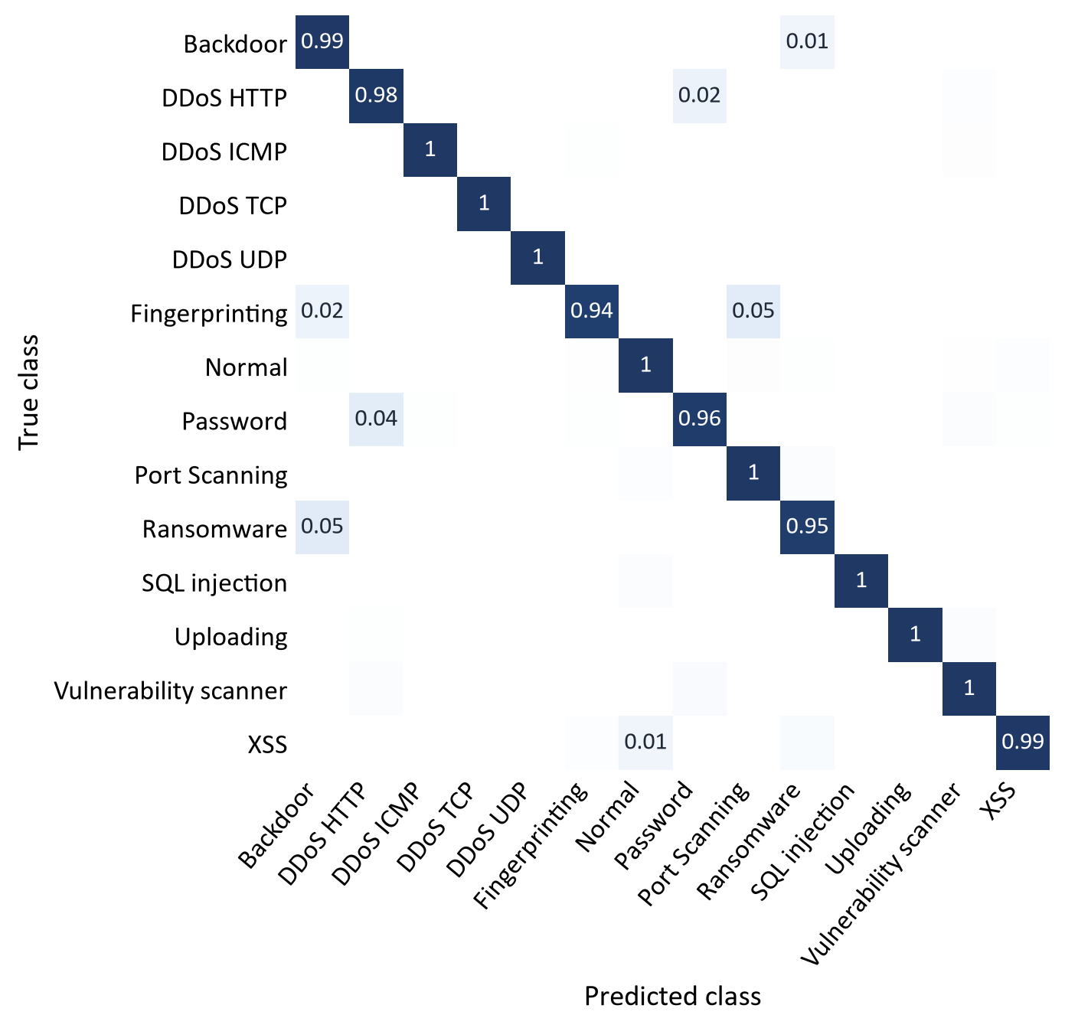
Results: Confusion Matrix of the Final Classifier
99.72%
accuracy on 397,073 packets from connections never seen in training
0.983
macro F1 across the 14 classes in the test split
Largest remaining errors: Password called DDoS HTTP (4%), DDoS HTTP called Password (2%). Both are HTTP requests to the same web server.
Ransomware called Backdoor (5%): both use port 4321.
MITM is not in the matrix: it is one ARP connection.
Shading is stretched so small errors show; each cell is the share of its true class.
Notes:
Flow-grouped test split, seed 42, 397,073 packets, row-normalised. MITM has no test rows (one connection).

Slide 16
Results: Federated Training on the Full Dataset
Attack macro-recall (cascade)
False alarms on normal traffic
1.89 million training rows, 20 rounds, one server and 10 or 20 client processes. Known attacks are caught in all six runs. Packet-level false alarms are 2.5% to 16.3%, but per connection only 0.34% to 1.04%, because the false alarms cluster in a few connections. Vertical axis of the left chart starts at 0.99.
Notes:
Six real multi-process runs, 20 rounds, no attackers (report Table 6.4). Seeds 42, 43, 44 change the split, partition and initialisation. Per-packet false alarms are high in some runs; per connection they are 0.34% to 1.04%.

Slide 17
Results: Detecting Unseen (Zero-Day) Attacks
Mean detection of the held-out class
Per held-out class (mean of three seeds)
Each of the 14 attack classes was removed from all training in turn, then scored.
Notes:
Leave-one-class-out on the full dataset, 14 attack classes, seeds 42/43/44 (report Tables 6.8 and 6.9). Per-class chart shows the mean over the three seeds.

Slide 18
Results: Resistance to Poisoned Clients
Known-attack macro-recall vs attackers
Autoencoder alone at 30% attackers
Known attacks stay at 0.985 to 0.997 recall up to 50% attackers. The trust filter protects the autoencoder: at 30% attackers its recall alone is 0.245 to 0.490, against 0.002 to 0.092 for plain FedAvg. The filter lets more attackers through than at 60,000 rows, and at 50% its median reference fails.
Notes:
Poisoning sweep and ablation on the full dataset, sign-flip attackers, seeds 42/43/44 (report Tables 6.6 and 6.7). At 50% the median-based filter breaks down as expected.

Slide 19
Results: Pruning and an Adaptive Attacker
Autoencoder recall alone vs pruning
Attacker survival in the filter
Share of weights set to zero. Cascade macro-recall stays at 0.993 or above at every level, but updates are still sent dense, so no communication saving is shown.
Survival is the share of attacker updates kept by the filter. The white-box stealth attacker is mostly missed. Single seed (42).
Notes:
Seed 42 only (report Tables 6.11 and 6.12). Pruning during training, no attackers; stealth attacker is white-box. Single seed, so these are indications, not firm trends.

Slide 20
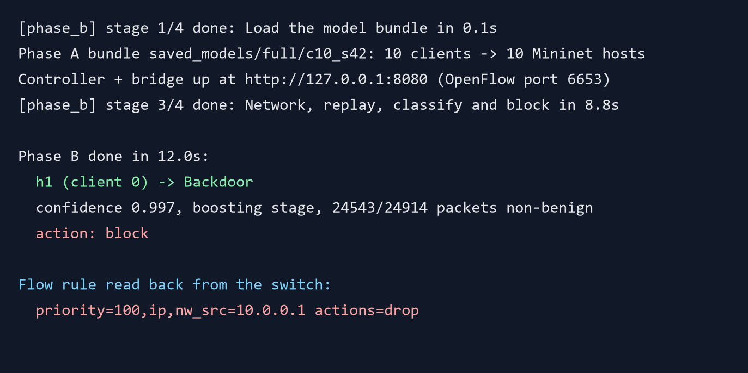
Results: SDN Mitigation (Phase B)
Confidence of the verdict per capture
14 of 14
12 of 14
captures end in a block decision and a drop rule read back from the switch
classified as the right attack type
MITM was called Ransomware and OS fingerprinting DDoS ICMP; both were still blocked.
Notes:
All 14 attack captures replayed through Mininet with the full-pool bundle, 10 clients, seed 42 (report Table 6.15). Snapshot lines are from logs/full/c10_s42/phase_b.log.

Slide 21
Results: Training Time and Decision Time
Time per full-dataset run (seconds)
Median time to decide on one packet (ms)
3,760 packets/s
cascade throughput in batch mode, one CPU thread; model time only
Federated training is 82% to 90% of each run (18 to 31 minutes in total).
Notes:
Training times from journey.json of each bundle (report Table 6.13). Latency from tools/latency_benchmark.py on one CPU thread (report Table 6.14); model time only, Phase B is not inline.

Slide 22
Conclusion
Objective | What the measurements show
1. Malicious-client filtering | Known-attack recall 0.985 to 0.997 up to 50% sign-flip clients. At 30% the filtered autoencoder keeps 0.245 to 0.490 recall; plain FedAvg falls to 0.002 to 0.092. A stealth attacker is mostly missed.
2. Efficient, private FL and enforcement | Clients send only weights (about 39 kB) and histograms. Runs take 18 to 31 minutes on 1.89 million rows. All 14 captures blocked.
3. Pruning | Autoencoder recall falls from 0.457 to 0.350 at 70% sparsity; cascade recall stays at 0.993 or above. No communication saving yet.
4. Anomaly-based detection | Unseen attack classes: cascade 0.895 to 0.944, classifier alone 0.723 to 0.757, autoencoder alone 0.590 to 0.728.
Beyond the objectives: the classifier reaches 99.72% accuracy and 0.983 macro F1 on unseen connections, and the models decide on a packet in a median 0.642 ms. Limits: mitigation is per capture rather than inline, and the trust filter is weaker at full scale than on the 60,000-row pool.
Notes:
Objectives and evidence from report Table 6.16. All figures are from full-dataset runs unless stated.

Slide 23
Future Enhancements
1
Streaming mitigation
2
Stronger defence
Classify flows after the first few packets so a rule is installed while an attack is still running.
Defend against the white-box stealth attacker, for example with a small trusted root dataset.
3
Full-scale repeats
4
Second dataset
Explain why the filter lets more attackers through at full scale; repeat the stealth, pruning and clipping tests over more seeds.
Validate on traffic that includes benign web use, to test how much the service-port feature depends on the testbed.
5
Sparse updates
6
Real hardware
Send pruned updates to save communication, and test zero-day detection of pruned models.
Federate the classifier, then deploy on edge devices and a hardware OpenFlow switch.
Notes:
Report Chapter 7, Future Work.

Slide 24
Papers Published
No paper has been published yet.
A research paper describing the cascade, the trust filter and the connection-level evaluation is in preparation.
Status: writing in progress (November 2026 onwards).
Material for the paper: the repaired MITM class, the connection-held-out evaluation and the full-dataset federated results.
Notes:
No paper is published yet; the research paper is being written (report Table 1.1, phase 19).

Slide 25
References
[1] M. A. Ferrag et al., “Edge-IIoTset: A new comprehensive realistic cyber security dataset of IoT and IIoT applications for centralized and federated learning,” IEEE Access, vol. 10, pp. 40281–40306, 2022.
[2] V. Mothukuri et al., “Federated-learning-based anomaly detection for IoT security attacks,” IEEE Internet of Things Journal, vol. 9, no. 4, pp. 2545–2554, 2022.
[3] B. Li et al., “DeepFed: Federated deep learning for intrusion detection in industrial cyber-physical systems,” IEEE Trans. Industrial Informatics, vol. 17, no. 8, pp. 5615–5624, 2021.
[4] H. Zhang et al., “A two-stage intrusion detection method based on light gradient boosting machine and autoencoder,” Math. Biosciences and Engineering, vol. 20, no. 4, pp. 6966–6992, 2023.
[5] Z. Abou El Houda, A. S. Hafid, L. Khoukhi, “MiTFed: A privacy preserving collaborative network attack mitigation framework based on federated learning using SDN and blockchain,” IEEE Trans. Network Science and Engineering, vol. 10, no. 4, 2023.
[6] J. L. Hernandez-Ramos et al., “Intrusion detection based on federated learning: A systematic review,” ACM Computing Surveys, vol. 57, no. 12, 2025.
[7] X. Cao, M. Fang, J. Liu, N. Z. Gong, “FLTrust: Byzantine-robust federated learning via trust bootstrapping,” NDSS, 2021.
[8] D. Yin, Y. Chen, K. Ramchandran, P. Bartlett, “Byzantine-robust distributed learning: Towards optimal statistical rates,” ICML, PMLR 80, pp. 5650–5659, 2018.
[9] M. M. Galal, “Provenance, not behaviour: A serialisation artifact in Edge-IIoTset,” arXiv:2608.15761, 2026.
Notes:
Selected from the 15 references in the report; the full list is in the report.

Slide 26
Thank You
Questions?
Results and report: aronnnn1.github.io/FL-IDS-showcase

