Slide 1

FL-IDS: Federated Learning-Based Intrusion Detection System for IoT/IIoT
Aaron B Ajay
1BM23CS003
Aaryan Prakash
1BM23CS006
Amal Roy
1BM23CS025
Amogh Krishna JS
1BM23CS029
Mr. Syed Akram
Assistant Professor
Department of Computer Science and Engineering
B.M.S. College of Engineering
Notes:
Good morning. We are presenting FL-IDS: an intrusion detection system for IoT and industrial IoT networks that learns across many sites without collecting their traffic, resists poisoned training, catches attacks it has never seen, and blocks attackers on the network switch.

Slide 2
OUTLINE
Problem Statement
High level Design
Detailed Design
Implementation
Results (Table, Graphs, ....Datasets Used (If Any)) and Snapshots of the output
Conclusion and Future Enhancements
Paper published
References
Notes:
This is the flow of the talk: the problem, the design, how we implemented it, the results, and what comes next.

Slide 3
Sustainable Development Goals (SDGs) Addressed
SDG 9: Industry, Innovation and Infrastructure
• Enhances secure network infrastructure
• Supports smart systems
SDG 11: Sustainable Cities and Communities
• Secure IoT systems for smart cities, including traffic systems, healthcare and energy grids
• Helps ensure safe and reliable operation of connected urban infrastructure
SDG 16: Peace, Justice and Strong Institutions
• Strengthens cybersecurity
• Protects sensitive digital data
Promotes secure and resilient digital ecosystems
Notes:
Three Sustainable Development Goals. SDG 9: we make network infrastructure more secure and support smart systems. SDG 11: smart cities run on IoT, in traffic systems, healthcare and energy grids, and securing it keeps that urban infrastructure safe and reliable. SDG 16: the project strengthens cybersecurity and protects sensitive data. Together, these promote secure and resilient digital ecosystems.

Slide 4
Collaboration
Category: Not a multidisciplinary project
A Computer Science and Engineering project; not community-oriented or multidisciplinary.
Field work / collaboration
No external collaboration.
We use the public Edge-IIoTset dataset and its real packet captures, recorded on a seven-layer IoT/IIoT testbed with 10+ kinds of sensors (Ferrag et al., IEEE Access, 2022).
Notes:
This is not a multidisciplinary or community-oriented project; it sits within computer science and engineering. We had no external collaborator; all experiments use a public dataset recorded on a real IoT testbed.

Slide 5
Problem Statement
IoT and industrial IoT devices are everywhere, lightly protected, and attacked constantly.
Privacy
Sending every site's raw traffic to one place exposes how a factory or building runs.
New attacks
A normal classifier can only name attacks it was trained on.
Sabotage
In shared training, a few bad participants can poison the model.
No action
Detecting an attack does not stop it.
Our goal
One system that solves all four, and classifies attacks with at least 95% accuracy and 0.95 macro F1.
Notes:
Four problems with existing intrusion detection for IoT. Privacy: central collection of raw traffic. New attacks: classifiers only know their training labels. Sabotage: shared training can be poisoned. No action: a detector that only raises alerts doesn't stop anything. Our goal was one system for all four, with at least 95% accuracy and 0.95 macro F1. Macro F1 means every attack type counts equally, so a model can't hide poor results on rare attacks behind the large amount of normal traffic.

Slide 6
Objectives
1. Malicious Client Detection & Filtering
To develop a malicious client detection mechanism using anomaly-based or trust-based evaluation to identify and filter compromised participants in the federated network.
2. Efficient Privacy-Aware FL Design
To design a lightweight and efficient federated learning framework that balances privacy and performance while minimizing computational and communication overhead in resource-constrained IoT environments.
3. Model Optimization for Scalability
To enhance system scalability by applying model optimization techniques such as weight pruning, reducing computational and communication overhead.
4. Semi-Supervised & Anomaly-Based Detection
To integrate semi-supervised learning and Autoencoder-based anomaly detection to effectively identify abnormal or potentially poisoned patterns without relying entirely on labeled data.
Notes:
Our four objectives. One: detect and filter malicious clients in federated training, using trust-based evaluation. Two: a lightweight, privacy-aware federated learning design that keeps computation and communication low on IoT hardware. Three: model optimization such as weight pruning for scalability; our model is already small, and pruning itself is future work. Four: autoencoder-based anomaly detection that does not depend only on labelled data, so it can flag new or poisoned patterns.

Slide 7
High level Design
Phase A: training (offline, federated)
Phase B: protection (live)
10 sites; traffic stays local
each site trains its own copy
checks every update, drops bad ones, combines the rest
trained classifier + anomaly detector
live traffic checked; attacker blocked
1
IoT sites
2
Local learning
3
Server
4
Detector
5
SDN switch
Raw traffic never leaves a site: only model updates travel to the server. Phase A produces a saved model bundle; Phase B loads it on an emulated network (Mininet + Open vSwitch).
Notes:
The big picture has two phases. In Phase A, ten sites each train a copy of the detector on their own traffic and send only the model updates to the server. The server checks each update, throws out suspicious ones and combines the rest. The trained detector is saved. In Phase B we load it on an emulated network: traffic is checked live, and when an attack is found the switch gets a rule to block it.

Slide 8
Detailed Design: Two Checks per Packet
yes, sure
Check 1: Known attack?
LightGBM classifier names the attack type
Attack type
e.g. “SQL injection” (≥ 70% sure)
Network traffic
packets + connection features
no / unsure
too different
Anomalous
possible new (zero-day) attack
Check 2: Looks normal?
autoencoder compares it to this site's normal traffic
Normal
matches normal
Notes:
Every packet goes through two checks. Check 1 is a LightGBM classifier that knows the 14 attack types; if it is at least 70% sure it's an attack, that is the answer. Otherwise Check 2 runs: an autoencoder that has learned what this site's normal traffic looks like. If the packet is too different from normal, it is flagged as anomalous, which is how we catch attacks nobody trained us on.

Slide 9
Detailed Design: Training Safely Together
server sends the current detector to all 10 sites
each site trains on its own traffic, which never leaves
server compares each site's change with the group's typical change
suspicious changes are dropped; the rest are averaged robustly
1
Send model
2
Learn locally
3
Trust check
4
Combine
repeated for 20 rounds
The trust check in one line
Like a teacher comparing homework: if one student's answer points the opposite way to the class's typical answer, or keeps disagreeing round after round, it is set aside. Large answers are also capped so one student can't dominate.
Notes:
This is federated learning with a trust filter. Each round the server sends the current model out, each site trains on its own data, and sends back only how its model changed. The server compares every change with the typical change across all sites using cosine similarity. A change that points the opposite way, is an outlier, or comes from a site that keeps disagreeing is dropped. The rest are size-limited and combined with a trimmed mean, which ignores the extremes.

Slide 10
Implementation
Part | Built with
Data preparation | Python, pandas: cleaning, dataset repairs, new features
Check 1: classifier | LightGBM (gradient-boosted trees)
Check 2: anomaly detector | PyTorch autoencoder, one per site
Federated training | Flower: 1 server + 10 real client processes
Network + blocking | Mininet, Open vSwitch, os-ken OpenFlow controller
Live traffic features | TShark + tcpreplay (replays real attack captures)
Monitoring | Streamlit live dashboard
Quality | 224 automated tests; one config file; repeatable runs
Ran on: Ubuntu VM (UTM) on a MacBook Pro M5, 4 CPUs, 7 GB RAM, all free and open-source software
Notes:
These are the tools for each part. Everything is open source and runs on one laptop inside a virtual machine.

Slide 11
Implementation: Step by Step
2.2 million labelled packets, 15 classes
label leak (Galal 2026); broken MITM rows
service port, content, connection behaviour
LightGBM on the server's labelled set
1
Load dataset
2
Fix dataset errors
3
Build features
4
Train classifier
each site gets very different traffic
local training + trust check, 20 rounds
accuracy, sabotage tests, unseen-attack tests
replay attack → detect → block on switch
5
Split into 10 sites
6
Federated rounds
7
Evaluate
8
Live demo
Notes:
Eight steps from raw data to a blocked attacker. Steps 1 to 3 prepare the data, including fixing two errors in the public dataset: broken MITM rows we found, and a label leak first reported by Galal. Step 4 trains the classifier. Steps 5 and 6 are federated training across ten simulated sites. Step 7 evaluates everything, and step 8 is the live demo.

Slide 12
Implementation: How We Raised Accuracy
The problem: in web attacks like SQL injection and XSS, only 5–17% of packets carry any content. The rest are identical “acknowledgement” packets, the same for every attack, so the classifier could not tell them apart.
1. Which service?
The server port of each connection: web (80), MQTT (1883), etc.
2. What was sent?
Numbers describing the content: length, randomness, SQL or script keywords, uploads, logins.
3. How did the conversation behave?
Group packets into connections; every packet gets its connection's totals and rates.
+ rare attack types weighted higher. We never use IP addresses or timestamps, since those would let the model cheat.
Notes:
This is the main improvement this semester. The classifier was stuck at about 0.89 macro F1 because most packets of web attacks carry no content: they are empty acknowledgements that look the same for every attack. We added three kinds of information: which service a connection is for, numbers describing what was sent, and how the whole connection behaved. Then each empty packet carries what its connection did. We also weighted rare attack types more. We deliberately never used IP addresses or timestamps, because in this dataset they would reveal the answer.

Slide 13
Results: Dataset and How We Tested
Edge-IIoTset | Value
Packets | 2.2 million
After cleaning | 1.99 million
Classifier trained on | 1.43 million
Tested on (unseen) | 397 thousand
Classes | 15 (Normal + 14 attacks)
Normal traffic | 71%
Rarest attacks | MITM, Fingerprinting
A strict test
We test on whole connections the model has never seen, so it cannot pass by memorising them.
Repeated with 3 different random seeds.
Accuracy = share of correct answers. Macro F1 = average score over all 15 classes, so rare attacks count as much as common ones.
Fixed first: a formatting error in the public dataset gave away the answer (one column alone separated normal from attack perfectly), and the MITM rows were in the wrong columns.
Notes:
The dataset is Edge-IIoTset: about two million packets after cleaning, fifteen classes, 71% normal traffic. The classifier is trained on 1.43 million of them and tested on 397 thousand it never saw. The federated part first ran on a 60 thousand row sample; the main results now use the whole pool, about 1.89 million rows, with each conversation kept together. We test strictly, on whole connections never seen in training, and repeat with three seeds. Before any of this we fixed two errors in the public data. One was a formatting difference that alone separated normal from attack traffic perfectly; Galal reported it first, in August 2026, and we credit that paper. The other, MITM rows stored under the wrong column names, we found and repaired ourselves.

Slide 14
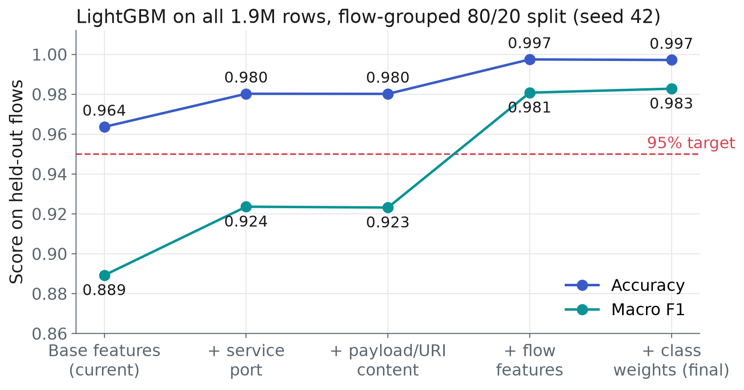
Results: Accuracy Target Met
99.7%
accuracy (was 96.4%)
0.983
macro F1 (was 0.889)
Target: ≥ 95% and ≥ 0.95.
Same result with 3 seeds (0.983–0.985).
Still 99.7% / 0.979 when trained on only 5% of the data.
Notes:
This is the headline result. With the original features, accuracy was 96.4% but macro F1 only 0.889. Each new kind of information pushes it up; the connection features give the big jump. The final classifier reaches 99.7% accuracy and 0.983 macro F1 on connections it never saw, well above the 95% target. It holds across three seeds, and even when trained on only 5% of the data, which is what our server actually holds.

Slide 15
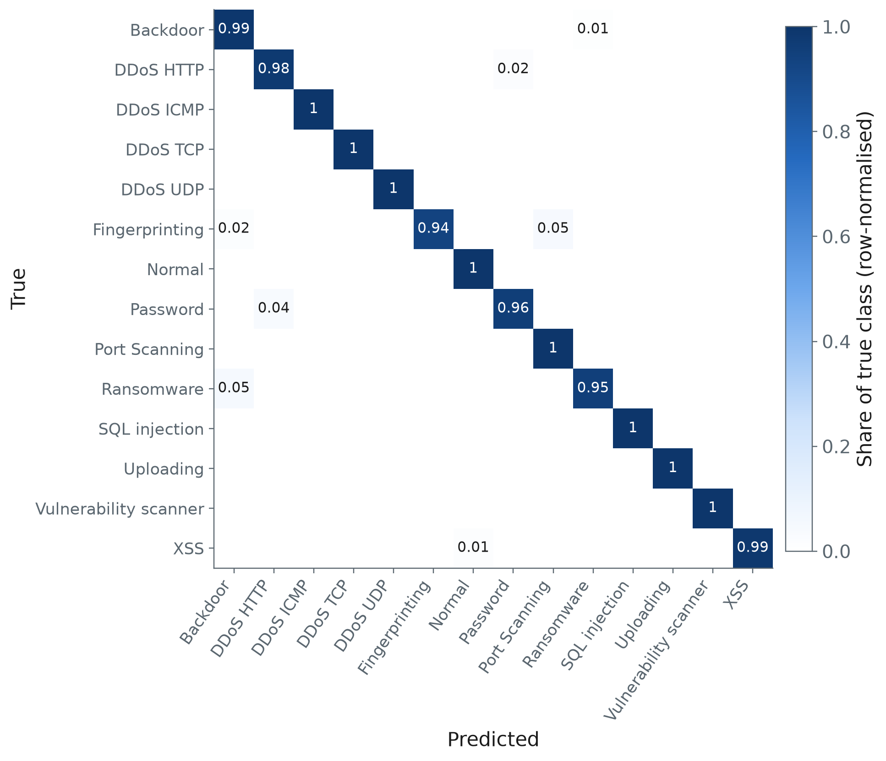
Results: Confusion Matrix (Final Classifier)
How to read it
Rows = the real attack, columns = what we predicted. A perfect model is a dark diagonal.
Almost perfect: 11 of 14 classes are 0.98–1.00.
Small mix-ups: Password ↔ DDoS HTTP (both hit the same web server), Ransomware → Backdoor (same port).
MITM is a single connection, so it can't appear in this strict test (random split: F1 0.99).
Notes:
The confusion matrix shows where the model is right and wrong. Each row is the real class and each column the prediction, so a perfect model is a dark diagonal. Ours is almost entirely diagonal. The only visible mix-ups are between Password attacks and HTTP floods, which both send web requests to the same server, and Ransomware sometimes taken for Backdoor because they use the same port.

Slide 16
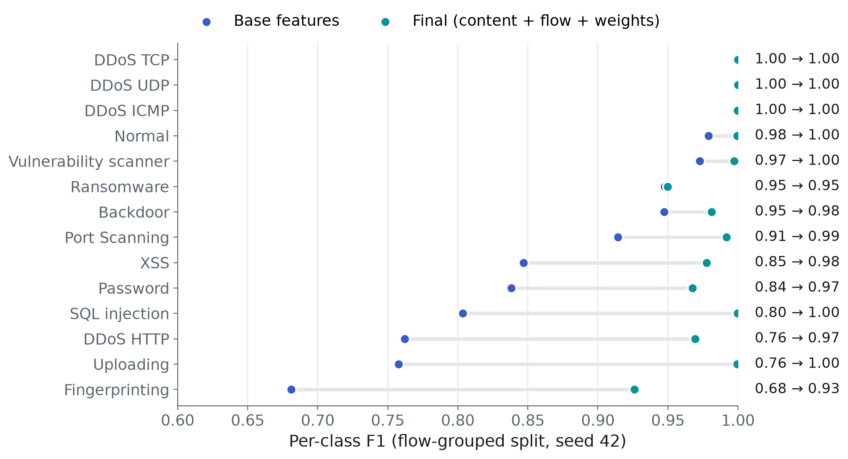
Results: Every Attack Type Improved
Biggest gains
Uploading 0.76 → 1.00
DDoS HTTP 0.76 → 0.97
SQL injection 0.80 → 1.00
Password 0.84 → 0.97
XSS 0.85 → 0.98
Fingerprinting 0.68 → 0.93
Exactly the web and rare attacks that were weak before.
Notes:
Per attack type, every class is now above 0.92 F1. The largest gains are exactly the web attacks that used to be confused with each other, plus Fingerprinting, the rarest class, which benefited from class weighting.

Slide 17
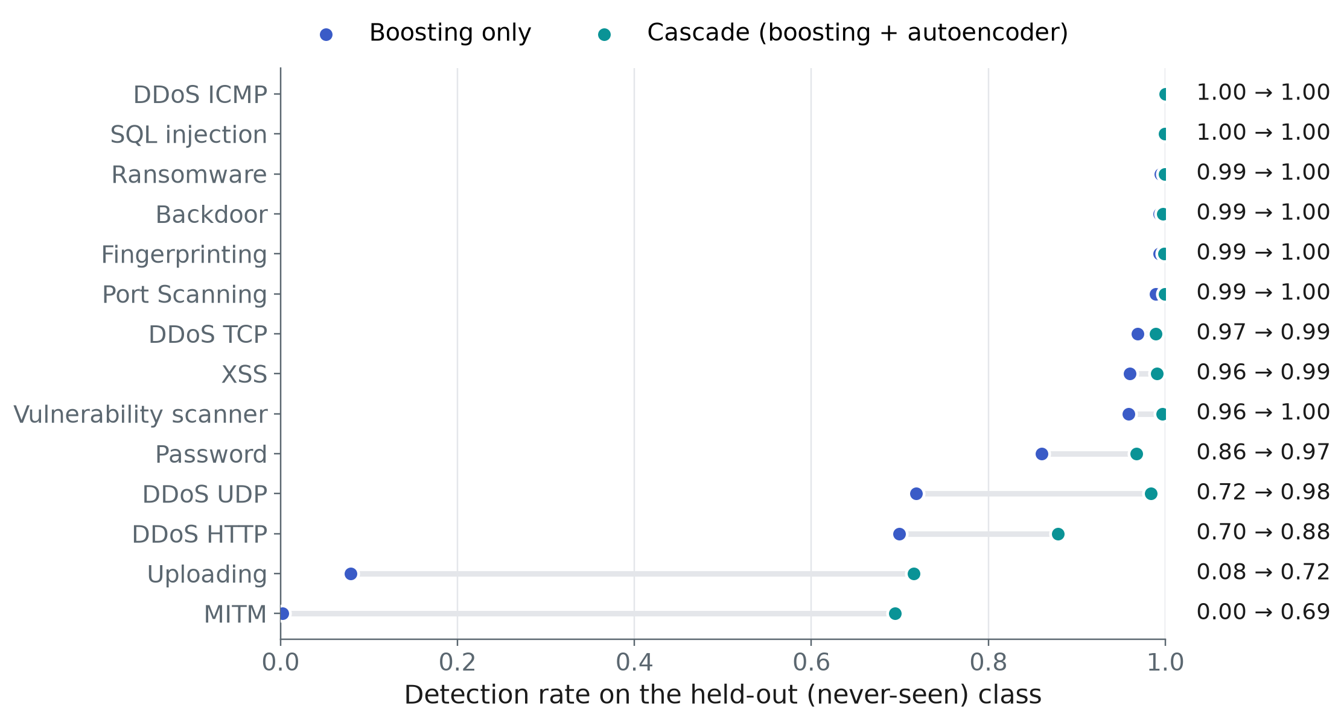
Results: Catching Attacks Never Seen Before
0.94
detection with both checks (was 0.74)
0.80
classifier alone (was 0.53)
Each attack type was hidden from training, then tested.
Password 0.44 → 0.97, XSS 0.52 → 0.99.
Worse: MITM 0.89 → 0.69.
Notes:
To test unseen attacks, we hid each attack type completely from training, one at a time, and then checked whether it was still caught. With the new features, the classifier alone catches 80% on average; with the anomaly check added it is 94%, up from 74% before the new features. The web attacks improved the most, for example Password from 44% to 97%. One honest exception: MITM dropped from 89% to 69%, because its single connection now looks fairly ordinary to the anomaly check.

Slide 18
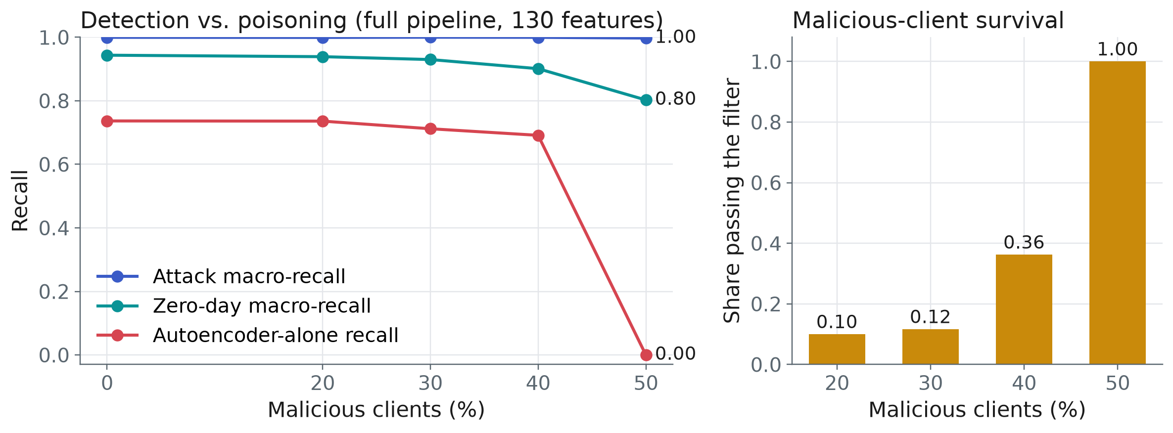
Results: Resisting Sabotage
What it shows
Detection stays at 99.7–100% with up to 50% malicious sites, and new-attack detection at 90–94% up to 40%. Without the trust check (plain averaging) the anomaly check is ruined at 30%. At 50% attackers become the majority and the check fails, a known limit of this kind of defence.
Notes:
Here some of the ten sites are attackers that send poisoned updates. Detection stays at almost 100%, and detection of new attacks stays above 90% up to 40% attackers. On the right: only 10-12% of attacker updates get through at 20-30%, and 36% at 40%. Without our trust check, plain federated averaging broke at 30%. At 50% the attackers are the majority, so the 'typical' update is theirs and the check fails, which is the expected limit of any median-based defence.

Slide 19
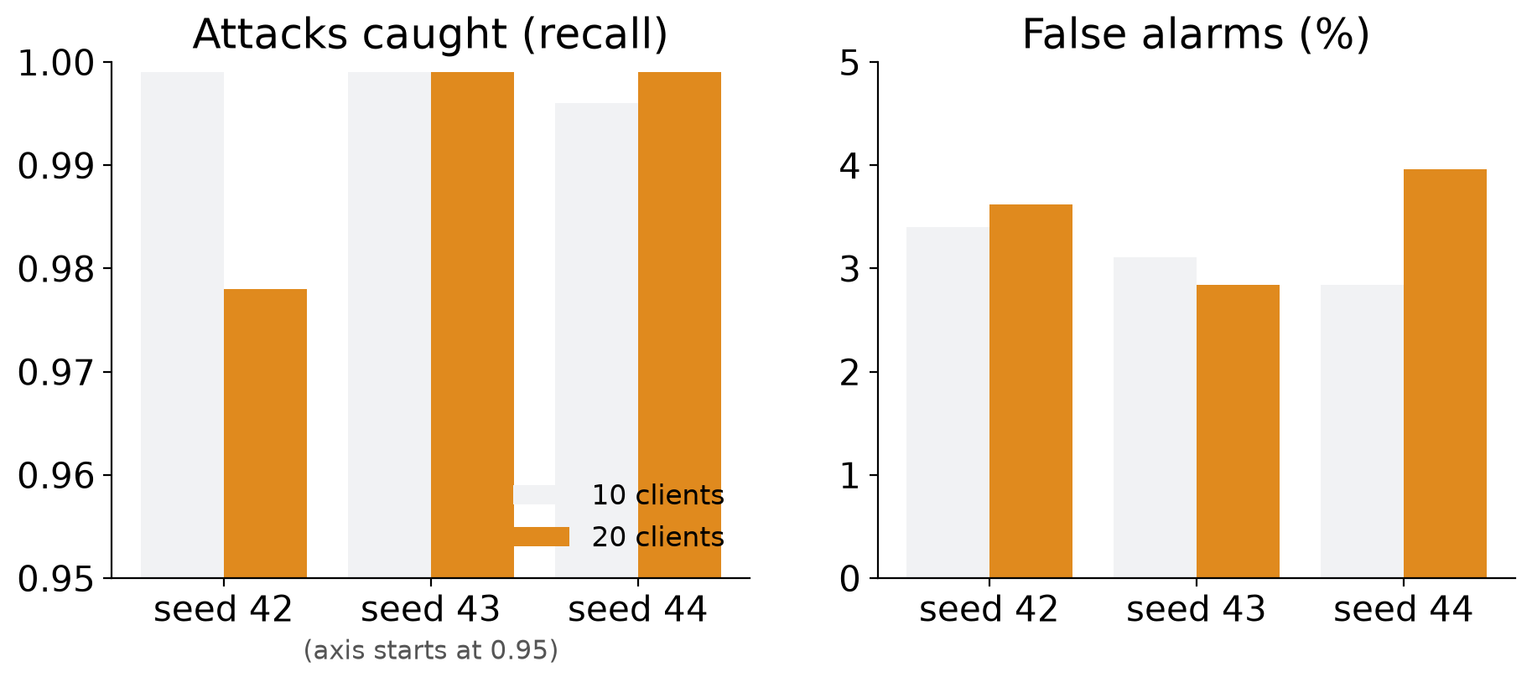
Results: Scaling Up and Repeating
What it shows
Real runs, not a simulation: 10 and 20 separate client processes, three seeds each. Attacks caught on average: 0.998 with 10 sites and 0.992 with 20; false alarms stay at 2.8–4.0%. One 20-site run (seed 42) dips to 0.978 and is not yet explained.
Notes:
Earlier we only had a one-process simulation of 20 sites. We now ran the real thing: one server and 20 separate client programs, on a virtual machine with enough memory. We repeated it with three different random seeds for both 10 and 20 sites. Attack detection stays very high; one 20-site run at seed 42 is lower at 0.978, and we have not yet found out why. Only three seeds, so we do not claim confidence intervals.

Slide 20
Results: Live Demo (Detect and Block)
real Backdoor attack capture, 24,914 packets, into the emulated network
classified as Backdoor with 99.7% confidence
confidence ≥ 85% → block
drop rule installed on the switch and read back to confirm
1
Replay
2
Detect
3
Decide
4
Block
Rule on the switch
priority=100, ip, nw_src=10.0.0.1 actions=drop
Real 10-site federated run: 0.999 attack detection (was 0.889), 3.5% false alarms. 24,669 of 24,914 packets flagged. Limitation: the decision is made after the capture is analysed, not packet by packet.
Notes:
Finally the live demo. We replayed a real Backdoor attack into the emulated network. The detector classified it as Backdoor with 99.7% confidence, chose to block, and installed a drop rule on the switch, which we read back from the switch itself to confirm. One honest limitation: right now the decision is made after the whole capture is analysed, not packet by packet.

Slide 21
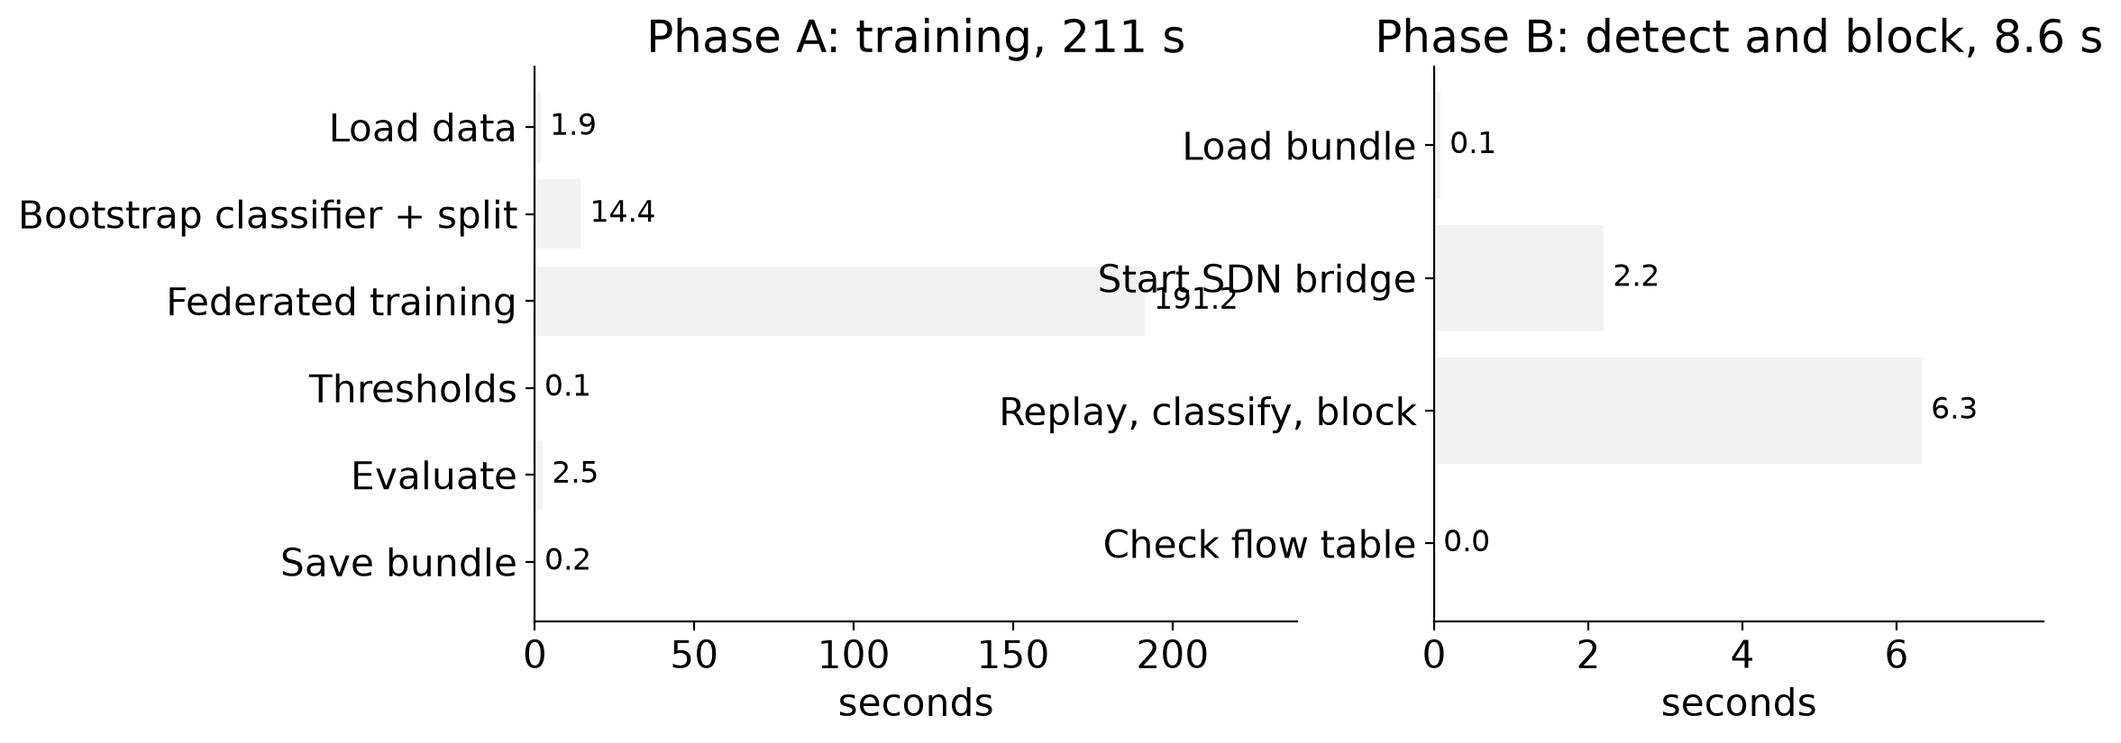
Results: One Whole Run, Timed
What it shows
A complete run, from raw data to a block rule on the switch, took about 219 seconds. Training the shared model is almost all of it; once a model exists, spotting and blocking an attack takes seconds.
Notes:
This is one complete run on 10 sites with the data features already prepared. The shared model takes a few minutes to train. Afterwards the live part, replaying the attack, classifying it and installing the drop rule, takes seconds.

Slide 22
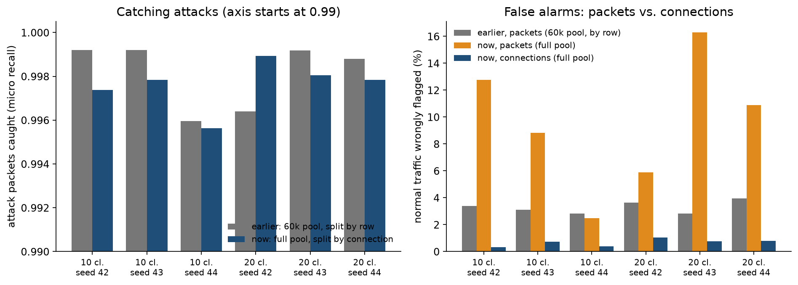
Results: The Whole Dataset
What it shows
Everything now trains on all 1.99 million usable messages, with each conversation kept on one side of the exam. Known attacks: still 99.6% caught. False alarms: about 3% for a typical site, up to 16% of all normal packets, because a few very long normal conversations get flagged (under 1% of conversations). New attacks: 90–94% detected (was 94–95%). All 14 recorded attacks are blocked in the live demo; 12 are named correctly.
Notes:
This is the run you asked about: the whole federated system on the whole dataset, six real runs with 10 and 20 sites, three seeds. We also made the test stricter: all packets of one conversation stay together, so a test packet never has a twin in the practice data. Known attacks are caught as before, so nothing was inflated. False alarms depend on how you count: per packet some runs flag up to 16 percent of normal packets, but that is a handful of very long normal conversations being flagged as a block; per conversation it is under one percent. New-attack detection and the trust filter are somewhat weaker at this scale and we do not yet know why. In the live demo all 14 recorded attacks were blocked; two were labelled as the wrong attack type (the MITM recording as Ransomware, the fingerprinting recording as DDoS). These are the dataset's own recordings, so it is a demonstration, not a held-out test.

Slide 23
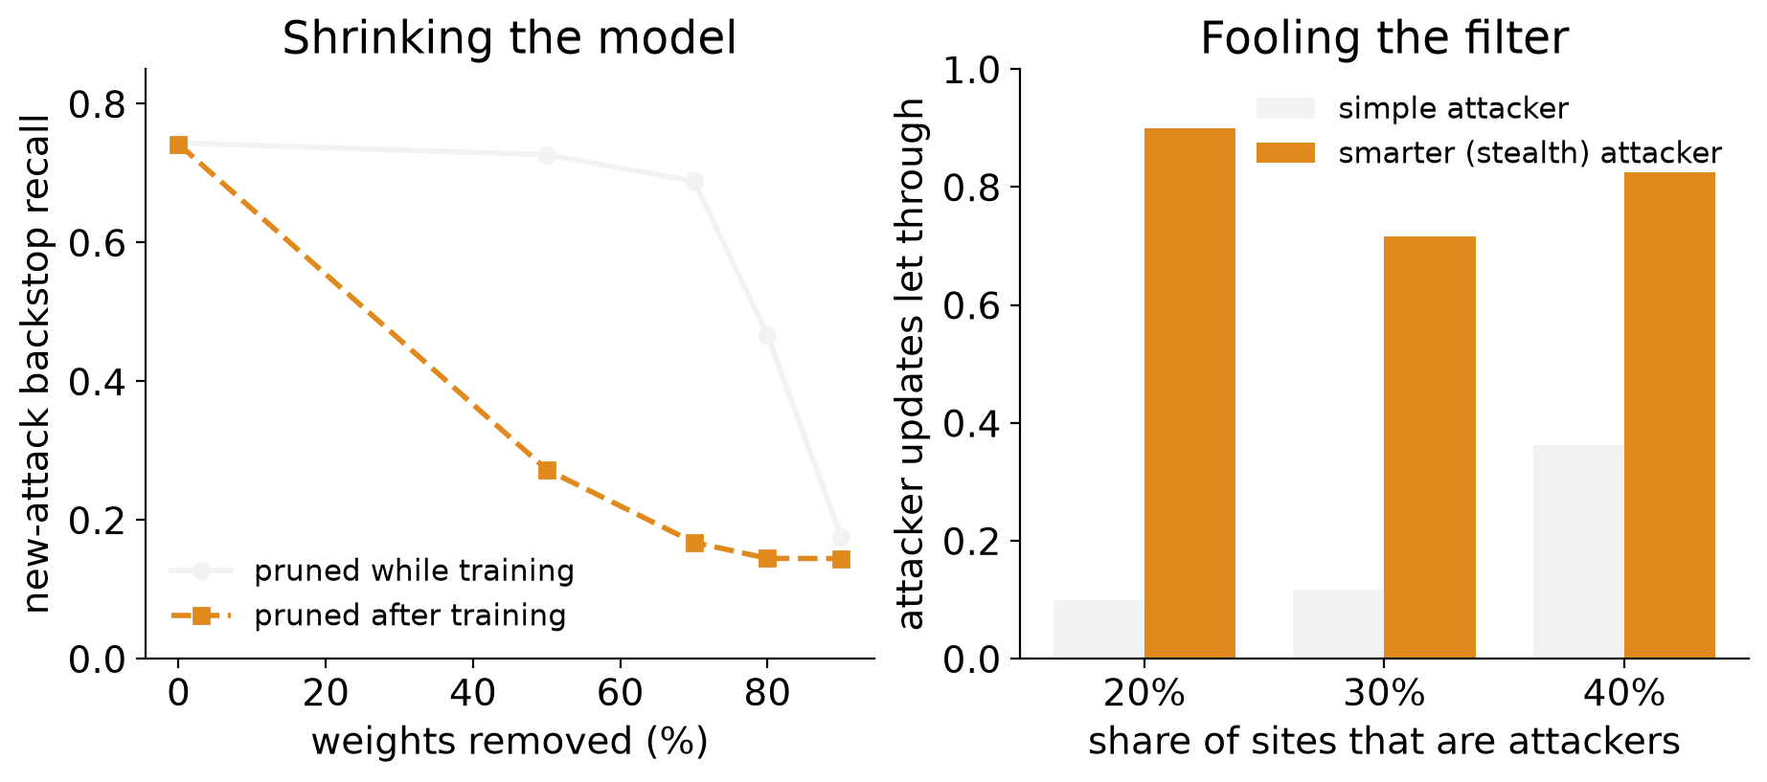
Results: Pruning and Smarter Attackers
What it shows
Removing 70% of the detector's weights costs little if done while training (backstop recall 0.74 to 0.69), but ruins it if done afterwards. A smarter attacker slips past the filter most of the time, though known attacks are still caught. Across 3 seeds, new-attack detection stays 0.94–0.95.
Notes:
Three follow-ups. First, weight pruning, which was one of our objectives: pruned while the shared model trains, 70 percent of the weights can go and the backstop barely changes; pruned afterwards it collapses. Second, a smarter attacker that knows how our filter works: it gets through most of the time, which is a real weakness, although the first-stage classifier still catches known attacks. Third, we repeated the big experiments with two more seeds and the conclusions held. Limits: single seed for pruning and the smart attacker, and we did not test new-attack detection against the smart attacker.

Slide 24
Conclusion
Accuracy target met: 99.7% accuracy and 0.983 macro F1 on 397k unseen packets (was 96.4% / 0.889)
Whole system improved: real 10-site run 0.999 detection (was 0.889)
Catches new attacks: 0.94 vs 0.80 detection of never-seen attack types (was 0.74 / 0.53)
Resists sabotage: steady with up to 40% malicious sites
Acts automatically: detected attacker blocked on the switch, verified
Honest data: found and repaired broken MITM rows; fixed a label leak first reported by Galal (2026)
What's novel: we found no published system combining all five parts, and the MITM repair
Project complete: every planned phase done and verified end to end; paper being written
Notes:
To conclude: the project is complete. We met the accuracy target with a strict test, the second check catches attacks never seen before, the training resists sabotage up to 40% bad sites, and detections turn into verified blocking rules. We also found and repaired broken MITM rows in a popular public dataset, and fixed a label leak first reported by Galal. Our searches found no published system that combines all five parts, though that is based on targeted searches, not a full systematic review.

Slide 25
Future Enhancements
Send sparse updates and test pruned models on new attacks (pruning itself is done; communication is not yet reduced)
Block attacks while they are still happening (decide after the first few packets)
Test smarter attackers, and more than 50% bad sites
Repeat every federated experiment with several seeds
Test on a second dataset that includes normal web traffic
Deploy on real edge devices and a hardware switch
Notes:
Next steps: prune the model to cut communication further, make blocking happen while an attack is still in progress, test smarter attackers, and validate on a second dataset.

Slide 26
Papers Published
Status: paper in preparation (draft in progress)
Working title: FL-IDS: Federated Learning-Based Intrusion Detection System for IoT/IIoT
Venue: not yet submitted
Notes:
Our paper is in preparation. All the experiments are complete, so we are now writing it up for submission.

Slide 27
References
M. A. Ferrag et al., “Edge-IIoTset: A new comprehensive realistic cyber security dataset of IoT and IIoT applications for centralized and federated learning,” IEEE Access, vol. 10, pp. 40281–40306, 2022.
V. Mothukuri et al., “Federated-learning-based anomaly detection for IoT security attacks,” IEEE IoT Journal, vol. 9, no. 4, 2022.
B. Li et al., “DeepFed: Federated deep learning for intrusion detection in industrial cyber–physical systems,” IEEE TII, vol. 17, no. 8, 2021.
X. Cao, M. Fang, J. Liu, N. Z. Gong, “FLTrust: Byzantine-robust federated learning via trust bootstrapping,” NDSS, 2021.
J. Xu et al., “Byzantine-robust federated learning through collaborative malicious gradient filtering (SignGuard),” IEEE ICDCS, 2022.
H. Zhang et al., “A two-stage intrusion detection method based on LightGBM and autoencoder,” Math. Biosci. Eng., vol. 20, no. 4, 2023.
Z. Abou El Houda, A. S. Hafid, L. Khoukhi, “MiTFed: … federated learning using SDN and blockchain,” IEEE TNSE, vol. 10, no. 4, 2023.
J. L. Hernandez-Ramos et al., “Intrusion detection based on federated learning: a systematic review,” ACM Computing Surveys, vol. 57, no. 12, 2025.
I. Sharafaldin, A. H. Lashkari, A. A. Ghorbani, “Toward generating a new intrusion detection dataset and intrusion traffic characterization,” ICISSP, 2018.

Slide 28
Thank You
Notes:
Thank you. We're happy to take questions.

