Slide 1
Implementation of Item Management System in Online Games using Blockchain Technology
4조
2014105085 정재훈
2014105061 원응호
2014105044 서창호
2014105030 노경환
Notes:
발표 준비 시스템 개요도, 역할분담, 면담사진, 논문 초안 및 계획 10p 분량

Slide 2
Index
Story Board
Project Plan
Why BlockChain
Roles
Notes:
목차
왜 블록체인을 선택했는지
스토리보드
역할분담
프로젝트 계획

Slide 3
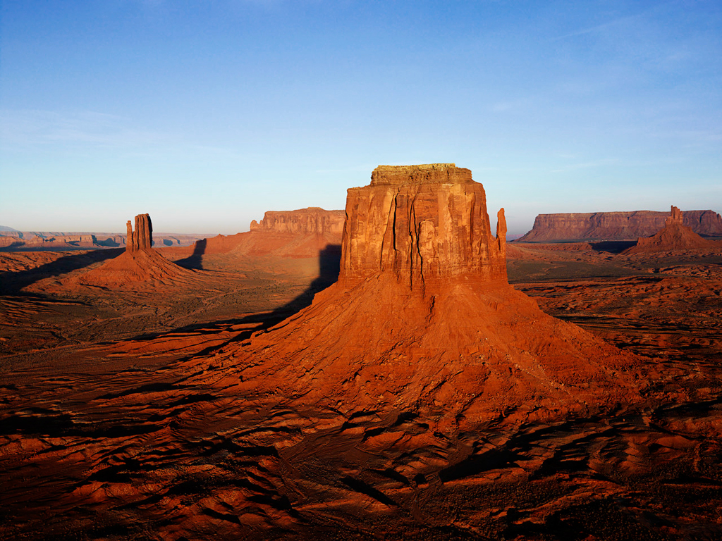
Story Board
The First Screen
Log In
(Use account information)
WELCOME
ID
PW
ID
PW
①
Login
Notes:
Story

Slide 4

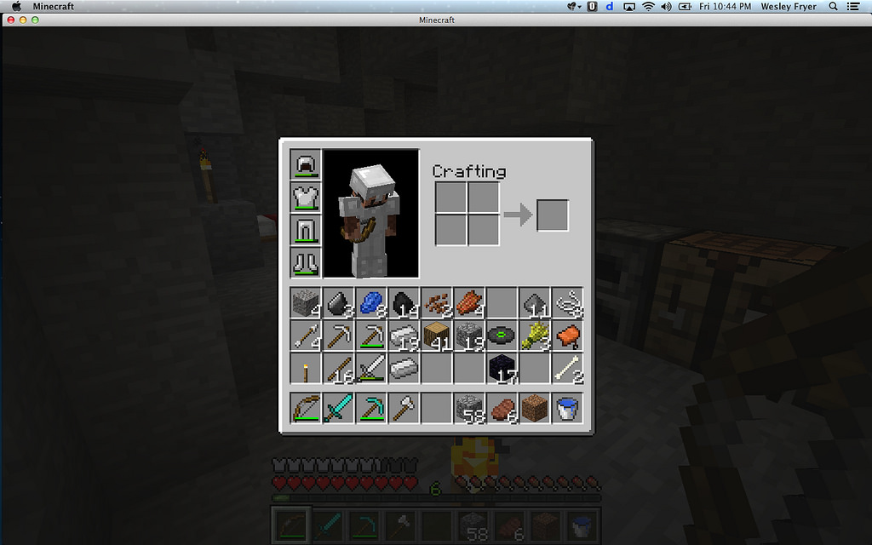


Story Board
In-game screen
Application for exchange with other account characters
Leverage Inventory
Menu
②
산와머니
교환신청
***
***
①
③
메뉴

Slide 5
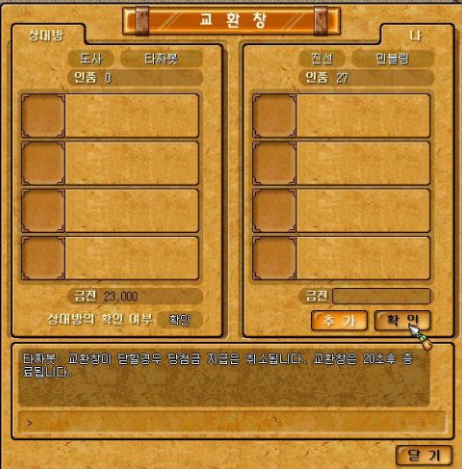
Story Board
In-game screen
Exchange with other account characters
Save exchange record as Log data
①
②
메뉴

Slide 6

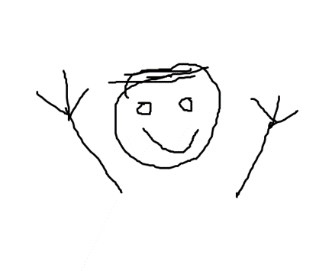
Roles
JEONG Jae-Hun
(Team Leader)
- Implementing Blockchain of demo game
- Visualize Blockchain Transaction
WON Eung-Ho
(Blockchain Director)
- Monitoring Blockchain System
Implementing contract of Blockchain
- Implementing Development environment

Slide 7
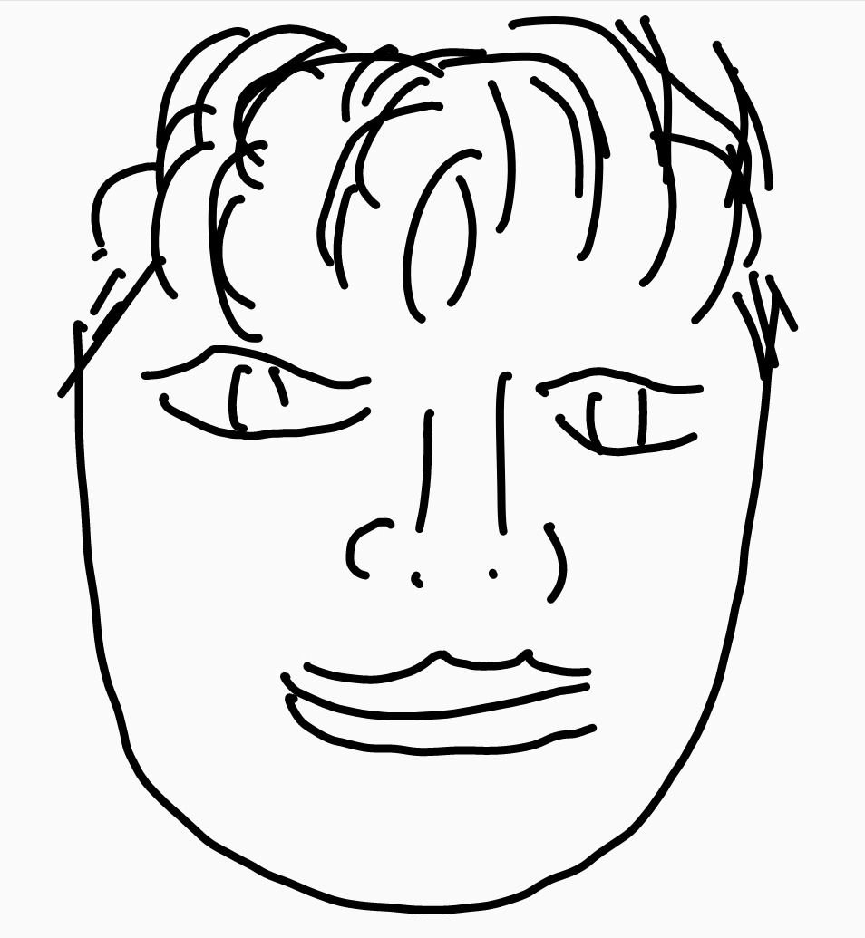
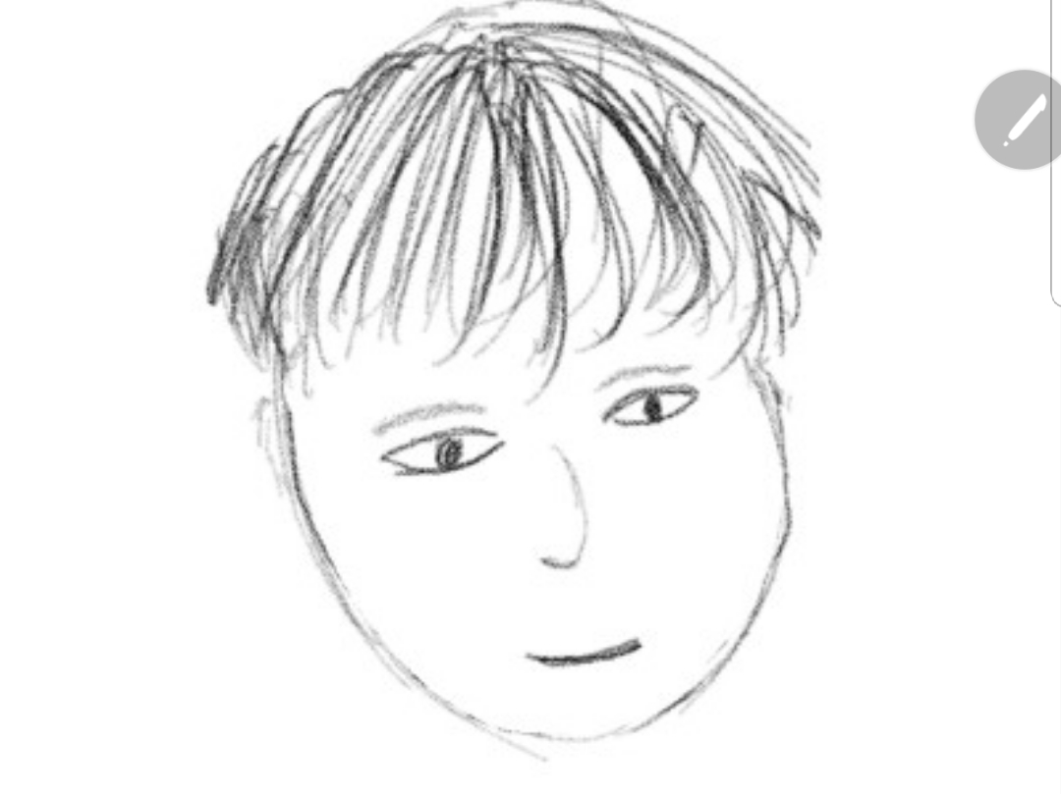
Roles
SEO Chang-Ho
(Implement Director)
- Development of Demo Game through Unity
- Extracting game log data with SQLite
NOH Kyung-Hwan
- Development of Demo Game through Unity
- UI/UX Integration
- Testing

Slide 8
Project Plan
 |  |  |  |  |  |  |  |  | planned period |  |  |  |  |  | actual starting date |  |  |  |  | completion rate
 |  |  |  |  |  | Period |  |  |  |  |  |  |  | actual(overdue) |  |  |  |  |  | % completion(overdue)
Activity | Planned Starting Week | Planned Period | Actual Starting Week | Actual Period | Completion Rate | Sep |  |  |  | Oct |  |  |  |  | Nov |  |  |  | Dec
 |  |  |  |  |  | 1 | 2 | 3 | 4 | 5 | 6 | 7 | 8 | 9 | 10 | 11 | 12 | 13 | 14 | 15
First Meeting with Mentor | 1 | 1 | 1 | 1 | 100%
Writing Paper | 1 | 2 | 1 | 2 | 100%
Plan Presentation | 2 | 2 | 2 | 2 | 100%
Design Demo game | 3 | 3 | 3 | 3 | 100%
Design Contraction | 3 | 3 | 3 | 3 | 70%
Implementing demo games | 6 | 7 |  | 6 | 0%
Implementing System | 6 | 2 |  | 8 | 0%
Implementing Server | 6 | 2 |  | 6 | 0%
Implementing Private Blockchain | 6 | 7 |  | 3 | 0%
Implementing DB | 6 | 4 |  | 6 | 0%
Extracting Log Data | 6 | 5 |  | 7 | 0%
Distributing Log Data with Block Chain | 9 | 4 |  | 8 | 0%
Testing Demo game | 10 | 3 |  | 3 | 0%
Testing Whole System | 13 | 3 |  | 7 | 0%
Notes:
유니티 게임
인벤토리 구현
서버 구현
로그 추출
로그 트랜잭션
게임 동작 테스팅
프라이빗 블록체인 구현
트랜잭션 확인

Slide 9
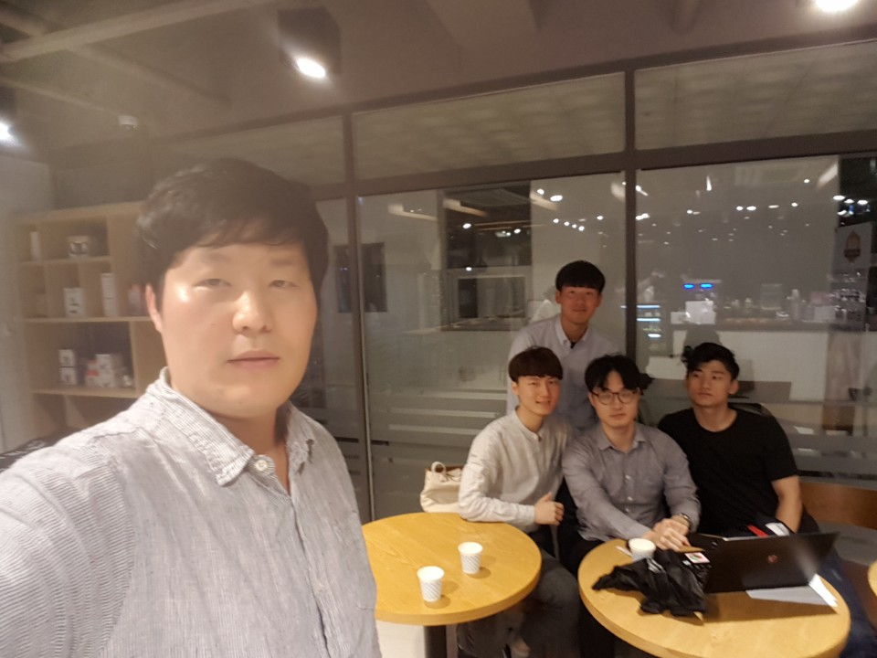
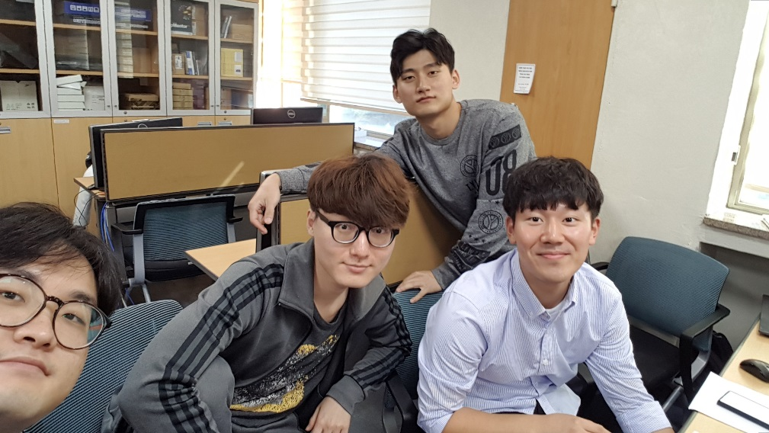
Pictures of meeting
9/30 Meeting
9/28 Meeting

