Slide 1
FINAL YEAR PROJECT DEFENSE
Multi-Agent Market Research Platform (MARP)
Automating Out-of-Home Advertising Audits, Field Operations & Consumer Intelligence in Pakistan
PRESENTER 1
Aroon Kumar
Seat No: 2312466
Module 01: User & Workspace Management
PRESENTER 2
Mudasir Ali
Seat No: 2312465
Module 02: Questionnaire Logic Engine
PRESENTER 3
Abdullah Zafar Khan
Seat No: 2312467
Module 03: Campaign & Asset Registry

Slide 2
PROBLEM STATEMENT & MOTIVATION
The Market Research Dilemma in Pakistan
CHALLENGE 01
Massive Unverified OOH Ad Spends
Pakistani telecom, FMCG, and banking brands invest billions of PKR annually in roadside billboards and digital SMDs with near-zero automated verification of illumination, structural integrity, or physical visibility.
CHALLENGE 02
Manual Paper Surveys & Data Forgery
Traditional consumer research relies on clipboard paper surveys prone to surveyor fabrication, lack of timestamp authentication, and delayed manual transcription.
CHALLENGE 03
Absence of GPS-Validated Ground Truth
Field surveyors cannot be reliably tracked to physical locations, leading to discrepancy between claimed site visits and genuine on-ground data collection.
CHALLENGE 04
No Unified Multi-Market Platform
Enterprise clients juggle fragmented agencies, unstandardized Excel spreadsheets, and unstructured WhatsApp photos instead of a centralized, multi-tenant digital platform.

Slide 3
TECHNICAL IMPLEMENTATION
Full-Stack Enterprise Monolith Architecture
LAYER 01: Next.js 14 App Router (Frontend)
React 18, Tailwind CSS design system, responsive flexbox layout, Lucide icons, Recharts interactive widgets, Urdu RTL Nastaliq typography support.
LAYER 02: FastAPI Async API Layer (Backend)
Modular domain design (Users, Questionnaires, Campaigns, Dashboard), Pydantic v2 validation, PyJWT bearer token authentication, dependency injection.
LAYER 03: Relational Database & Migrations
SQLAlchemy 2.0 ORM, PostgreSQL & SQLite compatibility, Alembic automated schema migrations, 28 normalized relational entities with full foreign key cascades.
LAYER 04: Enterprise Security & Device Trust
Passlib/BCrypt password hashing, 5-role RBAC authorization matrix, Android hardware IMEI device pairing with remote revocation, tamper-evident audit logging.

Slide 4
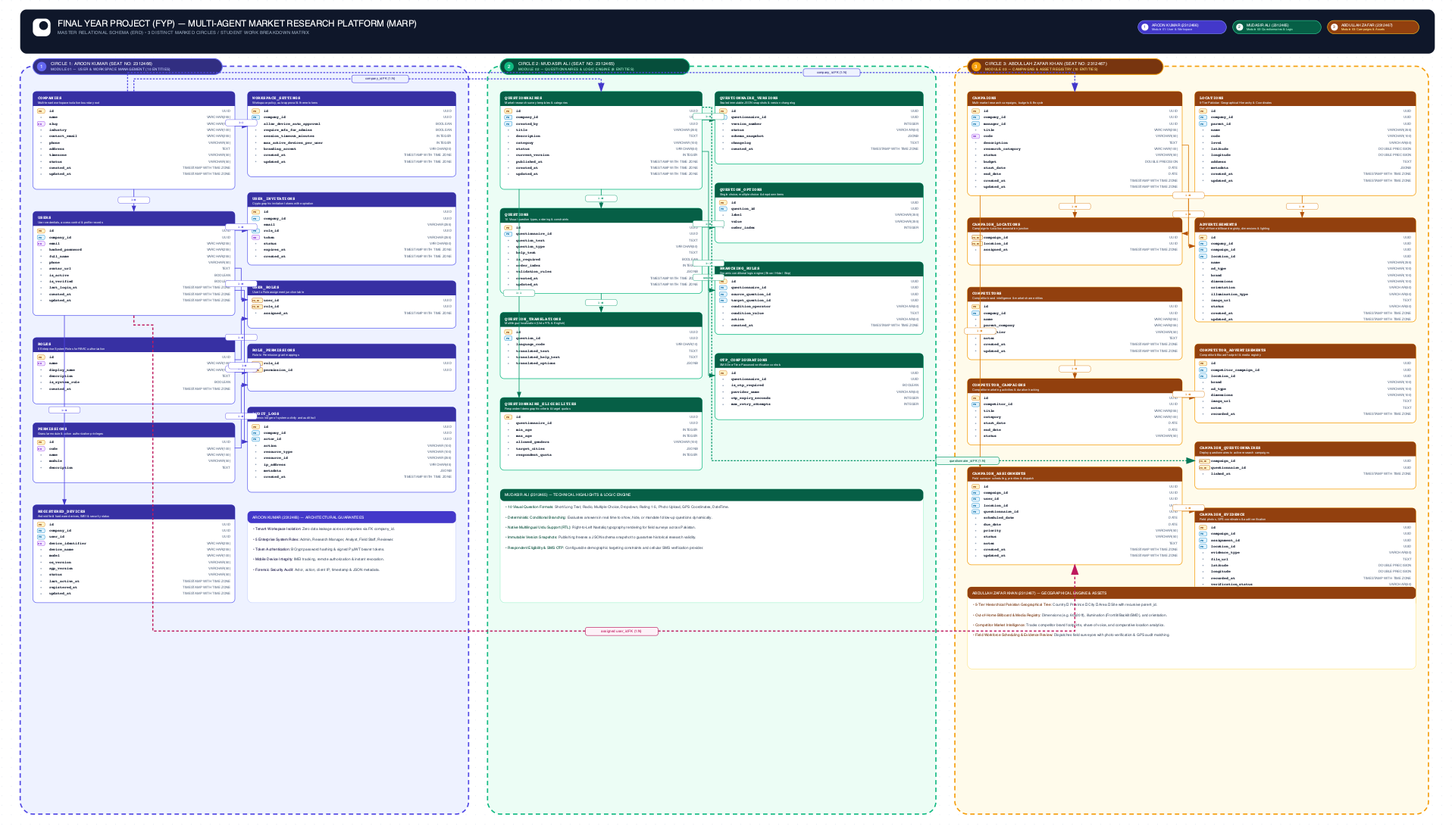
SYSTEM ENTITY RELATIONSHIP DIAGRAM
Unified Database Architecture • 3 Marked Circles (28 Tables)

Slide 5
INDIVIDUAL CONTRIBUTION 1
Aroon Kumar (2312466) — Module 01: User & Workspace Management
• Multi-Tenant Workspace Isolation:
Companies root entity ensures 100% data boundary isolation across corporate clients, preventing cross-tenant information exposure.
• BCrypt Authentication & JWT Tokens:
Secure credential management using modern passlib hashing and cryptographically signed PyJWT tokens with configurable session expiry.
• 5 Enterprise RBAC System Roles:
Configured and enforced 5 granular roles: Company Administrator, Research Manager, Analyst, Field Staff, and Evidence Reviewer.
• Android Hardware IMEI Device Security:
Field surveyors pair their physical Android phones via unique IMEI identifiers; administrators approve, monitor, or revoke device access.
• Tamper-Evident Forensic Audit Trail:
Systematic audit logging capturing actor, action code, target resource, timestamp, client IP, and structured JSON metadata.

Slide 6
INDIVIDUAL CONTRIBUTION 2
Mudasir Ali (2312465) — Module 02: Questionnaire Logic Engine
• 10 Visual Question Formats:
Built dynamic visual builder supporting Short Text, Paragraphs, Single Choice, Multiple Choice, Dropdown, Rating scale (1-5), Date & Time, Photo Upload, and GPS Coordinates.
• Deterministic Conditional Branching:
Live rule engine evaluating answers (e.g. if 'Billboard Condition = Poor' -> dynamically mandates close-up damage photograph).
• Native Urdu RTL Localization:
Integrated bilingual question schemas with Right-to-Left (RTL) Nastaliq rendering for Pakistani field surveyors.
• Immutable Version Snapshots:
Publishing seals an immutable JSON snapshot preventing retrospective data corruption in active research surveys.
• Respondent Eligibility & SMS OTP:
Demographic quota filters (age, gender, target city) and SMS OTP carrier integration controls for verified consumer surveys.

Slide 7
INDIVIDUAL CONTRIBUTION 3
Abdullah Zafar Khan (2312467) — Module 03: Campaigns & Asset Registry
• 5-Tier Hierarchical Pakistan Location Tree:
Self-referencing parent-child geography: Country (Pakistan) → Province → City → Area → Specific Audit Sites with GPS coordinate tagging.
• Out-of-Home Billboard Media Registry:
Detailed physical asset tracking: exact dimensions (60x20 ft), illumination (Frontlit/Backlit/SMD), orientation, and reference photos.
• Competitor Intelligence & Share of Voice:
Tracking competitor outdoor placements (Zong vs Jazz vs Telenor), media footprint comparison, and market presence density.
• Field Workforce Dispatch & Scheduling:
Assigning active Field Staff to campaigns, locations, and questionnaires with scheduled deadlines and priority levels.
• Field Evidence Verification Pipeline:
Human reviewer workflow inspecting uploaded billboard photos, matching surveyor GPS coordinates against registered billboard sites, approving/rejecting proofs.

Slide 8
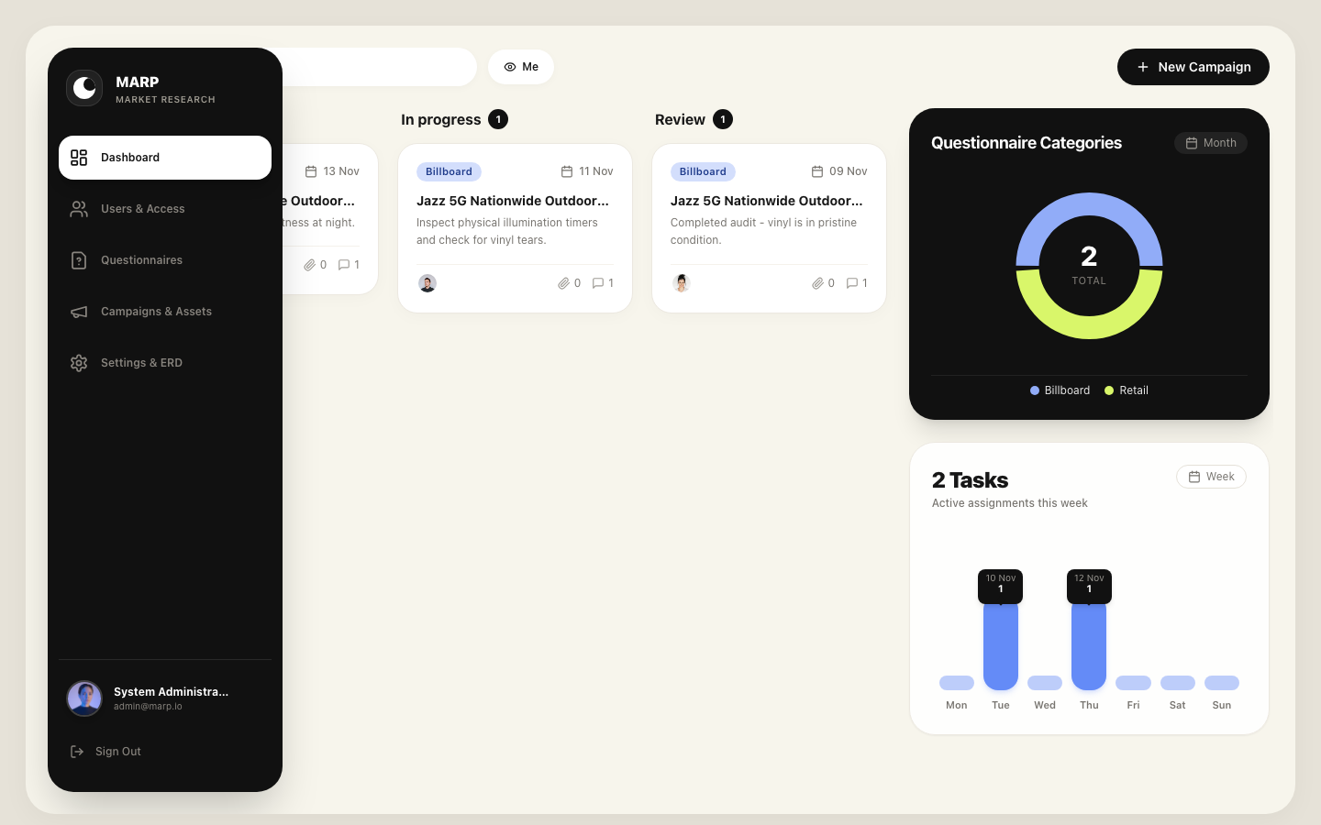
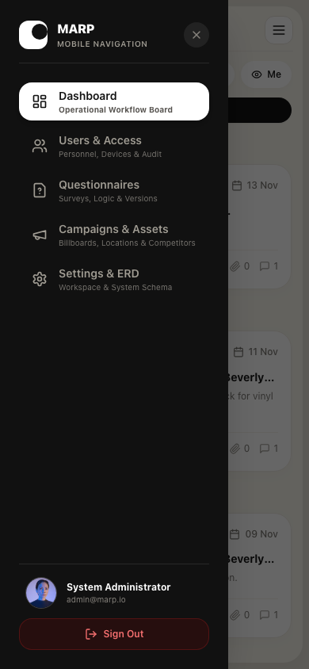
USER EXPERIENCE & DESIGN
Responsive SaaS Experience & Visual Parity

Slide 9
QA AUDIT RESULTS
Quality Assurance, Test Coverage & Verification
✔ 20 / 20 Pytest Tests Passed
100% automated test pass rate covering Authentication, User Management, Branching Rule Evaluation, Campaigns, and Operational Dashboard queries.
✔ Multi-Device Playwright Visual QA
Verified seamless responsiveness across Desktop (1440px), Laptop (1280px), Tablet (768px), and Mobile (390px iPhone 14 Pro).
✔ Zero Horizontal Overflow
Data tables on /users, /campaigns, and /questionnaires wrapped in horizontal scroll containers preventing mobile layout breakage.
✔ Live Dynamic Flex Sidebar
Desktop sidebar expands from 80px to 256px on hover while main screen dynamically adjusts its width without overlap.

Slide 10
THANK YOU
Multi-Agent Market Research Platform (MARP)
A complete, production-quality foundation for automated out-of-home advertising intelligence.
We now welcome questions and evaluator feedback.

