Slide 1

OpenSeizureDetector – Installation and Testing
Graham Jones, April 2022

Slide 2
Contents
What is OpenSeizureDetector?
System Components
Android App Installation
Garmin Watch App Installation
System Operation

Slide 3
What is OpenSeizureDetector?
OpenSeizureDetector is a system to detect if the user is experiencing a Tonic-Clonic epileptic seizure and raise an alarm to warn a carer that the user may need assistance.
It comprises an Android device (most will work) and a Garmin smartwatch.
The watch collects acceleration (movement) data as well as heart rate and blood oxygen level data if the watch has those sensors available, and sends the data to the phone.
The phone analyses the data to determine if the user appears to be suffering from a seizure, and raises an audible alarm.
There is an option for the system to send an SMS text message to specified phone numbers to warn carers of the alarm and send the user’s location to the carer to help them find the user.
The software is Open Source and is provided free of charge.

Slide 4
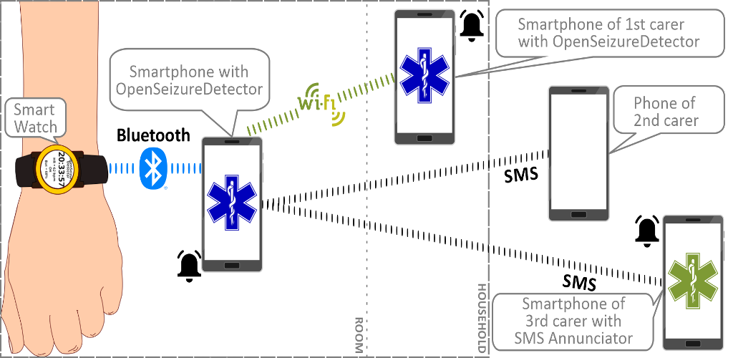
System Components
An Android device running Android Version 6 or higher. The device must be a phone with a working SIM card to send the (optional) SMS location alarm text messages.
The phone runs the OpenSeizureDetector Android App, which is available from Google Play Store
A Garmin smartwatch – it must be one of the devices that allows the user to install apps. A VenuSQ is the lowest cost compatible device at the time of writing (April 2022)
The watch runs a custom watch application (GarminSD.prg), which must be downloaded onto a computer and saved onto the watch.

Slide 5
Android App Installation
Go to Google Play Store and search for OpenSeizureDetector

