Slide 1
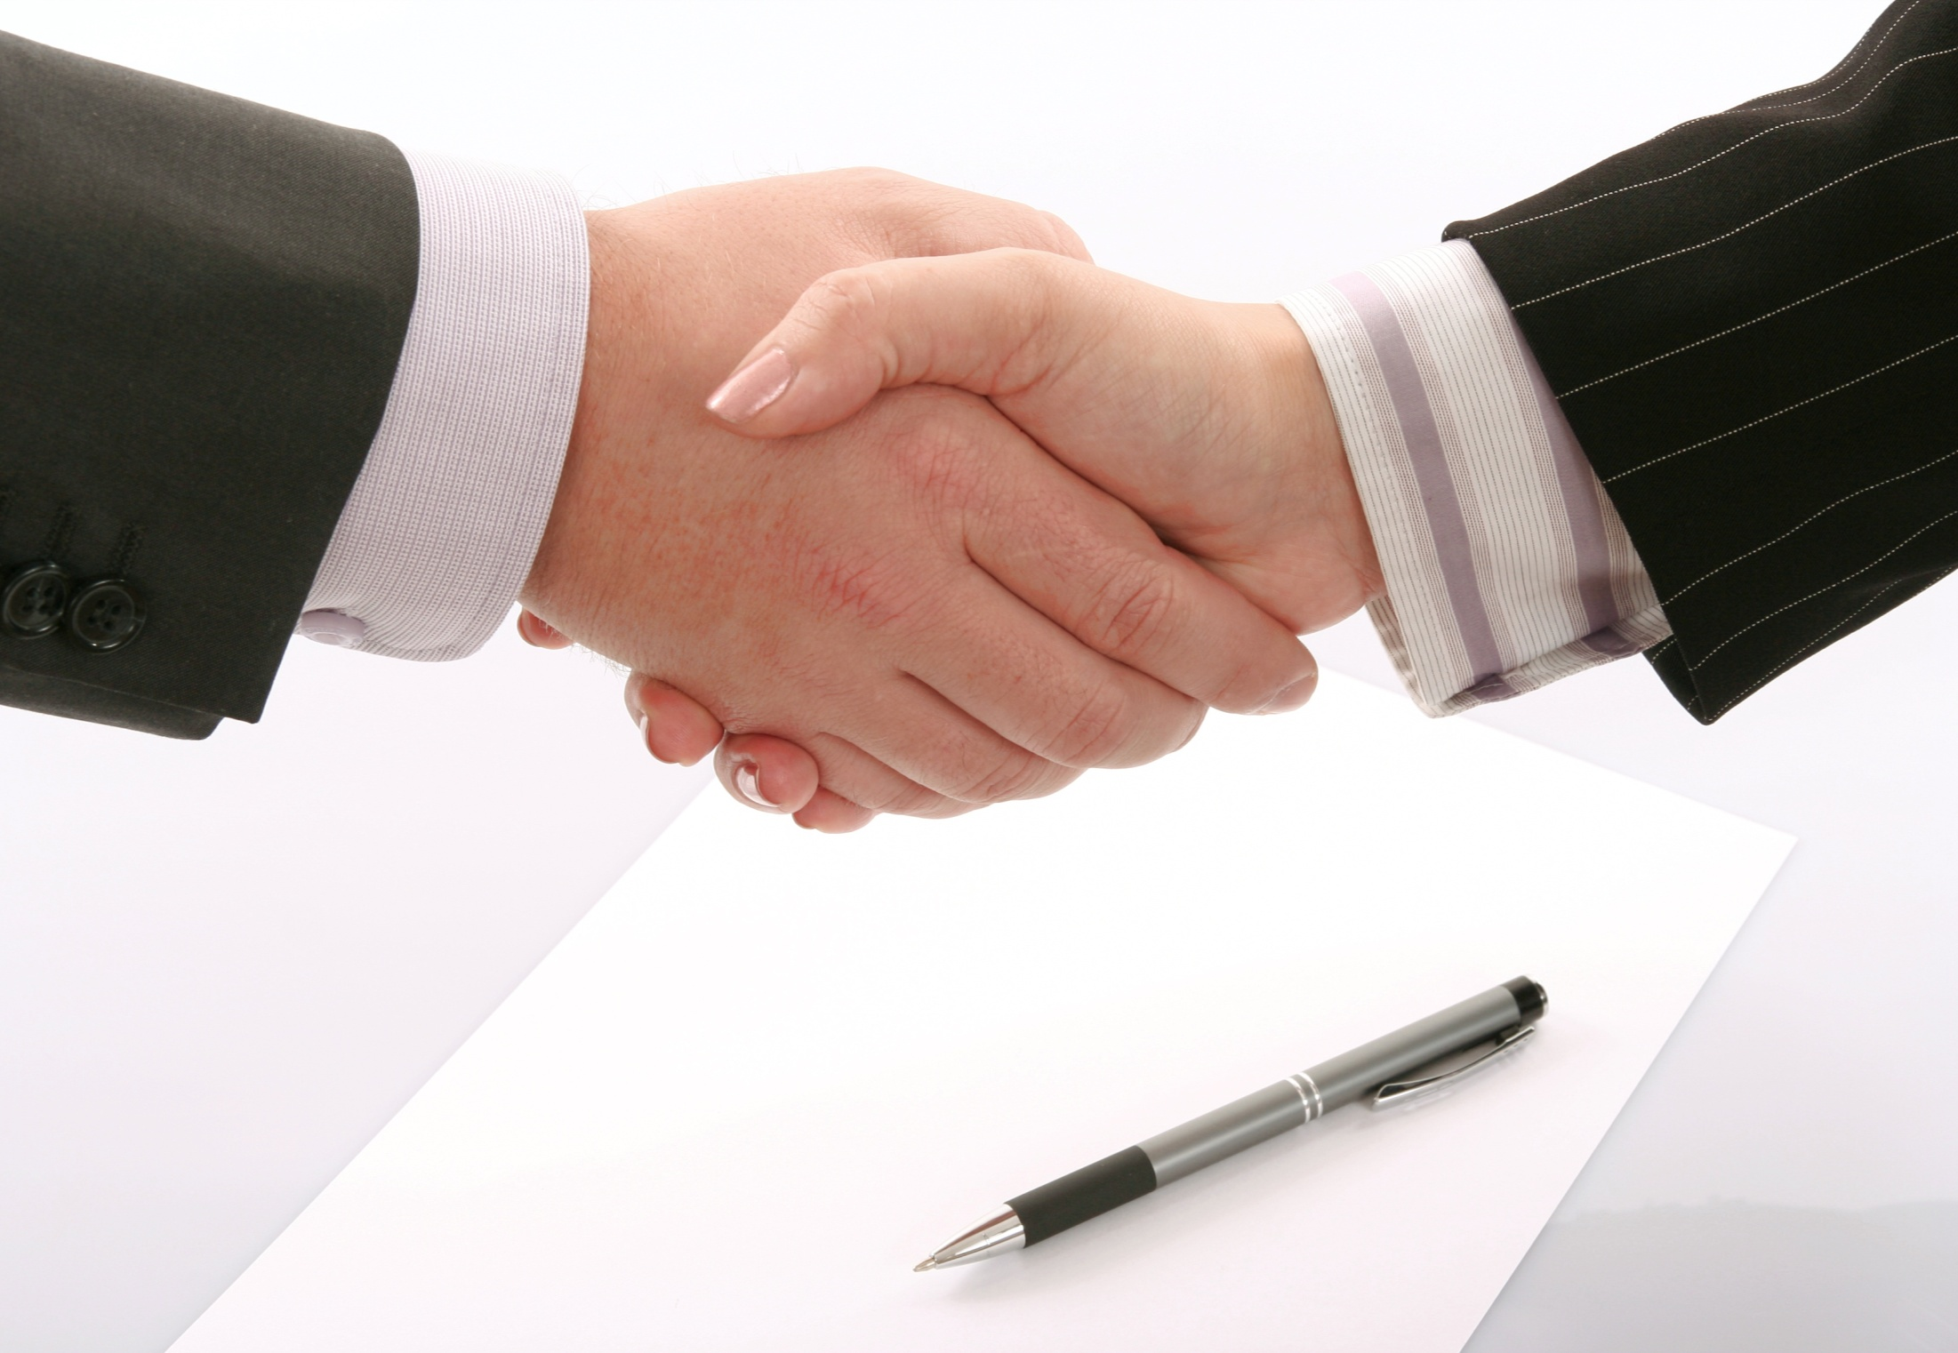
MVC Basics
By: Munish Arora

Slide 2
Introduction
In this, we will cover
MVC Architecture
Routes
Attribute Routing
Designing Controllers
Designing Views
Passing Data From Controller To View
Strongly Typed Views
Razor View Engine
Layout Structure Of Views

Slide 3

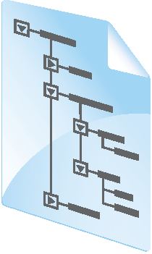

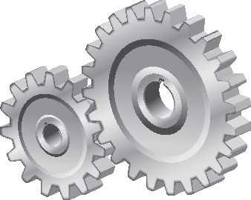


MVC Architecture
SQL
View
Model
Database
Controller
Response
HTTP
Web Server
Browser

Slide 4
Controllers
Controllers are .NET Framework-based classes that inherit from the Microsoft.AspNetCore.Mvc.Controller base class.
They implement input logic—this means that they receive input from the user in the form of HTTP requests and select both the correct model and the correct view to use, to formulate a response.
For each controller there can be many actions—each action is implemented as a method in the controller and usually returns a view.
You often require separate actions for the GET and POST HTTP request verbs

Slide 5
Model
The MVC Model class are structures for containing all application logic (business logic, validation logic, and data access logic), except pure view and controller logic.
The model class does not handle directly input from the browser.
Models are also refered as objects that are used to implement conceptual logic for the application.
public class Person{
public int PersonId { get; set; }
public string Name { get; set; }
public int Age { get; set; }
}

Slide 6
Views
The user interface is created by building views
There is a one-to-many relationship between MVC controllers and views.
For example, a controller might use one view to display a single photo, another view to display several photos, and a third view to enable users to upload new photos
As you plan views, you should also consider parts of the user interface that appear on all pages. You can place these user interface components in a layout to create a consistent look and feel across pages.
For example, the company logo, main site menu, links to legal information, and sign-in controls might need to appear on every page.

Slide 7
Routes
Routing is the replacement of the concrete, physical files used in the URLs. In other words, routing is the phenomenon in which controller and actions execute rather than the concrete physical files.
Routing is a pattern matching system that matches the incoming request to the registered URL pattern (/s)

Slide 8
Route
Route is declared in Program.cs
var builder = WebApplication.CreateBuilder(args);
// Add services to the container.
builder.Services.AddControllersWithViews();
var app = builder.Build();
// Configure the HTTP request pipeline.
if (!app.Environment.IsDevelopment())
{
app.UseExceptionHandler("/Home/Error");
}
app.UseHttpsRedirection();
app.UseStaticFiles();
app.UseRouting();
app.UseAuthorization();
app.MapControllerRoute(
name: "default",
pattern: "{controller=Home}/{action=Index}/{id?}");
app.Run();

Slide 9
Attribute Routes
Attribute routing uses attributes to define routes.
In Attribute Routing, the route attribute is defined at the top of the action method.
Attribute routing gives you more control over the URIs in your web application.
At run time, when the request comes, then ASP.Net Core routing handler checks if the route matches with the route attribute specified at the top of action method (/controller), and is thereby invoked

Slide 10
Attribute Route
tripname will be fetched from uri
Attribute Route is declared at top of class Method
Here the attribute route is defined above at class and optionally at method level
[Route("/api/trips/{tripName}/stops")]
public class StopController : Controller
{
[HttpGet("")]
public JsonResult Get(string tripName)
{
…
}
[HttpDelete("/api/trips/{tripName}/stops/remove/{stopname}")]
public JsonResult Post(string tripName, string stopname)
{
…
}
}

Slide 11
Attribute Route
Here the attribute route is defined at class level and optionally at method level
For example, Get method of api may be invoked via URL http://servername//api/trips/{tripName}/stops
If any other uri is motioned at HttpGet, that will override the uri mentioned at class level
For example, Delete method of api may be invoked via URL http://servername//api/trips/{tripName}/stops/remove/{stopname}

Slide 12
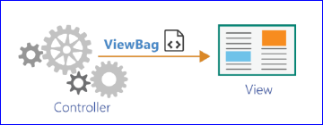
Passing Data From Controller to View
There are various options for passing data from Controller to View
The various options can be
ViewBag
ViewData
Model
Which One to Choose:
Models are the best way to pass data from Controller to the View
In some cases, you may want to augment the model with additional data without modifying the model

Slide 13
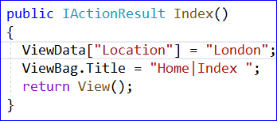

Passing Data From Controller to View
ViewData /ViewBag
Valid only for the duration of the current request.
You set it in a controller action and use it in the view. Then it disappears
Difference ViewData /ViewBag :
ViewData is a dictionary, whereas
ViewBag is just a dynamic wrapper around this dictionary.
Example:
In the controller you have a method
and inside the view, you could use these values
from ViewData, as you fetch from dictionary
from ViewBag you can access the dynamic object

Slide 14
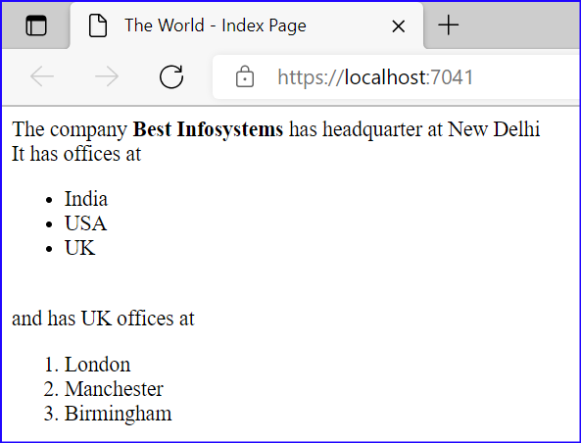
ViewBag and ViewData
Let us create the MVC application
Pass the data using ViewData and ViewBag from controller and access it in view

Slide 15
Strongly Typed View
Strongly typed views are used for rendering specific types of model objects.
When controller invokes the view, it passes the model to the view
Also By specifying the type of data, you get access to IntelliSense for the model class.

Slide 16
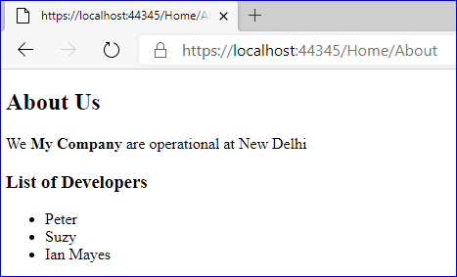
Strongly Typed Views
Let us create the MVC application
We will make use of Strongly typed model, where-in we will create Strongly Typed views by storing the data in Object of Type Model and display the results by accessing the same from Model

Slide 17


Knowledge check
Which of the following is true?
Models are the best way to pass data from Controller to the View
ViewBag /ViewData are the best way to pass data from Controller to the View
In some cases, you may want to augment the model with additional data without modifying the model then ViewBag /ViewData may be utilized
Which of the following is true?
Attribute route is defined at class level and optionally at method level
The uri motioned at method level will override the uri mentioned at class level
The uri motioned at class level will override the uri mentioned at method level

Slide 18
View Engine
View Engine in ASP.NET MVC is used to translate our views to HTML and then render to response
Code Snippet for Razor View Engine is as follows:
It’s quite clear that Razor syntax is clean and
@foreach (var student in Students)
{
@if(student.IsPassed)
{
@student.Name promoted to next Grade.
} else {
@student.Name not promoted to next Grade.
}
}

Slide 19
Razor View Engine
Razor is a view engine, introduced with MVC 3, that uses a simple and fluid syntax, and the code appears to quiet clean.
Task | Razor Syntax
Current Dt | @DateTime.Now
If statement | @if (DateTime.Today.Year == 2019) { <span> Current year </span> }else { <span> Past year </span> }
foreach Loop | <ul> @for (int i=0; i<10; i++){ <li>@i</li> } </ul>
Code Blocks | @{ var name = "Jose"; var message = "Welcome " + name; } <p>Hello! @message </p>

Slide 20
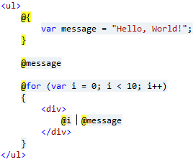
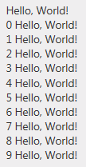
Razor View Engine: Coding
In Razor you can create blocks of code nearly anywhere using @{ }.
A block of code doesn't emit anything into the output, but you can use the block to manipulate a model, declare variables, and set local properties on a view.
Be extremely careful about having too much code in a view, however, because it's not the best place for logic.
E.g. following code will produce the output

Slide 21
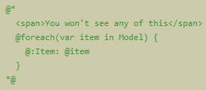
Razor View Engine: Comments
Comments in Razor can start with @* and end with *@.
Nothing inside a comment will execute or appear in the output, not even HTML markup.

Slide 22
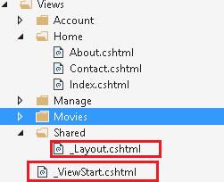

Understanding the Layout of Views
The view _ViewStart.cshtml internally uses another view(_Layout.cshtml) to render content.
There is a Razor feature called layouts in which the Layout property of the view defines a shared view that will be used as a template for the content in the view that implements it.
Using layouts helps you to keep look-and-feel consistency across your entire web site.
Contents of _ViewStart.cshtml:
So, we can think of Layout as a master page, where-in parts get filled-in by various views.

Slide 23
Understanding the Layout of Views
The contents of the view will be shown in RenderBody() section. Rest will be generic section to be shown on all views
Further you can include HTML sections where content from views will be “slotted in” to the layout page called sections.
<div class="container body-content">
@RenderBody()
<hr />
<footer>
<p>&copy; 2016 - MvcMovie</p>
</footer>
</div>
@RenderSection("scripts", required: false)

Slide 24
Summary
In this, we covered
Routes
Attribute Routing
Designing Controllers
Designing Views
Passing Data From Controller To View
Strongly Typed Views
Razor View Engine
Layout Structure Of Views

Slide 25
THANK YOU!

