Slide 1

Typescript
By: Munish Arora
Munish.arora@gmail.com

Slide 2
Introduction
In this, we will cover
TypeScript
Demo
TypeScript
Installing and Using Typescript
Variables, Types n Modules
Demo:
Routes
Angular App In ASP.Net Core

Slide 3
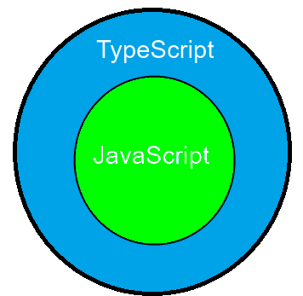
TypeScript
Typescript is superscript of JavaScript
TypeScript is a free and open-source programming language developed and maintained by Microsoft.

Slide 4
TypeScript
Strong Typing
Object Oriented, we can create classes, properties, generics and so
Compile Time Errors
Intellisense

Slide 5
TypeScript
Browsers don’t understand TypeScript
Typescript Code
Transpile
JavaScript Code
source-to-source compilers

Slide 6
Variables in TypeScript
We can define the variables in TypeScript in any of the following ways
var i=5;
let i=5;
var and let are both used for variable declaration in typescript.
var is function scoped
let is block scoped.

Slide 7
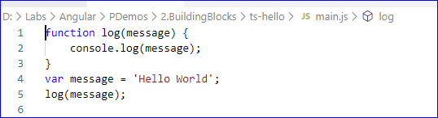

Demo: TypeScript
1 TypeScript
1.1 Installing TypeScript
1.2 TypeScript File
1.2.1 Creating TS File
1.2.2 Executing the Code

Slide 8

JavaScript Versions
JavaScript Language Standards is officially called ECMAScript
Until now, these were defined by numbers
ES5 , released in 2009, supported by all browsers
ES6 specifications was approved in Jun 2015
All the current browsers have full support to ES6
Legacy browsers that do not support ES6 modules, are supported in angular using polyfills
After this we have year numbers, instead of version nos.
ES2016, ES2017, ES2018, ES2019, ES2020 and ES2021
Notes:
1. Ref: Wikipedia
ECMA stands for European Computers Manufacturing Association
History:
The ECMAScript specification is a standardized specification of a scripting language developed by Brendan Eich of Netscape;
initially it was named Mocha, later LiveScript, and finally JavaScript.^{[3]}
In December 1995, Sun Microsystems and Netscape announced JavaScript in a press release.^{[4]}
In March 1996, Netscape Navigator 2.0 was released, featuring support for JavaScript.
2. A polyfill is a browser fallback, made in JavaScript, that allows functionality you expect to work in modern browsers to work in older browsers

Slide 9
Module
In TypeScript, a module is a way to create a group of related variables, functions, classes, and interfaces, etc.
It executes in the local scope, not in the global scope.
We can create a module by using the export keyword and can use in other modules by using the import keyword.

Slide 10
Modules in TypeScript
Export
Export
Import
File 1
File 2
File 3
<<Module>>
<<Module>>
<<Module>>
These types can be classes, functions variables,
In angular, these modules are more to do with organization of code into smaller functional areas

Slide 11

Demo: TypeScript Variables, Types n Modules
1 TypeScript
1.1 Variables
1.2 Types
1.3 Modules

Slide 12


Knowledge check
Which of the following is true?
Typescript is superscript of JavaScript
Browsers don’t understand TypeScript, so typescript is required to be compiled to javascript
Typescript supports Intellisense, is Object Oriented, we can create classes, properties, generics and so
What are variables in Typescript?
A variable name should contain alphabets and numeric digits
B. It cannot contain spaces and special characters except underscore (_) and dollar ($) sign
C. A variable name cannot begin with a digit
D. All

Slide 13
THANK YOU!

