Slide 1

Navigation And Routing
By: Munish Arora
Munish.arora@gmail.com

Slide 2
Introduction
In this, we will cover
How Routing Works
Configuring Routes
Tying Routes to Actions
Pacing The View

Slide 3
Routes
Routes are defined to navigate between multiple views in our application.
As we design and build our application, we provide ways for the user to navigate its pages and features.
With routing, we define the paths through the application and the user actions required to access each path
When user clicks on the link, the corresponding view is displayed

Slide 4
How Routing Works
As part of our application design, we provide a menu, a toolbar, buttons, images, or data links that allow the user to select the view to display.
We tie a route to each option or action.
<a RouterLink="/products">Products List</a>
When the user selects the option or performs the action, the associated route is activated, and it looks for associated component with that path.
Path and associated routes are usually registered in corresponding module

Slide 5
Configuring Routes
Angular provides a RouterModule, that exposes the routes we configure, in the Angular router package that registers the router service provider.
By importing the RouterModule, our component templates can use router directives (RouterLink and RouterOutlet).
Before we can navigate to a route, we ensure that the routes are available to the application by calling forRoot method RouterModule and pass our array of routes to that method.
@NgModule({
….
imports: [
…….
RouterModule.forRoot(appRoutes)
],

Slide 6
How Routing Works
For example, a typical module will appear as follows
const appRoutes: Routes = [
{ path: '', component: HomeComponent },
{ path: 'product', component: ProductComponent },
]
@NgModule({
….
imports: [
…….
RouterModule.forRoot(appRoutes)
],
providers: [
{ provide: APP_BASE_HREF, useValue: '/' }
],
bootstrap: [AppComponent]
})
export class AppModule { }
When this route is activated, this URL path segment is appended to the URL of our application.

Slide 7
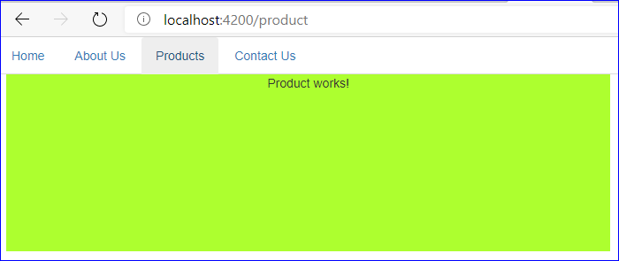
Demo: Routes
1 Implementing Routes
1.1 Creating an application
1.2 Configuring Application
1.3 Creating Routes
1.4 Running The Application

Slide 8


Knowledge check
Which of the following is true?
Typescript is superscript of JavaScript
Browsers don’t understand TypeScript, so typescript is required to be compiled to javascript
Typescript supports Intellisense, is Object Oriented, we can create classes, properties, generics and so
What are variables in Typescript?
A variable name should contain alphabets and numeric digits
B. It cannot contain spaces and special characters except underscore (_) and dollar ($) sign
C. A variable name cannot begin with a digit
D. All

Slide 9
THANK YOU!

