Slide 1

Forms
By: Munish Arora
Munish.arora@gmail.com

Slide 2
Introduction
In this, we will cover
Angular Forms
Template Driven Forms
Demo: Template Driven Forms
Data Binding
Demo: Data Binding
Validation
Demo: Validations

Slide 3
Angular forms
Angular forms are used to handle user's input.
We can use Angular form in our application to enable users to log in, to update profile, to enter information, and to perform many other data-entry tasks.
In Angular, there are 2 approaches to handle user's input through forms
Reactive forms
Template-driven forms
Both approaches are used to collect user input events from the view, validate the user input, create a form model and data model to update, and provide a way to track changes.

Slide 4
Template-driven vs Reactive forms
Template-driven forms
Reactive forms
Uses Component Template
Uses Component Template
Create a Form Model in TypeScript (This must be in sync with the template)
Unit Test against DOM
Unit Test Against Form Model
Validation in Form Model
If just html5 info is to be processed, then template driven forms is better choice
If you absolutely need unit testing, reactive forms is better choice

Slide 5
Template Driven Forms
Template-driven forms rely on directives defined in the FormsModule
The ngModel directive reconciles value changes in the attached form element with changes in the data model, allowing you to respond to user input with input validation and error handling.
The ngForm directive creates a top-level FormGroup instance and binds it to a <form> element to track aggregated form value and validation status.
As soon as you import FormsModule, this directive becomes active by default on all <form> tags. You don't need to add a special selector.
The ngModelGroup directive creates and binds a FormGroup instance to a DOM element.

Slide 6
FormsModule
To use forms, we import FormsModule from @angular/forms
import { BrowserModule } from '@angular/platform-browser';
import { NgModule } from '@angular/core';
import { AppComponent } from './app.component';
import { FormsModule } from '@angular/forms';
@NgModule({
declarations: [
AppComponent
],
imports: [
BrowserModule,
FormsModule
],
providers: [],
bootstrap: [AppComponent]
})
export class AppModule { }

Slide 7
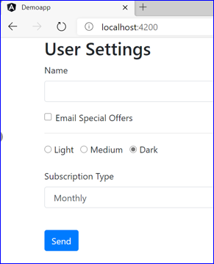
Demo: Forms Basics
1 Forms
1.1 Creating Angular Application using CLI
2 Angular Forms
2.1 Creating Form
2.2 Adding Bootstrap
2.2.1 Adding Textbox and Button
2.2.2 Adding Checkbox and Radio Button
2.2.3 Select And Options
2.2.4 Other Form Controls

Slide 8
Data Binding
Data-binding in AngularJS apps is the automatic synchronization of data between the model and view components
Data binding can also mean that if an outer representation of the data in an element changes, then the underlying data can be automatically updated to reflect the change.
The way that Angular implements data-binding lets you treat the model as the single-source-of-truth in your application.

Slide 9
ngForm
It's simply a directive exported from FormsModule which gets automatically added to all <form> tags in your Angular templates once you import the module.
Behind the curtains, the ngForm directive creates a top-level FormGroup instance and binds it to your <form> tag to enable you to work with the form.

Slide 10
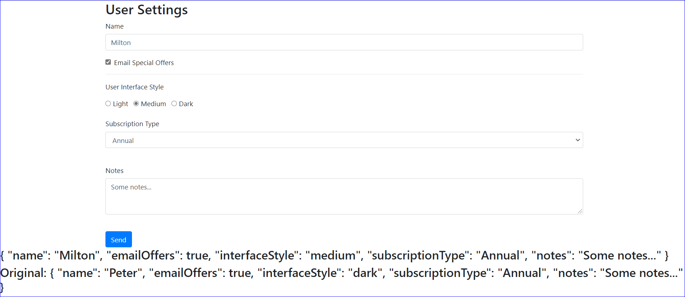
Demo: Data Binding
1 Data Binding
1.1 Using ngForm
1.1.1 Adding FormsModule to the application
1.1.2 Categorizing Form to be Angular Form
1.2 Using ngModel
1.3 Data Model
1.4 Two Way Data Binding
1.5 Preserving Original Data

Slide 11
Validation
HTML5 Validation Attributes
required
pattern
minlength
maxlength
min
max

Slide 12
Validation
Validation Classes in Angular
ng-untouched
ng-touched
ng-pristine
ng-dirty
ng-valid
ng-invalid
Field starts with ng-untouched
Field is initially unmodified and is pristine, when it is modified it is marked as dirty
If we have an attribute on field for validation, angular will know about that and will mark field as valid or invalid

Slide 13
Validation
Classes and Associated ngModel Properties
ng-untouched
ng-touched
ng-pristine
ng-dirty
ng-valid
ng-invalid
untouched
touched
pristine
dirty
valid
invalid

Slide 14
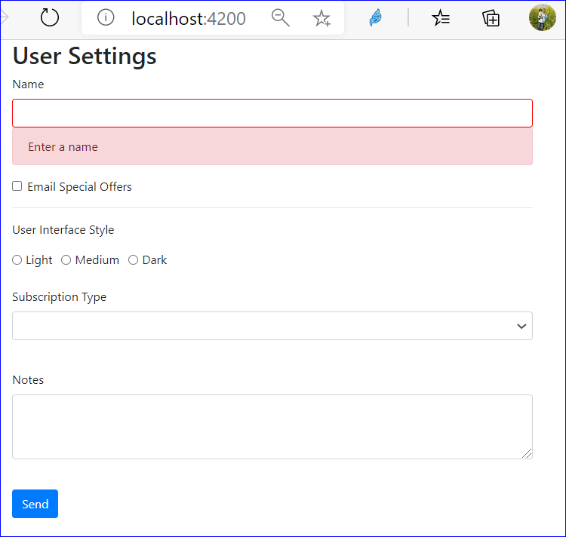
Demo: Validation
1 Validation
1.1 HTML5 Field Validation
1.2 CSS Classes For Validation
1.3 ngModel Properties
1.4 Styling Forms
1.5 Submitting Forms
1.6 Form Control Events

Slide 15


Knowledge check
Which of the following is true?
A template driven forms is used when we have a simple form like user registration form or master data entry form.
Building a form using the reactive approach means more component code and less HTML.

Slide 16
Summary
In this, we will covered
Angular Forms
Template Driven Forms
Demo: Template Driven Forms
Data Binding
Demo: Data Binding
Validation
Demo: Validations

Slide 17
THANK YOU!

