Slide 1

Building Apps
By: Munish Arora

Slide 2
Introduction
In this, we will cover
Creating ASP.Net Core Web App Using Static Files
Convert existing App to MVC architecture
Creating Layout
Using Tag Helpers
ViewModel classes
Dependency Injection
Validations
Partial Views
Filters

Slide 3
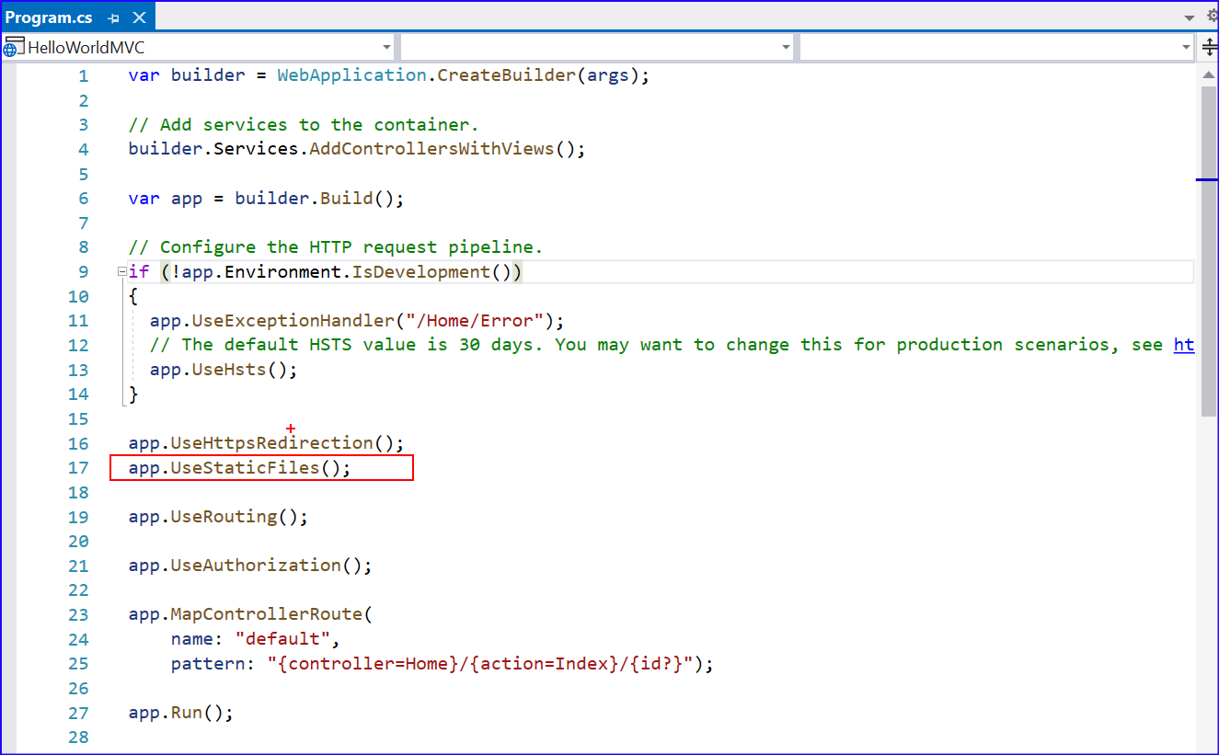
Static Files
An important part of every web application is the ability to serve static files, these may be images or CSS stylesheets or JavaScript files.
By calling UseStaticFiles, the application will automatically match relative paths to files inside the wwwroot folder of the application and serve them.

Slide 4
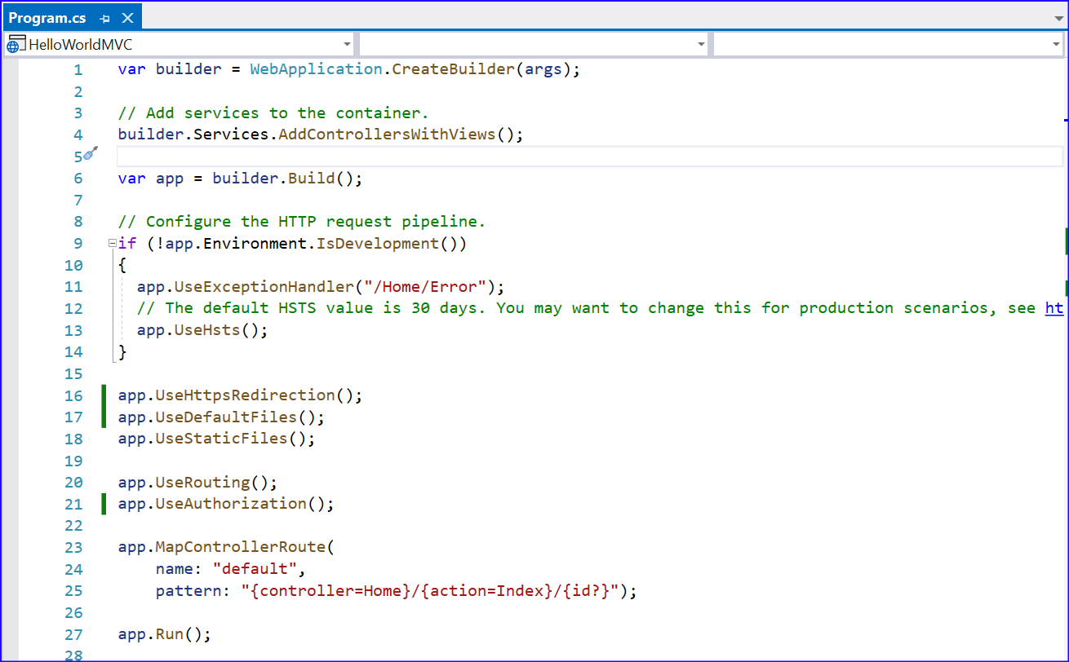
Static Files
Mapping Current Path
UseDefaultFiles method enables default file mapping on the current path
Default files like index.html or default.html under wwwroot can be served.
It must be before useStaticFiles method.

Slide 5
Static Files from Outside the wwwroot
For this,
call the UseStaticFiles middleware with a StaticFileOptions parameter.
Set the FileProvider property, and you can assign PhysicalFileProvider, which allows you to choose a file path
For example, in the following code application accesses static files from ‘static’ folder.
app.UseDefaultFiles(); //use default.html | index.html if available, must
be called before
app.UseStaticFiles(); // when hosted in IIS, it will look for static files
under www root folder
app.UseStaticFiles(new StaticFileOptions
{
FileProvider = new PhysicalFileProvider(
Path.Combine(Directory.GetCurrentDirectory(), "static"))
});

Slide 6
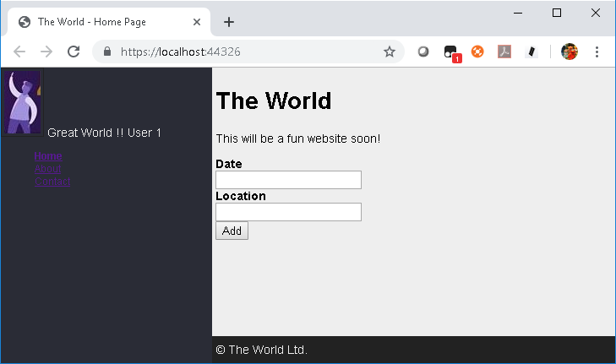
Default Website Using Static Pages
Let us create a Website Using Static Pages
1 Creating the GreatWorld Application
1.1 Selecting Template
1.2 Adding files to Application
1.3 Configuring Startup and Running the Application

Slide 7
Problems with Serving Static Files
All files served by using UseStaticFiles will always be available, there is no way to require authorization for them, and they will be available to all users.
Files served from UseStaticFiles will potentially be able to reveal information about the application structure, as all of them and their paths are accessible.
Depending on the hosting operating system, these files may or may not be case sensitive.

Slide 8
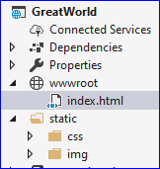
Static Files from folder Outside wwwroot
static folder is outside wwwroot folder
For this,
call the UseStaticFiles middleware with a StaticFileOptions parameter.
Set the FileProvider property, and you can assign PhysicalFileProvider, which allows you to choose a file path
The following code is an example of hosting static files from wwwroot and from a folder named Static Folder
app.UseDefaultFiles(); //use default.html | index.html if available, must be called before
app.UseStaticFiles(); // when hosted in IIS, it will look for static files under www root folder
app.UseStaticFiles(new StaticFileOptions
{
FileProvider = new PhysicalFileProvider(
Path.Combine(Directory.GetCurrentDirectory(), "static"))
});

Slide 9
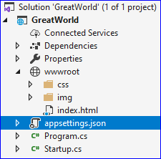
Static Files from folder Outside wwwroot
Move the files to their earlier structure
public void Configure(IApplicationBuilder app, IWebHostEnvironment env)
{
if (env.IsDevelopment())
{
app.UseDeveloperExceptionPage();
}
app.UseDefaultFiles(); //use default.html | index.html if available, must be called before
app.UseStaticFiles(); // when hosted in IIS, it will look for static files under www root folder
app.UseRouting();
}

Slide 10
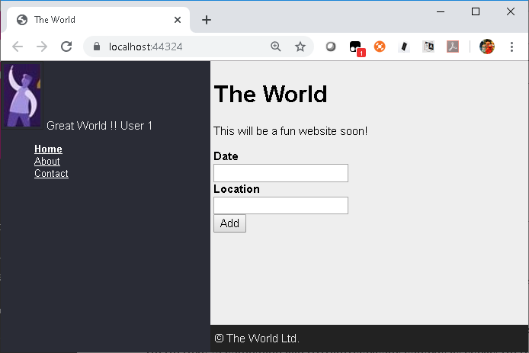
Create MVC Application
Let us Convert existing App to MVC architecture
1 Converting Existing App to MVC Architecture
1.1 Creating Controllers And Views
1.2 Configuring the Application
1.3 Running the Application
1.4 Specifying the relative path of referenced files

Slide 11
Layout
Instead of creating the same parts again and again in the views, the duplicate parts are moved to _Layout view and each view contains the main part

Slide 12
Create Layout
Let us create and apply a common layout to our existing MVC application
Add the common layout

Slide 13
Add More Views
MVC application
Add two more views for About and Contact page

Slide 14
TagHelpers
It is one of the new features introduced in ASP.Net Core, and is quiet clean approach.
The syntax looks like HTML (elements and attributes) but is processed by Razor on the server.
Role is similar to the one played in previous versions of ASP.NET MVC by HtmlHelpers
E.g. For action link, you specify in following ways for HTML Helper vs Tag Helper
HTML Helper
Tag Helper
The HTML produced by both approaches is identical:
@Html.ActionLink("Back Home", "Index", "Home")
<a asp-action="Index" asp-controller="Home">Back Home</a>
<a href="/">Back Home</a>

Slide 15
Tag Helpers vs HTML Helpers
HTML Helpers are invoked as methods that are mixed with HTML inside your Razor views.
<div class="form-group">
@Html.LabelFor(m => m.Email, new {@class = "col-md-2 control-label" })
<div class="col-md-10">
@Html.TextBoxFor(m => m.Email, new {@class="col-md-10 form-control" })
</div>
</div>
Tag Helpers are attached to HTML elements inside your Razor views and can help you write markup that is cleaner and easier to read
<div class="form-group">
<label asp-for="Email" class="col-md-2 control-label">Email Id</label>
<input asp-for="Email" class="col-md-10 form-control"/>
</div>

Slide 16
Taghelpers
Prerequisite
You need to add a view _ViewImports.cshtml and add associated tag helpers
Or you may add this to your cshtml file
@addTagHelper "*, Microsoft.AspNetCore.Mvc.TagHelpers"
The code above uses the wildcard syntax ("*") to specify that all Tag Helpers in the specified assembly (Microsoft.AspNetCore.Mvc.TagHelpers) will be available to every view file in the Views directory or sub-directory.

Slide 17
Tag Helper: Link (Action Tag Helper)
Add a link for redirecting to Home page, on click of ‘Back Home’ link
@model FirstMVCApp.Model.CompanyInfo
@{ ViewBag.Title = "About";}
<!DOCTYPE html>
<html>
<head></head>
<body>
<h2>About Us</h2>
We <b> @Model.Name</b> are operational at @Model.Location
<h3>List of Developers</h3>
<ul>
@foreach (var item in @Model.Developers)
{
<li>@item</li>
}
</ul>
<a asp-action="Index" asp-controller="Home">Back Home</a>
</body>
</html>

Slide 18
How TagHelpers Work
MVC 6 includes a set of predefined TagHelpers:
Anchor (for generating hyperlinks)
Cache (for managing partial page caching)
Environment (for controlling content rendering based on the runtime environment)
Form (for generating form elements)
Input (generation of input elements)
Label (outputs label elements)
Link (processes link elements)
Option (targets individual options in a select list)
Script (processes script tags)
Select (generates dropdown lists)
TextArea (processes textarea tags)
ValidationMessage (generates individual validation errors)
ValidationSummary (renders the validation summary message)
For details, pls. refer to https://docs.microsoft.com/en-us/aspnet/core/mvc/views/tag-helpers/authoring?view=aspnetcore-3.1

Slide 19
Using TagHelpers
GreatWorld Application
Using TagHelpers in the links on sidebar to invoke the Views

Slide 20


Knowledge check
Which of the following is true?
UseDefaultFiles method enables default file mapping on the current path
UseStaticFiles method enables default file mapping on the current path
UseStaticFiles method enables the application to automatically match relative paths to files inside the wwwroot folder
Which of the following is true?
HTML Helpers are invoked as methods that are mixed with HTML inside your Razor views.
TagHelpers are invoked as methods that are mixed with HTML inside your Razor views.
Tag Helpers are attached to HTML elements inside your Razor views and can help you write markup that is cleaner and easier to read
Compared to TagHelpers, HTML Helpers can help you write markup that is cleaner and easier to read

Slide 21
View-Model classes
ViewModels are the model of the view.
The view model classes provide information passed in from controllers to views, so that the views know what to render in the user’s browser.
For example, a view model class can contain product information that is used by a view to display the product name, price, and images.

Slide 22
View-Model classes
E.g. view model may appear like
namespace MvcMovie.Models.AccountViewModels
{
public class LoginViewModel
{
[Required]
[EmailAddress]
public string Email { get; set; }
[Required]
[DataType(DataType.Password)]
public string Password { get; set; }
[Display(Name = "Remember me?")]
public bool RememberMe { get; set; }
}
}

Slide 23
View-Model classes
Then you refer this viewmodel in the view as follows
........
@model LoginViewModel
@{
ViewData["Title"] = "Log in";
}
<h2>@ViewData["Title"].</h2>
<div class="row">
<div class="col-md-8">
<section>
<form asp-controller="Account" asp-action="Login" asp-route-returnurl="@ViewData["ReturnUrl"]" method="post" class="form-horizontal">
<h4>Use a local account to log in.</h4>
<hr />
<div asp-validation-summary="All" class="text-danger"></div>
<div class="form-group">
<label asp-for="Email" class="col-md-2 control-label"></label>
<div class="col-md-10">
……….

Slide 24
Dependency Injection
A coding pattern in which of class receives instances of the objects it needs (called dependencies) from external source rather than creating them itself

Slide 25

Dependency Injection
Dependency injection is a technique that follows the Dependency Inversion Principle, allowing for applications to be composed of loosely coupled modules.
ASP.NET Core has built-in support for dependency injection, which makes applications easier to test and maintain.
Dependency Inversion: The Dependency Inversion Principle (DIP) states that
high level modules should not depend on low level modules; both should depend on abstractions.
Abstractions should not depend on details.
Details should depend upon abstractions.
E.g. we have a button class implementing Ibutton
Lets say in our webform, we have buttons. But these buttons should depend on abstraction i.e. IButton

Slide 26
Dependency Injection
In ASP.Net Core,
It has built in service container
Register the Service Type (Interface), and its implementation with service container in ConfigureServices method in Startup.cs
If we have only a class without any corresponding interface, then class is registered with service container in ConfigureServices method in Startup.cs
Now when client requests for object of type interface (as in step 2), the container will supply the instance as registered in step 2.

Slide 27
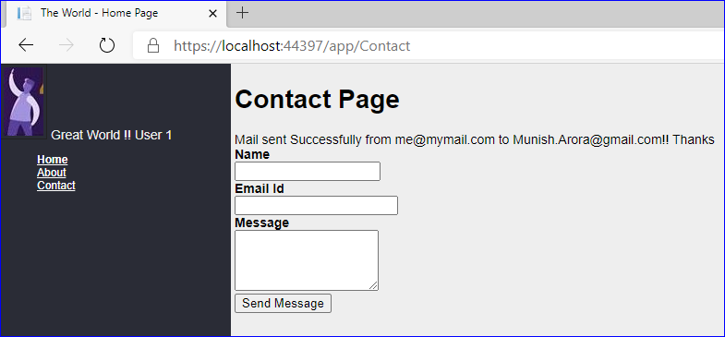
Adding Validation
Let us create
1 Contact Page
1.1 Create Contact View
1.2 Bind Contact View with View Model for Validations
1.3 Add a service for sending the mail
1.4 Read sender’s email id from config file
1.5 Display Message after mail has been sent
1.6 Send Mail via service

Slide 28
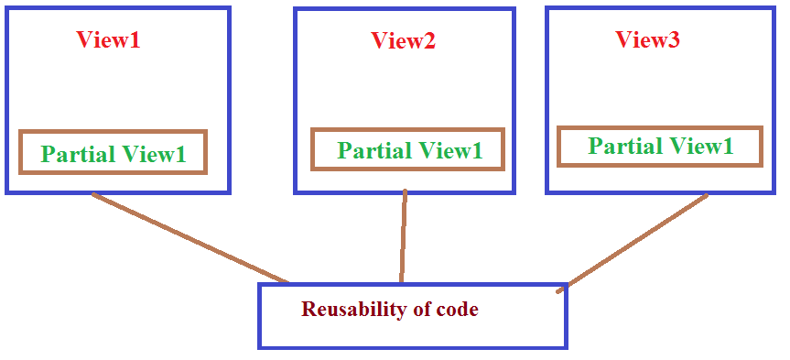
Partial Views
A partial view is a view that is rendered within another view.
It is a reusable view.
You can create partial view in ASP.NET MVC for re-usability of code. Thereby Reducing the duplication of common markup content across markup files.
The HTML output generated by executing the partial view is rendered into the calling (or parent) view.

Slide 29
Referencing Partial Views
The simplest is to use partial tag helper, as follows:
When using an HTML Helper, the best practice is to use PartialAsync. PartialAsyncreturns an IHtmlContent type wrapped in a Task<TResult>. The method is referenced by prefixing the awaited call with an @ character:
The following example references a partial view with a relative path:
<partial name="_footer.cshtml" />
@await Html.PartialAsync("_PartialName")
@await Html.PartialAsync("../Account/_LoginPartial.cshtml")

Slide 30
Accessing Data From Partial Views
When a partial view is instantiated, it gets a copy of the parent view’s ViewData dictionary.
Updates made to the data within the partial view are not persisted to the parent view. ViewDatachanged in a partial view is lost when the partial view returns.
You can pass an instance of ViewDataDictionary to the partial view:
You can also pass a model into a partial view. This can be the page’s view model, or some portion of it, or a custom object. Simply pass in the model as the second parameter when calling
You can pass an instance of ViewDataDictionary and a view model to a partial view:
@Html.Partial("PartialName", customViewData)
@Html.Partial("PartialName", viewModel)
@Html.Partial("PartialName", viewModel, customViewData)

Slide 31
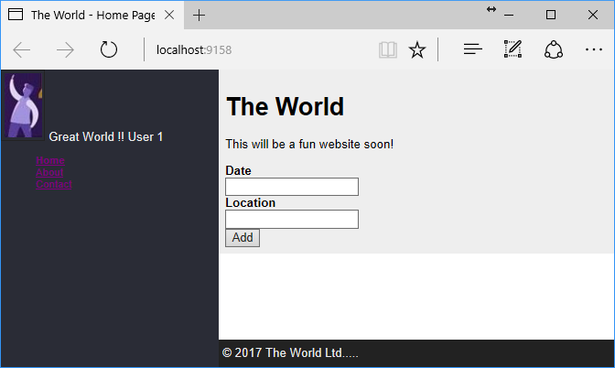
Partial Views
Let us
Create the partial view to display the footer in Great World App

Slide 32
Action Filters
Filters allow us to run custom code before or after executing the action method.
Allows us to handle scenarios where requirements may be relevant to
many parts of your application and cut across logical boundaries.
For example, authorization must be applied to many sensitive actions and controllers, regardless of the model and views that they use.
You can apply a filter to a controller action by annotating the action method with the appropriate attribute.
Filters run after an action is chosen to run. They run within a filter pipeline. The stage in the filter pipeline in which the filter is run is determined by the type of the filter.

Slide 33
Action Filters
The following are examples of filter types:
Authorization filters. Authorization filters run before any other filter and before the code in the action method. They are used to check a user’s access rights for the action.
Resource Filters. Resource filters appear in the filter pipeline after the authorization filters and before any other filters. They can be used for performance reasons. Resource filters implement either the IResouceFilter interface or the IAsyncResourceFilter interface.
Action Filters. Action filters run before and after the code in the action method. You can use action filters to manipulate the parameters that an action receives. They can also be used to manipulate the result returned from an action. Action filters implement either the IActionFilter interface or the IAsyncActionFilter interface

Slide 34
Action Filters
Exception Filters. Exception filters run only if an action method or another filter throws an exception. These filter classes are used to handle errors. Exception filters implement either the IExceptionFilter interface or the IAsyncExceptionFilter interface.
Result Filters. Result filters run before and after an action result is run. Result filters implement either the IResultFilter interface or the IAsyncResultFilter interface.

Slide 35
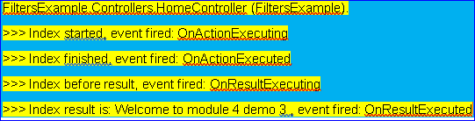
Action Filters
Let us
Create the Filter with name CustomActionFilter
Apply the filter and see the order in which various methods execute

Slide 36
Authoring Tag Helper
A tag helper is any class that implements the ITagHelper interface.
However, when you author a tag helper, you generally derive from TagHelper, doing so gives you access to the Process method.

Slide 37
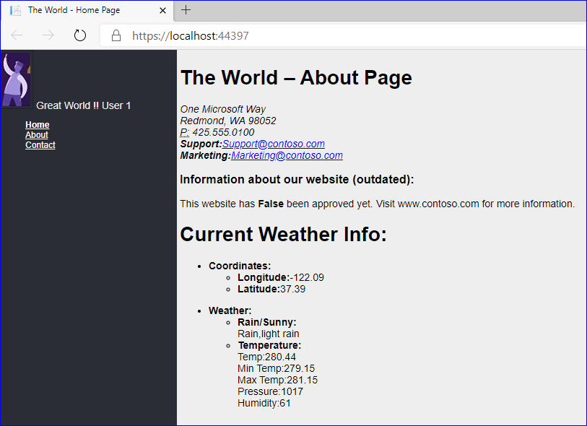
Demo: Authoring Tag Helper
Let us see the example of
1 Authoring TagHelper
1.1 Add New Controller: AppTHController
1.2 TagHelpers
1.2.1 Minimal TagHelper
1.2.2 Setting Attribute and Content
1.2.3 Passing Model
1.2.4 Condition TagHelper
1.2.5 Asynchronous communication

Slide 38
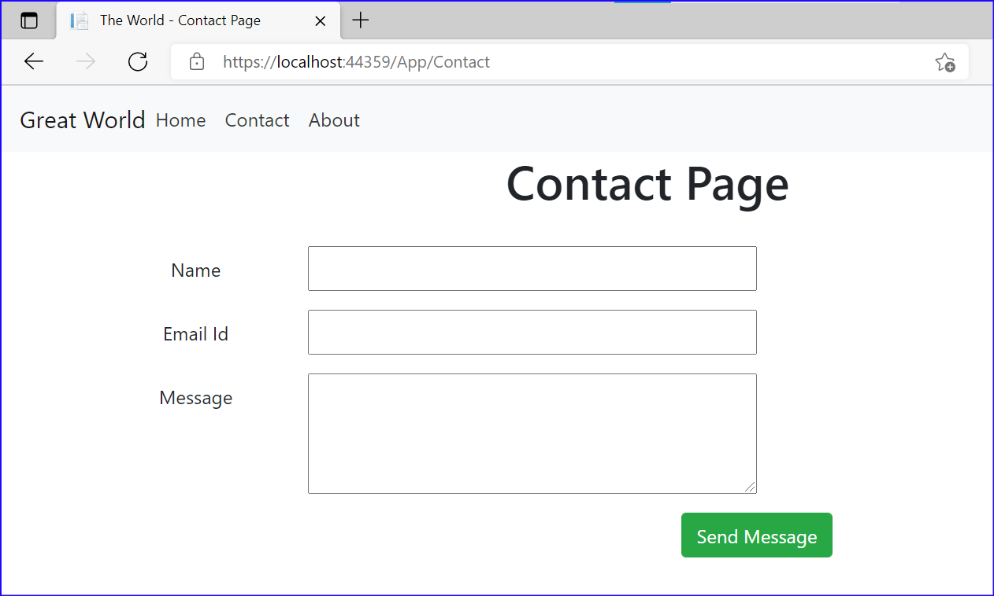
Demo: Responsive App
Let us see the example of
1 Responsive Application
1.1 Apply Bootstrap to Index View
1.2 Modifying Layout to have Navigation Bar and Bootstrap
1.3 Apply Bootstrap to Contact View

Slide 39
Summary
In this, we covered
Creating ASP.Net Core Web App Using Static Files
Convert existing App to MVC architecture
Creating Layout
Using Tag Helpers
ViewModel classes
Dependency Injection
Validations
Partial Views
Filters
TagHelpers

Slide 40
THANK YOU!

