Slide 1

ASP.Net Core API
By: Munish Arora

Slide 2
What we will cover?
In this, we will cover
What is Web API
Why Web API
APIController
APIController
How to use Web API in MVC
Demo:
extend our existing application to expose Web API
Retrieve Trip Info With Stops
Add New Trip to the existing database using Web API
Add New Stops
to Existing Trip

Slide 3
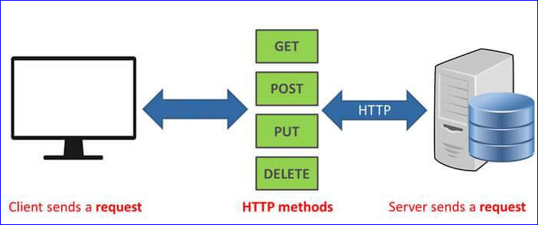
What is Web API
Web API is a framework for building HTTP services /Restful services
In the REST architectural style, data and functionality are considered resources and are accessed using Uniform Resource Identifiers (URIs), typically links on the Web.
The resources are acted upon by using a set of simple, well-defined operations
Definition: When a RESTful API is called, the server will transfer to the client a representation of the state of the requested resource.
.NET Framework is an ideal platform for building RESTful services

Slide 4
What is Web API
For example, when a client calls
Get method of, the API will return the state as in the Get method of API.
Similarly, will do that for other methods (Post, Put and Delete, when invoked).
The representation of the state can be in a JSON format, or XML or any other format as requested and implemented.
The client supplies
URL (Uniform Resource Locator) for the resource, also known as the endpoint.
The operation you want the server to perform, in the form of an HTTP method, or verb. The common HTTP methods are GET, POST, PUT, and DELETE.

Slide 5
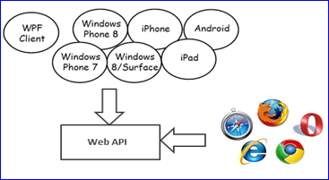
Why Web API?
Web API is open source
Expose your service data to the browsers and modern devices apps in fast and simple way.
Unlike WCF Rest service, it uses full features of HTTP (like URIs, request/response headers, caching, versioning, various content formats)
No config settings for different devices are required unlike WCF service

Slide 6
Why Web API?
Full support for routes: Web APIs now support the full set of route capabilities, including route parameters and constraints.
Mapping to actions has full support for conventions. You no longer need to apply attributes such as [HttpPost] to your methods.
Content negotiation: The client and server can work together to determine the right format for data being returned from an API.
Filters: Web APIs now supports filters, including well-known filters such as the [Authorize] attribute.
Self-host: Web APIs can be hosted in your own process in addition to IIS

Slide 7
Http Status Codes
For each request server also sends the status code along with the response
The Status-Code element in a server response, is a 3-digit integer where the
first digit of the Status-Code defines the class of response and
Last two digits do not have any categorization role.
There are 5 values for the first digit:

Slide 8
Http Status Codes
There are 5 values for the first digit:
Code | Description
1xx: Informational | It means the request has been received and the process is continuing.
2xx: Success | It means the action was successfully received, understood, and accepted.
3xx: Redirection | It means further action must be taken in order to complete the request.
4xx: Client Error | It means the request contains incorrect syntax or cannot be fulfilled.
5xx: Server Error | It means the server failed to fulfill an apparently valid request.

Slide 9
Http Status Codes
1xx: Information
Message | Description
100 Continue | Only a part of the request has been received by the server, but as long as it has not been rejected, the client should continue with the request.
101 Switching Protocols | The server switches protocol.

Slide 10
Http Status Codes
2xx: Successful
Message | Description
200 OK | The request is OK.
201 Created | The request is complete, and a new resource is created .
202 Accepted | The request is accepted for processing, but the processing is not complete.
203 Non-authoritative Information | The information in the entity header is from a local or third-party copy, not from the original server.
204 No Content | A status code and a header are given in the response, but there is no entity-body in the reply.
205 Reset Content | The browser should clear the form used for this transaction for additional input.

Slide 11
Http Status Codes
2xx: Successful
Message | Description
206 Partial Content | The server is returning partial data of the size requested. Used in response to a request specifying a Range header. The server must specify the range included in the response with the Content-Range header.

Slide 12
Http Status Codes
3xx: Redirection
Message | Description
300 Multiple Choices | A link list. The user can select a link and go to that location. Maximum five addresses .
301 Moved Permanently | The requested page has moved to a new url .
302 Found | The requested page has moved temporarily to a new url .
303 See Other | The requested page can be found under a different url .
304 Not Modified | This is the response code to an If-Modified-Since or If-None-Match header, where the URL has not been modified since the specified date.
306 Unused | This code was used in a previous version. It is no longer used, but the code is reserved.

Slide 13
Http Status Codes
3xx: Redirection
Message | Description
307 Temporary Redirect | The requested page has moved temporarily to a new url.

Slide 14
Http Status Codes
4xx: Client Error
Message | Description
400 Bad Request | The server did not understand the request.
401 Unauthorized | The requested page needs a username and a password.
402 Payment Required | You can not use this code yet.
403 Forbidden | Access is forbidden to the requested page.
404 Not Found | The server can not find the requested page.
405 Method Not Allowed | The method specified in the request is not allowed.
406 Not Acceptable | The server can only generate a response that is not accepted by the client.

Slide 15
Http Status Codes
4xx: Client Error
Message | Description
407 Proxy Authentication Required | You must authenticate with a proxy server before this request can be served.
408 Request Timeout | The request took longer than the server was prepared to wait.
409 Conflict | The request could not be completed because of a conflict.
410 Gone | The requested page is no longer available .
411 Length Required | The "Content-Length" is not defined. The server will not accept the request without it .
412 Precondition Failed | The pre condition given in the request evaluated to false by the server.

Slide 16
Http Status Codes
4xx: Client Error
Message | Description
413 Request Entity Too Large | The server will not accept the request, because the request entity is too large.
414 Request-url Too Long | The server will not accept the request, because the url is too long. Occurs when you convert a "post" request to a "get" request with a long query information .
415 Unsupported Media Type | The server will not accept the request, because the mediatype is not supported .
416 Requested Range Not Satisfiable | The requested byte range is not available and is out of bounds.
417 Expectation Failed | The expectation given in an Expect request-header field could not be met by this server.

Slide 17
Http Status Codes
5xx: Server Error
Message | Description
500 Internal Server Error | The request was not completed. The server met an unexpected condition.
501 Not Implemented | The request was not completed. The server did not support the functionality required.
502 Bad Gateway | The request was not completed. The server received an invalid response from the upstream server.
503 Service Unavailable | The request was not completed. The server is temporarily overloading or down.
504 Gateway Timeout | The gateway has timed out.

Slide 18
Http Status Codes
It is advisable to return the proper HTTP status code in response to a client request.
ASP.NET Core has inbuilt methods for the most common status codes. Like
return Ok(); // Http status code 200
return Created(); // Http status code 201
return NoContent(); // Http status code 204
return BadRequest(); // Http status code 400
return Unauthorized(); // Http status code 401
return Forbid(); // Http status code 403
return NotFound(); // Http status code 404

Slide 19
Http Status Codes
Sometimes, you will need to return status codes without such an inbuilt method.
In ASP.Net Core, Status codes returned through the StatusCode method which accepts an integer as an input. You can pass the status code number. Like,
[HttpGet]
[Route("AnotherMethod")]
public IActionResult AnotherMethod()
{
return StatusCode(405);
}

Slide 20
Http Status Codes
ASP.NET Core has a class named StatusCodes, having constant for all HTTP status code. You can use constant fields defined in StatusCodes class. Like,
[HttpGet]
[Route("AnotherMethod")]
public IActionResult AnotherMethod()
{
return StatusCode(Microsoft.AspNetCore.Http.StatusCodes.Status200OK);
}

Slide 21
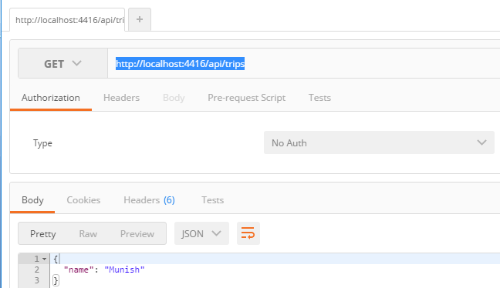
Demo: Web API
Let us
Extend our existing application to expose Web API
And check that this API is in working state using Postman

Slide 22
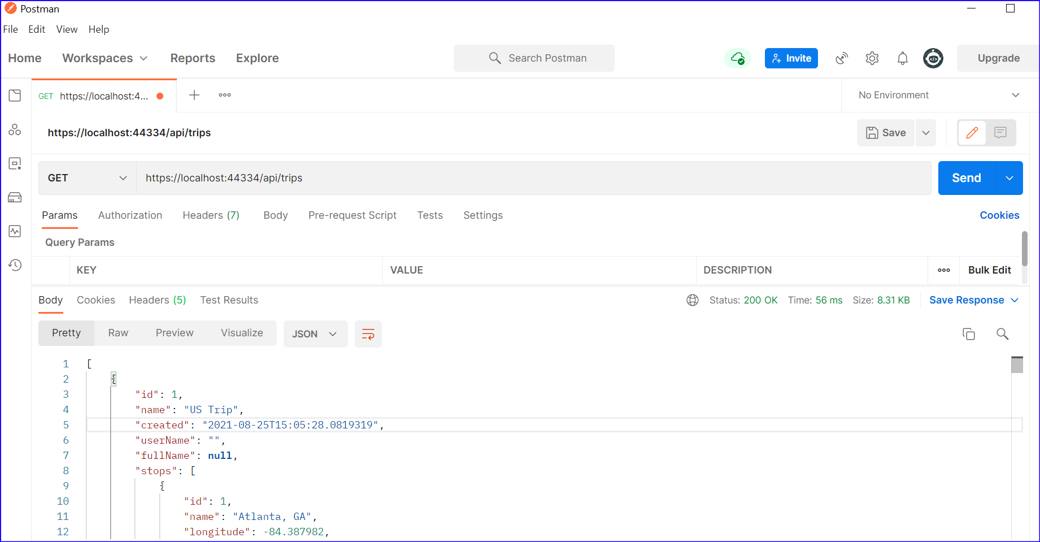
Demo: Web API
Let us
Retrieve Trip information With Stops

Slide 23
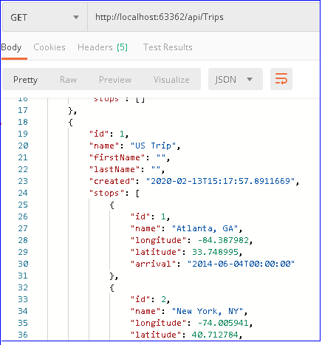
Demo: Web API
Let us
Add New Trip to the existing database using Web API

Slide 24


Knowledge check
In the REST architectural style, data and functionality are considered resources and are accessed using Uniform Resource Identifiers (URIs), typically links on the Web.
True
False
Mapping to actions has full support for conventions. You no longer need to apply attributes such as [HttpPost] to your methods.
True
False

Slide 25
Knowledge check
AutoMapper is an object-object mapper that allows you to solve the problem of manually mapping each property of a class with the same properties of another class.
As an example, you might need to map the DTOs (Data Transfer Objects) and respective properties in your application to the model objects
True
False

Slide 26
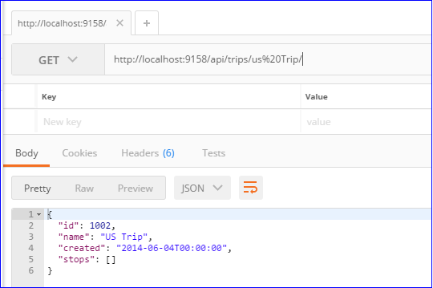
Quick Exercise 4.1: Web API
Modify the TripController to
Fetch details of particular trip without stops
http://localhost:9158/api/trips/US%20Trip/
Notes:
Modify the Get method of TripController to invoke GetAllTrips
[HttpGet("")]
public IActionResult Get()
{
// _repository.GetAllTripsWithStops() returns IEnumerable collection of Trips
//var results = _mapper.Map<IEnumerable<TripViewModel>>(_repository.GetAllTripsWithStops());
var results = _mapper.Map<IEnumerable<TripViewModel>>(_repository.GetAllTrips());
return ok(results);
}

Slide 27
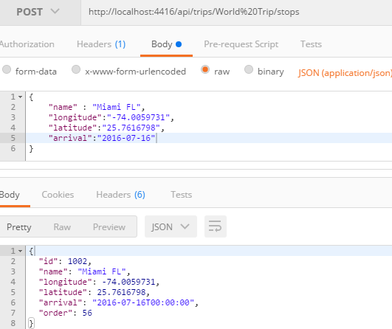
Demo: Web API
Let us create an MVC Application
Add New Stops to Existing Trip

Slide 28
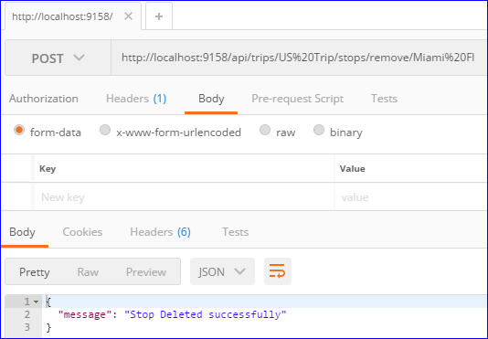
Exercise 5.2: Web API
Modify the StopController to
Delete the particular stop by specifying the stop name
http://localhost:9158/api/trips/US%20Trip/stops/remove/Miami%FL
Notes:
Modify StopController to have a new method
[HttpDelete("/api/trips/{tripName}/stops/remove/{stopname}")]
public IActionResult Post(string tripName, string stopname)
{
try
{
//Check if stop exists, if yes remove it
bool stopRemoved = _repository.RemoveStop(tripName, stopname);
if (!stopRemoved)
{
Response.StatusCode = (int)HttpStatusCode.BadRequest;
return Ok(new { Message = "Stop " + stopname + " does not exist" });
};
if (_repository.SaveAll())
{
Response.StatusCode = (int)HttpStatusCode.Created;
return Ok(new { Message = "Stop "+ stopname +" deleted successfully" });
}
}
catch (Exception ex)
{
Response.StatusCode = (int)HttpStatusCode.BadRequest;
return BadRequest(new { Message = ex.Message });
}
Response.StatusCode = (int)HttpStatusCode.BadRequest;
return BadRequest (new { Message = "Validation failed on new stop" });
}
2. Modify IGreatWorldRepository to have net method
bool RemoveStop(string tripName, string stopname);
3. Modify GreatWorldRepository to have implementation of RemoveStop
public bool RemoveStop(string tripName, string stopName)
{
Stop theStop = GetStopByName(tripName, stopName);
//Remove the stop
if (theStop != null)
{
_context.Stops.Remove(theStop);
return true;
}
return false;
}
public Stop GetStopByName(string tripName, string stopName)
{
Trip theTrip = GetTripByName(tripName);
return theTrip.Stops
.Where(t => t.Name == stopName)
.FirstOrDefault();
}

Slide 29
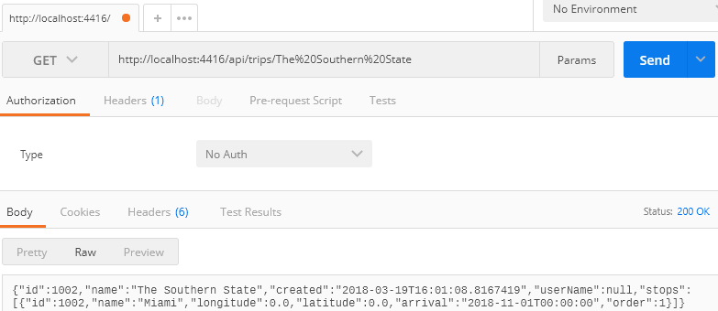
Exercise 5.3: Web API
Modify the TripController to
Display the trip and stops
Notes:
Modify tripController to accept tripname, and return the results accordingly
[HttpGet("/api/trips/{TripName}")]
public IActionResult Get(string TripName)
{
if (TripName != null)
{
var results1 = _repository.getTripByName(TripName);
return Ok( results1);
}
// _repository.GetAllTripsWithStops() returns IEnumerable collection of Trips
var results = Mapper.Map<IEnumerable<TripViewModel>>(_repository.GetAllTripsWithStops());
return Ok(results);
}

Slide 30
Enabling Cross-Origin Requests (CORS)
Browser security prevents a web page from making requests to a different domain than the one that served the web page. This restriction is called the same-origin policy. The same-origin policy prevents a malicious site from reading sensitive data from another site.
These two URLs have the same origin:
https://example.com/foo.html
https://example.com/bar.html
These URLs have different origins than the previous two URLs:
https://example.net – Different domain
https://www.example.com/foo.html – Different subdomain
http://example.com/foo.html – Different scheme
https://example.com:9000/foo.html – Different port
Internet Explorer doesn't consider the port when comparing origins.

Slide 31
CORS with named policy and middleware
Cross-Origin Resource Sharing (CORS) is an HTTP-header based mechanism that allows a server to indicate any origins (domain, scheme, or port) other than its own from which a browser should permit loading of resources.
Cross-Origin Resource Sharing (CORS) Middleware handles cross-origin requests. The following code enables CORS for the entire app with the specified origin
For further details, pls. refer to https://docs.microsoft.com/en-us/aspnet/core/security/cors
For example, pls. refer to https://code-maze.com/enabling-cors-in-asp-net-core/

Slide 32
Format Delivery: Media Formatters
Web API uses a default OutputFormatter to turn objects into JSON, which is the default format to send data in a structured way
We can support the other media format by adding support for that in ConfigureServices method in Startup file
With content negotiation, the client is able to decide which format it wants to retrieve. They specify the content type of the format in the Accept-Header.
The response data can be formatted using specific formats or in response to client requested format.

Slide 33
Web API Request/Response Data Formats
Media type (aka MIME type) specifies the format of the data as type/subtype e.g. text/html, text/xml, application/json, image/jpeg etc.
In HTTP request, MIME type is specified in the request header using Accept and Content-Type attribute.
Accept header is used by HTTP clients to tell the server what content types they'll accept.
An example of an Accept header for a xml request to a REST based service will be the : Accept: application/xml or text/xml

Slide 34
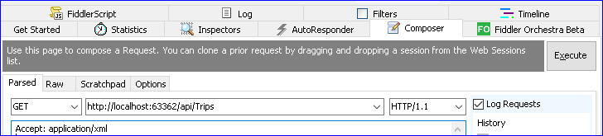
Web API Request/Response Data Formats
For example, if a client wants response data in XML format then it will send following GET HTTP request with Accept header to the Web API.
GET http://localhost:63362/api/Trips HTTP/1.1 Accept: application/xml

Slide 35
Content Type Header
The Content-Type entity-header field indicates the media type of the entity-body sent to the recipient
As a sample if a json is being sent from a browser to a server, then the content type header would look like this: Content-Type: application/json
However, as you may have noticed, HTTP requests like PUT and POST can also contain Content-Type headers.
The Content-Type header tells the server what the data actually is (and thus determines how the server will parse it).

Slide 36
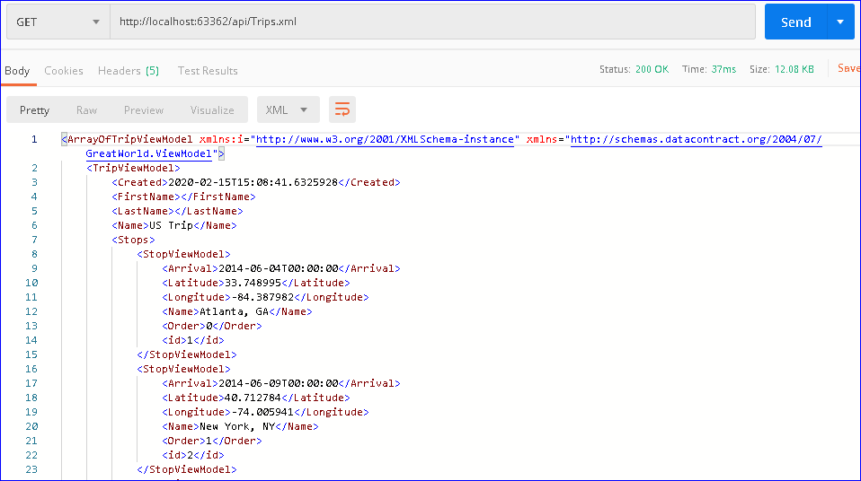
Demo: Content Nego and Query String
Let’s modify the existing app to see
1 Displaying Data
1.1 Use Content Negotiation to display data in in xml /json format
1.2 By fetching the Format from Query String
Notes:
Modify tripController to accept tripname, and return the results accordingly
[HttpGet("/api/trips/{TripName}")]
public JsonResult Get(string TripName)
{
if (TripName != null)
{
var results1 = _repository.getTripByName(TripName);
return new JsonResult( results1);
}
// _repository.GetAllTripsWithStops() returns IEnumerable collection of Trips
var results = Mapper.Map<IEnumerable<TripViewModel>>(_repository.GetAllTripsWithStops());
return Json(results);
}

Slide 37
Summary
Here we saw
What is Web API
Why Web API
APIController
How to use Web API in MVC
Creating small application

Slide 38
THANK YOU!

