Slide 1

ASP.NET Core
By: Munish Arora

Slide 2
Introduction
In this, we will cover
State Management
Using hidden fields
Session and application state
Custom model bindings
Caching

Slide 3
State Management
Application state refers to any data that is used to represent the current representation of the application. This includes both global and user-specific data.
In ASP.NET Core, application state can be managed in a variety of ways, depending on when and how the state is to be retrieved.
Application state in ASP.NET Core apps can be stored or managed in a variety of ways
HttpContext.Items: The Items collection is the best location to store data that is only needed while processing a given request. Its contents are discarded after each request. Best Use: communicating between components or middleware
Querystring and Post: State from one request can be provided to another request by adding values to the new request’s querystring or by POSTing the data.
Cookies: Very small pieces of state-related data can be stored in Cookies. These are sent with every request, and so the size should be kept to a minimum.

Slide 4
State Management
The application state in ASP.NET Core apps may be stored using:
Session: Session storage relies on a cookie-based identifier to access data related to a given browser session (a series of requests from a particular browser and machine).
Cache / Cookies: Caching provides a means of storing and efficiently retrieving arbitrary application data based on developer-defined keys. It provides rules for expiring cached items based on time and other considerations.
Configuration: Configuration can be thought of as another form of application state storage, though typically it is read-only while the application is running.
Other Persistence: Any other form of persistent storage, whether using Entity Framework and a database or something like Azure Table Storage, can also be used to store application state, but these fall outside of what ASP.NET supports directly

Slide 5
Working with HttpContext.Items
The HttpContext abstraction provides support for a simple dictionary collection of type IDictionary<object, object>, called Items.
This collection is available from the start of an HttpRequest and is discarded at the end of each request. You can access it by simply assigning a value to a keyed entry, or by requesting the value for a given key.
For example, some simple Middleware could add something to the Items collection:
and later in the pipeline, another piece of middleware could access it:
app.Use(async(context, next) => {
// perform some verification
context.Items["isVerified"] = true;
await next.Invoke();
});
app.Run(async(context) => {
await context.Response.WriteAsync("Verified request? " + context.Items["isVerified"]);
});

Slide 6
Installing and Configuring Session
ASP.NET Core ships a session package that provides middleware for managing session state. You can install it by including a reference to the Microsoft.AspNetCore.Session package in your project.
Once the package is installed, Session must be configured in your application’s Startup class.
A distributed cache is a cache shared by multiple app servers, typically maintained as an external service to the app servers that access it.
Session is built on top of IDistributedCache, so you must configure this as well (A distributed cache is the cache shared by multiple app servers)
To configure session using this in-memory option
add Microsoft.Extensions.Caching.Memory package in your project and
add the following to ConfigureServices:
services.AddDistributedMemoryCache();
services.AddSession();

Slide 7
Installing and Configuring Session
Then, add the following to Configure and you’re ready to use session in your application code:
Because Session is built on top of IDistributedCache, you must always serialize the object instances being stored.
However, there are extension methods that make working with simple types such as String and Int32 easier, as well as making it easier to get a byte[] value from session.
app.UseSession();
// session extension usage examples
context.Session.SetInt32("key1", 123);
int? val = context.Session.GetInt32("key1");
context.Session.SetString("key2", "value");
string stringVal = context.Session.GetString("key2");
byte[] result = context.Session.Get("key3");

Slide 8
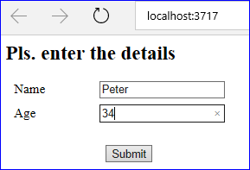
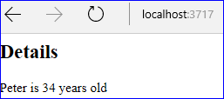
Storing and Retrieving from Session
Let us create a MVC application
In this application , we will see how can we retrieve the values
FormCollection
Session
Sending Objects via session - Serialize and Deserializing

Slide 9
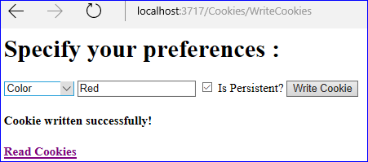

Storing and Retrieving from Cookies
Let us create a MVC application
In this application , we will see how to
save values in cookies
retrieve values from cookies
Is Persistant means that should it have an expiry Date.
If Checked =Yes, means No Expiry Date, else expire after 1 day

Slide 10
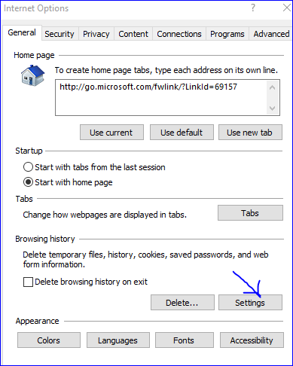
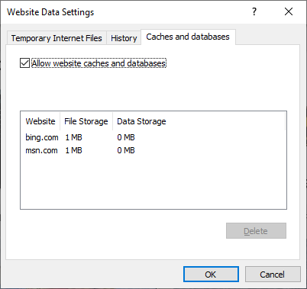
Cookies Location
In Google Chrome:
Cookies are stored at C:\Users\Munish\AppData\Local\Google\Chrome\User Data\Default
In Internet Explorer:

Slide 11
Caching
ASP.NET Core supports a couple of caching mechanisms to improve the performance and responsiveness of applications.
Here are few options to implement cache at various levels
Response Cache
In Memory Cache
Distributed Caching in SQL Server or In memory cache server

Slide 12
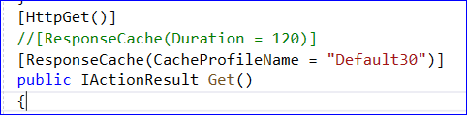
Response Caching
Response Caching adds cache related header in response from application if we decorate ResponseCache attribute to Action, Controller or Global level.
ResponseCache does not store HTTP response in server unlike Output Cache in prior versions of ASP.NET. It just adds the "Cache-Control" header in response, now it's the client's choice to cache the response in the browser or some intermediate server, if any. It can reduce the number of server roundtrip if the browser or cache server cached the previous response and server to any subsequent request.
Here we have decorated ResponseCache Action with the "ResponseCache" attribute which takes the Duration parameter.

Slide 13
Response Caching: Fine points
For the cache to work must meet a number of requirements:
The request must result in a 200 (OK) response from the server.
Terminal middleware, such as Static File Middleware, must not process the response prior to the Response Caching Middleware.
The Authorization header must not be present.
The Pragma: no-cache header/value must not be present if the Cache-Control header is not present, as the Cache-Control header overrides the Pragma header when present. The Set-Cookie header must not be present.
The Content-Length header value (if set) must match the size of the response body.
Notes:
The Pragma: no-cache header field is an HTTP/1.0 header is a means for the browser to tell the server and any intermediate caches that it wants a fresh version of the resource

Slide 14
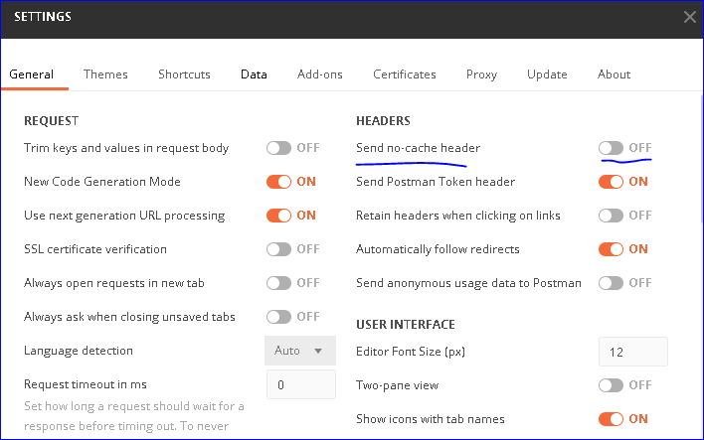
Response Caching: Fine points
For the cache to work must meet a number of requirements:
if the request is being made from Postman disable the option "do not send the cache header".
Notes:
The Pragma: no-cache header field is an HTTP/1.0 header is a means for the browser to tell the server and any intermediate caches that it wants a fresh version of the resource

Slide 15
In memory Caching
In memory caching uses memory allocated to process for storing information.
It is not distributed and scalable because the cached data is stored in server process. To configure In Memory cache, we need to modify the Program.cs.
And thereafter can be used in Controller
…….
services.AddMemoryCache();
services.AddMvc();

Slide 16
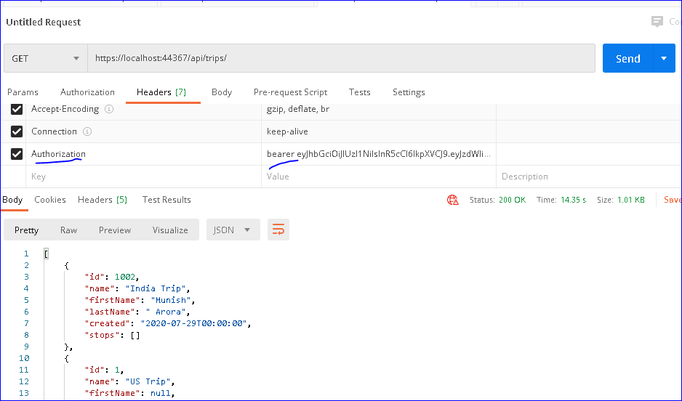
Demo Caching
Let’s see how the following can be utilized
a. Response Caching
b. In Memory Caching
Notes:
Modify tripController to accept tripname, and return the results accordingly
[HttpGet("/api/trips/{TripName}")]
public JsonResult Get(string TripName)
{
if (TripName != null)
{
var results1 = _repository.getTripByName(TripName);
return new JsonResult( results1);
}
// _repository.GetAllTripsWithStops() returns IEnumerable collection of Trips
var results = Mapper.Map<IEnumerable<TripViewModel>>(_repository.GetAllTripsWithStops());
return Json(results);
}

Slide 17
THANK YOU!

