Slide 1

Introduction
By: Munish Arora
Munish.arora@gmail.com

Slide 2
Introduction
In this, we will cover
What is Angular
Angular vs AngularJS
Advantages of using Angular and When to User Angular?
Angular Architecture
Component
Template
AppComponent
Traditional vs SPA Applications
Angular Router
Installation: nodejs
Relation: Node, Angular and npm

Slide 3
What is Angular
A JavaScript framework that helps build web and mobile applications
It is an open source JavaScript framework which simplifies binding code between JavaScript objects and HTML UI elements
Angular is an open source project, which means it can be freely used, changed, and shared by anyone.
Angular is an excellent framework for building both Single Page Applications (SPA) and Line of Business Applications

Slide 4

Some Renowned Websites..
Some of the renowned web applications, which are powered with the flexible and robust Angular framework.

Slide 5
Development History
Originally developed in 2009 by Misko Hevery at Brat Tech LLC, with first release in Oct 2010.
It was originally developed as a software behind an online JSON storage service, that would have been priced by the megabyte, for easy-to-make applications for the enterprise
Was originally located at the web domain "GetAngular.com", and had a few subscribers, before the two decided to abandon the business idea and release Angular as an open-source library.
It is now being mainly maintained by Google and by a community of individuals and corporations to address many of the challenges encountered in developing single-page applications.

Slide 6

Development History
Releases
Angular JS 1.x
Initial release 1.0 was in October 20, 2010
Since then 1.x.x releases have been released on periodic basis. The current stable release of AngularJS is 1.6.0
Angular Releases
Release Schedule
minor releases every week, and
major release every 6 months
Sep' 2014 | AngularJS 2.0 was announced at the ng-europe conference
Dec 2015 | AngularJS 2 moved from Alpha to Developer Preview.
May 2016 | first release candidate was published in May 2016
Sep 2016 | Angular 2.0 released
Mar 2017 | Angular 4.0 released

Slide 7
Angular vs AngularJS
AngularJS is JavaScript-based while Angular is TypeScript based.
TypeScript is a primary language for Angular application development. It is a superset of JavaScript with design-time support for type safety and tooling.
Angular is component-based while AngularJS uses directives
AngularJS framework follows MVC architecture.
Angular uses components that are directives with templates.
There are two kinds of directives in Angular.
Structural directives: they alter the DOM’s layout by replacing its elements.
Attributive directives: it changes how the DOM behave and the appearance of the element.

Slide 8
Angular vs. AngularJS
AngularJS depends on third-party tools such as IDE and WebStorm, whereas Angular uses the Command Line Interface (CLI) to reduce the time when creating applications.
AngularJS does not provide mobile support while Angular supports mobile support.

Slide 9
Advantages of using Angular
Angular is faster than traditional apps like .Net or other apps.
Streamlined framework: Angular is a more streamlined framework that allows programmers to focus on simply building JavaScript classes.
Components: Views and controllers are replaced with components, which can be described as a refined version of directives. These are considerably easier to read, and their API features less jargon than Angular 1.x's directives.
TypeScript: TypeScript is developed by Microsoft and is supported by angular 2. It introduces static types which makes things like IDEs and builders/compilers more effective. In some scenarios it also makes writing and testing of code easier.
Modular: Angular apps are quite modular i.e. organizing your code into independent chunks or buckets such that each of such bucket offers similar kind of functionality. This makes testing, upgradation and maintenance of the app a lot more convenient.

Slide 10
Advantages of using Angular
Improved *ngIf and *ngFor: if/else style syntax has been introduced where you can assign local variables such as when unrolling an observable. And its awesome to use.
Animations: Angular comes with a separate package for animation which actually quite effective and saves your breath from learning other animation libraries along with angular.
Flat ES Modules: Modules are shipped as flattened version that helps in reducing the size of generated bundles.
Angular CLI: Angular command line interface (idea derived from ember) is pretty cool and makes your app development process easier.
[Angular CLI is a great tool to create and work with Angular Applications . It takes away all the pain staking work one has to do otherwise manually by making all the configuration files required for bootstrapping an angular application. With few commands it becomes easier to build working components, Services, directives etc .]

Slide 11
When to User Angular?
Generally speaking, Angular is heavier framework
S. No. | Reason to Consider | Reason (not to use Angular)
1. | Large Projects | Small Projects (even jQuery may work for smaller simple projects)
2. | Large Development Teams | Small Development Teams
3. | Complex | Simple
4. | Single Page Applications (esp. when you have loads and loads of images, animations etc..) | Multi Page Applications

Slide 12
Angular Architecture
Angular is a framework for building client applications in HTML and JavaScript
The framework consists of several libraries, some of them core and some optional
You write Angular applications by
composing HTML templates with Angularized markup
Writing component classes to manage those templates
Adding application logic in services, and
boxing components and services in modules.
Then you launch the app by bootstrapping the root module

Slide 13
Angular: Architecture
User Interface (UI)
Data And Processing
Application Programming
Interface (API)
Front-end
Back-end
Response
HTML
CSS
TypeScript
Angular
APIs
Database
Notes:
You write Angular applications by composing HTML templates with Angularized markup,
writing component classes to manage those templates,
adding application logic in services,
and boxing components and services in modules.
Every Angular app has at least one Angular module class, the root module, conventionally named AppModule.
An Angular module, whether a root or feature, is a class with an @NgModule decorator.
[Decorators are functions that modify JavaScript classes. Angular has many decorators that attach metadata to classes so that it knows what those classes mean and how they should work.]
Angular templates are dynamic. When Angular renders them, it transforms the DOM according to the instructions given by directives.
A directive is a class with a @Directive decorator.
Two other kinds of directives exist: structural and attribute directives.
They tend to appear within an element tag as attributes do, sometimes by name but more often as the target of an assignment or a binding.
Structural directives alter layout by adding, removing, and replacing elements in DOM.
The example template uses two built-in structural directives:
<li *ngFor="let hero of heroes">
</li>
*ngFor tells Angular to stamp out one <li> per hero in the heroes list.
<hero-detail *ngIf="selectedHero">
</hero-detail>
*ngIf includes the HeroDetail component only if a selected hero exists.
Attribute directives alter the appearance or behavior of an existing element. In templates they look like regular HTML attributes, hence the name.
The ngModel directive, which implements two-way data binding, is an example of an attribute directive. ngModel modifies the behavior of an existing element (typically an <input>) by setting its display value property and responding to change events.
<input [(ngModel)]="hero.name">

Slide 14
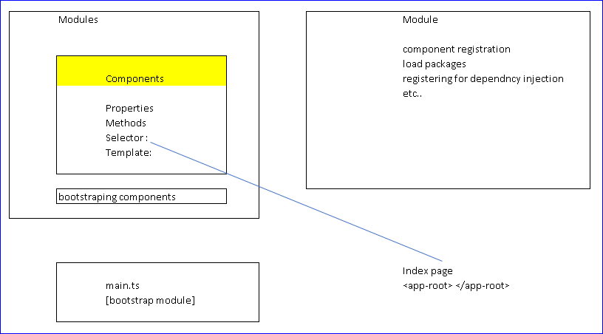
Angular Architecture
So, in simple terms, here is how it will look like
the first code has to be executed from "main.ts" file, i.e., "main.ts" file is the main file from where the execution of an Angular application starts. It loads AppModule by default.

Slide 15
Angular: Architecture
Module
Template
Event Binding
Component
Metadata
Property Binding
Directive
Injector
The component consists of template for display the html, and component holding properties and functions
Metadata
Module Service
Notes:
You write Angular applications by composing HTML templates with Angularized markup,
writing component classes to manage those templates,
adding application logic in services,
and boxing components and services in modules.
Every Angular app has at least one Angular module class, the root module, conventionally named AppModule.
An Angular module, whether a root or feature, is a class with an @NgModule decorator.
[Decorators are functions that modify JavaScript classes. Angular has many decorators that attach metadata to classes so that it knows what those classes mean and how they should work.]
Angular templates are dynamic. When Angular renders them, it transforms the DOM according to the instructions given by directives.
A directive is a class with a @Directive decorator.
Two other kinds of directives exist: structural and attribute directives.
They tend to appear within an element tag as attributes do, sometimes by name but more often as the target of an assignment or a binding.
Structural directives alter layout by adding, removing, and replacing elements in DOM.
The example template uses two built-in structural directives:
<li *ngFor="let hero of heroes">
</li>
*ngFor tells Angular to stamp out one <li> per hero in the heroes list.
<hero-detail *ngIf="selectedHero">
</hero-detail>
*ngIf includes the HeroDetail component only if a selected hero exists.
Attribute directives alter the appearance or behavior of an existing element. In templates they look like regular HTML attributes, hence the name.
The ngModel directive, which implements two-way data binding, is an example of an attribute directive. ngModel modifies the behavior of an existing element (typically an <input>) by setting its display value property and responding to change events.
<input [(ngModel)]="hero.name">

Slide 16
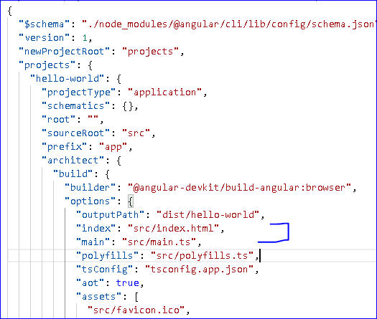
Angular Architecture
At the vey start we have main.ts
main.ts compiles the web-app and bootstraps the AppModule to run in the browser.
The location of this file is specified in angular.json
angular.json

Slide 17
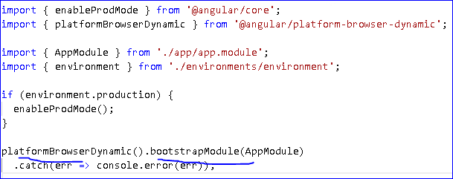
Angular Architecture
In main.ts, we specify that we are compiling the code for browser, and bootstrapping it with AppModule
When we build angular application using ngbuild, one of the webpack that gets created is main.bundle.js. This bundle contains main.ts
This bundle is the one responsible for starting the bootstrap process, which is specified in main.ts.
Notes:
When we build angular application using ngbuild, one of the webpack that gets created is main.bundle.js. This bundle is the one responsible for starting the bootstrap process.
It is built by the Angular compiler based on the config read from angular.json, which is where it is indicated that main.ts is the main bootstrap file.

Slide 18
Angular Architecture: AppModule
An Angular module class describes how the application parts fit together.
Every application has at least one Angular module, the root module that you bootstrap to launch the application.
You can call it anything you want. The conventional name is AppModule.
Notes:
When we build angular application using ngbuild, one of the webpack that gets created is main.bundle.js. This bundle is the one responsible for starting the bootstrap process.
It is built by the Angular compiler based on the config read from angular.json, which is where it is indicated that main.ts is the main bootstrap file.

Slide 19
Angular Architecture: AppModule
import { BrowserModule } from '@angular/platform-browser';
import { NgModule } from '@angular/core';
import { AppComponent } from './app.component';
import { CourseComponent } from './course/course.component';
@NgModule({
declarations: [
AppComponent
],
imports: [
BrowserModule
],
providers: [],
bootstrap: [AppComponent]
})
export class AppModule { }
NgModule decorator is used to organize Angular apps by adding metadata in the @NgModule decorator.
We are bootstrapping AppComponent, so the component will be available for getting rendered
Notes:
When we build angular application using ngbuild, one of the webpack that gets created is main.bundle.js. This bundle is the one responsible for starting the bootstrap process.
It is built by the Angular compiler based on the config read from angular.json, which is where it is indicated that main.ts is the main bootstrap file.

Slide 20
Component
A component is a controller class with a template which mainly deals with a view of the application and logic on the page.
To register component, we use @Component annotation and can be used to break up the application into smaller parts.
Component consists of the following −
Properties
Methods
Selector, the node via which the view /template gets selected
Template − This is used to render the view for the application
 | Component
 | Properties
 | Methods
 | Selector :
 | Template:

Slide 21
Component Decorators
Decorators are functions that modify JavaScript classes, that allow you to mark a class as an Angular component and provide additional metadata
This metadata determines how the component should be processed, instantiated and used at runtime
import { Component } from '@angular/core';
@Component({
selector: 'rio-hello',
templateUrl: './app.component.html'
})
export class HelloComponent {
name: string;
constructor() {
this.name = 'World';
}
}
Metadata
The architectural takeaway is that you must add metadata to your code so that Angular knows what to do.

Slide 22
Template
The component's view can be defined by using the template
Template tells Angular how to display the component. For instance, below simple template shows how to display the name:
<div>
Your name is : {{name}}
</div>

Slide 23
Angular Architecture: AppComponent
Angular loads a root AppComponent dynamically because it's listed by type in @NgModule. bootstrap .
Other entry components are loaded dynamically by other means, such as with the router.
import { Component } from '@angular/core';
@Component({
selector: 'app-root',
templateUrl: './app.component.html',
styleUrls: ['./app.component.css']
})
export class AppComponent {
title = 'World';
}
Notes:
When we build angular application using ngbuild, one of the webpack that gets created is main.bundle.js. This bundle is the one responsible for starting the bootstrap process.
It is built by the Angular compiler based on the config read from angular.json, which is where it is indicated that main.ts is the main bootstrap file.

Slide 24
app.component.html
If app.component.html reads like as follows
<div>
Hello {{title}}
</div>
And when the node <app-root> is added in html page, it will display ’Hello World’

Slide 25
Traditional Web Applications
Client (browser) requests a page to the server.
Client
Initial Request
Server
HTML
The server then processes the request and sends the HTML of the page to the client
Post
Page Reload
HTML
When the user navigates to a link or submits a form with data, a new request is sent to the server and the flow starts again.

Slide 26
Single Page Application (SPA) : Angular
The entire page is loaded into the browser after the initial request, but subsequent interactions take place using Ajax requests
Client
Initial Request
Server
HTML
Ajax
JSON
This means that the browser must update only the portion of the page that has changed
The SPA approach reduces the time taken by the application to respond to user actions, resulting in a more fluid experience

Slide 27
Client Side Templating
With Client Side Templating, the server just sends the data and html page, and complete page building is done at client side
Client Browser
Initial Request
Server
HTML
Page
HTML,
JavaScript
JSON |
JavaScript Variables
|Data
The client, browser takes the html page, variables and data, and combines them to produce the end page
The server processing is faster now as server just sends the blank html page and data

Slide 28
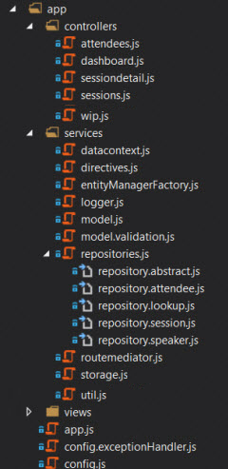
Structure: Sort By Type
The structure on RHS is ok for small apps
But as the size increases, it gets more difficult to find what you are looking for.
It can be good to start here if you are not sure how else to organize the code as it is quite easy to shift to the technique on the right: structure by feature

Slide 29
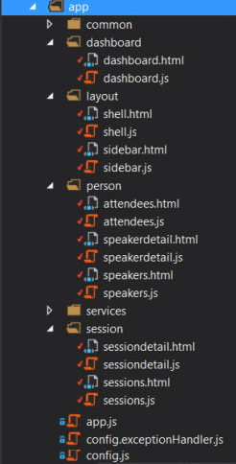
Structure: Sort By Feature (Preferred)
This feature-wise structure can be implemented fairly easily once you start to gather multiple modules.
Here, we have created the feature-wise folders, and some common folders
All of the layout views and controllers go in the layout folder
The feature content goes in the corresponding <<featurename>> folder
Services that are used by all of the areas /features go in the services folder.

Slide 30
TypeScript
A strict superset of JavaScript with added features maintained by Microsoft
Optional static typing
Class based Object Oriented Programming
Resembles languages like Java or C /C++

Slide 31
Services
Services are used for reusable data services to share data between components throughout an application
Refactoring data access to a separate service keeps component lean and focused on supporting the view
Services are invariable asynchronous.

Slide 32
Angular Router
It is vital part of application
Loads the respective components with respect to requested route
Allows us to control different routes, data and components that render the data
Component B
Component A
router
Component C
Component D

Slide 33
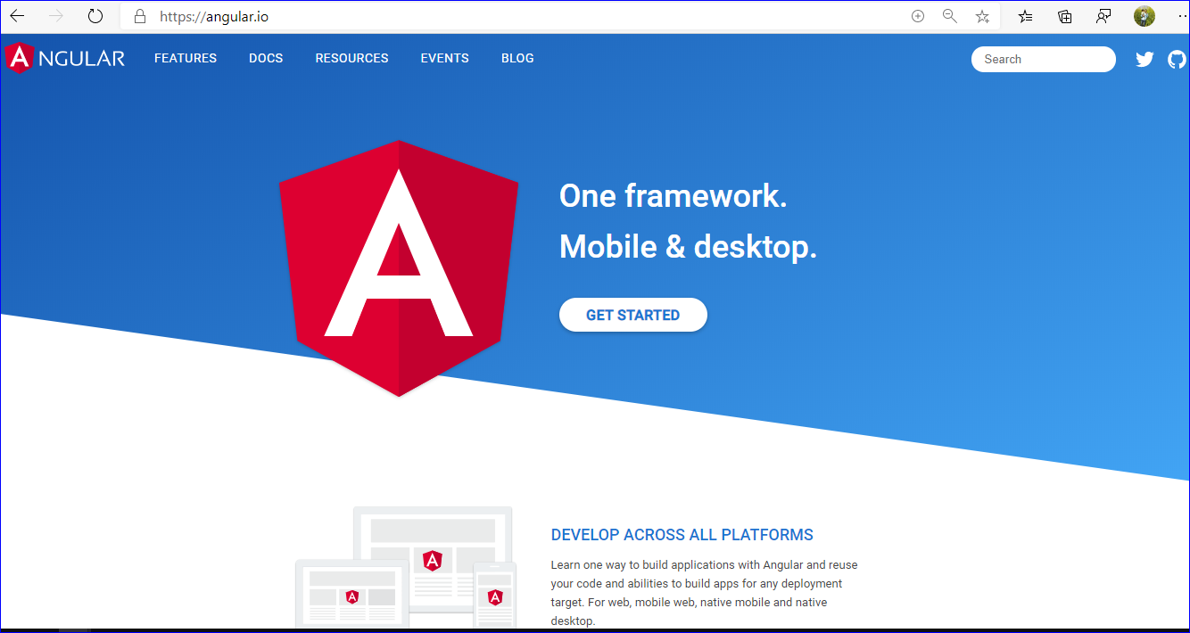
Details
You can go to Angular.io website and click on Get Started button, and it will take you to documentation page

Slide 34
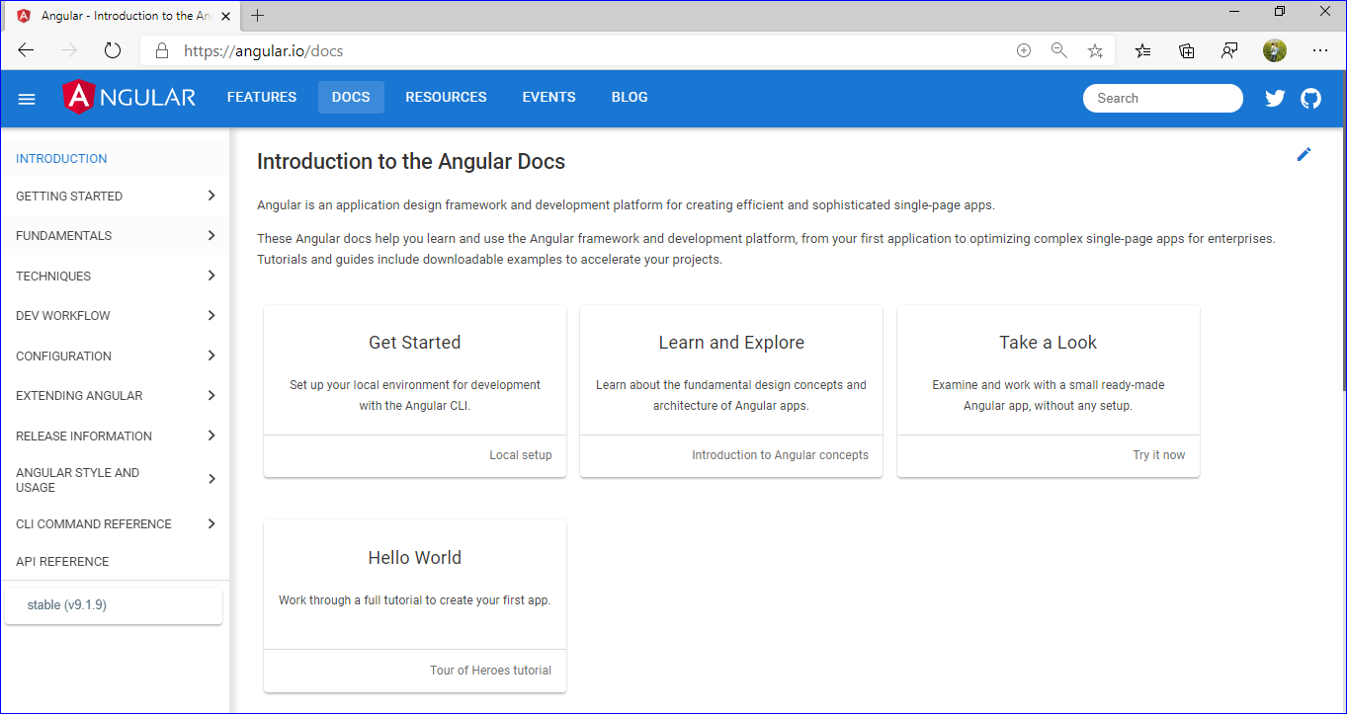
Details
In documentation (https://angular.io/docs), you can read about the basics, snippets and samples.

Slide 35
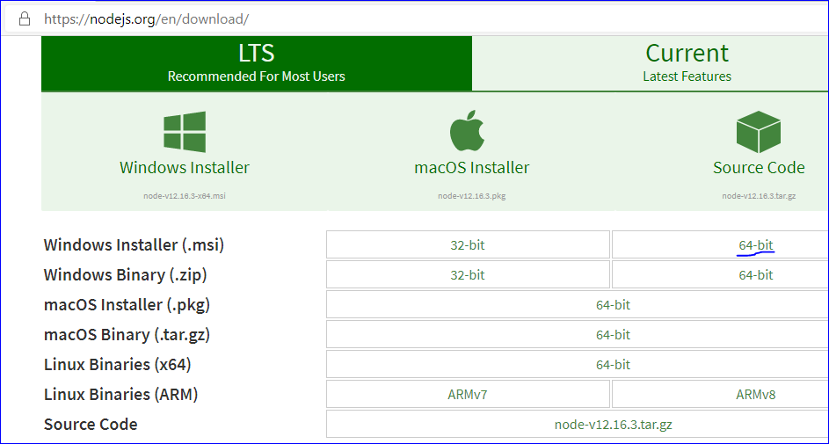
nodejs: Installation
Node: Go to https://nodejs.org/en/download. Download and install the installer
It will also install npm (node package manager)

Slide 36
Node and Angular
Node JS is a cross-platform runtime system and environment for applications written in JavaScript.
When you debug the angular application, it uses node server to serve the requests.
Usually, the command is ng serve or ng s which basically compiles the application and launches the node server to serve the application at localhost on port 4200 by default.
When you build the angular application, usually by the command ng build --prod, it generates Html and JavaScripts and CSS files along with all the assets and saved in the build folder in the root of the source by default.

Slide 37
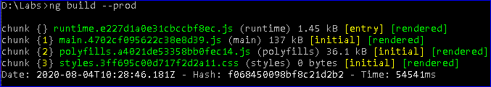
Node and Angular
When you build the angular application, usually by the command ng build --prod, it generates Html and JavaScripts and CSS files along with all the assets and saved in the build folder in the root of the source by default.
For prod builds the vendor bundle is integrated in your main bundle, because it is using the build optimizer per default.
According to the angular-cli documentation: Total bundle sizes with Build Optimizer are smaller if there is no separate vendor chunk

Slide 38
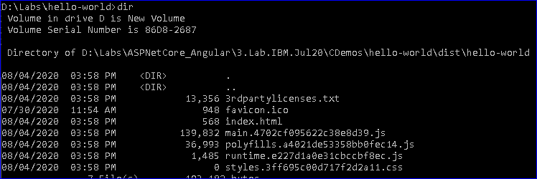
Node and Angular
It will be generated in app-root>dist>app-root folder

Slide 39
Node and Angular
Question: Do I need node.js to use Angularjs?
Answer:
On client side, you do not need Node. js to use AngularJS.
Angular is a front-end javascript framework which operates in the clients web browser.
Node is a service which can execute javascript and is often used on a server
If someday you will want to upload and store those files on a server and make them accessible by multiple clients - then yes you will also need a server. This server could be made with NodeJS.

Slide 40
What is Node Package Manager (npm)?
It is a command line utility, that interacts with repository of open source projects and downloads the packages and libraries.
NPM Repository : accessible via url https://www.npmjs.com/package/repository
NPM Repository contains open-source software packages hosted by npm for the Node.js developer community.

Slide 41
THANK YOU!

