Slide 1
Introduction
By: Munish Arora
Munish.arora@gmail.com

Slide 2
Introduction
In this, we will cover
Introduction to business intelligence
Introduction to data analysis
Introduction to data visualization
Overview of self-service BI
Considerations of self-service BI
Microsoft tools for self-service BI
Power BI Desktop
Power BI Report Server
Configure tools

Slide 3





What is BI
Business intelligence, or BI, is an umbrella term that refers to a variety of software applications used to analyze an organization's raw data
Software Applications

Slide 4
What is BI
BI as a discipline is made up of several related activities including
ETL Operations
Online Analytical Processing and Querying
Reporting
Extraction, Transformation and Loading

Slide 5
Overview of Data Analysis
What is happening in my business?
Why it is happening in your business
What is likely to happen in the future based on previous trends and patterns?
Descriptive
Diagnostic
Predictive
Descriptive analytics helps answer questions about what has happened, based on historical data
Diagnostic analytics techniques take the findings from descriptive analytics and dig deeper to find the cause.
Predictive analytics techniques use historical data to identify trends and determine if they're likely to recur.

Slide 6
Overview of Data Analysis
Determine best course of action to choose to bypass or eliminate future issues
Combines different technologies like artificial intelligence, machine-learning algorithms,
Prescriptive
Cognitive
Prescriptive Analysis, use insights from predictive analytics, data-driven decisions can be made.
Cognitive analytics helps you to learn what might happen if circumstances change and how you might handle these situations, derive conclusions based on existing knowledge bases

Slide 7

Roles in Data Analysis
Responsible for profiling, cleaning, and transforming data, designing, and building scalable and performant data models, and enabling and implementing the advanced analytics capabilities into reports for analysis.
Use of on-premises and cloud data services and tools to take, sending out, and transform data from multiple sources
Managing databases
Closer to the business itself and is a specialist on interpreting the data that comes from the visualization.
Perform advanced analytics to extract value from data. Their work can vary from descriptive analytics to predictive analytics.

Slide 8
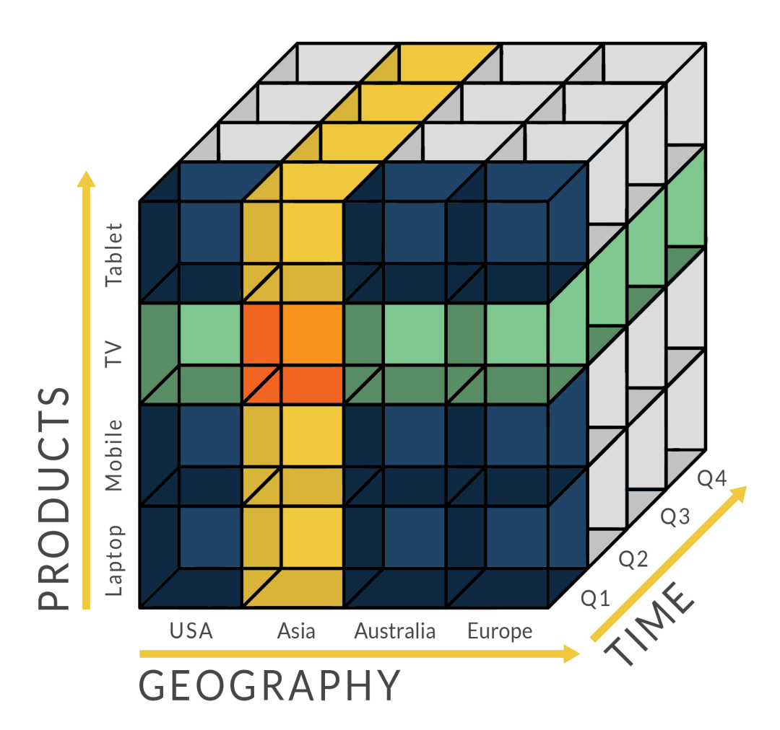
Online Analytical Processing
OLAP performs multidimensional analysis of business data
It provides the capability for complex calculations, trend analysis, and sophisticated data modeling.
Data with OLAP is structured in a way that it is fast to retrieve the data for multidimensional factors.
For example, in this cube, the data is stored in a way such that it is fairly quick to retrieve the data for various dimensions

Slide 9



SQL Server Business Intelligence
Microsoft
SQL Server Integration Services
Microsoft
SQL Server Analysis Services
Microsoft
SQL Server Reporting Services
Integrate
Analyze
Report
Data acquisition from source systems and integration
Data transformation and synthesis
Data enrichment, with business logic, hierarchical views
Data discovery via data mining
Data presentation and distribution
Data access for the masses

Slide 10
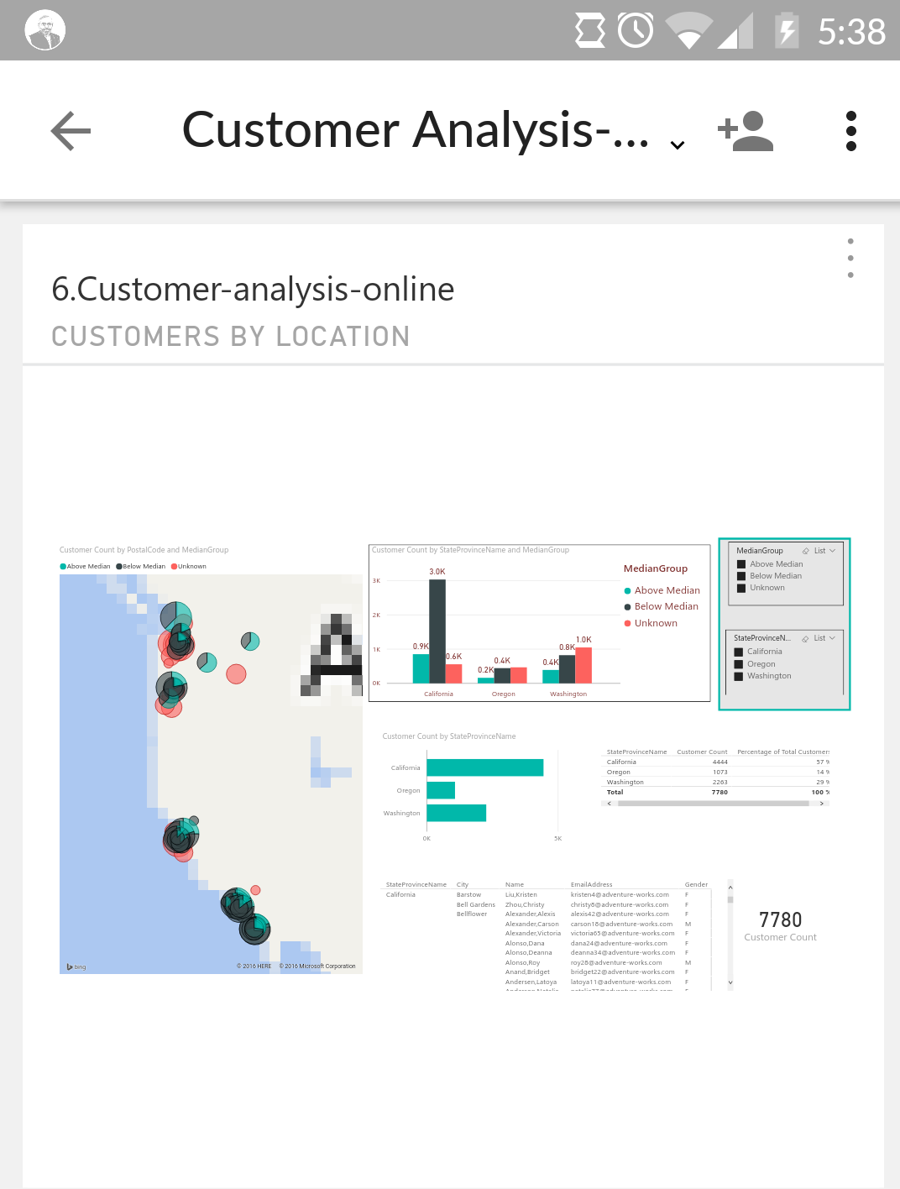
Power BI
Is a business analytics service provided by Microsoft
Provides interactive visualizations with self-service BI capabilities , where end users can create reports and dashboards by themselves, without having to depend on any IT and Database administration.
Provides cloud based BI services - known as Power BI Services, along with a desktop based interface - called Power BI desktop
Offers Data warehouse capabilities including data preparation, data discovery and interactive dashboards

Slide 11
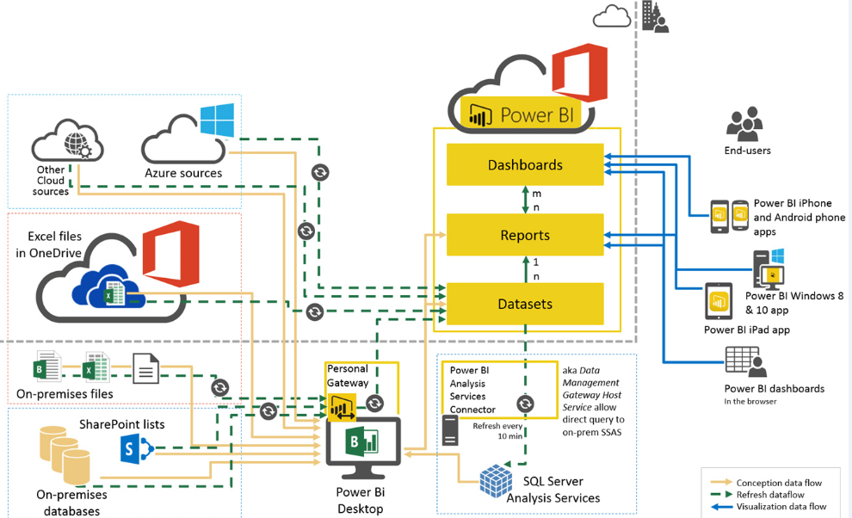
Power BI: Architecture
A dataset is a collection of data that you import or connect to.

Slide 12
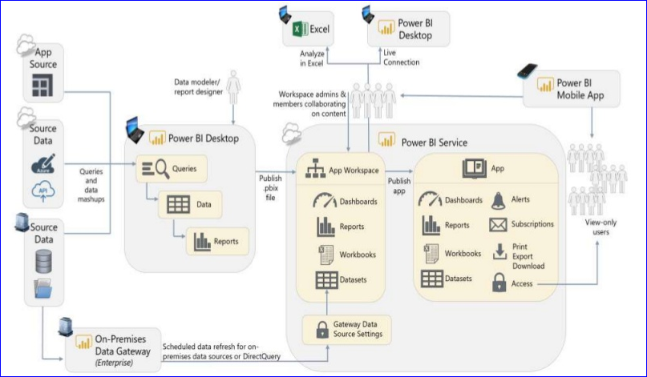
Power BI: Team Collaboration: Architecture

Slide 13
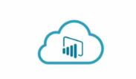
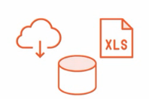





Getting Acquainted With Power BI
Cloud Based Service
On-Premise Service
Cloud and On-Premise Data
Data Models
Reports and Dashboards
Natural Language Queries and Quick Insights
Mobile Apps
Notes:
Power BI is a cloud based service.
Many features of this service are free whereas others require monthly subscription
This service lets you combine variety of data from cloud or on-premise databases or files
And use this to create data models that you can enhance to answer analytical questions and refine this to enable easy exploration of data
You can create dashboards for displaying your data along-with the charts and reports
Users can type queries and get results
And you can get your reports /dashboards designed specifically for Android or iPhone

Slide 14
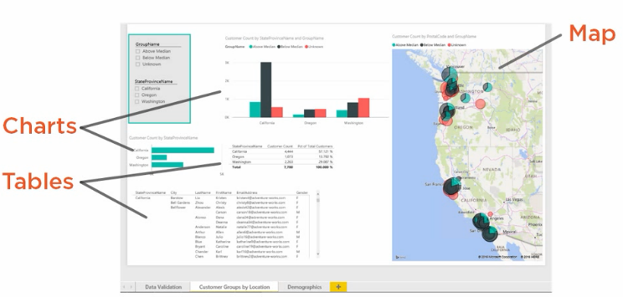
Data Analysis and Data Visualization
The data itself has no meaning unless it is analyzed and interpretations are drawn from it
We can display the data in various formats like
Chart
Tabular format
Map

Slide 15
Self-Service BI Dashboard
Dashboard allows different parts of report to be added (/pinned)
The rule can be created in Power BI to specify which data can be accessed by users having this role. For example, role can be created to create a filter region=“US”.
This rule can be assigned to individual users /groups will ensure that dashboard /reports will display the data after application of this rule.
Security:
With this approach, IT needs to focus on the design and integrity of the data warehouse instead of on defining disparate dashboards for heterogeneous groups of users.

Slide 16
Using Power BI Desktop
Get Data
Model
Report
Fetch the data from variety of sources
Create Data Models
Add Relations between tables, hide columns, add new columns in Data Model
Create Visualizations

Slide 17
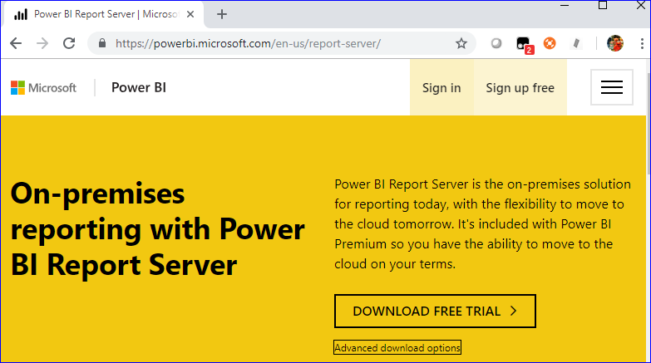
Power BI Report Server
Organizations who do not want their model / data to be sent outside their organization, can install Power BI Report Server in their own premise.

Slide 18
Power BI Desktop Versions
There is a separate Power BI Desktop version for Power BI Report Server
Power BI Desktop Optimized For Power BI Report Server:
The report server hosting the Power BI reports now resides within your environment.
The server version (PBI Report Server) and the client version (Power BI Desktop optimized for PBI Report Server) need to be controlled a bit tighter to ensure compatibility.

Slide 19
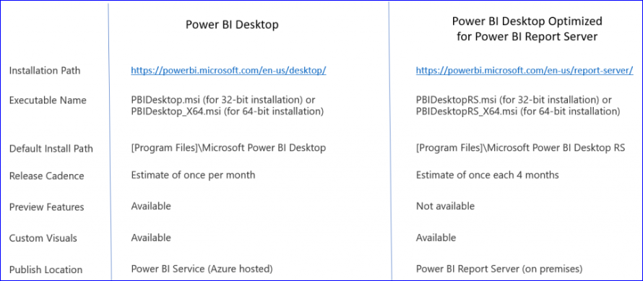
Differences
Let’s have a look at differences side by side
Further, you may also have side by side installation i.e. version released in last month and current month on Power BI desktop.

Slide 20

Knowledge Check
A Data Analyst
Is a specialist on interpreting the data that comes from the visualization.
Is responsible for profiling, cleaning, and transforming data, designing, and building scalable and performant data models, and enabling and implementing the advanced analytics capabilities into reports for analysis.
Is responsible for use of on-premises and cloud data services and tools to take, sending out, and transform data from multiple sources
Performs advanced analytics to extract value from data. Their work can vary from descriptive analytics to predictive analytics.
Which of the following is true
OLAP database is designed for reading and analysing large datasets (may be terabytes of data).
OLAP database is designed to ensure high transactions per second
Data with OLAP is structured in a way that it is fast to retrieve data for multidimensional factors.
Power BI Service uses OLAP database

Slide 21
Knowledge Check
Which of the following is true?
Power BI service Is a business analytics service provided by Microsoft
Power BI service provides reports with interactive visualizations with self-service BI capabilities.
Microsoft has provided two options for Power BI Service
1. Cloud based BI services - known as Power BI Services, and
2. Power BI Report Server, which can be deployed on-premise or hosted cloud
Power BI allows only visualizations from a single report to be pinned to a dashboard
A dataset is a collection of data that you import or connect to.
True
False

Slide 22
THANK YOU!

