Slide 1
Lab Files Organization
By: Munish Arora
Munish.arora@gmail.com

Slide 2
Power BI-Data
In this, we will cover
The data sources used in the solution

Slide 3
Lab Files Organization
Here-in we have got the data as follows
Customer file (customer.csv) containing Customer Data
Sales files containing Sales Data or customers
HVSales.csv
LVSales.csv
SalesHeaders.csv file containing the Headings of Sales files
Average Sale (AvgSales.csv) containing the Average Sale in the respective Cities in CA, OR and WA states
Customer Incidents (CustIncidents.csv) contains the incident reported at customer side with Severity, Incident Date, Closure Date)
Opportunity (Opportunities.csv) for Sales with respective customers
CustIncidents containing data

Slide 4
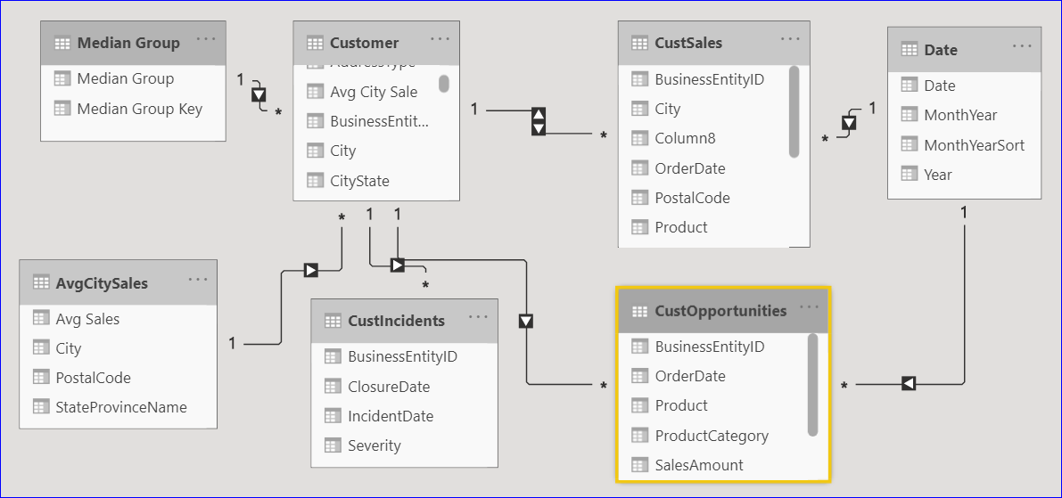
Model
These are related to each other as shown in diagram

Slide 5

Info: Customer.csv
Customer.csv contains a data w.r.t customer details, and contains data from many countries and states
Some key points
S.No | Observation | What has been done
1. | Each Record has BusinessEntityID | Unique Identifier
2. | Each customer has a AddressType , which is Home and Shipping | Data has been filtered with AddressType = “Home” to remove duplicate entries for reports /joins
3. | It has the data for many countries and states | Data has been filtered with StateProvinceName = “Oregon”, ”Washington” or “California”. These are the states for which data is to be analyzed.

Slide 6
Info: Customer.csv
Customer.csv contains a data w.r.t customer details, and contains data from many countries and states
Some key points
S.No | Observation | What has been done
4. | We have a column Demographics, which contains the data in xml format. | The data has been extracted, and columns have been extracted.

Slide 7
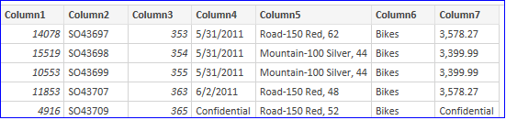
Sales: HVSales.csv, LVSales.csv
Sales folder contains the files HVSales.csv and LVSales.csv
Some key points
S.No | Observation | What has been done
1. | Files are available in a folder ‘Sales’ | Fetch the data from folder, and the data in one file will be appended to data in another in another file, and a new table Sales (Same as name of the folder) will be created in Power BI.
2. | Each record has BusinessEntityID | Join it with BusinessEntityID of Customer
3. | Each record has OrderDate | We need to create a new date table with connective date fields, and join it with OrderDate.

Slide 8
Info: SalesHeader.csv
SalesHeader.csv contains a headers for sales data
Some key points
BusinessEntityID | SalesOrderNumber | SalesOrderDetail | OrderDate | Product | ProductCategory | SalesAmount
ID Of Customer | Order No | SalesOrderDetail No | Order Date | Product | Category | Sales Amount
S.No | Observation | What has been done
1. | It has two records, first is column name and second is description | Removed the second record
2 | First Row is column header | Append Sales table, which we are going to see in next slidem to this table And This table has been renamed this table to CustSales and data has been appended underneath it (from HVSales and LVSales)

Slide 9
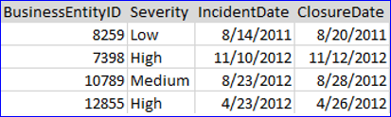
Info: CustIncidents.csv
SalesHeader.csv contains the incident reported at customer side with Severity, Incident Date, Closure Date)
Some key points
S.No. | Observation | What has been done
1. | Each Record has Business Entity ID | This will be connected with Customer table for further Analysis
2. | Each record contains Severity of Incident Raised, Date of Incident, and Closure Date | Open issues do not have a closure date

Slide 10

Info: Manual Data
Manual data has been entered for MedianGroup table as follows
S.No | Observation | What we need to do
1. | There are three records | These records tell us what meaning of each Id is
2. | How is this related? | Each customer has Sales Amount, and we have Average Sales in that Area (postal code). Based on his Total Sales Amount, we compare this with Average Sales, and accordingly mark the customer as below median /above median etc.

Slide 11
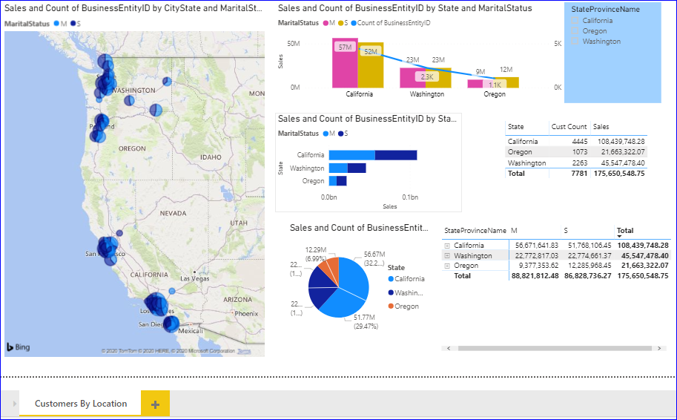
Final Output
Finally, we have created the report that looks as follows

Slide 12
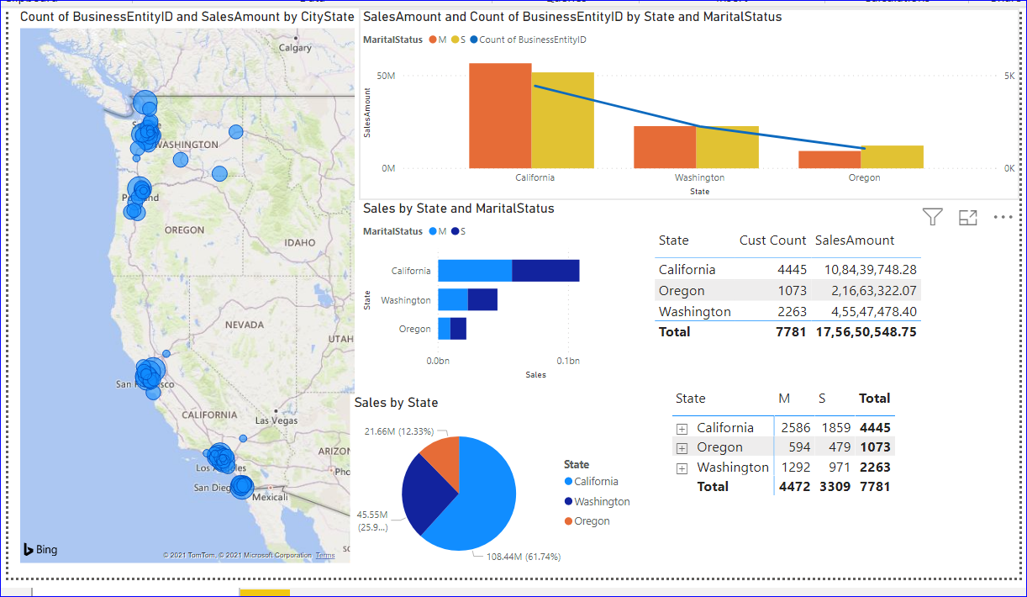
Final Output
Finally, the report has been generated as follows

Slide 13
THANK YOU!

