Slide 1




Fog Computing
Notes:
Hinweis:
Anpassen der Fußzeile: Die PowerPoint-Vorlagen weisen alle eine Fußzeile auf, die sich natürlich individuell anpassen lässt. Um z.B. den Titel des Vortrages und den Namen des Referenten einzutragen muss dazu der Hauptfolienmaster geändert werden. In PowerPoint 2007/2010 muss man dazu unter dem Menü-Punkt "Ansicht" den Button "Folienmaster" anklicken. Am linken Bildschirmrand wird dann die Liste der Masterfolien angezeigt. Der oberste ist der Hauptmaster in dem sich die Textfelder der Fußzeile problemlos ändern lassen.
<Foliennummer>

Slide 2
To understand Fog, we need to understand Cloud
„The cloud is just someone else‘s comuputer.“
NIST: „model for enabling ubiquitous, convenient, on-demand network access“ [2]

Slide 3
And what is Fog?
„Fog is an emergent architecture for computing, storage, control and networking that distributes these services closer to the end-user along the cloud-to-things continuum.“ - M. Chiang and T. Zhang [3]

Slide 4
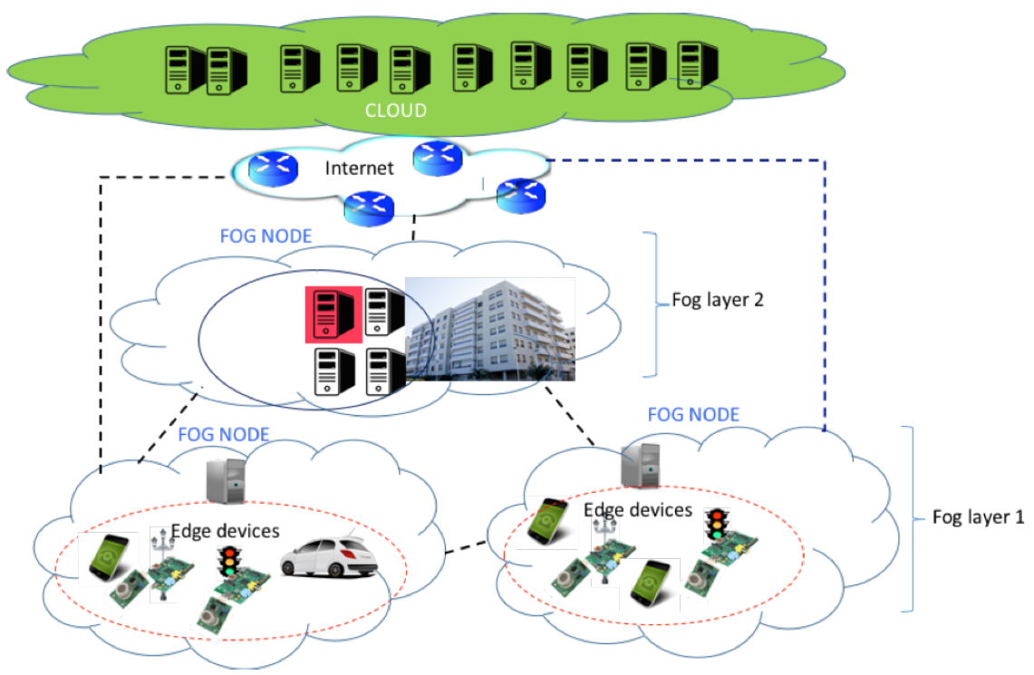
[4]

Slide 5
Internet of Things
17 – 30 billion IoT devices by 2020
Often access to sensible information
High security standard needed

Slide 6
Rising Challenges of IoT
Stringent Latency Requirements
Network bandwidth constraints
Resource-constrained devices
Cyber-physical systems
Uninterrupted services
Security

Slide 7
How does Fog help?
CEAL:
  Cognition
  Efficiency
  Agility
  Latency

Slide 8
OpenFog
OpenFog Consortium
  Founded by:
  Arm, Cisco, Dell, Intel, Microsoft and Princeton University
  Now has 55 members and rising

Slide 9
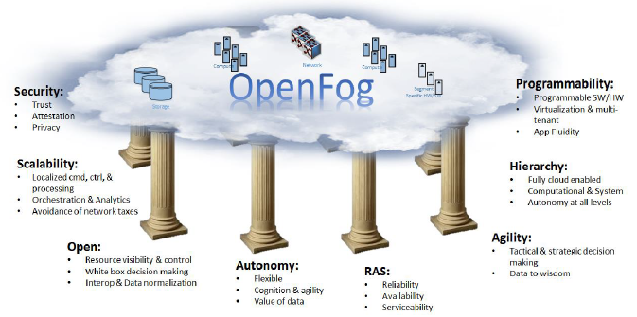
The Pillars of OpenFog
[5]

Slide 10
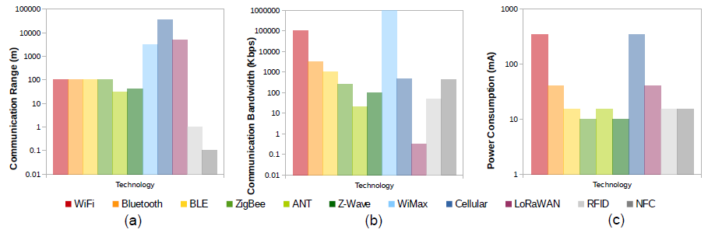
Communication Protocols
[1]

Slide 11
Use Cases
Data Plane
Control Plane
Smart Agriculture
Smart Health and Well-Being
Smart Greenhouse Gases Control
Client-Bases HetNets Control
Shread and Spread
Bandwidth Management at Home Gateway

Slide 12
Thank you for your attention!
Any Questions?

Slide 13
References
C. Perera, Y. Qin, J. C. Estrella, S. Rei-Marganiec, and A. V. Vasilakos, „Fog computing for sustainable smart cities: A survey," ACM Comput. Surv., vol. 50, no. 3, pp. 32:1{32:43, Jun. 2017. [Online]. Available: http://doi.acm.org/10.1145/3057266
P. Mell and T. Grance, „The nist denition of cloud computing," 2011. [Online]. Available: http://nvlpubs.nist.gov/nistpubs/Legacy/SP/nistspecialpublication800-145.pdf
M. Chiang and T. Zhang, „Fog and iot: An overview of research opportunities," IEEE Internet of Things Journal, vol. 3, no. 6, pp. 854{864, 2016. [Online]. Available: https://doi.org/10.1109/JIOT.2016.2584538
E. Marn-Tordera, X. Masip-Bruin, J. G. Almi~nana, A. Jukan, G. Ren, J. Zhu, and J. Farre, „What is a fog node A tutorial on current concepts towards a common denition," CoRR, vol. abs/1611.09193, 2016 [Online]. Available: http://arxiv.org/abs/1611.09193
„Openfog architecture overview." [Online]. Available: https://www.openfogconsortium.org/wp-content/uploads/OpenFog-Architecture-Overview-WP-2-2016.pdf

