Slide 1
COVID-19 Detection from Chest X-ray Images using CNN
DATS 6450 - 12: Cloud Computing Fall 2024
Group 10: Aroub Halawani, Long Peter Huynh, Jesse Liu
Nov 18th, 2024

Slide 2
Presentation Outline
Project Definitions (Recap)
Project Architecture (Recap)
Project Implementation
Cost Analysis
Demo
Conclusions

Slide 3
Project Definitions

Slide 4
Scope of Project
Project Significance: Using machine learning techniques to detect COVID-19 in chest x-rays offers a scalable and automated improvement to the healthcare diagnosis process, possibly leading to earlier and more accurate diagnoses, and ultimately better patient outcomes.
Project Goals:
Build and train a machine learning model to accurately classify chest x-ray images as COVID-positive or COVID-negative.
Develop a cloud infrastructure to host the the dataset and deploy the trained model.

Slide 5
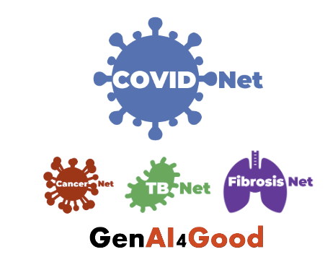
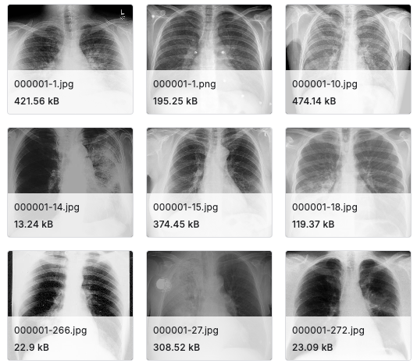
Data Sources
Data Source: The data used for this project is the COVIDx CXR-4 Dataset, provided by the COVID-Net Open Source Initiative
Data: 67,900 chest radiography images (jpg files) of COVID-19 positive and negative patients
Data Link: https://www.kaggle.com/datasets/andyczhao/covidx-cxr2/data
Data Model: Pre-trained ResNet50, a deep Convolutional Neural Network (CNN), will be used to detect and classify chest radiography images
ResNet50 is widely recognized for its robustness and efficacy in handling complex image recognition tasks²
Pre-trained model (Transfer Learning) significantly reduces training time and promotes resource efficiency
²Kim, H., Hong, H., & Yoon, S. H. (2022). Diagnostic performance of CT and reverse transcriptase-polymerase chain reaction for coronavirus disease 2019: A meta-analysis. Radiology, 296(3), E145–E155. https://www.ncbi.nlm.nih.gov/pmc/articles/PMC8933872/
Notes:
Add footnote: https://www.ncbi.nlm.nih.gov/pmc/articles/PMC8933872/

Slide 6
Features To Be Implemented
Amazon S3:
Object storage of COVIDx CXR-4 jpg image dataset and trained ResNet50 model (HDF5 format) in separate S3 buckets
Will use Amazon S3 Intelligent-Tiering to optimize storage costs
Will store these buckets in private subnets
Amazon EC2:
General purpose EC2 instances will be used to host the jupyter notebook environment where the ResNet50 model will be trained on the COVIDx CXR-4 dataset
Data preprocessing
Perform model evaluation on general purpose EC2 instances
EC2 instance will be hosted on public subnet; access the jupyter notebook via web browser
Amazon SageMaker:
Optimize the trained model using Hyperparameter Optimization (HPO)
Model deployment
Model evaluation
Amazon API Gateway:
Inference API
AWS Lambda:
Deploy the trained model using AWS Lambda (for serverless deployment) and Sagemaker Endpoints for scalable API access
Amazon Cloudwatch:
Monitor performance and CPU usage of EC2 instances, key metrics of S3 storage and SageMaker model optimization
Monitors SageMaker endpoint performance

Slide 7
Expected Outcomes
Successfully develop a ResNet50 CNN model trained on the COVIDx CXR-4 dataset.
Successfully engineer and deploy the machine learning environment on AWS cloud infrastructure.
Perform optimizations for machine learning model performance and accuracy.

Slide 8
Project Architecture

Slide 9
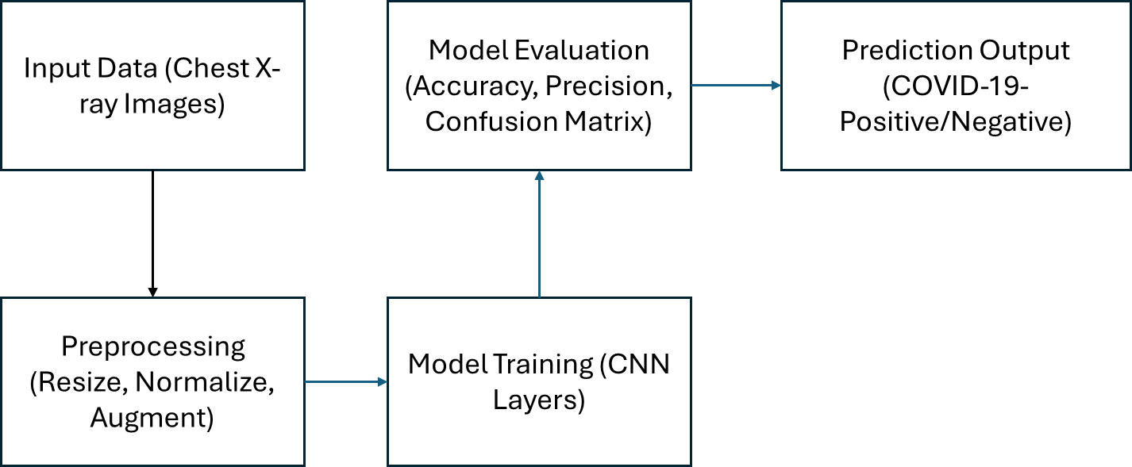
Data Flow

Slide 10
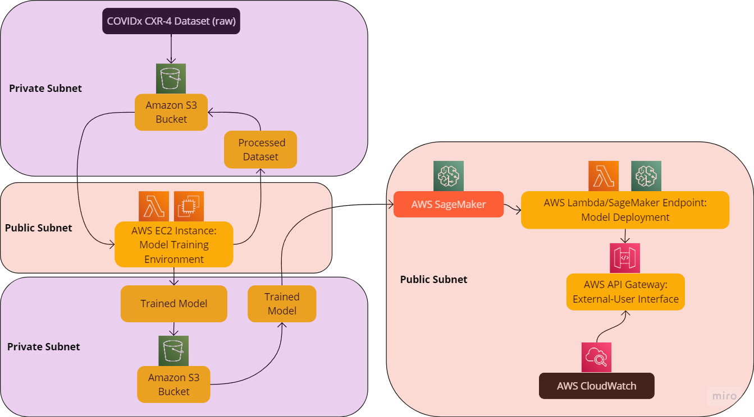
Project Architecture
Private Subnet:
Amazon S3 intelligence-tier buckets
Public Subnet:
Amazon EC2 General Purpose Instances
Amazon SageMaker
AWS API Gateway
Amazon-Managed Features:
Amazon Cloudwatch
AWS Lambda
Project Architecture Schema

Slide 11
Project Implementation

Slide 12
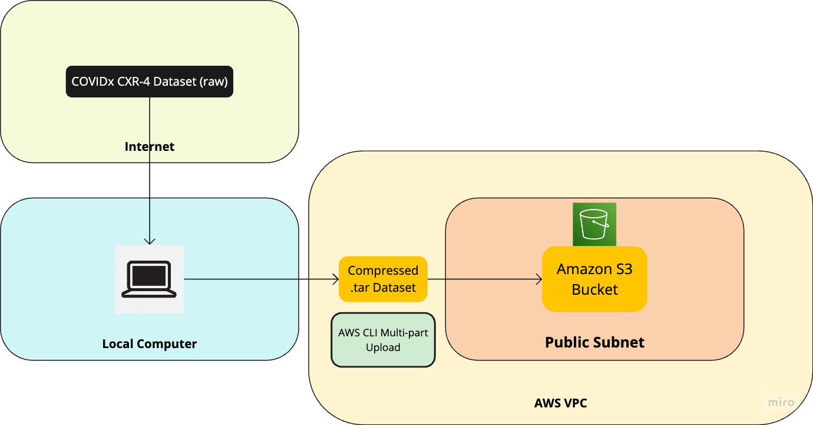
Importing Data
Workflow
COVIDx CXR-4 training, validation, testing datasets were downloaded from Kaggle to local computer
Compressed datasets into .tar file, used AWS CLI and multipart upload to upload single compressed file into Amazon S3 bucket
Analysis
Benefits: Single upload request ($0.005/PUT request), parallel uploads (handles large files efficiently; retry on failure), pause and resume feature
Disadvantages: .tar files need to be decompressed on the EC2 instance (may take additional time) and individual file names may be altered
Recommendation: upload COVIDx CXR-4 datasets using single uploads, explore S3 Transfer acceleration (routes traffic through edge locations) if we experience high latency
Importing Data Schema

Slide 13
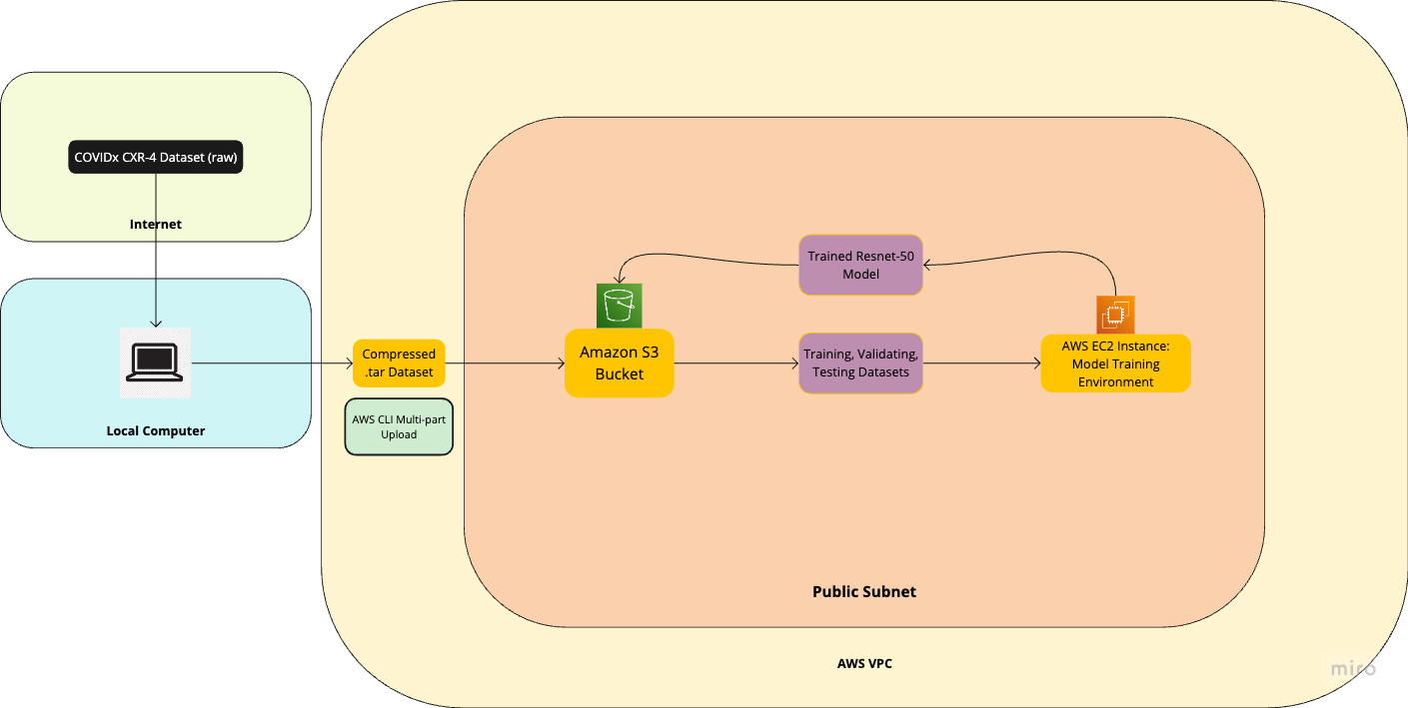
Training, Validating, Testing Model - Initial Schema
Workflow
Set-up and launch EC2 instance (free tier t2.micro CPU) with Ubuntu components (Jupyter, Python3, Tensorflow, etc.)
Train, validate, test Resnet-50 CNN model on Jupyter notebook instance on datasets located in S3 bucket
Save model in S3 bucket
Analysis
Highly inefficient setup: T2.micro only has 1 vCPU and low baseline performance. Training could take weeks or months.
Optimal setup: GPU instance (g4dn.xlarge, p3.2xlarge; 70-300x faster than CPUs) - cost effective and can handle heavy ResNet-50 model; Deep Learning OSS NVIDIA Driver AMI GPU TensorFlow 2.17 (Ubuntu) AMI provides optimized, preconfigured, scalable environment for TensorFlow models
Consider additional features such as spot instances to lower costs
S3 bucket contained in the same public subnet as EC2 instance lowers operational costs
Recommendation: configure EC2 instance for specific testing environment
Training, Validating, Testing Model - Initial Schema

Slide 14
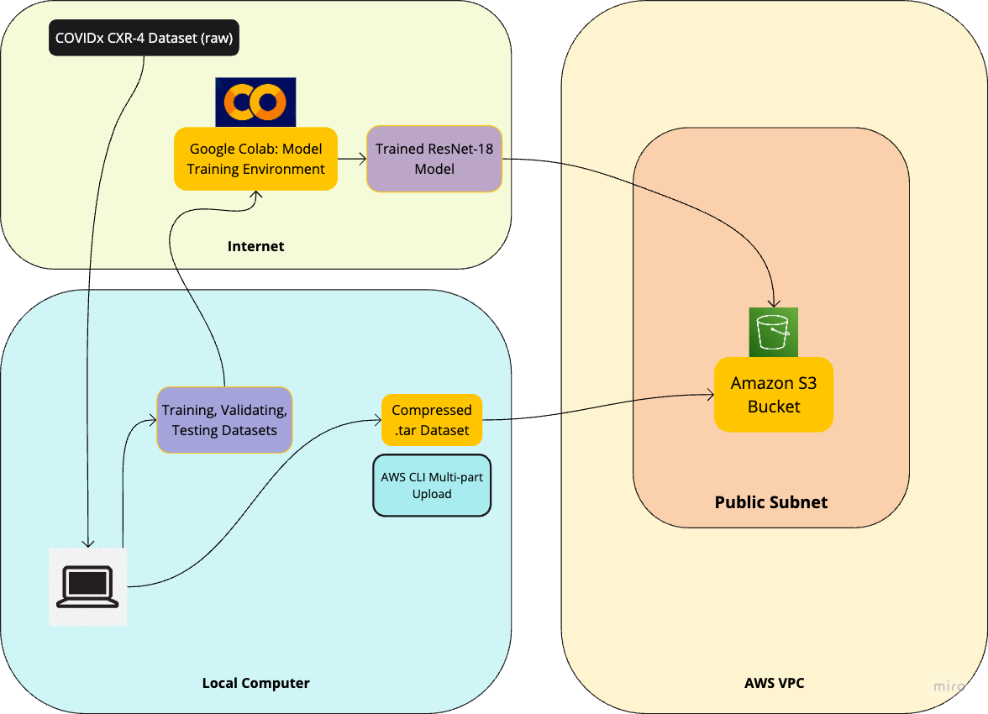
Training, Validating, Testing Model - Actual Implementation
Workflow
Implemented Google Colab notebook for model training, validation, and testing environment on 20% of of the 83.8k lung x-ray .jpg files (16.7k; 6.4 GB). Model was trained on ResNet-18 model for image classification
Saved final PyTorch model as as state dictionary .pth file in S3 bucket
Analysis
In testing model training between EC2 instance and, Google Colab, Google Colab provided a better testing environment for our time and resource constraints
G4dn, P4 EC2 instances were not available. The best performing available EC2 instances were CPU (c6i.4xlarge using Intel Xeon Scalable Processor; $0.085/hour) and not optimized for deep learning. However, Google Colab provides free access to NVIDIA T4/K80 GPUs, as well as pre-installed PyTorch and TensorFlow libraries
ResNet-18 model was chosen over ResNet-50 model because it is far lighter and a better fit within our computational limitations; can still effectively train model with COVIDx CXR-4 dataset
Training, Validating, Testing Model - Actual Implementation

Slide 15
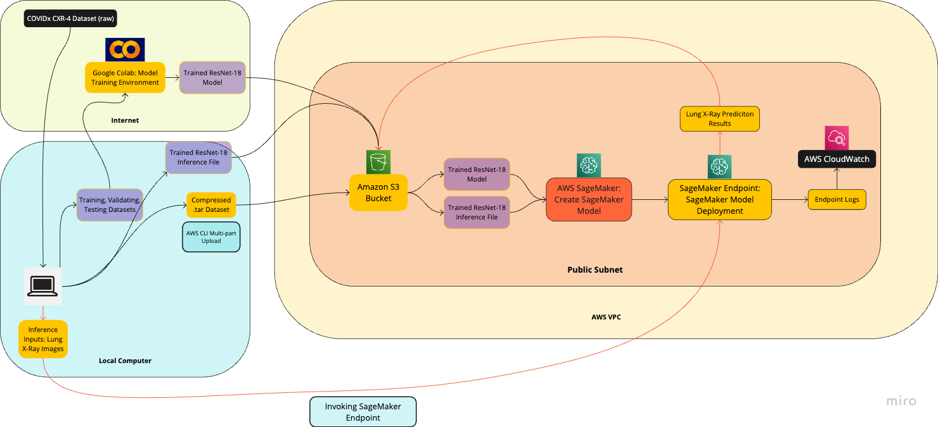
Model Deployment - Initial Schema
Workflow
Upload trained model (.pth state dictionary file) and inference file to S3 bucket
Create SageMaker model using model artifacts and AWS pre-built SageMaker container image hosted in Amazon Elastic Container Registry (ECR). Create Endpoint configuration and endpoint
Use AWS CLI to invoke SageMaker endpoint with sample lung-images (inference inputs). The output predictions (.json files) are saved to S3 bucket.
Created AWS CloudWatch log streams for endpoints to help debug
Analysis
Difficult to find a pre-built SageMaker GPU container image, chose a CPU PyTorch instance image and may have compatibility and performance issues
Inference file did not properly load trained model into SageMaker and model was not able to be deployed on Sagemaker; Further debugging is needed
Model Deployment - Initial Schema

Slide 16
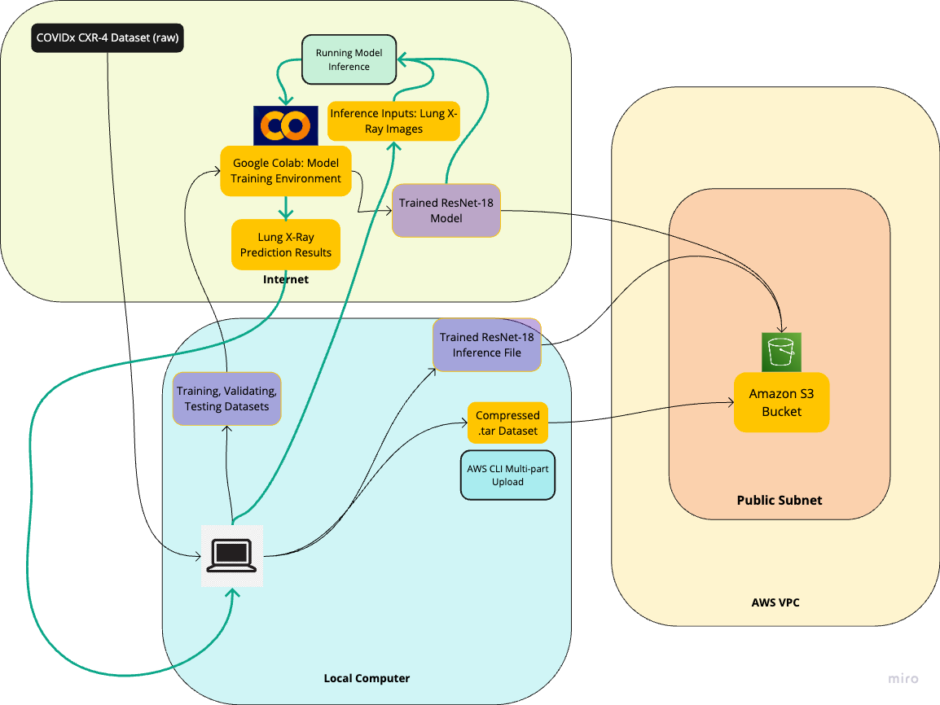
Model Deployment - Actual Implementation
Workflow
Utilized Google Colab Notebook environment to run model inference using sample Lung X-Ray images as inference inputs. Outputs were then returned to the local computer with prediction results as either showing positive or negative Covid-19 infections
Analysis
Running the model inference is a key step in model deployment and Google Colab provides a optimal environment for quick experimentation and validation.
Google Colab does not provide as secure environment as AWS SageMaker (SageMaker provides IAM role customization for models) and doesn’t serve live API endpoints.
Model Deployment - Actual Implementation

Slide 17
Cost Analysis

Slide 18

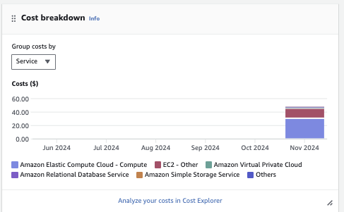
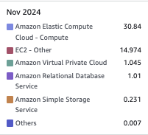

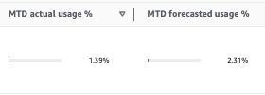
Cost Breakdown
Percentage of Total Costs
Total: $48.11
EC2: 95.23%
VPC: 2.17%
RDS: 2.10%
S3: 0.48%
Others: 0.01%

Slide 19
Demo

Slide 20
Conclusions
AWS S3 is a optimal storage solution for our COVIDx CXR-4 image classification datasets and trained PyTorch models, and is highly integrated for deep learning workflows, including CNN tasks. However, for image classification tasks, specific consideration needs to be given for data structure in order to optimize data processing and preprocessing.
Image classification tasks on EC2 instances can be very computationally intensive. Special consideration should be given for selecting EC2 instance types and pre-built AMIs when designing the optimal EC2 environment, especially due to the limited number of GPU instances.
AWS SageMaker provides a very integrative solution for model deployment and provides built-in API endpoint services that Google Colab does not. Additionally, CloudWatch provides instant and detailed log data for endpoints that enables efficient monitoring and debugging capabilities to optimize deployment.
Further work involving COVIDx CXR-4 image classification involves continuing to train the model on the full dataset in order to increase model accuracy. Additionally, extensive suite of SageMaker tools, as well as other AWS services, may be explored to facilitate image classification workflows.

Slide 21
Questions?
More information about this project can be found on our project Github repository
Thank you!

Slide 22
Appendix
Zhao, A. (2020). COVIDx CXR-2 dataset [Data set]. Kaggle. https://www.kaggle.com/datasets/andyczhao/covidx-cxr2?select=train
Kim, H., Hong, H., & Yoon, S. H. (2022). Diagnostic performance of CT and reverse transcriptase-polymerase chain reaction for coronavirus disease 2019: A meta-analysis. Radiology, 296(3), E145–E155. https://doi.org/10.1148/radiol.2020201343
Wong, A. (n.d.). COVID-Net. https://alexswong.github.io/COVID-Net/

