Slide 1

Automate CR Audit
13/11/2020

Slide 2
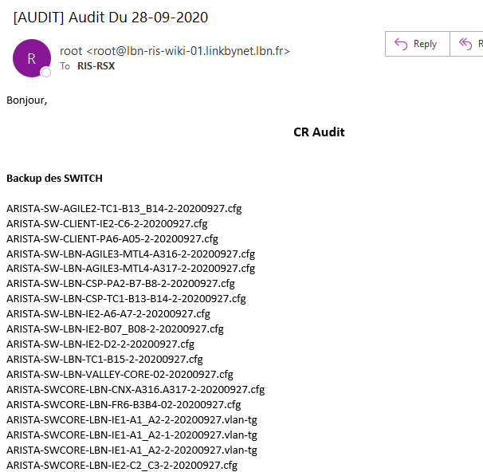
Intro

Slide 3


Intro - Brief
E.g. ARISTA-SW-AGILE2-TC1-B13_B14-2-20200927.cfg
The network admin/engineer/manager must verify the date of the last backup performed.
If not well done he/she will now have to investigate why the backup has not been done regularly.

Slide 4
Backup des SWITCH = 96
Backup CKP = 22
Backup BIGIP = 37
Total
96 + 22 + 37 = ???

Slide 5
Backup des SWITCH = 96
Backup CKP = 22
Backup BIGIP = 37
Total
96 + 22 + 37 = 155

Slide 6

Problem arise while performing manual checks

Slide 7



Problem arise while performing manual checks
Reduce errors
Reduce Risk of human errors and more reliable
Less time consuming
1 script works faster than 1 person

Slide 8
Before

Slide 9
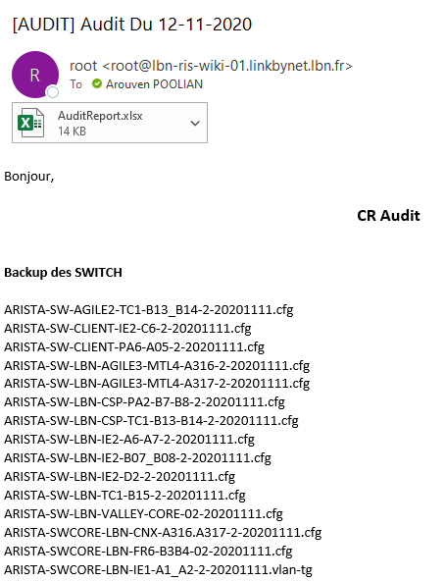
After

Slide 10
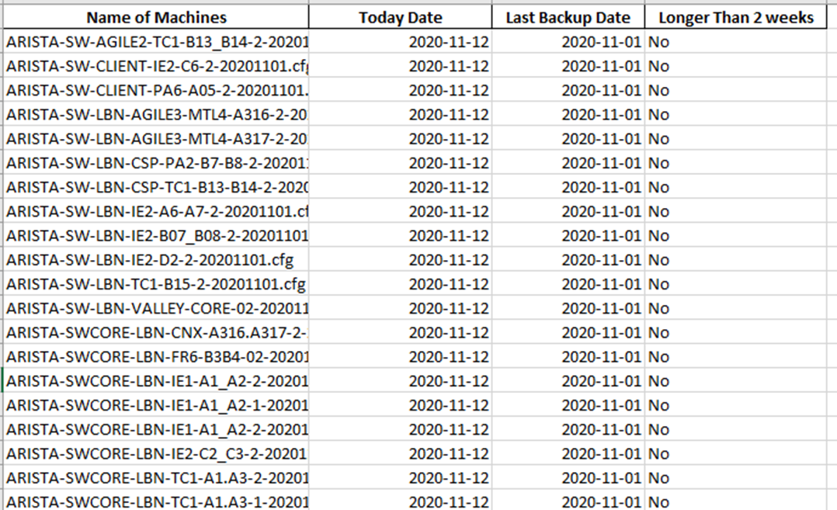
Excel e.g.

Slide 11
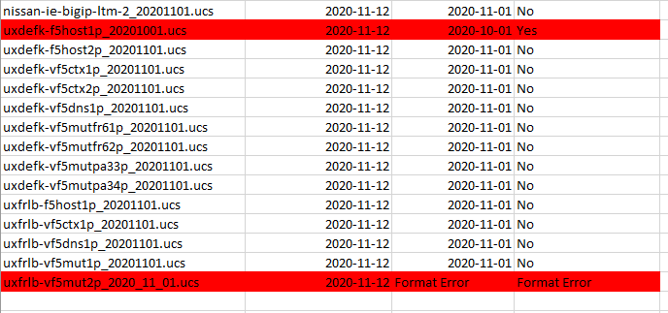
Excel e.g.

Slide 12
Format to follow
xxxxxxYYYYMMDD
xxxxxxYYYYMMDD.extension
Examples:
ARISTA-SW-AGILE2-TC1-B13_B14-2-20200927.cfg
SWITCH-LBN-AGILE-V-1-20200927

Slide 13
Intro – 1st Question answered
E.g. ARISTA-SW-AGILE2-TC1-B13_B14-2-20200927.cfg
The network admin/engineer/manager must verify the date of the last backup performed.
If not well done he/she will now have to investigate why the backup has not been done regularly.

Slide 14
2nd Permission problem
E.g. ARISTA-SW-AGILE2-TC1-B13_B14-2-20200927.cfg
The network admin/engineer/manager must verify the date of the last backup performed.
If not well done he/she will now have to investigate why the backup has not been done regularly.

Slide 15


5-9 RUE DE L’INDUSTRIE
93200 SAINT-DENIS

