Slide 2
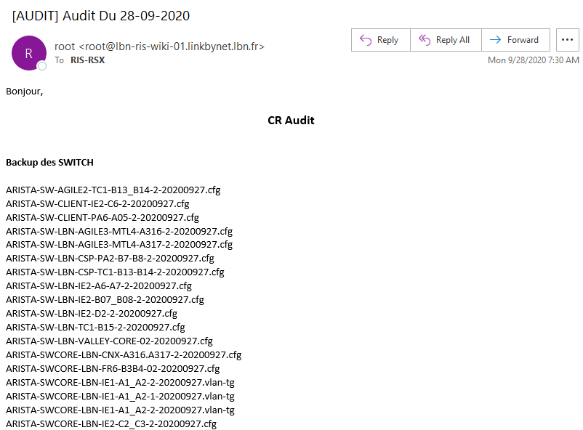
Intro

Slide 3
Intro
E.g. ARISTA-SW-AGILE2-TC1-B13_B14-2-20200927.cfg
The network admin/engineer/manager must verify the date of the last backup performed.
If not well done he/she will now have to investigate why the backup has not been done regularly.

Slide 4
Intro
E.g. ARISTA-SW-AGILE2-TC1-B13_B14-2-20200927.cfg
The network admin/engineer/manager must verify the date of the last backup performed.
If not well done he/she will now have to investigate why the backup has not been done regularly.

