Slide 1
Conversational Fashion Outfit Generator powered by GenAI
Team - 686157-UVX1433L

Slide 2

Team members details
Team Name | 686157-UVX1433L
Institute Name/Names | BITS Pilani, COEP Tech
Team Members > | 1 (Leader) | 2 | 3
Name | Aneerban Roy Raja | Ashwin Sathish Kumar | Rohit Shidid
Batch | 2020 | 2020 | 2020

Slide 3
Glossary
SentenceTransformer:Neural network architectures designed to generate fixed-size embeddings from variable-length text inputs.
GPT-2 (Generative Pre-trained Transformer 2): A state-of-the-art language model from OpenAI, designed for natural language processing tasks including text generation.
MiniLM: A smaller, distilled version of larger Transformer models, maintaining a balance between efficiency and language understanding capabilities.
Util.pytorch_cos_sim: A utility function to compute cosine similarity in PyTorch between two sets of embeddings, facilitating comparison of textual representations.
torch.topk:A PyTorch function used to retrieve the top 'k' values and indices from a tensor. It's useful in recommendation systems to get top matches.

Slide 4
Use-cases
P0 (High Priority):
Personalized Outfit Recommendations: The primary use case is to provide users with personalized outfit recommendations based on their past purchase history, browsing data, and social media trends. This includes analyzing user preferences, style, color choices, and favorite brands to suggest outfits that align with the user's unique fashion taste.
Complete Outfit Coordination: Generating well-coordinated outfit recommendations that include clothing, accessories, and footwear, ensuring that users receive complete and stylish outfit ideas.
Interactive Feedback: Allowing users to provide feedback on the recommended outfits in a conversational manner.
Notes:
List the use cases that are targeted/ identified.
Prioritize the use cases in order of impact (P0, P1, P2 etc)

Slide 5
Use-cases
P1 (Medium Priority):
Occasion-Based Outfits: Offering outfit suggestions tailored to different occasions such as casual, formal, and party wear.
Regional Preferences: Customizing outfit recommendations based on regional preferences, ensuring cultural relevance.
P2 (Lower Priority):
Outfit Customization: Enabling users to make minor adjustments to recommended outfits based on their preferences.
Trend Analysis and Integration: Analyzing and integrating social media trends, current fashion trends, styles, and influencers to offer up-to-date fashion recommendations that are in line with what's popular and fashionable at the moment.
Notes:
List the use cases that are targeted/ identified.
Prioritize the use cases in order of impact (P0, P1, P2 etc)

Slide 6
Solution statement/ Proposed approach
Data Aggregation: Fashion article details are extracted from the HNM dataset
Sentence Embeddings for Item Matching: A SentenceTransformer with MiniLM converts user queries and product descriptions into embeddings, facilitating item matches based on cosine similarity.
Generative Language Model for Suggestions: The GPT-2 model generates tailored fashion advice in response to user queries, emulating a human-like interaction.
Interactive Feedback Loop: Users can provide feedback on shown items, allowing the system to iteratively refine and personalize its recommendations.
Visual Representation of Suggestions: Images of suggested fashion items are displayed using Matplotlib, augmenting the user's interactive experience.
Notes:
Break the problem statement to smaller problems and describe briefly the solutions at an overall and sub-problem level.
Add a simple block diagram if ready.

Slide 7
Limitations
Static Dataset Dependency: The system relies on a static CSV dataset. Without periodic updates, it might not reflect the latest fashion trends or available products, potentially offering outdated suggestions.
Computational Overhead: Using both SentenceTransformer and GPT-2 together can be computationally intensive, especially for large datasets or extended interactions. This might lead to latency in generating recommendations, affecting the user experience.
Limited Feedback Mechanism: The feedback loop is binary (like/dislike). A more nuanced feedback system capturing preferences in style, fit, or other fashion attributes could lead to better-tailored recommendations.
Accuracy of Matching: The solution may not always perfectly match a disliked item based on name substring searches, which could lead to incorrect exclusions or inclusions in the refined suggestions.
Notes:
List the limitations of this design/ solution that is being proposed here

Slide 8
Future Scope
Voice and Conversational Interfaces: Enable voice-based queries and interactions, allowing users to search for fashion items using natural language.
AR/VR Integration: Consider integrating augmented reality (AR) or virtual reality (VR) for immersive fashion try-on experiences.
Sustainability Focus: Incorporate sustainability aspects into the recommendations, helping users make eco-friendly fashion choices.
Community Building: Foster a community around the fashion discovery tool, enabling users to share their style, tips, and experiences.
User Engagement Features: Add features like wishlists, social sharing, and user-generated content to enhance user engagement and create a sense of community around fashion discovery.
Multimodal Search: Integrate both text-based and image-based search capabilities, allowing users to mix and match different types of queries. For example, a user could input a text query along with an image for more precise results.
Notes:
Mention the future scope and upcoming details here

Slide 9
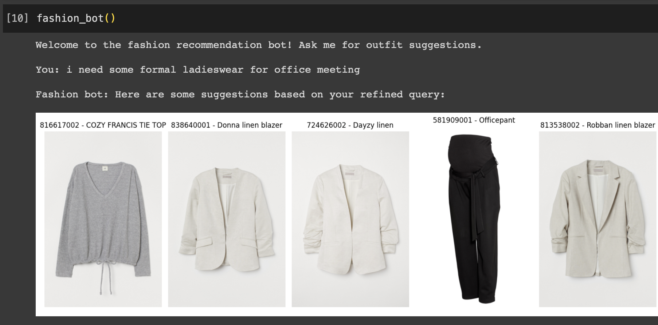
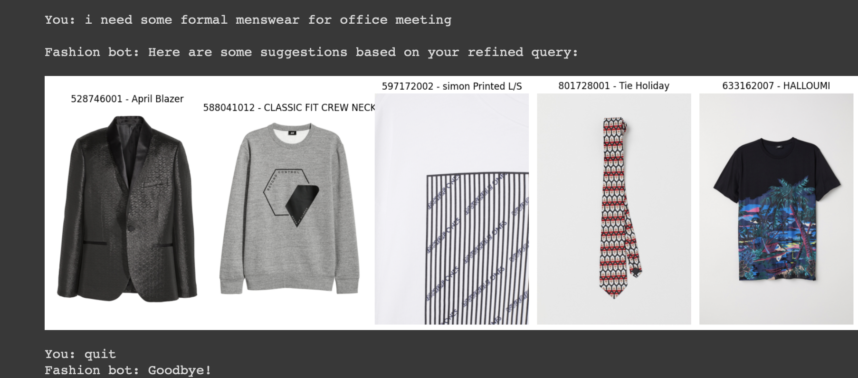
Some past results

Slide 10
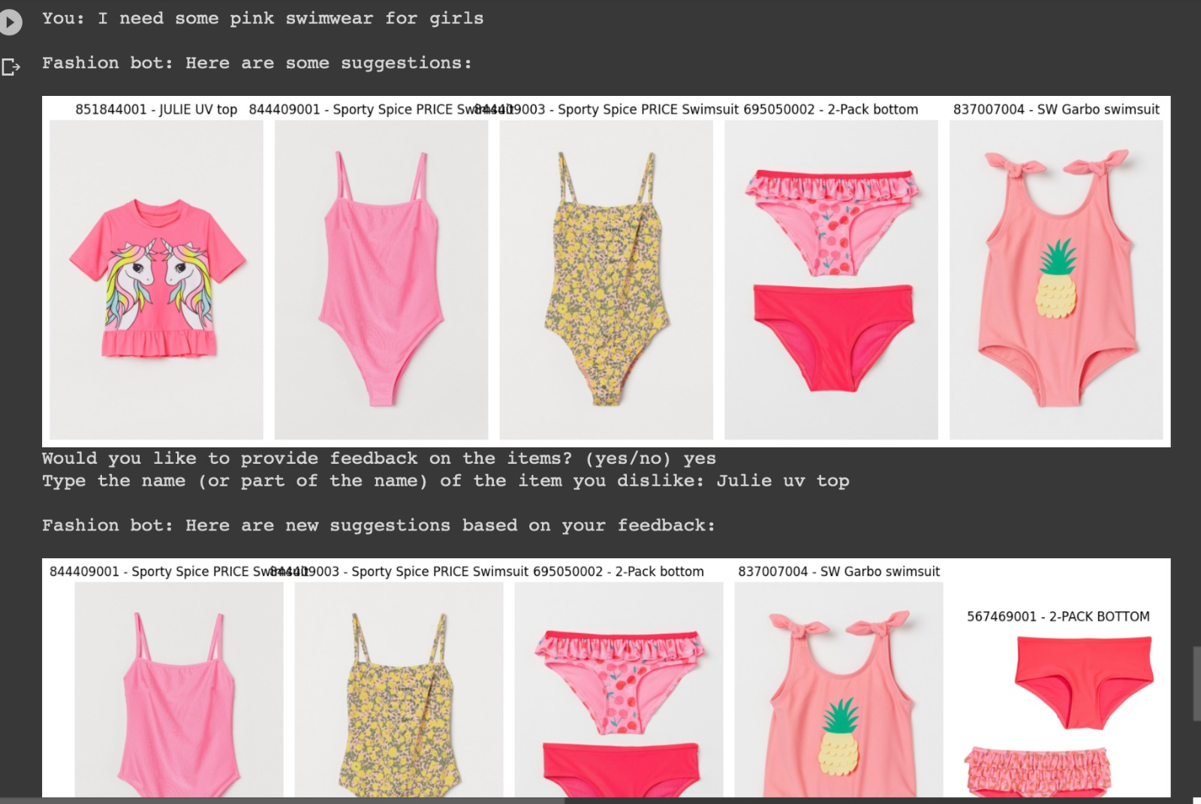
Demonstration (final finetuned model)

Slide 11
Thank You

