Slide 1
Nonlinear Dynamical System in Humanoid Robots
By Andrew Rozniakowski

Slide 2
Background
Paper was written by Jan Ijspeert, Jun Nakanishi and Stefan Schaal
Created a Dynamical System for autonomous robotic movements
Models arm movements
Dynamical System works as a Control Policy which sends messages to the controller of the humanoid robot
Movement is represented in Kinematic movements

Slide 3
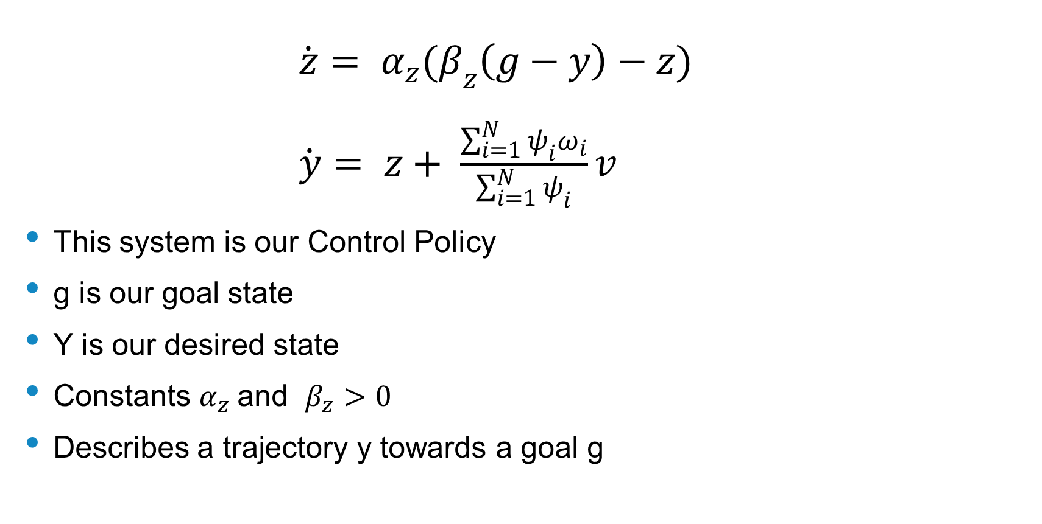
Dynamical System
$\dot{z}= α_{z}(β_{z}\left(g−y\right)−z)$
$\dot{y}= z+ \frac{\sum_{i=1}^{N}{ψ_{i}ω_{i}}}{\sum_{i=1}^{N}{ψ_{i}}}v$
This system is our Control Policy
g is our goal state
Y is our desired state
Constants $α_{z}$and $β_{z}>0$
Describes a trajectory y towards a goal g

Slide 4
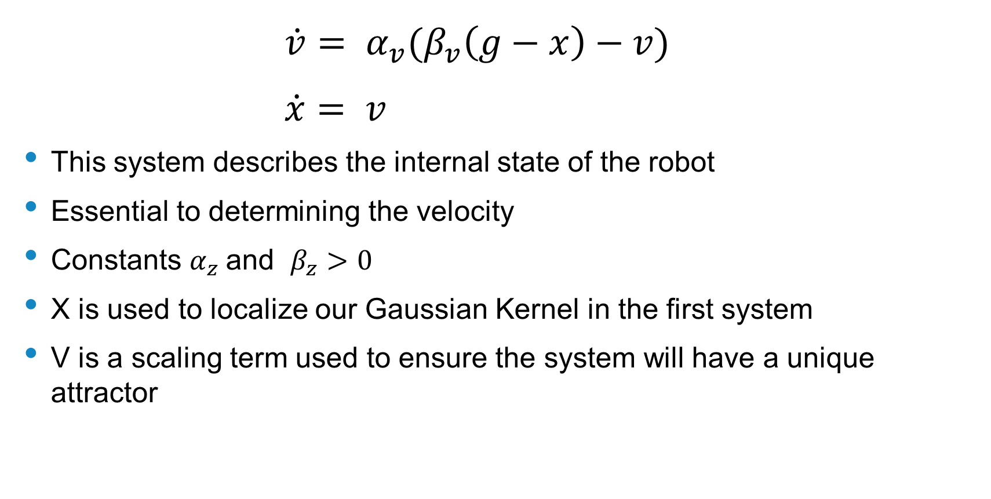
Dynamical System Cont.
$\dot{v}= α_{v}(β_{v}\left(g−x\right)−v)$
$\dot{x}= v$
This system describes the internal state of the robot
Essential to determining the velocity
Constants $α_{z}$and $β_{z}>0$
X is used to localize our Gaussian Kernel in the first system
V is a scaling term used to ensure the system will have a unique attractor

Slide 5
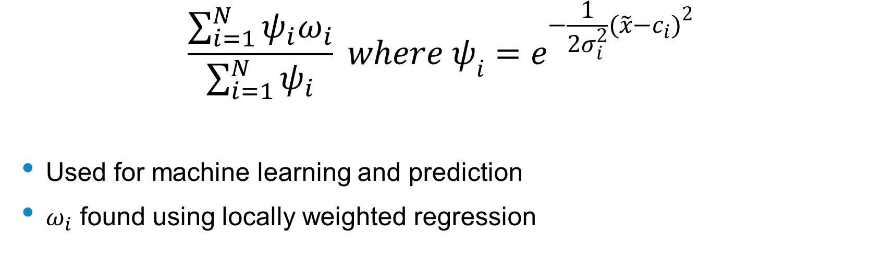
Gaussian Kernel
$$\frac{\sum_{i=1}^{N}{ψ_{i}ω_{i}}}{\sum_{i=1}^{N}{ψ_{i}}} where ψ_{i}=e^{−\frac{1}{2σ_{i}^{2}}{(\tilde{x}−c_{i})}^{2}}$$
Used for machine learning and prediction
$ω_{i}$ found using locally weighted regression

Slide 6
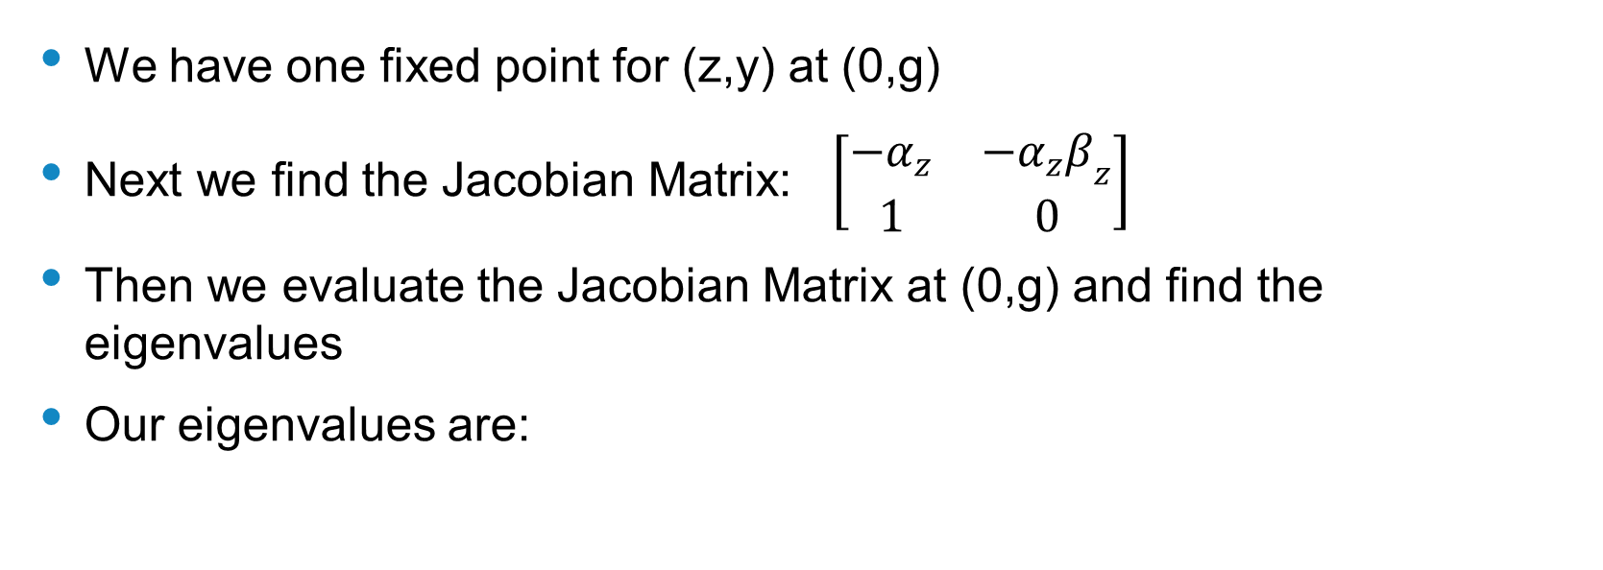
Stability
We have one fixed point for (z,y) at (0,g)
Next we find the Jacobian Matrix: $\left[\begin{matrix}{−α}_{z} & −{α_{z}β}_{z} \\ 1 & 0\end{matrix}\right]$
Then we evaluate the Jacobian Matrix at (0,g) and find the eigenvalues
Our eigenvalues are:

Slide 7
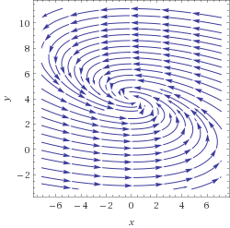
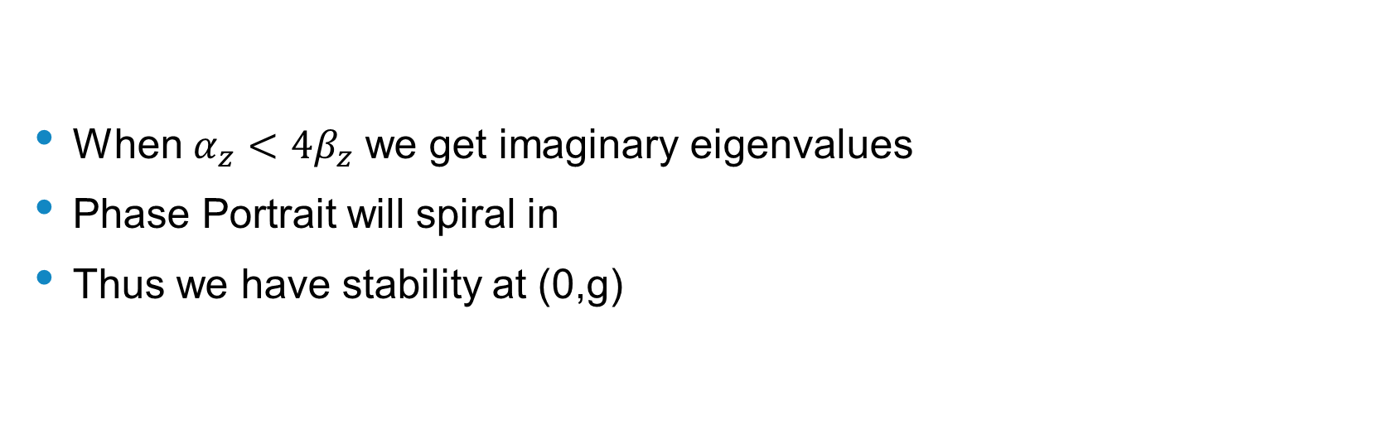
Stability – Imaginary Eigenvalues
When ${α_{z}<4β}_{z}$ we get imaginary eigenvalues
Phase Portrait will spiral in
Thus we have stability at (0,g)

Slide 8
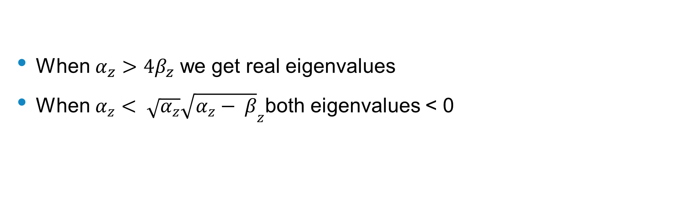
Stability – Real Eigenvalues
When ${α_{z}>4β}_{z}$ we get real eigenvalues
When ${α_{z}< \sqrt{α_{z}}\sqrt{α_{z}− β}}_{z}$both eigenvalues < 0

Slide 9
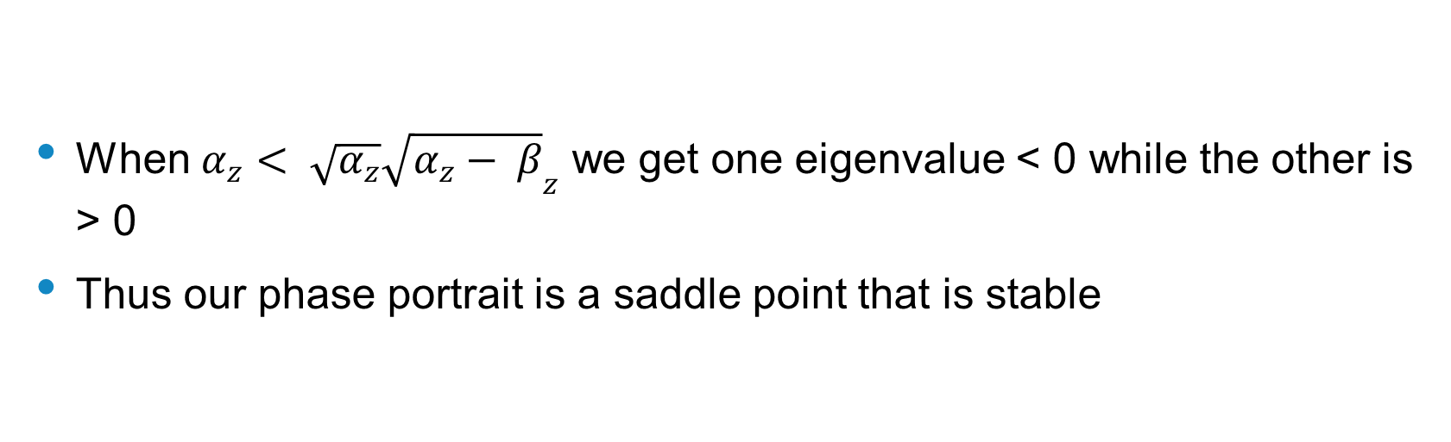
Stability – Real Eigenvalues
When ${α_{z}< \sqrt{α_{z}}\sqrt{α_{z}− β}}_{z}$ we get one eigenvalue < 0 while the other is > 0
Thus our phase portrait is a saddle point that is stable

Slide 10
Experiments
Experimented with 3 different movements
Reaching movements with an arm
Drawing 2D pattern movements
Tennis Swings

Slide 11
Conclusion
Applications:

