Slide 1
Recursive Spline Interpolation Methods
By Andrew Rozniakowski

Slide 2
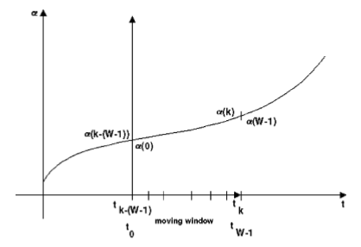
Background
Paper written by Alexander Stotsky and Attila Forgo
Created a new computationally efficient recursive spline interpolation algorithm
Designed for engine development and real time control of Volvo cars

Slide 3

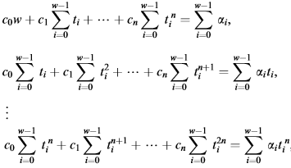
Background cont.

Slide 4



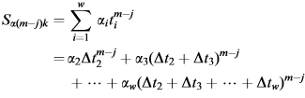

Recursion

Slide 5

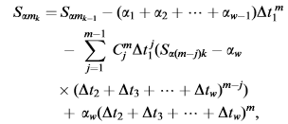
Recursion Cont.

Slide 6

Solving For Coefficients
Ac = b
$A=\left[\begin{matrix}w & S_{1k} & S_{2k} \\ S_{1k} & S_{2k} & S_{3k} \\ S_{2k} & S_{3k} & S_{4k}\end{matrix}\right]$
$b= \left[\begin{matrix}S_{αk} & S_{α1k} & S_{α2k}\end{matrix}\right]$

Slide 7
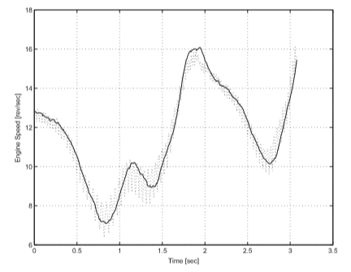
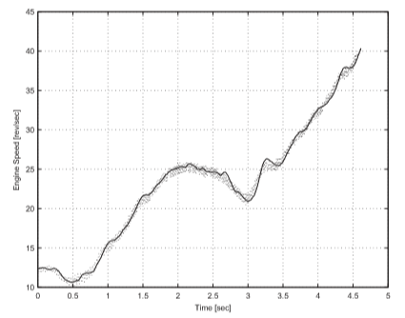
Their Results

Slide 8
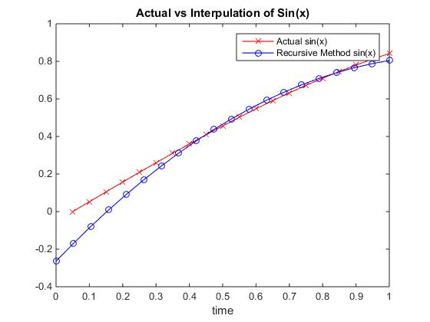
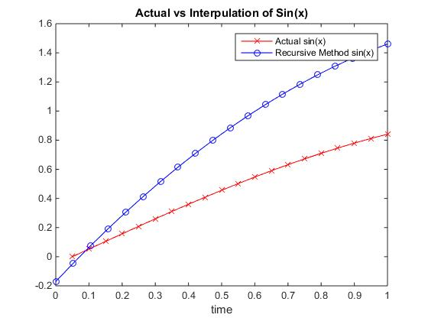
My Results

