Slide 1

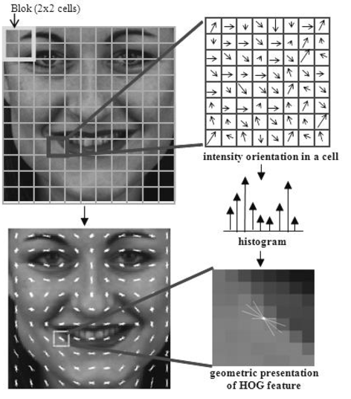
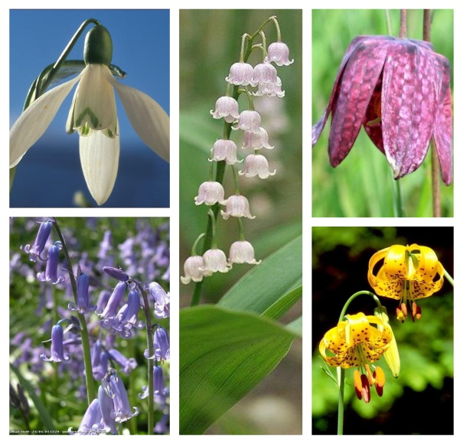
Flower classification
with HOG and SVM
Problem Description
Support Vector Machines
(SVM)
Results
Problem consists of recognizing different types of flowers on the given pictures.There are 5 types of flowers in the train and test dataset: Snowdrop, LilyValley, Bluebell, Tigerlily and ​Fritillary.
The goal is to achieve an accuracy better than 55% on the test dataset.
The training was performed on 320 images from the training set. The classification was performed on 80 images from the test set and the achieved accuracy was 61.25%.
Methodology
As the first step we load every image from the train and test dataset and resize all of them to the same dimensions (520x520).
For feature extraction of each image, we use a HOG descriptor, with a cell size of 24x24 pixels. For each cell we calculate the histogram of gradients with 20 intervals, each interval contains 9 degrees (0,9,18,...,171, 180), and then we normalize the results on a block sized 6x6 cells.
The next step is to use the thus obtained features to train an SVM classifier with linear kernel, and with the trained classifier we can now predict
An example image from each flower class
HOG visualized
Student: Arpad Varga Šomođi SW-35/2016
Soft computing

