Slide 1
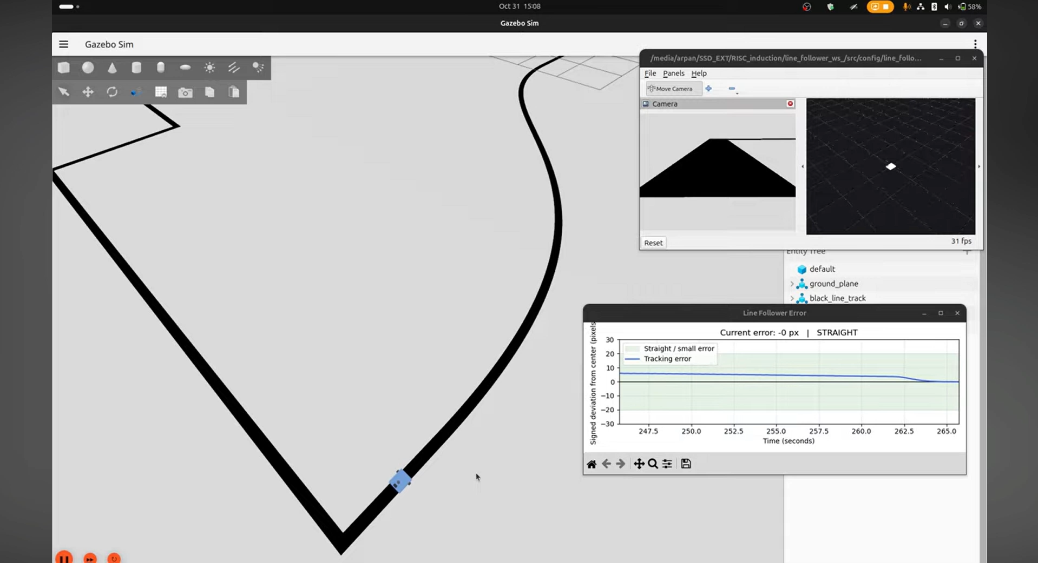
RISC INDUCTION / HACKATHON PITCH / TEAM 12
SEE THE TRACK.
CONTROL THE MOTION.
A camera-based autonomous line derivative robot that reads the grading track, estimates deviation, and steers itself in real time.
ROS 2 • Gazebo • PD control
LIVE TRACK ANIMATION
Robot marker following the current test path.
ROS 2 Line Follower
Model Dimensions: 140x120x20 mm
BY- Arpan Dash & Tej Thepade

Slide 2
RISC INDUCTION / HACKATHON PITCH 02 / 06
01 / THE CHALLENGE
The test challenges sharp 90° turns & S-curves
The current grading mesh introduces long straights, tight transitions, and changing curvature.
Gazebo world
+ robot camera
ROS–Gazebo
bridge
Line detector
›
›
CURRENT TEST TRACK
Challenges
›
01
Speed Adaptation
LineState
/line/state
Robot might overshoot at turns.
02
Perception stress
Curvature changes image error.
03
Repeatable
›
Same geometry for every run.
/cmd_vel
wheel motion
PID follower
/controller
04
Perspective Distortion
›
line appears wider and closer near the bottom of the frame
ROS 2 Jazzy | Gazebo Harmonic | Camera

Slide 3
RISC INDUCTION / HACKATHON PITCH 03 / 06
02 / THE SOLUTION (TECH STACK)
A closed-loop stack that can be inspected at every step
The current track is the source of truth; the controller is the measurable response.
CAMERA (CMOS type)
VISION
CONTROL
GAZEBO
RGB frame
Downward facing camera.
ROI → mask → centroid
PD → Twist
Mesh + diff drive
System Architecture
Publisher → Node → Subscriber | Topic
ROS 2 Jazzy | Gazebo Harmonic | Camera

Slide 4
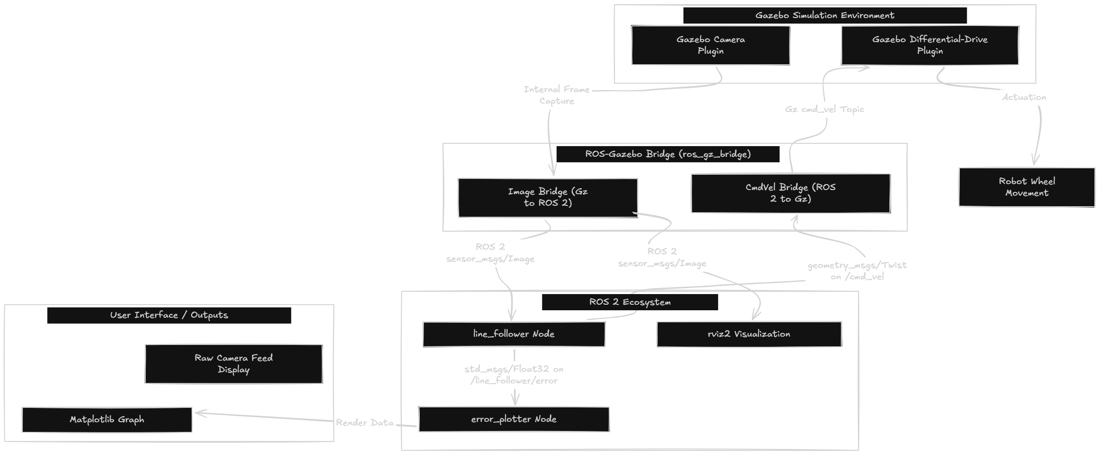
RISC INDUCTION / HACKATHON PITCH 05 / 06
04 / DATA FLOW
HOW THE NODES COMMUNICATE
ROS 2 Jazzy | Gazebo Harmonic | Camera

Slide 5
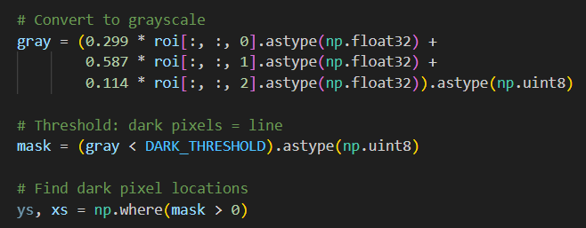
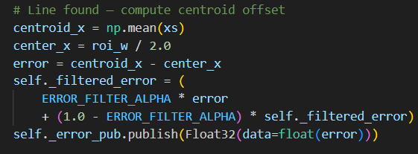
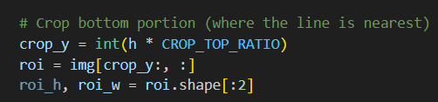
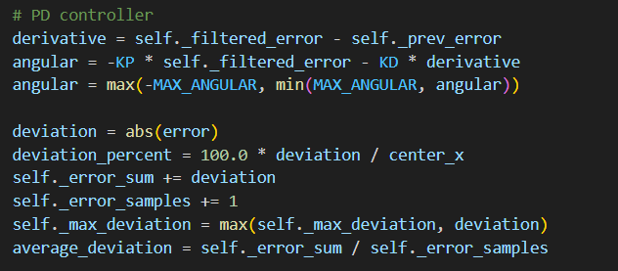
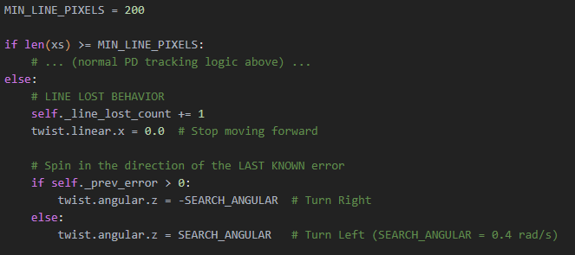

RISC INDUCTION / HACKATHON PITCH 04 / 06
03 / THE INTELLIGENCE
A transparent control loop: pixels become motion
No black box: steering is derived from one signed, plotted image-space error.
1
CROP
2
MASK
3
CENTER
Lower 55% of frame
Gray < 80
Line centroid
4
ERROR
5
PD
6
RECOVER
x − image center
Kp + Kd
Search spin
angular = −0.005 × error − 0.002 × derivative | speed reduces on sharp turns | max turn rate = 1.5 rad/s
ROS 2 Jazzy | Gazebo Harmonic | Camera
CONTROL LAW

Slide 6
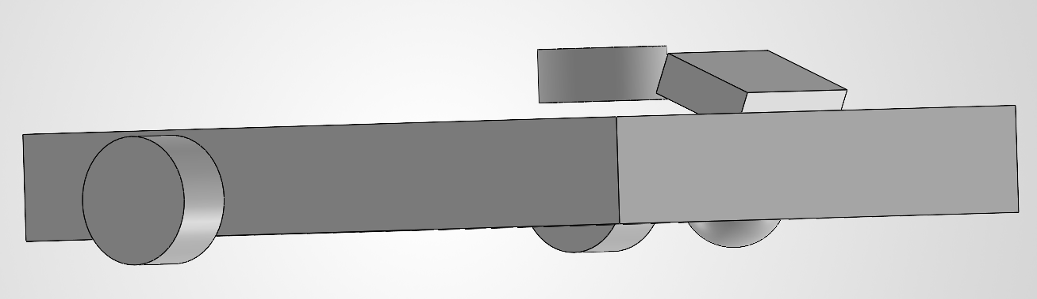

RISC INDUCTION / HACKATHON PITCH 06 / 06
05 / THE FINISH LINE
Future improvement and references
It connects actual grading geometry to explainable autonomy — and leaves a clear path to hardware.
NOW
NEXT
SCALE
•
Adding the integral term.
•
Actual grading mesh
•
Real camera + motors
•
Calibrate error to cm
•
Closed-loop camera tracking
•
Adaptive speed by curvature
•
Lighting robustness
•
Visible error + recovery algorithm
•
Automated lap metrics
•
Reusable perception node
Lidar distance sensor
Repo link:
Ref Repos:
https://github.com/Arpan-Dash/Line-Follower-Bot.git
Robot model and ROS 2 structure: nowaymlhr/line-follower-ros2PID
parameter ideas: Chouaib-Z/line_follower_robotLine-loss recovery
image-processing ideas: nivednivu1997/Line-Following-Robot-Simulation-in-ROS2-and-Gazebo-using-OpenCV
| Thank you |
ROS 2 Jazzy | Gazebo Harmonic | Camera

