Slide 1
Name- Arpan Sarkar
Title- Review of Global Supply Chain Management through an analytical approach
Problem Context
When the data set is related to global supply chain, it is very important to have an analytical study to find out the key causes that lead to profit making or incurring losses by exporting nations. It can identify known risks and can predict future by spotting patterns and trends, and as mathematical models and data infrastructures have improved predictive modeling and machine learning has become powerful in deriving insights through visuals.
Over the last three decades, global supply chains (GSCs) have increasingly gained importance in linking developing countries to international markets. Today a substantial share of the production processes of GSCs is taking place in developing countries. For developing countries and their enterprises, GSCs offer opportunities as well as challenges.
The analysis aims to describe the following points:
The factors that affect the performance in a GSCS.
Countries which fare better as a export nation.
Trend of global supply chain country wise, major factors and dependencies that affect the logistic process.
Motivation:
Supply Chain is a tricky business. One missing entity or a lack of synchronization can break the entire chain and mean millions in losses for a company. However, the use of analytics in this domain is resolving several pain points in supply chain management at the strategic, operational, and tactical levels.

Slide 2
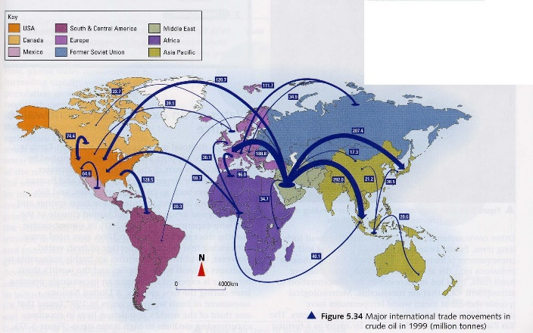
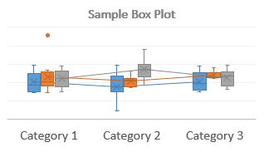
Major Indicators
Order Region
Order Profit/Loss
Mode Of Shipment& distance covered
Order Category
Order,Shipping,Delivery Dates
IDEAS
BRAINSTORM
Scatter plots help empirically to investigate the relationship between product nature and Supply Chain strategies.
Viz-Ideas
Possible Visuals
1.Flow Map
2.Box Plot
3.Scatter Plots
4.Density Plots
5.Line Plots
6.Corelation plots
7.Corelation Matrix
8.Bar Plots
Using Flow Maps we can generally show the movement of information geographically or objects from one location to another and their amount.
Interactive Filters
1.Drop Down
2.Slicer
3.Part to whole selection
4.Input value selection
5.Focus/zoom
Categories
1.Region,order status, mode of shipping.
2. Date range,Volume,count
3.Quantitave inputs, what if analysis
Line Plots are use-full in giving quick analysis and it’s the best visual representation for understanding the trend of a given time.
Box and whisker plots are highly effective visuals in summarizing data. It is a very convenient way of displaying the data distribution through their quartiles.

Slide 3
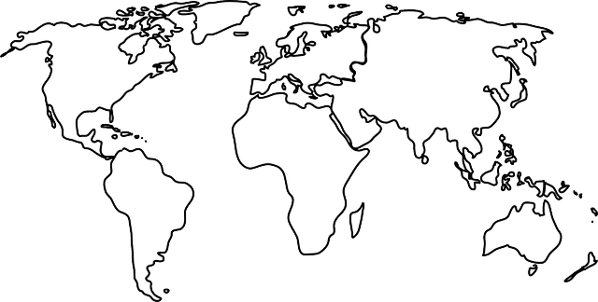
Initial Design1
Title- Global Supply Chain Flow
Author- Arpan Sarkar
Sheet-3
Date- 16-05-2021
Task- Compare volume and distribution of different products from different modes of shipping.
Filter Example
Region Filter
APAC
EMEA
Product/Channel filter
Product 1
Product 2
North America
LATAM
Product 3
Product 4
Operations
Hovering over each arrow will display the country name, volume of product, distance covered, amount or size.(Like a tooltip)
Thickness of the arrow displays the Volume of items which are getting delivered.
Each selection is interactive and will only highlight the selected segment.
channel1
channel2
channel3
Clustered Column Chart
Stacked Column Chart
Merits
The clustered column chart can be a very useful indicator for comparison between countries.
Stacked column chart can be very useful in determining proportion of different categories, products, channels etc.
Demerits
Bar graphs can be misleading since we organize it in a certain way, and statistically it might not be relevant.
Another issue is that it is hard to determine fractions and percents.

Slide 4
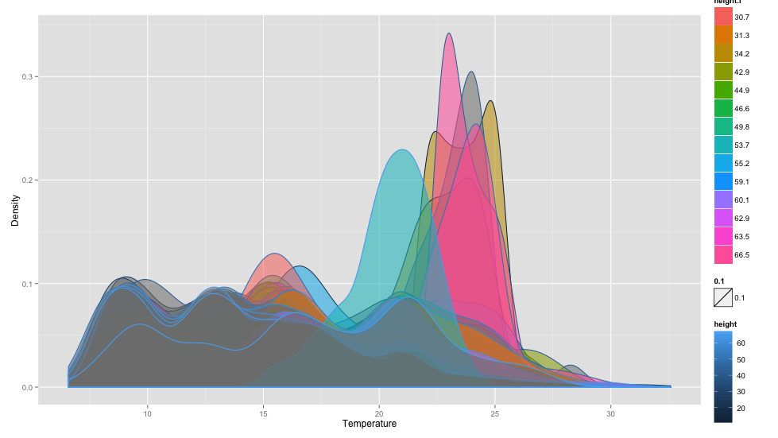
Initial Design 2
Title- Global Supply Chain Flow
Author- Arpan Sarkar
Sheet-4
Date- 16-05-2021
Task- Compare volume and distribution of different products and how the trend is prevailing in different sectors.
Filter Example
Region Filter
APAC
EMEA
Product/Channel filter
Product 1
Product 2
North America
LATAM
Product 3
Product 4
Operations
Hovering over each arrow will display the country name, volume of product, distance covered, amount or size.(Like a tooltip)
Thickness of the arrow displays the Volume of items which are getting delivered.
Each selection is interactive and will only highlight the selected segment.
channel1
channel2
channel3
Density Plot
Line Chart
Merits
A density Plot helps in observing the distribution of data over a continuous interval or time period.
Comparing it over line chart it is very effective for comparing trends with its distribution
Demerits
line graphs are generally good only when you have under 50 data values. It also requires that the range in your data not be too big.

Slide 5
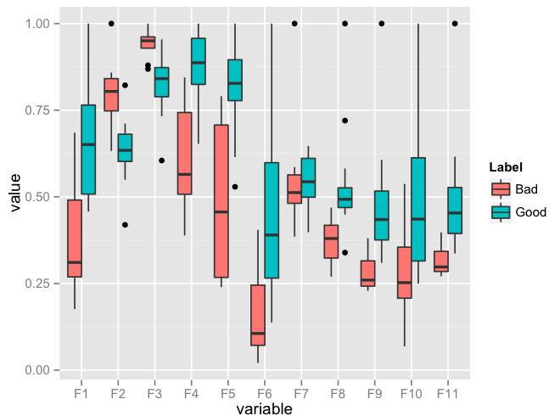
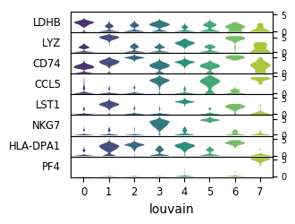
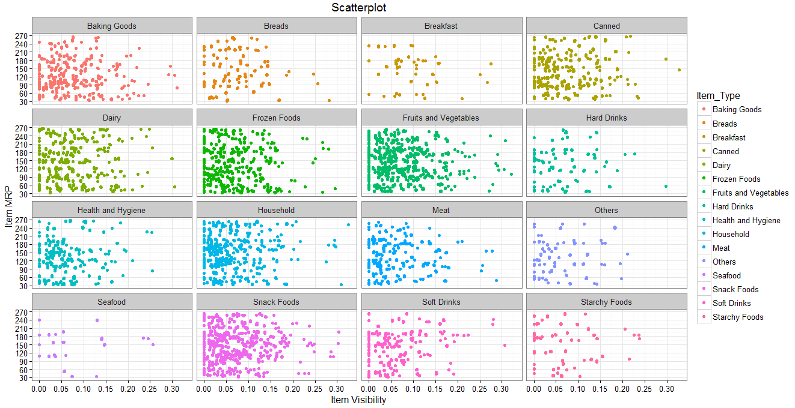
Initial Design 3
Title- Global Supply Chain Flow
Author- Arpan Sarkar
Sheet-5
Date- 16-05-2021
Task- Compare volume and distribution of different products from different modes of shipping into many levels.
Filter Example
Region Filter
APAC
EMEA
Product/Channel filter
Product 1
Product 2
North America
LATAM
Product 3
Product 4
Operations
Hovering over each arrow will display the country name, volume of product, distance covered, amount or size.(Like a tooltip)
Thickness of the arrow displays the Volume of items which are getting delivered.
Each selection is interactive and will only highlight the selected segment.
channel1
channel2
channel3
Box Plot
Violin Plot
Facet Scatter Plot
Merits
Box plots are standardized way of displaying distribution of different categories.
Violin plots are more informative way of showing data distribution and it is more useful when the data is multimodal.
Facet visuals are very effective when data has single variable with many levels.
Demerits
Box plots generally do not go well when the sample size of distribution is small.

Slide 6
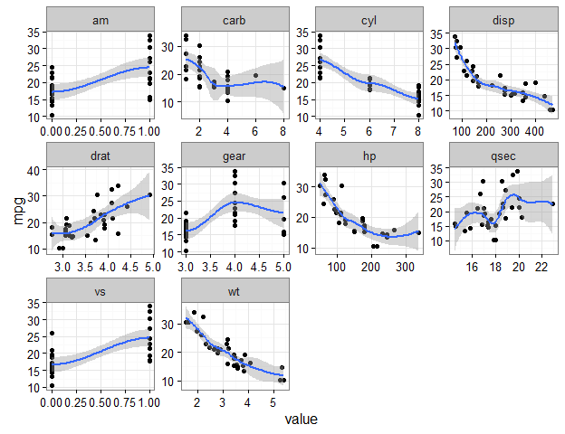
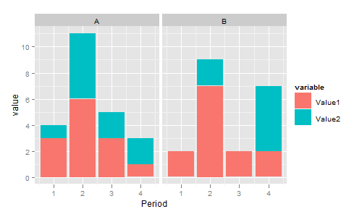
Combining and Refining
Title- Global Supply Chain Flow
Author- Arpan Sarkar
Sheet-6
Date- 16-05-2021
Task- Combining and refining different visuals on the basis of sheet 12&3
Filter Example
Region Filter
APAC
EMEA
Product/Channel filter
Product 1
Product 2
North America
LATAM
Product 3
Product 4
Operations
Hovering over each arrow will display the country name, volume of product, distance covered, amount or size.(Like a tooltip)
Thickness of the arrow displays the Volume of items which are getting delivered.
Each selection is interactive and will only highlight the selected segment.
Combination of static and interactive visuals.
channel1
channel2
channel3
Density Plot
Facet correlation scatter Plot
Stacked Bar Chart Split into 2 levels
Overview:
Combining all visuals from different sheets helps in analyzing all prospects of research question in a way it answers all the questions together as a whole, so it is very much necessary to refine the process for getting accurate insights for decision making.

Slide 7
Bibliography
Resources:
Academic Reference
Five Design Sheets
Statistic Inference
Flow Map Sankey Diagrams
Supply Chain Information
Title- Global Supply Chain Flow
Author- Arpan Sarkar
Student id: 32559844
Sheet-7
Date- 16-05-2021
MONASH UNIVERSITY

