Slide 1

Modeling on Personal Loans from Oct to Nov 2018
REDWOOD ALGORITHMS

Slide 2
Top Actionable
18 % Improvement for Insurance Campaign can be made by
Calling @9AM-11AM(Morning Time), 3PM-6PM(After Noon time) for more conversions rate.
Tuesday ,Wednesday and Saturday are best for closing sale.
Best target age group is 31 to 35.
Increasing contact to customer with follow up needed.
REDWOOD ALGORITHMS

Slide 3
Target strategy
For the target segment mentioned above, google/face book ads results in higher conversions.
70% conversions are through mobile and 21.4% conversions are through desktop, therefore mobile advertising can be prioritised.
The best working keywords are
" cho vay tiền trả góp“, (mortage loan)-score 8/10
“vay tiêu dùng”,(consumer loan) – score 7/10
“vậy nhanh online”-(so fast online)- score 8/10

Slide 4
Summary Metrics for Personal Loan Campaign
Key Metrics | Personal Loan
Number of Sales | 1st Oct– 25th Nov = 325 sales
Conversion / Lead | 325/10326 = 0.03
Number of Products X - Sell | 325
(80:20) Rule – Campaign Team | 336
(80:20) Rule - Day of the Week | Tuesday, Wednesday and Thursday
Target Segment | Age : 30-35 years
REDWOOD ALGORITHMS

Slide 5


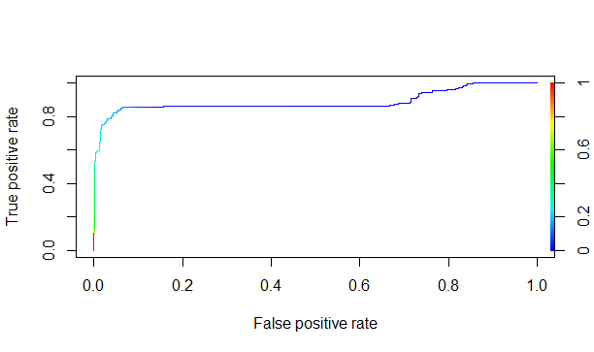
Training
Testing
Accuracy=98.3
Accuracy=98.2
REDWOOD ALGORITHMS

Slide 6
Presenting the modeling Result
Attribute (Variable) | Influencing Factor ( Drawn from Coefficient) | Actionable
Age | 10% | More conversion on targeted age group
Campaign Name | 15% | Combination of campaign with best team.
Vietnam call time | 3% | More conversion on particular time intervals
Day of call | 5% | Maximum conversion happened on Tuesday Wednesday and Saturday
Sales team | 45% | Follow up needed should be called quickly again for better response (State change = TSR)
REDWOOD ALGORITHMS

Slide 7
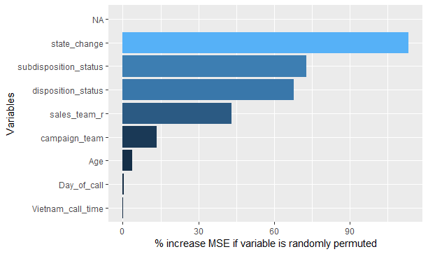
Independent variable significance
REDWOOD ALGORITHMS

Slide 8
REDWOOD ALGORITHMS

Slide 9
Describing the Models
Dependent variable(Target) : Sale _count
- 326 customers in status Doc_collected or in Sale =1 else 0
Independent variables :
- Campaign_team, Age, Sales_team_r, Vietnam_call_time and Day_of_call
Dataset : 10325
Split - 70:30
Train : 7281 & Test :3044
Multicollinearity : Subdisposition_status,dispostion_status and state_change
 | Campaign_team | Age | Sales_team_r | Vietnam_call_time | Day_of_call
Sale_count | Chisq test | 2 sample t-test | Chisq test | Chisq test | Chisq test
P value | <0.05 | <0.05 | <0.05 | <0.05 | <0.05
REDWOOD ALGORITHMS

Slide 10
The End
REDWOOD ALGORITHMS

