Slide 1
WELCOME
Notes:
Good morning everyone
This is team alpha consisting of 3 members : ARKA DAS ANJALI JHA AND ARPAN SANTRA guilded by sir Rupan panja and sir santosh kumar sharma
Now my friend arka will start with the demonstration of our project
Thank you

Slide 2

PRESENTING YOU
Notes:
Presentating you alpha forcast
Which is a computional study of predicting future stock

Slide 3

Introduction to the Stock Market
Today's world is of globalization, many businesses and Organization started developing international influence.
More data are created on a daily basis, which leads to fluctuation in stock market is very common.
Notes:
First of all we need 2 introduce what is stock market
It is a network of stock exchanges where traders and investers buy and sell shares

Slide 4
Challenges in Stock Market Prediction
Volatility
Unpredictable Events
Emotional Factors
Stock prices can fluctuate rapidly, making accurate prediction difficult.
Global events, political decisions, and company news can drastically impact the market.
Investor sentiment and psychology play a significant role in market movements.

Slide 5
Objective Of Our Stock Market Prediction Model
1
Develop accurate predictive models to forecast stock price movements
2
Identify patterns and trends in historical data to improve investment decisions
3
Utilize neural networks to navigate the complex and dynamic stock market
4
Use machine learning to beat traditional strategies

Slide 6

Problem Statement
The project aims to build a stock price prediction web-based application to stay one step ahead of the market, which uses machine learning algorithms to analyze historical data and find out the trends and patterns amongst them to predict future stock returns in real time.

Slide 7
Environment And Language Used in the project
Environment used :
Jupiter notebook --> For different preprocessing operations and building the prediction model
Visual Studio Code --> For building the web application
Language used :
Python --> Python is the most popular programming language for Machine Learning due to its readability, extensive libraries and frameworks, strong community support, compatibility with other languages and scalability.

Slide 8
Overview Of The Project
Creating a model that predicts the future price of the stock based on the original everyday closing price of the stock data
Creating a model that predicts the future price of the stock based on the Moving average of 200 days on the stock data
Creating a model that can predict the future top and bottom price of the stock i.e. The next maximum or minimum stock value before the stock price starts to go down or up respectively
Creating a model that can predict the days between the future maximum value and the next upcoming minimum value or vice versa.

Slide 9
Which Model to use?
We have tried using the Linear Regression model for our project work but it is limited of capturing simple patterns and hence was not suitable for our project.

Slide 10
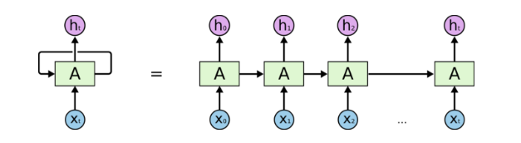
The Best Model To Do Our Job
LSTM(Long Short Term Memory) model
LSTM is a type of Recurrent Neural Network model which is suitable for processing suitable sequential data and are effective for long term dependencies such as stock prediction

Slide 11
Procedure Of Prediction of Our Model
Importing necessary library packages of python
NumPy --> For arithmetic operations
Pandas --> For data manipulation and data analysis
Yfinance --> For fetching the data from Yahoo Finance
Keras, TensorFlow --> For model creation, Training and Testing of data
Streamlit --> For web app implementation
Matplotlib --> For data visualization
Scikit-learn --> For data preprocessing
Shapely --> For data visualization in web app

Slide 12
Data collection
We collected data from the official Yahoo Finance site using the yfinance library package in Python with standard parameters from January 1, 1989, to December 31, 2023.

Slide 13
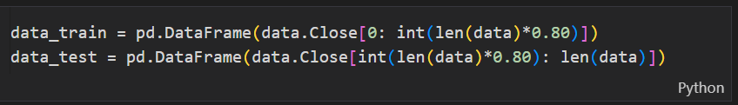
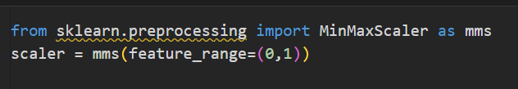
Dividing the data into training and testing data frames
The total data has been divided into training and testing data.
We have standardized 80% of data as training data and 20% as testing data
Feature scaling of the data
We have scaled the data from feature range 0,1 which helps in better fitting of the data in the model

Slide 14
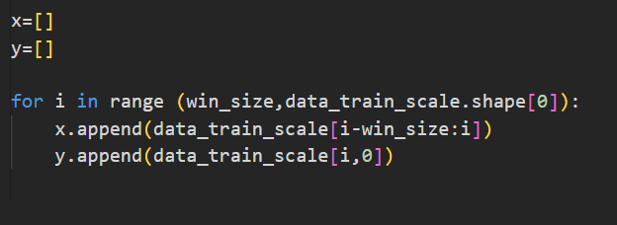
Array slicing
We feed the model an array of window size of 10
The data from 0-9,1-10,2-11 so that it can predict the 10th,11th, and 12th element respectively

Slide 15
Building the LSTM model and predicting the test dataset
Building the LSTM model
Feeding the training data to LSTM model
Predicting the test dataset
Comparing the prediction with test dataset

Slide 16
Results of original closing data vs predicted closing data
RMS → 11.430299810188243
R2 → 0.9844648691416579

Slide 17
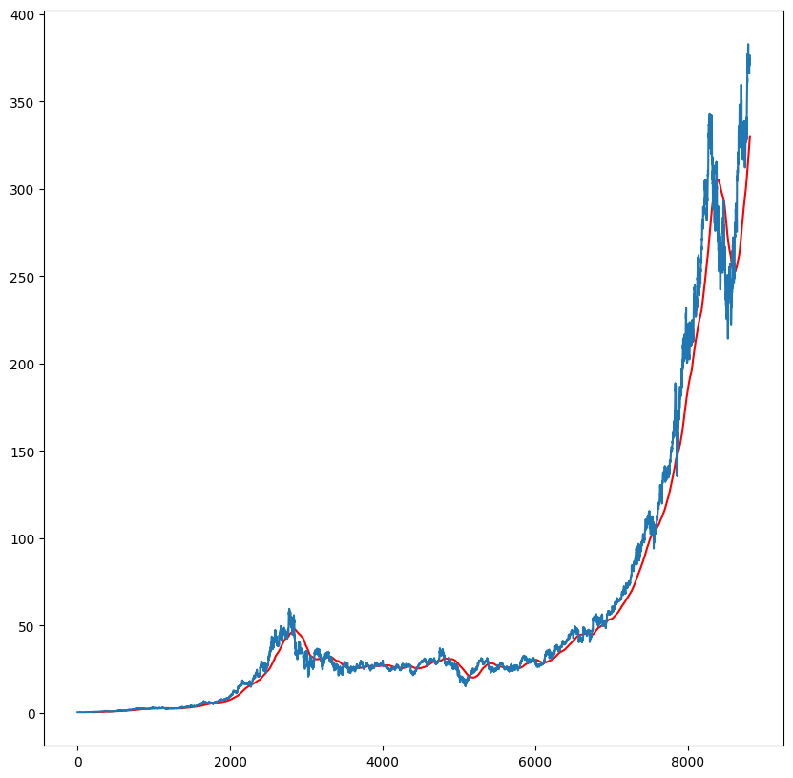
The Problem Faced In Prediction Based On The Original Closing Price
The volatility of the stock market on daily Closing prices
Leading to a very rough or haphazard closing curve
This can be improved by taking a Moving average of 200 days as shown below

Slide 18
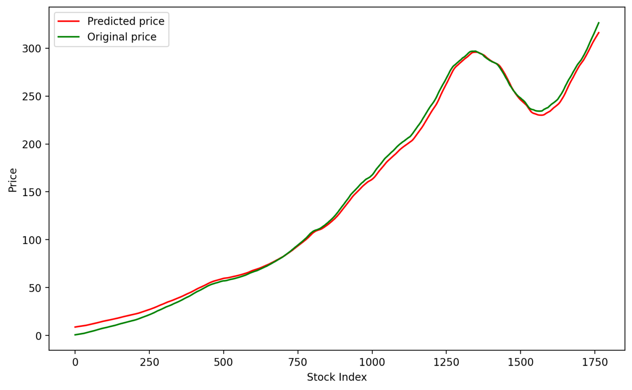
The Solution To The Problem
To overcome the problem, we came up with a solution.
Instead of using the actual daily closing price to train and test our model, we can utilize the 200-day moving average.
RMS --> 4.612743009107853 R2 --> 0.998001315036666

Slide 19
Significance of the previous prediction
From the previous prediction, we can forecast the stock price of the moving average of 200 days with acceptable accuracy. Therefore, this prediction can be very useful for long-term investments.

Slide 20
Approaches used to develop more precise model for short-term stock trading.
For short-term trading, our main goal is to make a model that can predict two things
Prediction of future maximum peak price after which it starts to drop again, say ‘tops’ or future minimum lowest price after which the stock starts rising again, say ‘bottoms’.
Prediction of the days between consecutive future tops and bottoms or future bottoms and tops respectively
Notes:
Until now we seen from the demonstration given by Anjali and arka that how our model can predict the future stocks for long term investment .
From now we will see how our model can be used for short term investment

Slide 21
Prediction of future ‘Tops’ or future ‘Bottoms’.

Slide 22
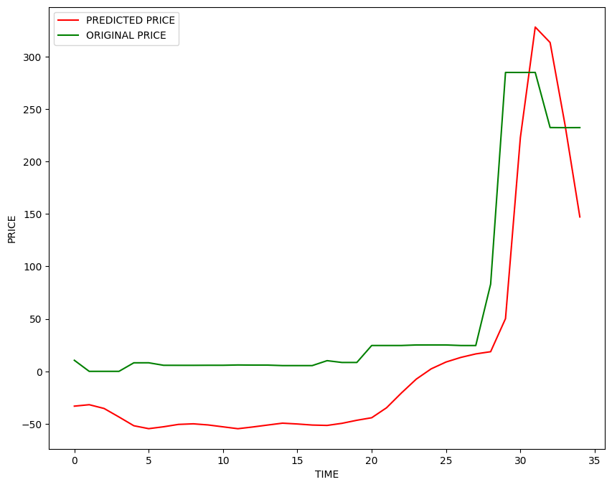
The Problem Faced In Prediction Of The Future Tops And Bottoms
The main challenge in this experiment was:-
To Identify significant Tops and Bottoms for training and testing the model.
This is because the data for Tops and Bottoms are typically local.
RMS --> 64.90939205224745
R2 -->0.5232009661042664
Notes:
Normally, if we take any algorithm to find the tops and bottoms it can be give birth to a problem of local maxima or minima
Which can see though the graph that our prediction curve doesn’t quite follow the original test curve

Slide 23
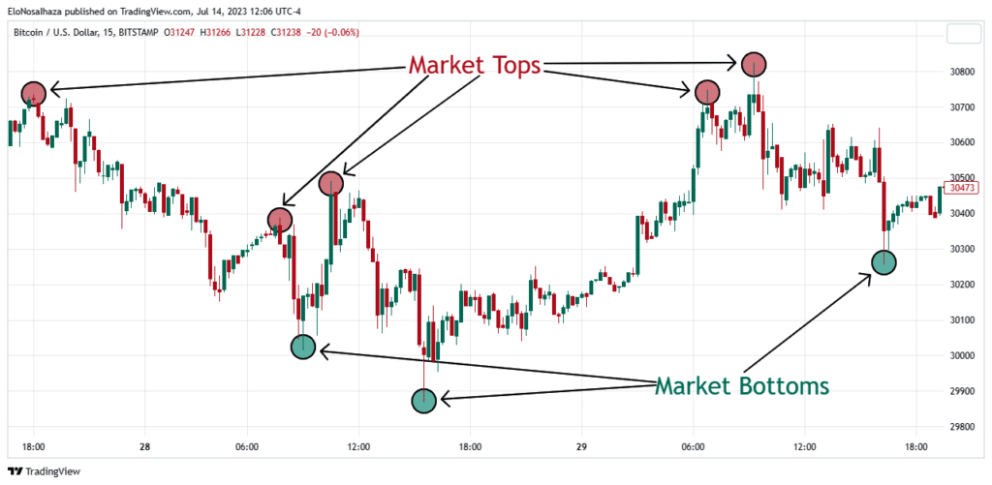
Solution To The Problem
The solution to the problem is to take only significant changes in value.
The idea is to take a top or bottom if the change is significant i.e. 1% or 2% of the previous value is changed.
The only catch is that if we increase the significance value the number of data points will decrease.

Slide 24
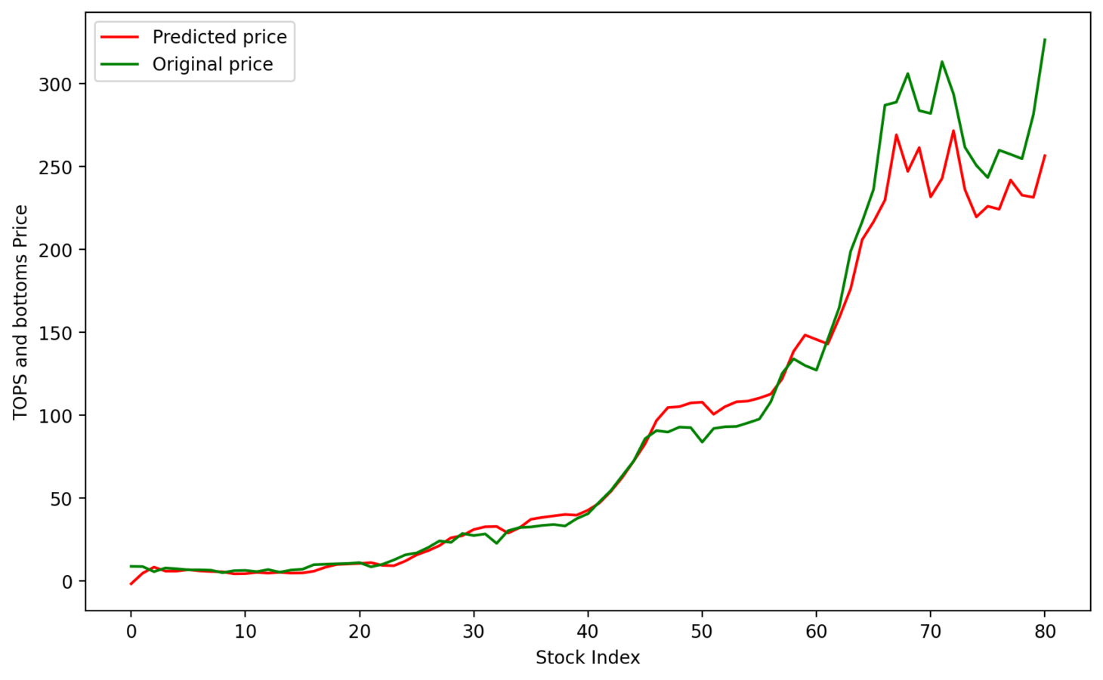
The Results Of Tops And Bottoms With Significant Change Value Of 1%.
With 1% significant change
RMS --> 19.628447670272106
R2 --> 0.9628299366037997

Slide 25
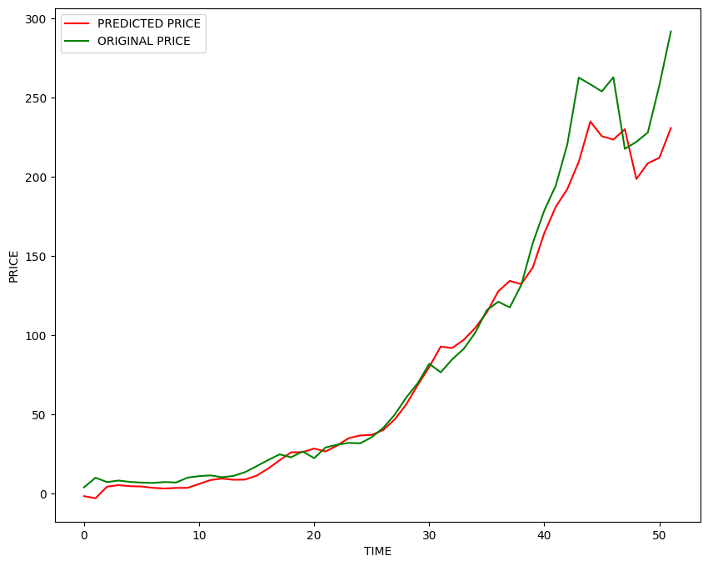
The Results Are Better For Higher Significant Values But The Data Set Keeps Decreasing.
With 2% significant change
RMS --> 17.21951007191948
R2 --> 0.9705352975536983
Notes:
Our first experiment goal concludes here

Slide 26
Prediction of the days between consecutive future tops and bottoms and vice versa

Slide 27
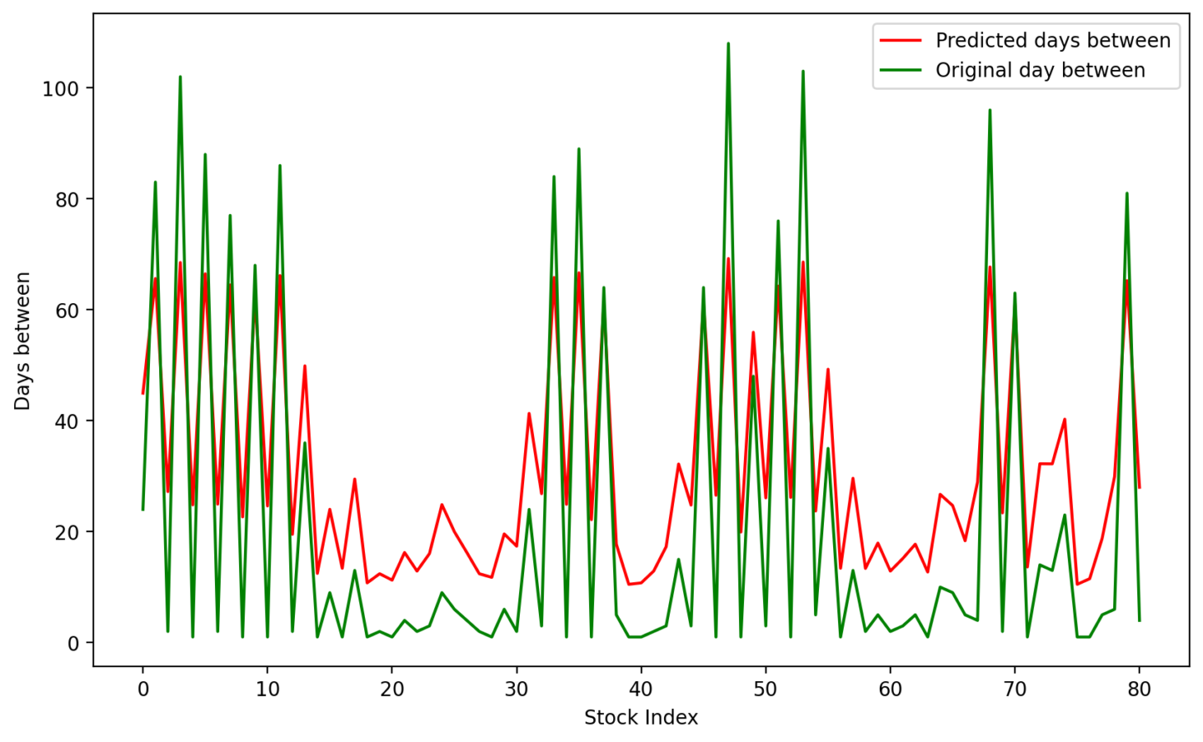
The Problem Faced In Prediction Of The Future Days Between Tops And Bottoms
The main challenge in this experiment was :-
To predict the days between two consecutive top-bottom points.
Due to a shortage of data and haphazard changes of days in between, the prediction was not as accurate as the previous cases.
RMS-->17.762214395836885
R2 -->0.6969085462946106
Notes:
R2 score is quite low compared to previous results

Slide 28
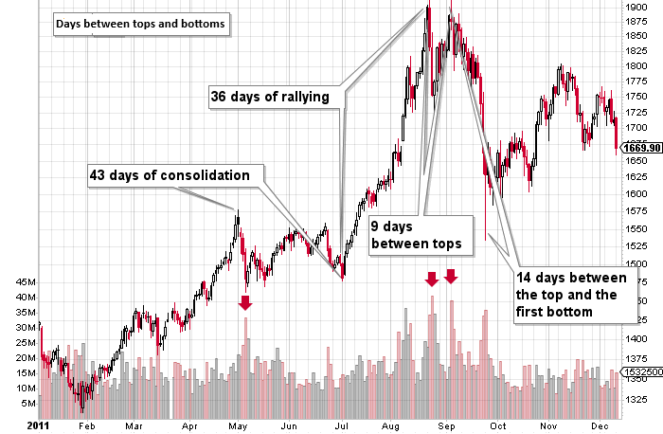
Scope Of Improvement In The Previous Experiment
Due to shortage of time, we could not devote much time to experiment 2.
We intend to work on this and develop a better model.

Slide 29
FUTURE OF OUR PROJECT

Slide 30
The ultimate goal of our project
The ultimate goal of our project is to achieve a web-based app that can predict stock movement both for long-term investment as well as short-term investment.
The goal for the long-term investment is already achieved
The goal for tracking precise stock movement, we require more resources and time to achieve our goal

Slide 31
Reports after all of our goals are met
We can report the user to buy a stock at its recent minimum price and after certain days when it reaches its peak position then the user can sell the stock and ultimately gain a profit
OR
We can report the user to sell a stock at its recent peak price and after certain days when it reaches its lowest price then the user can buy the stock and make a profit through sorting

Slide 32
Presented by:-
ARKA DAS
ANJAL JHA
ARPAN SANTRA
Guided by:-
RUPAN PANJA
SANTOSH KUMAR SHARMA

Slide 33
THANK YOU

