Slide 1
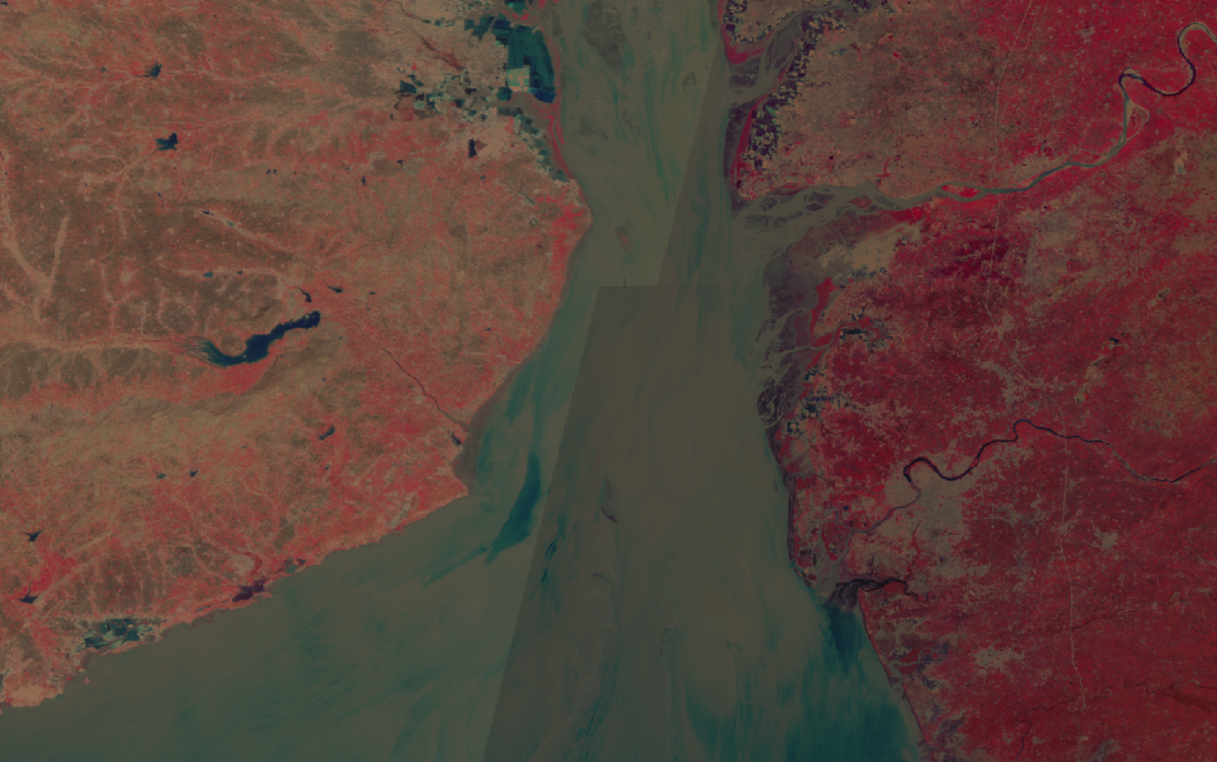



Contact us:
vedas@sac.isro.gov.in
VEDAS Sangrahi
Select, Collect, and Submit
v1.0
Space Application Centre,
Ahmedabad, Gujarat - 380058

Slide 2

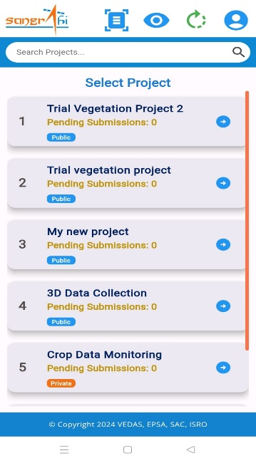
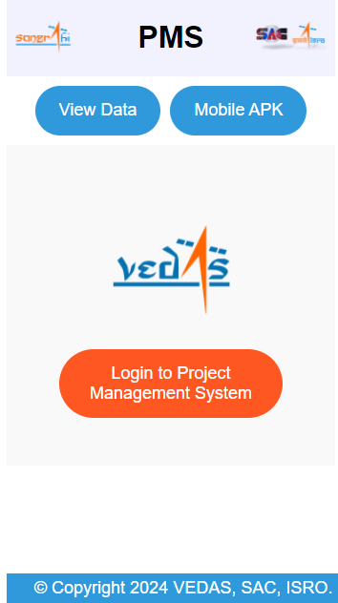

VEDAS Sangrahi
Universal Field Data Collection Platform of ISRO
Select, Collect, and Submit
v1.0
Sangrahi platform has three synergistic applications for data collection(online & offline), project management, and data visualization.
Sangrahi Mobile App
Sangrahi Project Management
Sangrahi Viewer
3 Step Field Data Collection by Authorized User.
Select: Select Project
Collect: Collect Geo-tagged Field Data
Submit: Submit collected records.
Offline Field Data Collection with Form Review.
Multi-Project, Multi-User Access.
Supports both Android & iOS.
Secure Access of Application.
Project Creation, Update and Deletion.
Form Field Management.
Authorization of Project FDC Users.
Unified Interface for All Projects.
Supports Both Private and Public Projects.
Latest Satellite Data Visualization.
Advanced Search Capabilities.

Slide 3
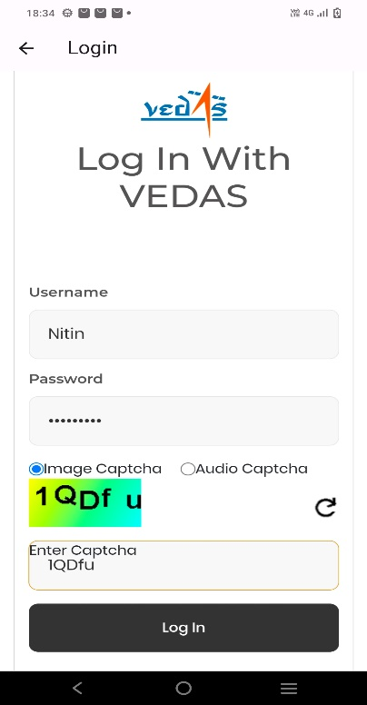
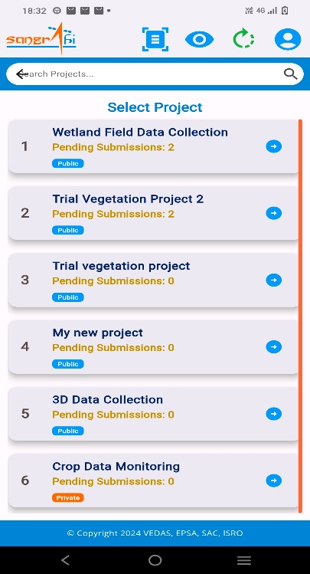
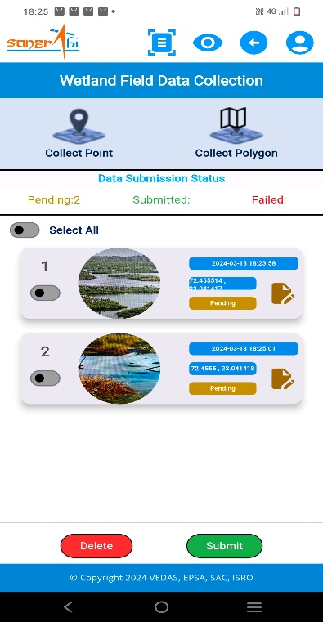
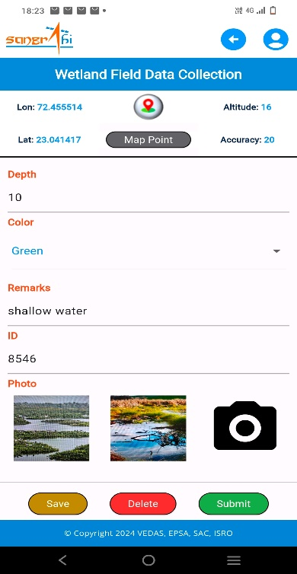
VEDAS Sangrahi
Universal Field Data Collection Platform of ISRO
Select, Collect, and Submit
v1.0
Sangrahi Mobile Application
Login
Select
Collect
Submit
Authorized users may log in for app, while new user can create an account and gain authorization from the project administrator.
User may select the project from the list of assigned project. Additionally user may see pending records and project access type (private or public)
User can collect new record (point, polygon etc.) or user can submit/review already collected field records.
User can collect new record (point polygon etc.) or user can submit/review already collected field records.

Slide 4
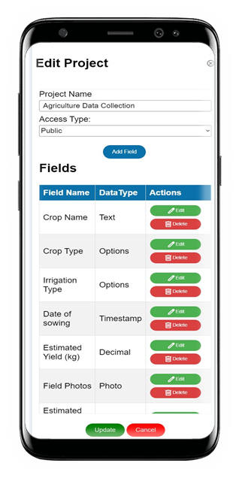
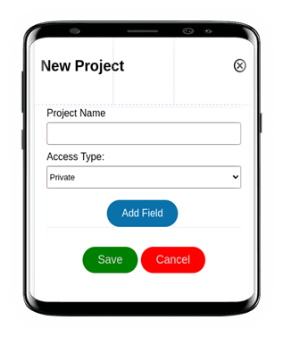
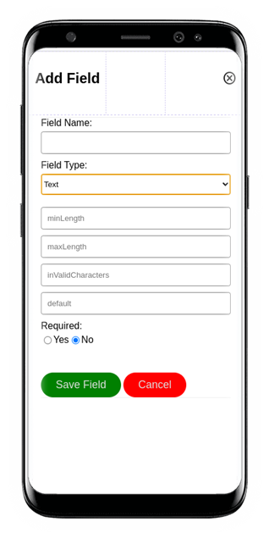
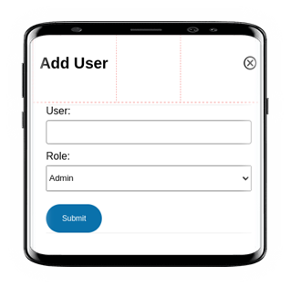
VEDAS Sangrahi
Universal Field Data Collection Platform of ISRO
Select, Collect, and Submit
v1.0
Sangrahi Project Management System

Slide 5
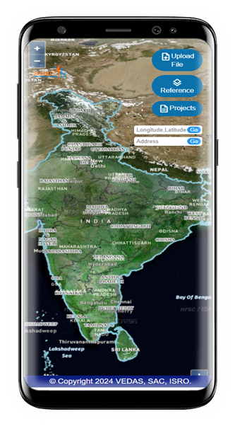
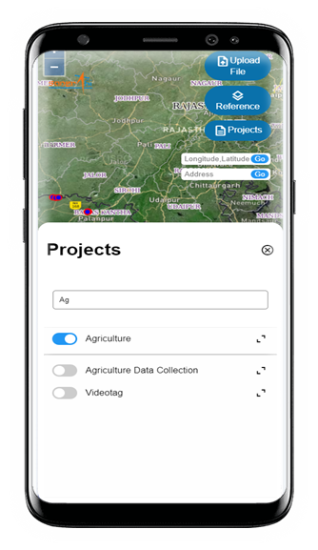
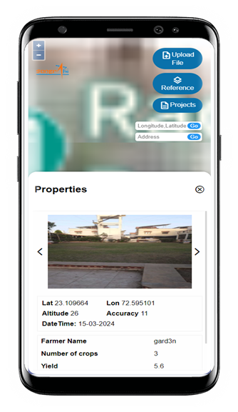
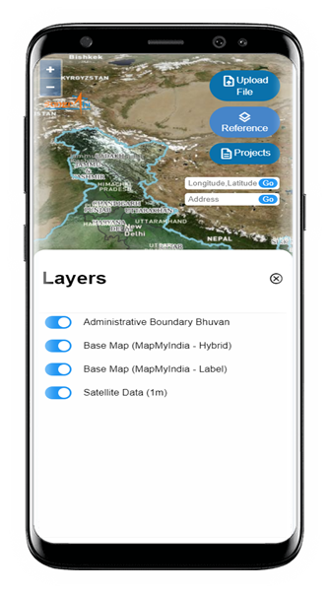
VEDAS Sangrahi
Universal Field Data Collection Platform of ISRO
Select, Collect, and Submit
v1.0
Sangrahi Viewer

