Slide 1
Unit-3:
SUPERVISED LEARNING
ALGORITHMS

Slide 2
Unit-3: SUPERVISED LEARNING ALGORITHMS Teaching Hours: 15 Hours
Learning through Optimisation: Gradient Descent, Linear Regression, Logistic Regression,
Computational Learning: Decision Trees, Naive-Bayes classification, Support Vector Machines, Ensemble Learners: Learning, Voting, Bagging, Stacking, Boosting, Random Forests, GridSearchCV
Lab Exercises:
5. Regression through Gradient Descent
6. Comparison of Different Classifiers
7. Illustration of Ensemble Learning Methods

Slide 3
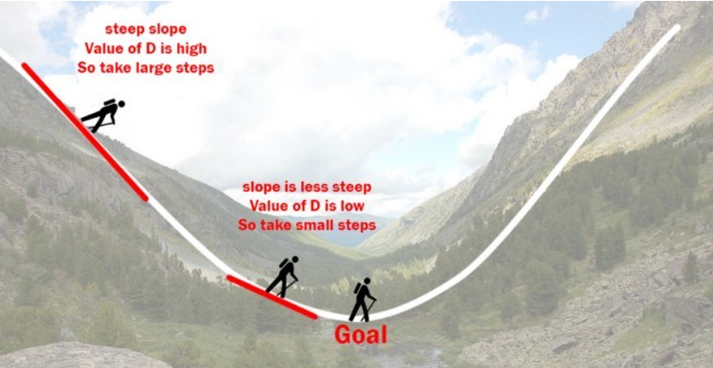
What is Gradient Descent?
Gradient Descent is an iterative optimization technique used to find the minimum of a differentiable function. Here that function is our Loss Function.
The goal of gradient descent is to find a local minimum of a differentiable function.
Think of it as finding the lowest point in a hilly landscape.
Helps adjust the model's internal parameters (weights and biases) to improve performance.
With respect to Linear Regression these weights and bias are Coefficients(Slope) and bias (intercept).
Weights (coefficients): These are the slope values for each input feature. They determine how much each feature contributes to the prediction. Example: In a house price model, the weight for "square footage" tells you how much the price increases per unit of area.
Bias (intercept): This is the baseline value when all inputs are zero. It shifts the regression line up or down

Slide 4
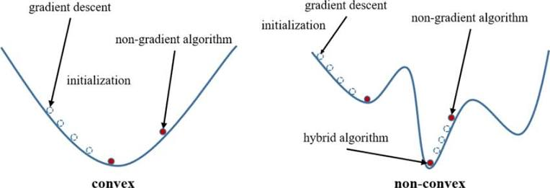
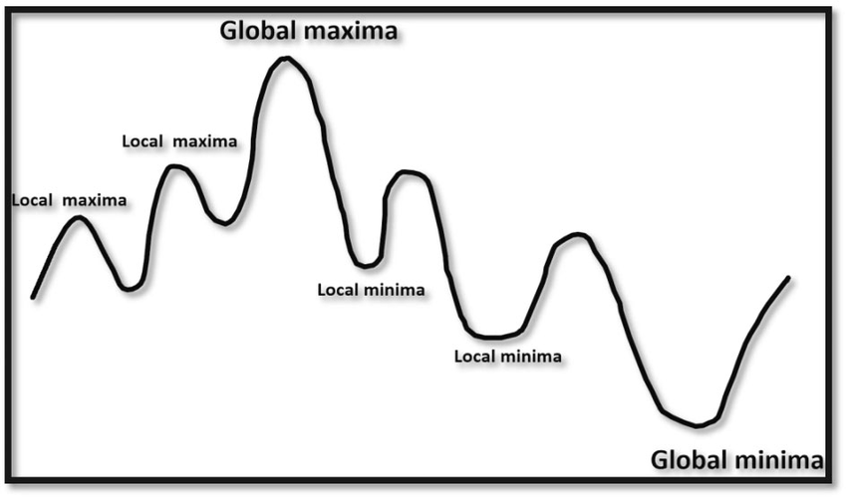
Gradient descent is a basic algorithm for finding the value of X that minimizes the function f(X) in k variables X.
Assumptions:
The function is differentiable, which means that its graph is smooth, i.e. without gaps (discontinuities) or cusps (corners)
The function is convex, which means that any line connecting two points on the curve doesn’t pass through another point on the curve. These are the function which have only one global minima.
For a function with these two properties, any local minimum is a global minimum.
https://medium.com/@gayatrinikam5103/convex-vs-non-convex-functions-in-ml-navigating-the-peaks-and-valleys-011e25409c6e

Slide 5
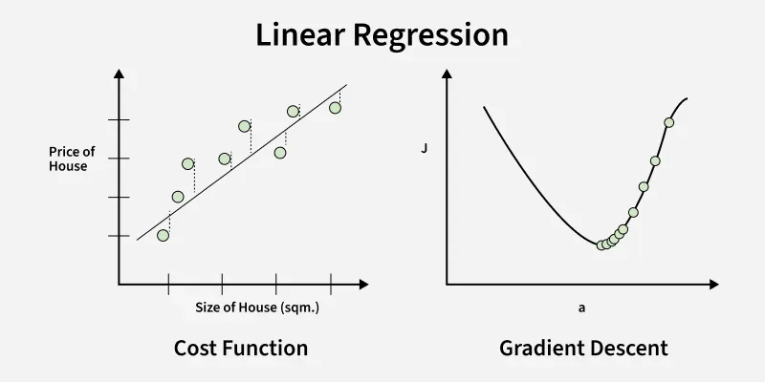
Why Do We Need Gradient Descent?
Machine learning models aim to minimize a loss function (a measure of error).
Gradient Descent helps find the best set of parameters that reduce this error.
Without Gradient Descent, models cannot improve their accuracy.

Slide 6
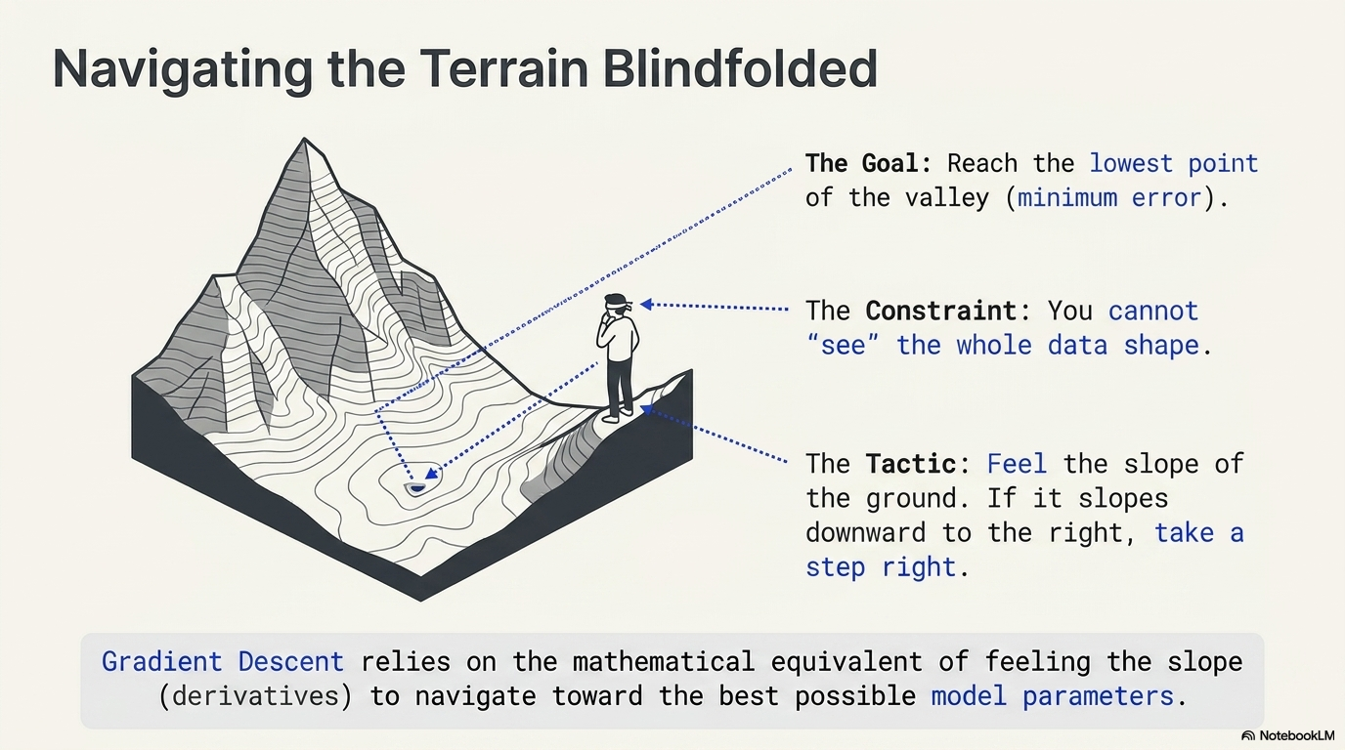
Example/Analogy
Imagine a valley and a person with no sense of direction who wants to get to the bottom of the valley.
• He goes down the slope and takes large steps when the slope is steep and small steps when the slope is less steep.
• He decides his next position based on his current position and stops when he gets to the
bottom of the valley which was his goal.

Slide 7
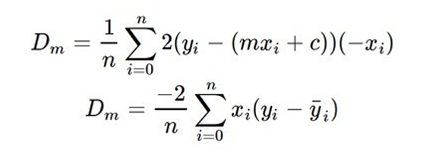
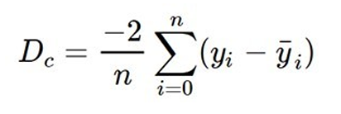
Let’s try applying gradient descent to m and c and approach it step by step:
– Initially let m = 0 and c = 0. Let L be our learning rate. Simple start from any random point.
1. This controls how much the value of m changes with each step. L could be a small value like 0.0001 for good accuracy.
2. Calculate the partial derivative of the loss function with respect to m, and plug in the current values of x, y, m and c in it to obtain the derivative value D (Loss Function).
D is the value of the partial derivative with respect to m. Similarly lets find the partial derivative with respect to c, Dc :

Slide 8
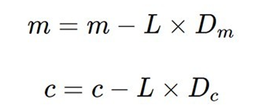
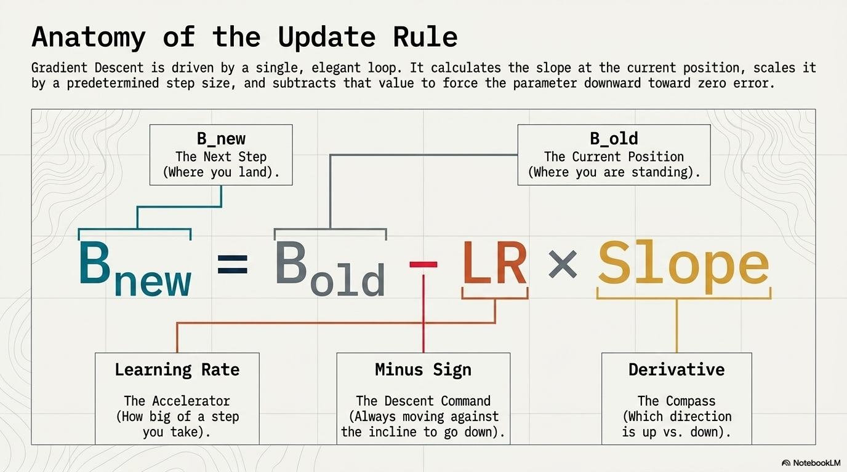
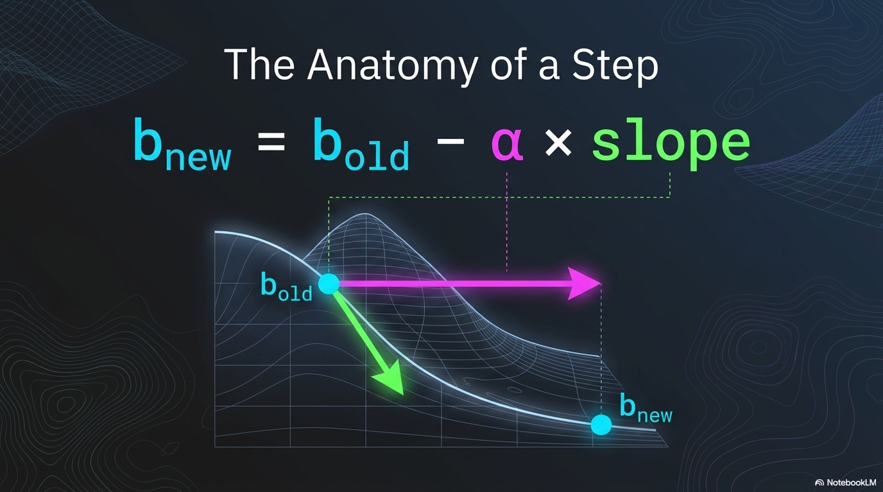
Now we update the current value of m and c using the following equation:
Here , Bnew is c represents the new value of the intercept.
L represents LR and Dc represents the slope.
4. We repeat this process until our loss function is a very small value or ideally 0 (which means 0 error or 100% accuracy). The value of m and c that we are left with now will be the optimum values.

Slide 9
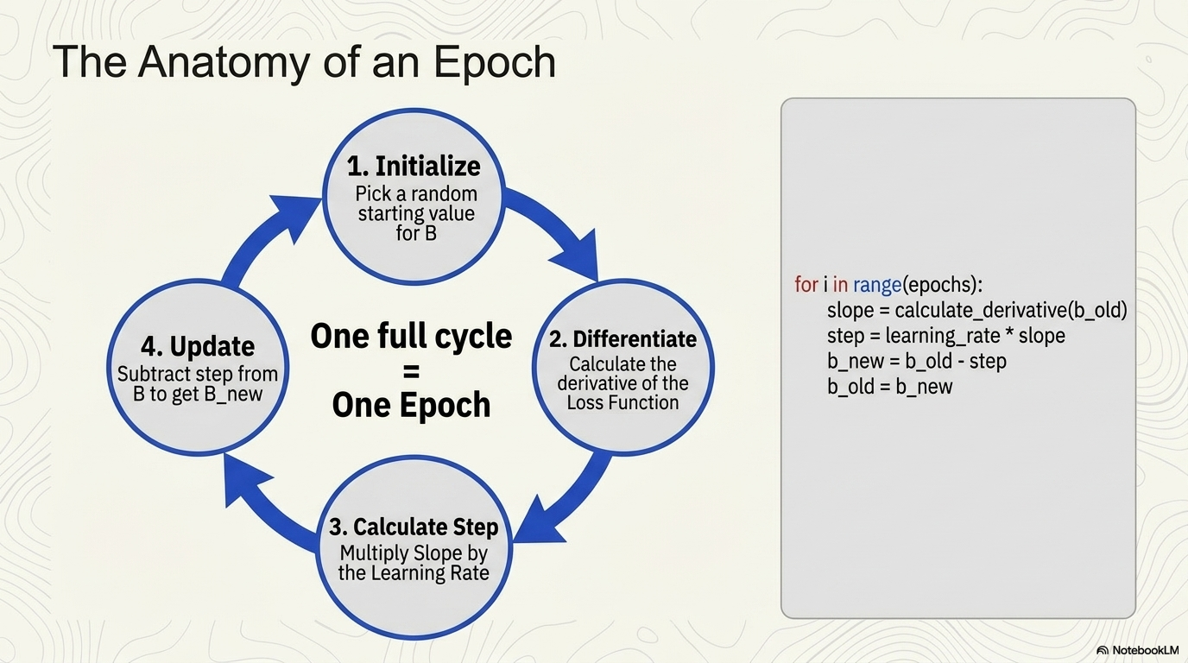

Slide 10
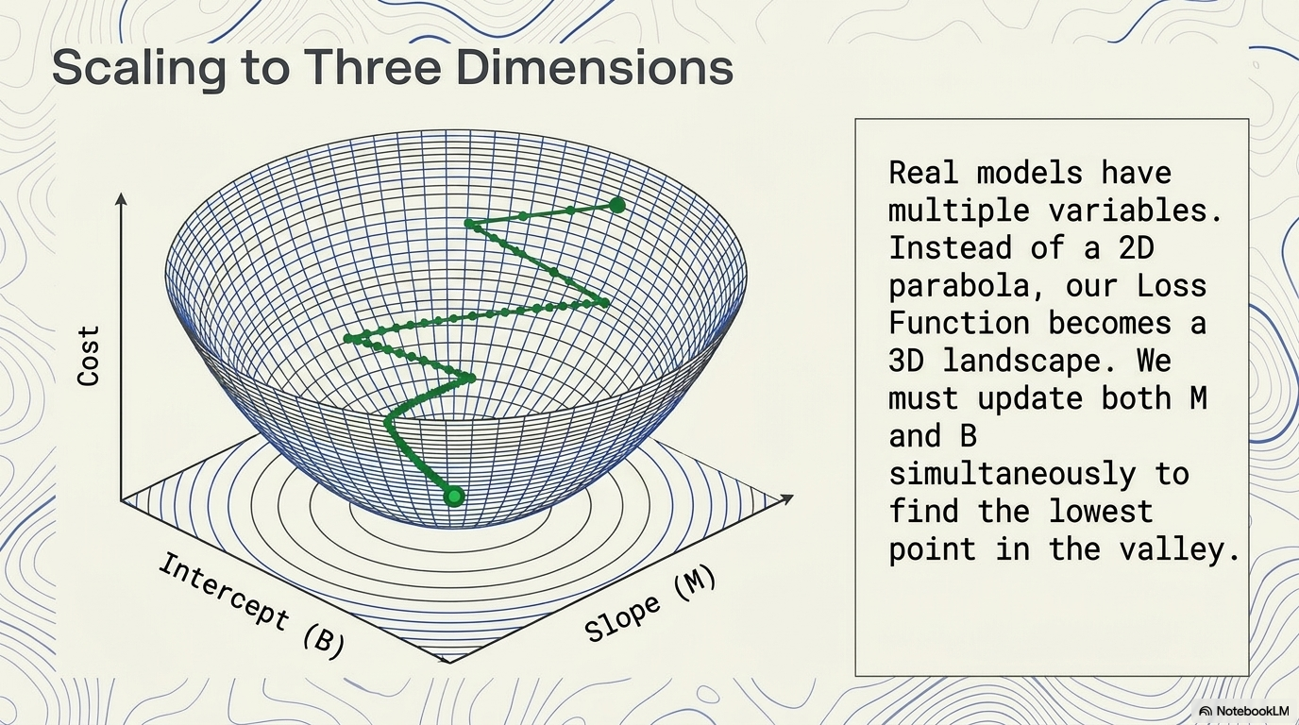
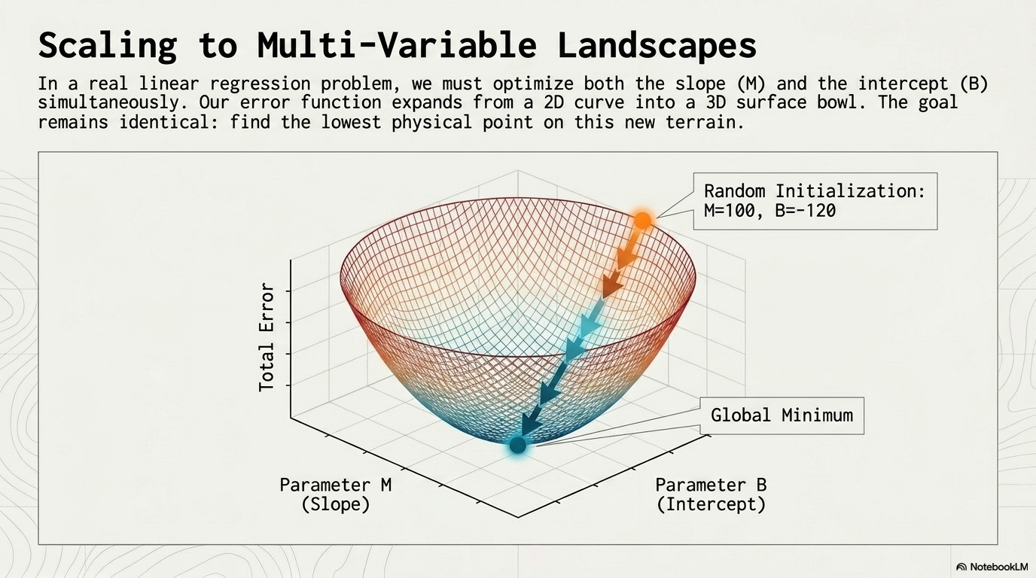

Slide 11
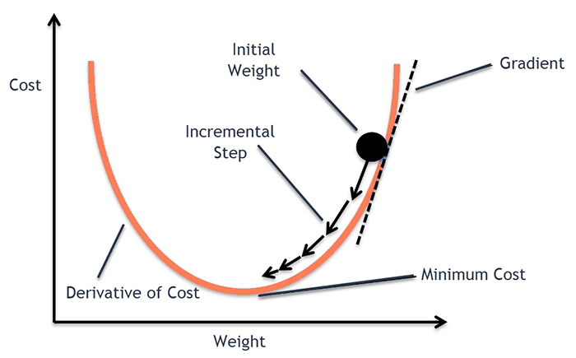
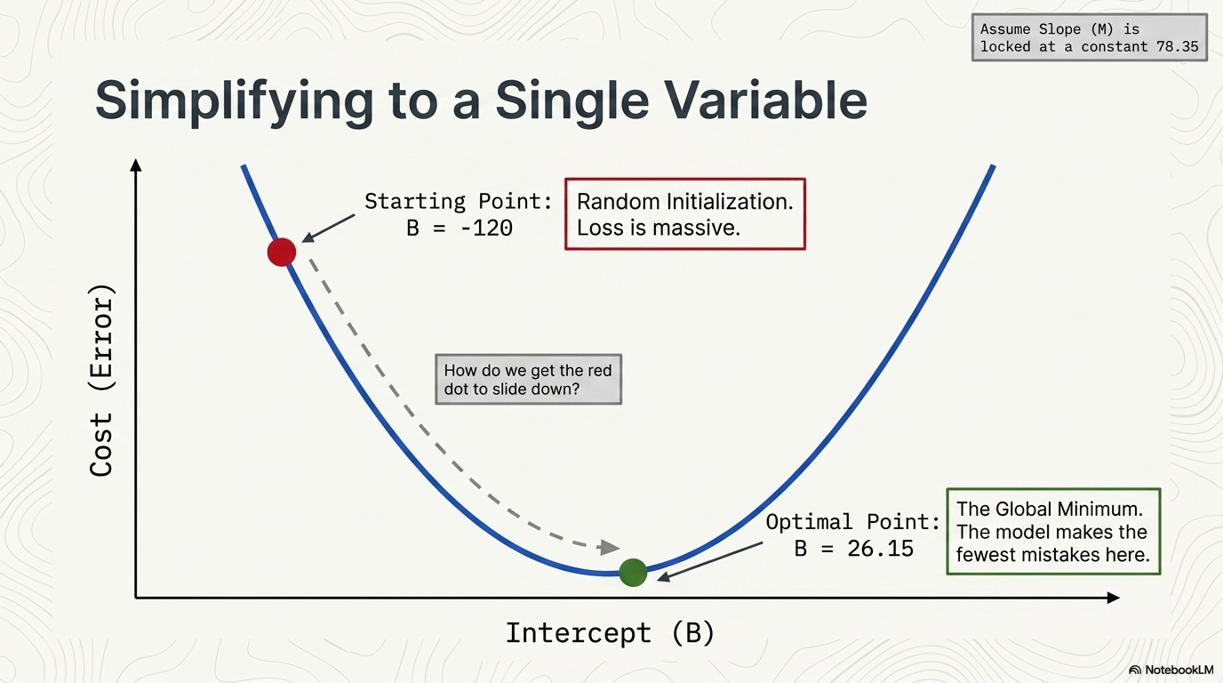
• Now going back to our analogy, m can be considered the current position of the person. D is equivalent to the steepness of the slope and L can be the speed with which he moves.
• Now the new value of m that we calculate using the above equation will be his next position, and L×D will be the size of the steps he will take.
• When the slope is more steep (D is more) he takes longer steps and when it is less steep (D is less), he takes smaller steps. Finally he arrives at the bottom of the valley which corresponds to our loss = 0.
• Now with the optimum value of m and c our model is ready to make predictions
https://www.kaggle.com/code/abdalimran/intuition-of-gradient-descent-for-machine-learning

Slide 12
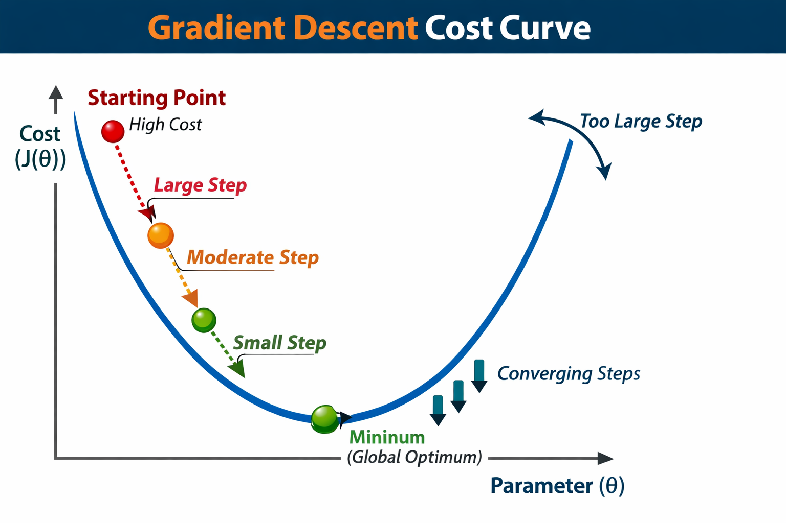

Slide 13
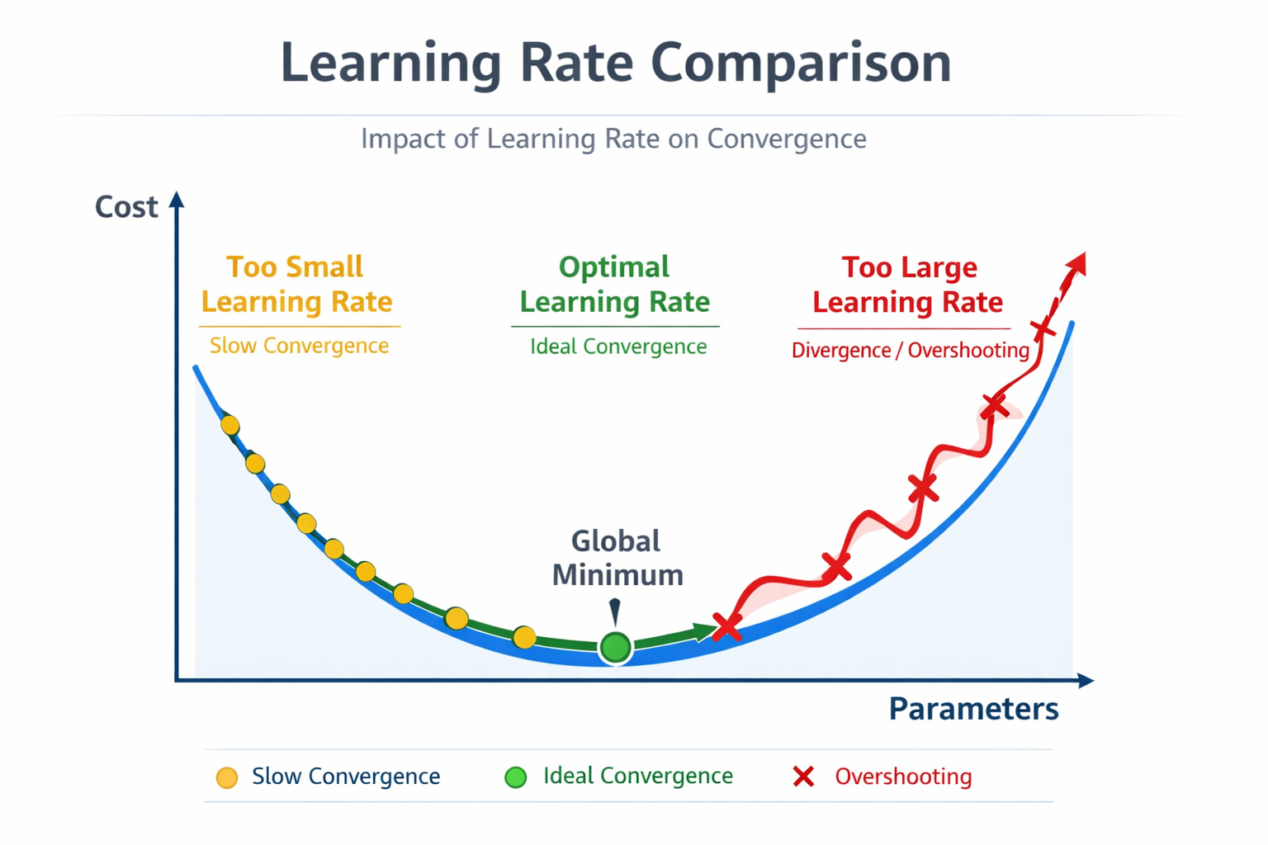
Challenges in Gradient Descent
Learning Rate:
It is a key parameter in machine learning that controls how much a model updates its weights during training. The learning rate determines the magnitude of the changes to make to the weights and bias during each step of the gradient descent process. The model multiplies the gradient by the learning rate to determine the model's parameters (weight and bias values) for the next iteration. In the third step of gradient descent, the "small amount" to move in the direction of negative slope refers to the learning rate.

Slide 14
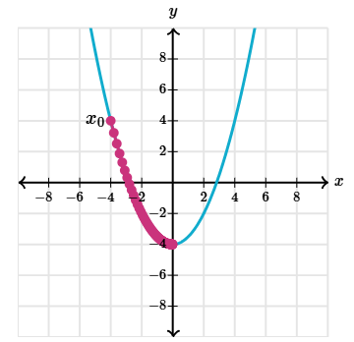
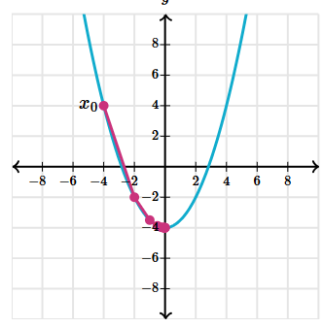
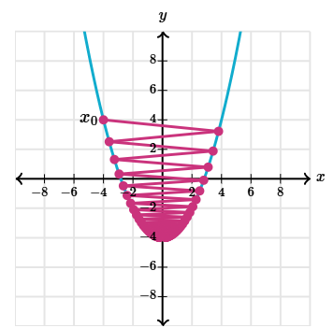
Contd..
Tiny step size converges slowly.
Good step size converges quickly.
Large step size converges slowly.
If the step size is too small, then we'll be more likely to converge, but we'll take far more steps than were necessary. This is a problem when the function we're minimizing has thousands or millions of variables, and evaluating it is cumbersome.
If the step size is too large, however, we may never converge to a local minimum because we overshoot it every time.

Slide 15
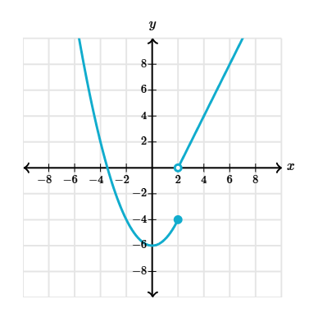
A final limitation is that gradient descent only works when our function is differentiable everywhere. Otherwise we might come to a point where the gradient isn't defined, and then we can't use our update formula.
Gradient descent fails for non-differentiable functions.

Slide 16
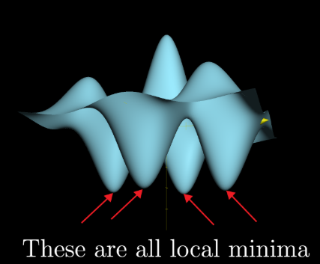
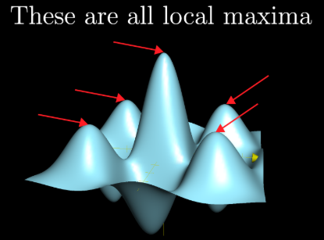
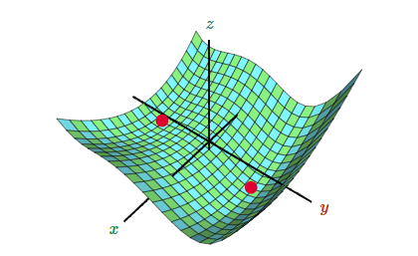
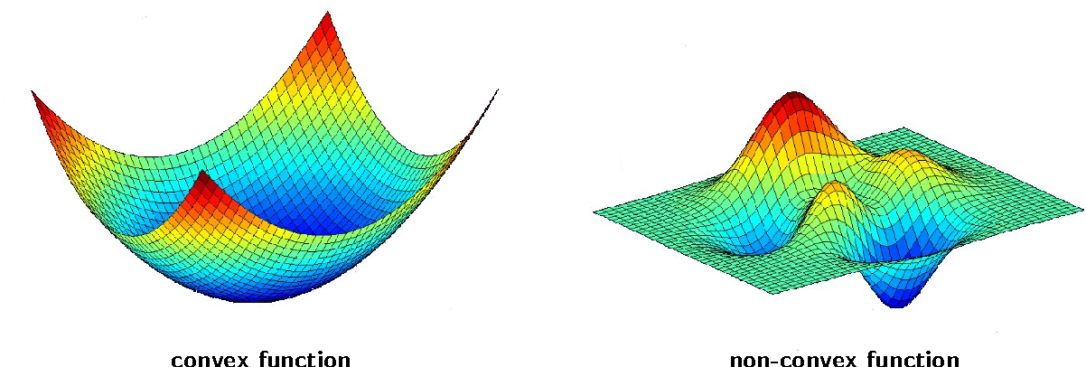
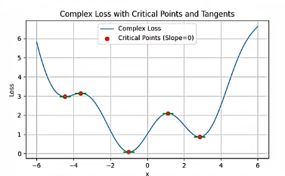
2. Local Minima:
- May get stuck in shallow dips.
One of its limitations is that it only finds local minima (rather than the global minimum). As soon as the algorithm finds some point that's at a local minimum, it will never escape as long as the step size doesn't exceed the size of the ditch.
For convex problems, gradient descent can find the global minimum with ease, but as nonconvex problems emerge, gradient descent can struggle to find the global minimum, where the model achieves the best results.

Slide 17
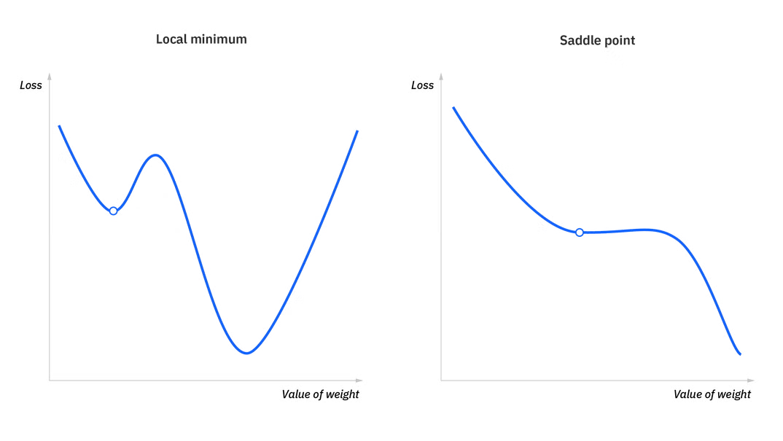
3. Saddle Points:
- Flat regions can slow down progress.
When the slope of the cost function is at or close to zero, the model stops learning. A few scenarios beyond the global minimum can also yield this slope, which are local minima and saddle points. Local minima mimic the shape of a global minimum, where the slope of the cost function increases on either side of the current point. However, with saddle points, the negative gradient only exists on one side of the point, reaching a local maximum on one side and a local minimum on the other. Its name inspired by that of a horse’s saddle.

Slide 18
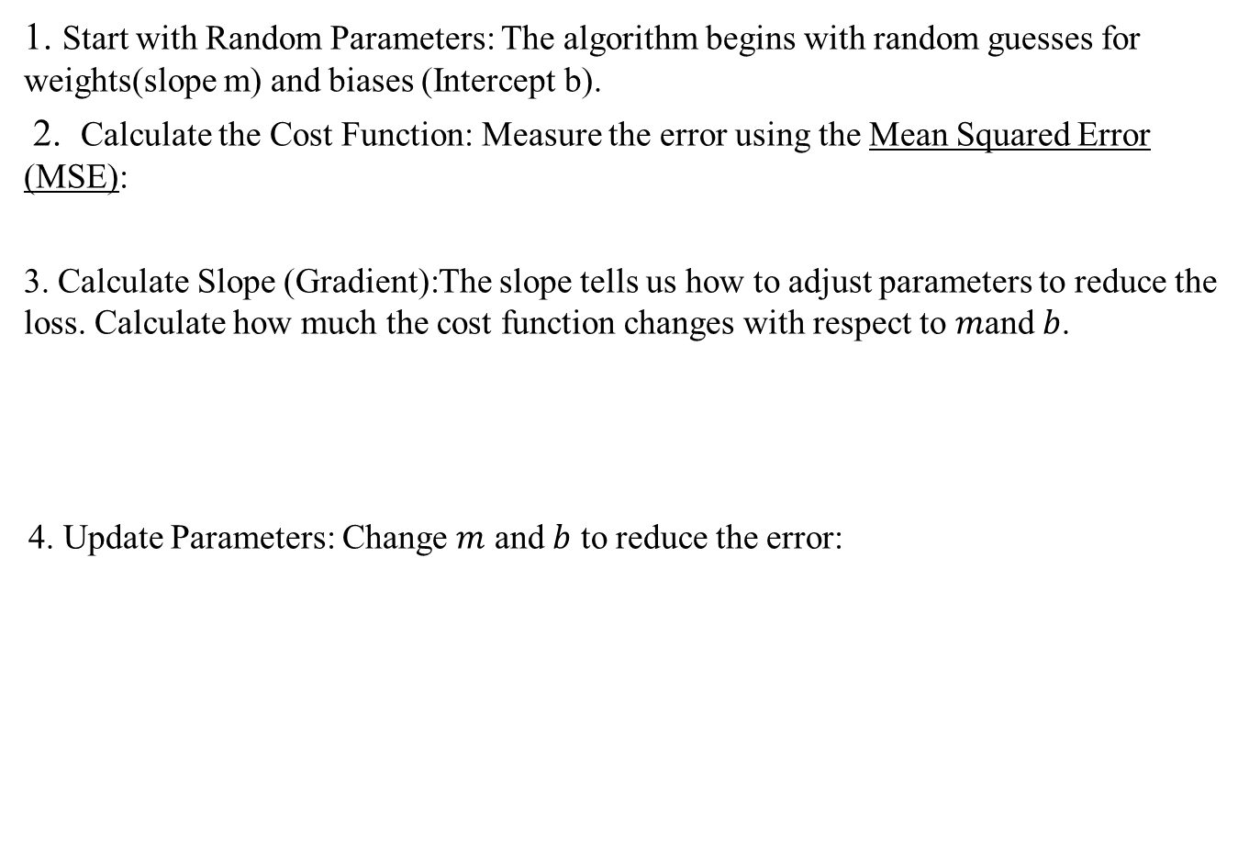

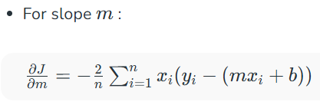
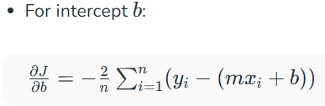
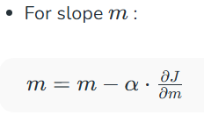
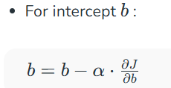
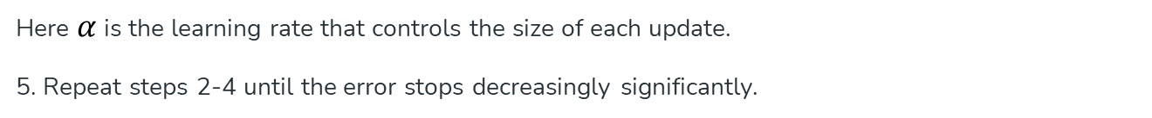
Working Steps of Gradient Descent with respect to Linear Regression

Slide 19
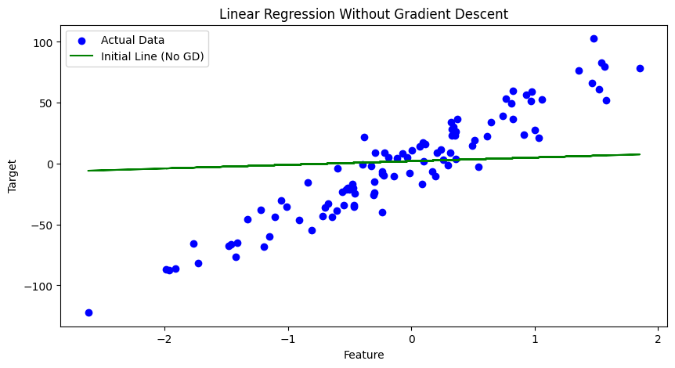
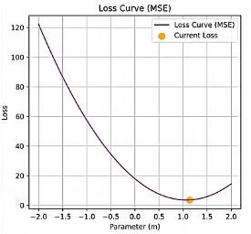
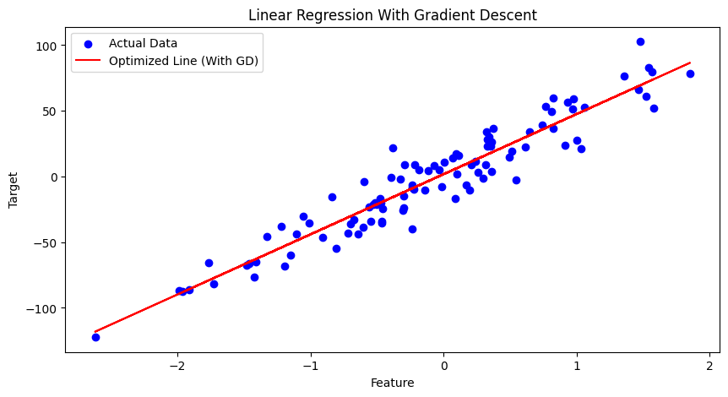

Slide 20
Types of Gradient Descent
1. Batch Gradient Descent:
- Uses the entire dataset to calculate the gradient.
- Accurate but slow.
2. Stochastic Gradient Descent (SGD):
- Uses one data point at a time.
- Faster but noisier.
3. Mini-Batch Gradient Descent:
- Uses a small group of data points.
- Balances speed and stability.

Slide 21
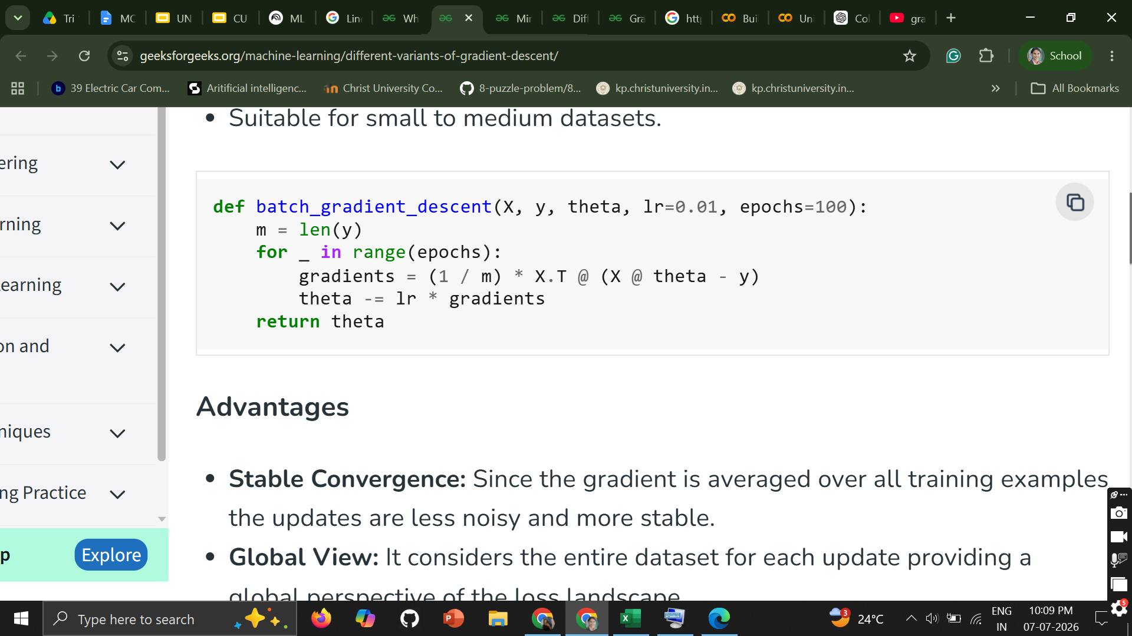
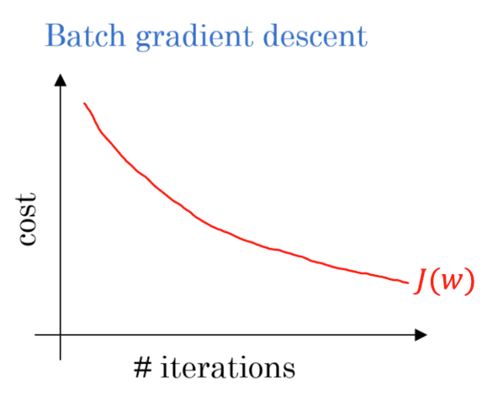
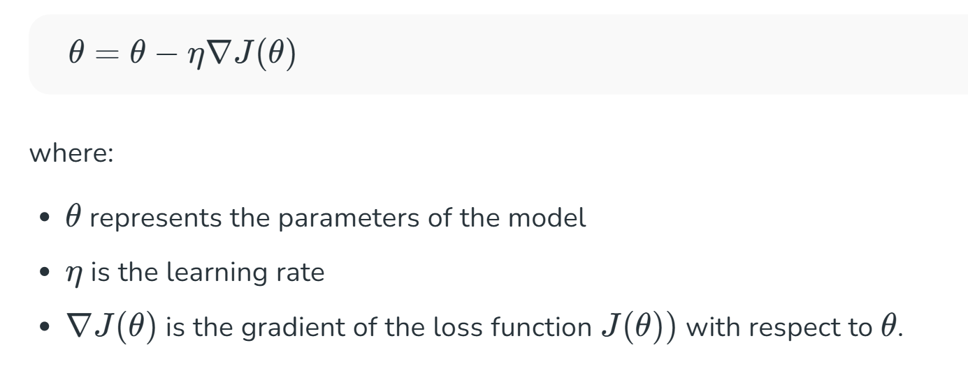
BATCH GRADIENT DESCENT
1. This is a type of gradient descent which processes all the training examples for each iteration of gradient descent.
2. But if the number of training examples is large, then batch gradient descent is computationally very expensive.
3. Hence if the number of training examples is large, then batch gradient descent is not preferred. Instead, we prefer to use stochastic gradient descent or mini-batch gradient descent

Slide 22
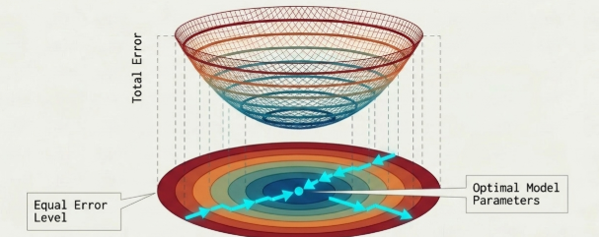
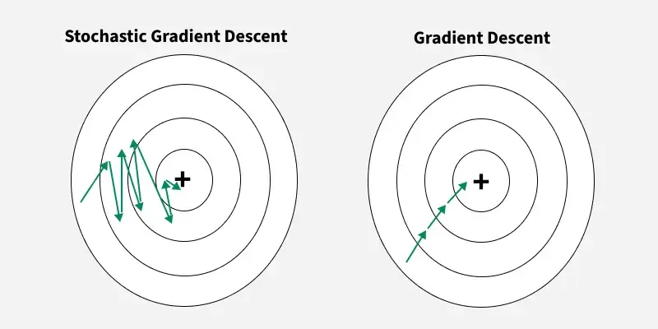
Stochastic Gradient Descent
• This is a type of gradient descent which processes 1 training example per iteration.
• Hence, the parameters are being updated even after one iteration in which only a single example has been processed. Hence this is quite faster than batch gradient descent.
• But again, when the number of training examples is large, even then it processes only one example which can be additional overhead for the system as the number of iterations will be quite large.
Stochastic Gradient Descent (SGD) is a variant of the gradient descent algorithm where the model parameters are updated using the gradient of the loss function with respect to a single training example at each iteration.

Slide 23
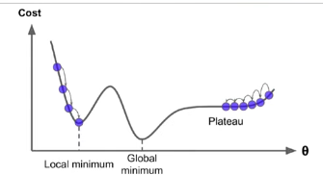
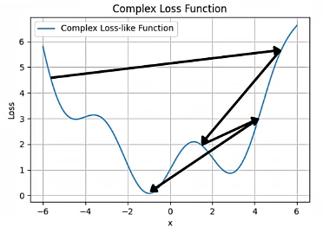
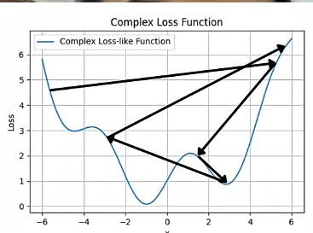
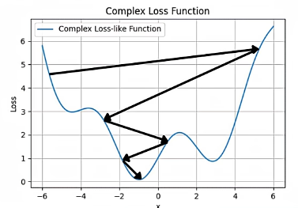
This issue can be solved through SDG (stochastic gradient descent)
What if not able to find global minima?? and stuck in this situation
Can be resolved by taking large lR in starting and then small by doing this we added a learning schedule and thats why its is known as Stochastic Gradient descent with learning schedule

Slide 24
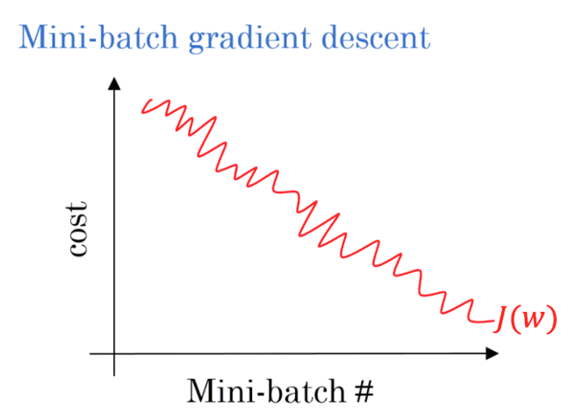
Mini Batch Gradient Descent
• This is a type of gradient descent which works faster than both batch gradient descent and stochastic gradient descent.
• Here B examples where b<m are processed per iteration. So even if the number of training examples are large , it is processed in batches of B training examples in one go.
Thus, it works for larger training examples and that too with lesser number of iterations.

Slide 25
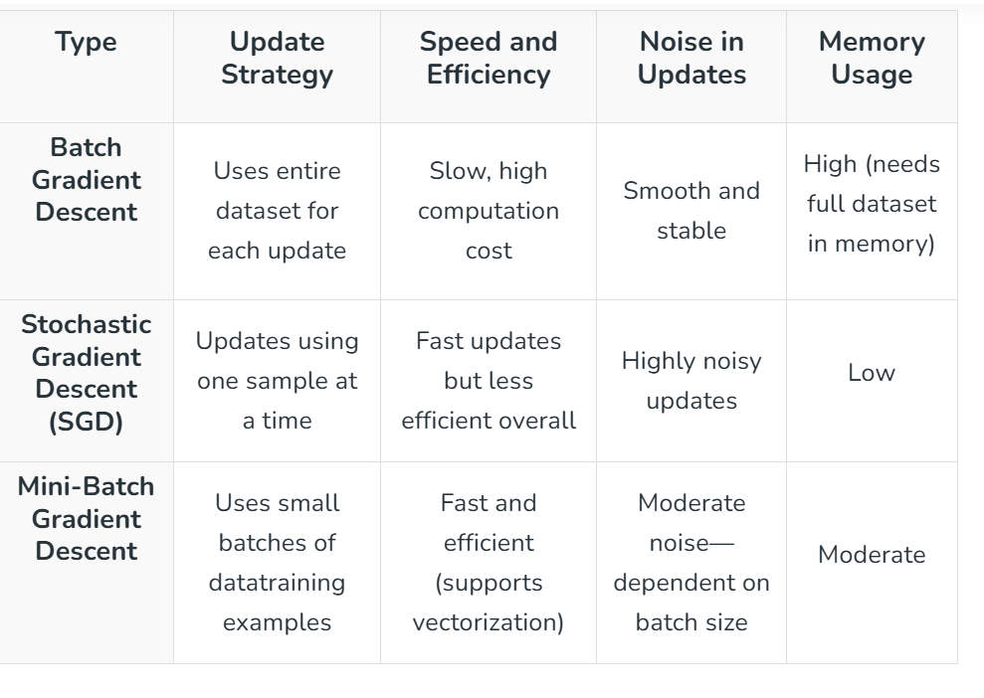

Slide 26
Hyperparameters
Hyperparameters are variables that control different aspects of training. Three common hyperparameters are:
Learning rate
Batch size
Epochs
In contrast, parameters are the variables, like the weights and bias, that are part of the model itself.
In other words, hyperparameters are values that you control; parameters are values that the model calculates during training.

Slide 27
Batch size
Batch size is a hyperparameter that refers to the number of examples the model processes before updating its weights and bias. You might think that the model should calculate the loss for every example in the dataset before updating the weights and bias. However, when a dataset contains hundreds of thousands or even millions of examples, using the full batch isn't practical.
Two common techniques to get the right gradient on average without needing to look at every example in the dataset before updating the weights and bias are stochastic gradient descent and mini-batch stochastic gradient descent:
Batch type | When weights and bias updates occur
Full batch | After the model looks at all the examples in the dataset. For instance, if a dataset contains 1,000 examples and the model trains for 20 epochs, the model updates the weights and bias 20 times, once per epoch.
Stochastic gradient descent | After the model looks at a single example from the dataset. For instance, if a dataset contains 1,000 examples and trains for 20 epochs, the model updates the weights and bias 20,000 times.
Mini-batch stochastic gradient descent | After the model looks at the examples in each batch. For instance, if a dataset contains 1,000 examples, and the batch size is 100, and the model trains for 20 epochs, the model updates the weights and bias 200 times.

Slide 28
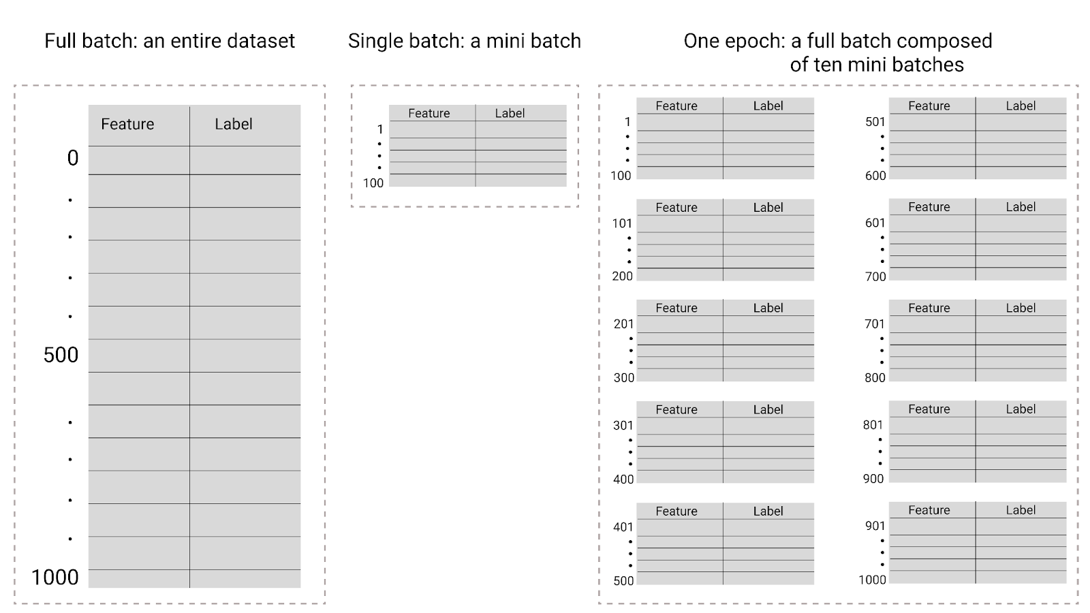
Epochs:- During training, an epoch means that the model has processed every example in the training set once. For example, given a training set with 1,000 examples and a mini-batch size of 100 examples, it will take the model 10 iterations to complete one epoch.
Training typically requires many epochs. That is, the system needs to process every example in the training set multiple times.
The number of epochs is a hyperparameter you set before the model begins training. In many cases, you'll need to experiment with how many epochs it takes for the model to converge. In general, more epochs produces a better model, but also takes more time to train.

Slide 29
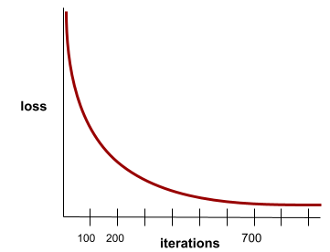
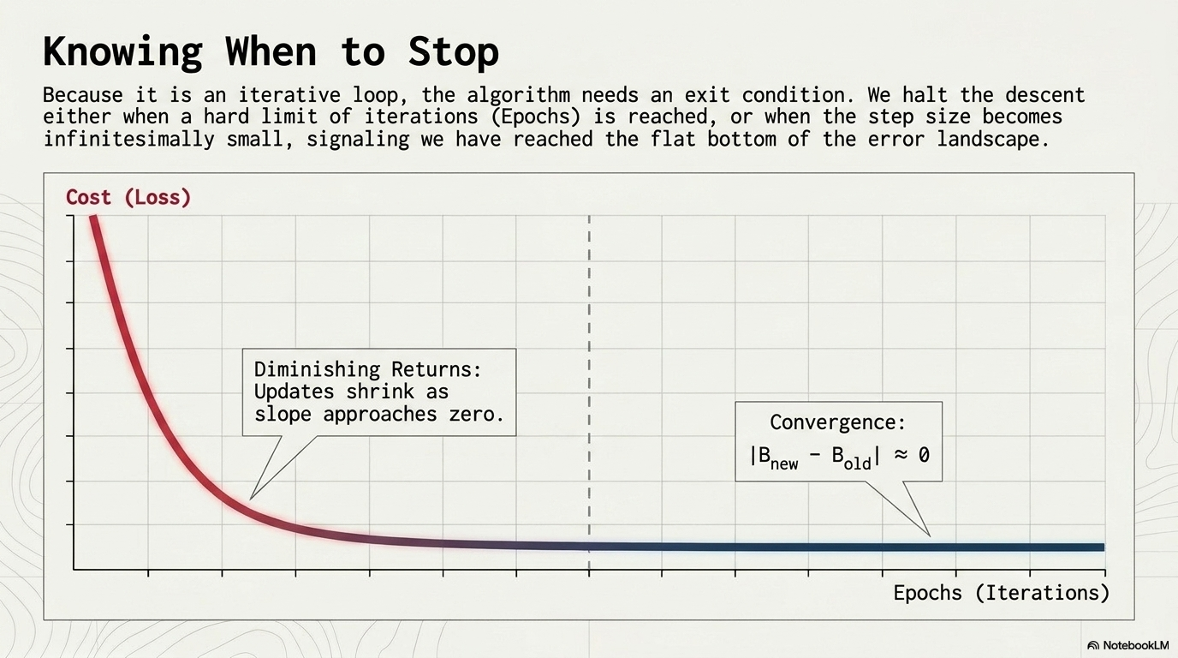

A state reached when loss values change very little or not at all with each iteration is known as Convergence. For example, the following loss curve suggests convergence at around 700 iterations:

Slide 30
Code
https://colab.research.google.com/drive/1al3JRKx_Z0HHJNk_i4IQdJ-LSo0lfLl2#scrollTo=bc7650e8

